Slide 1
COMP50016 Server Side Programming
Week 1.b : Understanding SSP
Dr Keerthi Gunawickrama
School of Computing/APIIT

Slide 2
Concepts to learn
Network, Internet
Routers, switches,
Hosts, clients, Servers
webpages
web applications
server side programming
..

Slide 3
Understanding Server Side Programing
How Web Works
Internet, Servers, Clients, TCP/IP, IP Address, Port, DNS
Understanding how web applications work
Web Scripting Languages ..Can make programs run via Web browser
Essentially, Server executes the program, sends the result to web browser as html
Eg. JavaScript/ECMAScript, PHP, Python, Rubu, Groovy, Perl, Lua, Bash, ..
..

Slide 4
Internet Infrastructure
Internet
Interconnected (networked) set of computing machines (devices)
Interconnection require infrastructure
structured cabling
routers
switches
..
Interconnection Require Data Transfer Mechanisms
TCP/IP Protocol
IP Addresses
Ports
..

Slide 5
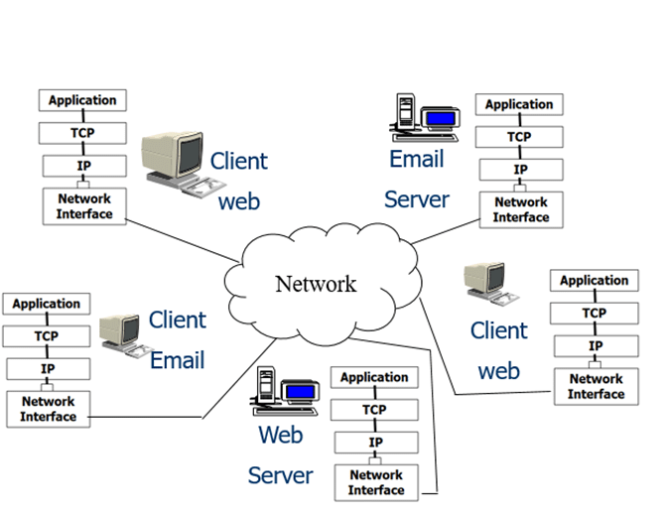
Remote Devices are identified by IP Address
What is your IP Address?
Google
whatismyipaddress.com/
Windows->cmd->ipconfig
Windows->cmd->netstat
Network-Icon->Properties
..
What are the ports allocated for applications in your machine?

Slide 6
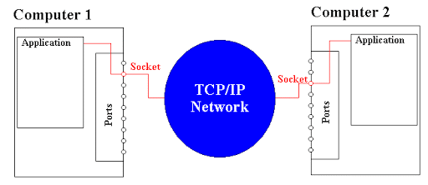
Two Computers in Internet
Computers are identified by IP Address
Applications within a Computer are Identified by Port
Socket = IP Address : Port

Slide 7
Socket = IP Address:Port
IP Address and Port pair is called socket
Use ipconfig and netstat –a in command line to see ip addresses and ports of your computer
Some well known port numbers used by server processes
80 (HTTP), 53 (DNS), 110 (POP3), 156 (SQL), 443 (HTTPS), 587 (SMTP)

Slide 8
Identification of Network Devices
Applications in network devices communicate (exchange data) with each other
Sender (device/application) and Receiver (device/application) need to be identified by each other
IP Address is used to identify the device
Port is used to identify the application
Eg. 10.50.225.222 – IP Address, 61233 – Port
Note: Format of IP addresses differ in IPv4 and IPv6

Slide 9
What is the use of Networked Computers (hosts)
Store Data
Data base
Keep web pages
Web Server
Use resources (view web pages, use data and applications) of other computers
clients
..

Slide 10
Naming hosts by application type
Computer that runs an application which
keep web pages/sites, allow other hosts to view them on request, is called web server
facilitate email messaging among users is called email server
facilitate viewing web pages is called web client
store data and make data available for other users is called database server
Application that provides service is a server
Application that request service is client

Slide 11
Client - Server
Client Program
Request (service)
Server Program
Reply (Provide Service)

Slide 12
Web Pages
Web pages are stored in the web server
Client (web browser) request web pages from the server
Sever sends web page to client
Client view web page by using the browser

Slide 13
Dynamic Web Pages
A dynamic web page is a web page that displays different content each time it's viewed. For example, the page may change with the time of day, the user that accesses the webpage, or the type of user interaction.
There are two types of dynamic web pages.
Client side
server side

Slide 14
Client vs Server side scripting
CLIENT-SIDE SCRIPTING
Web pages that change in response to an action within that web page, such as a mouse or a keyboard action, use client-side scripting.
Client-side scripts generate client-side content. Client-side content is content that's generated on the user's computer rather than the server. In these cases, the user's web browser would download the web page content from the server, process the code that's embedded in the web page, and then display the updated content to the user.
Scripting languages such as JavaScript and Flash allow a web page to respond to client-side events.
SERVER-SIDE SCRIPTING
Web pages that change when a web page is loaded or visited use server-side scripting. Server-side content is content that's generated when a web page is loaded. For example, login pages, forums, submission forms, and shopping carts, all use server-side scripting since those web pages change according to what is submitted to it.
Scripting languages such as PHP, ASP, ASP.NET, JSP, ColdFusion and Perl allow a web page to respond to submission events.

Slide 15
Web Application
A web application is a computer program that utilizes web browsers and web technology to perform tasks over the Internet.
Use Dynamic web pages

Slide 16
Web Applications
Web Server runs applications
Application usually connects with a database
Web client access web application though web browser
Web Browser (Client)
Request (service)
Web Server Program
Reply (Provide Service)

