Slide 1
COMP50016 Server Side Programming
Week 1.c : Setting up Development Environment for SSP1
Dr Keerthi Gunawickrama
School of Computing/APIIT

Slide 2
What we know
Web Server and Web Browser (client) connects via Internet)
Require, IP Address:Port
Internet
Web Browser (Client)
Request (service):
IP Address:Port
Web Server Program
Reply (Provide Service)

Slide 3
Can we run both Server and Client in single machine? Local Development Environment
Computer become the server host = localhost
Internet = Loopback
IP Address = 127.0.0.1 (localhost address, loopback address, .. )
Loopback
Web Browser (Client)
Request (service):
127.0.0.1:Port
Web Server Program
Reply (Provide Service)

Slide 4

Software used for Local Development Environment
LAMP, WAMP, MAMP, XAMPP
All used to create a local development environment
differ in the operating system they target:
LAMP: Linux
WAMP: Windows
MAMP: Mac
XAMPP: cross-platform

Slide 5
What is our setup?
XAMPP is the Server (Apache Web Server + MySQL + PHP)
IP Address = 127.0.0.1 or Domain Name localhost
Loopback
Any Web Browser (Edge, Chrome, ..)
Request (service):
127.0.0.1:Port
XAMPP (Web Server Program)
Reply (Provide Service)

Slide 6
XAMPP = Multiple Servers
Apache
web HTTP server
program that is used to host HTML files and other static web content
PHP, Perl
application server
used to write dynamic web content
most content management systems written in PHP
MySQL or MariaDB
database server
dynamic web pages need to store data
frequently on a different machine
maintained using phpMyAdmin
phpMyAdmin
Web Application to administer Database
XAMPP Control Panel
Start, Stop, Configure, Servers

Slide 7
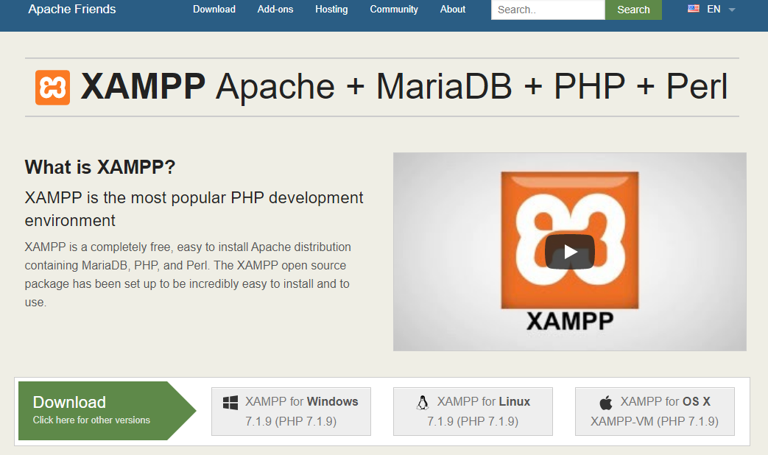
Install XAMPP
Download and Install XAMPP
XAMPP Installers and Downloads for Apache Friends
Choose the Right distribution to your
device (64bit, 32 bit), and
operating system (Windows, Linux, ..)
"XAMPP is the most popular PHP development environment"
Apache distribution containing MariaDB, PHP, and Perl
free
open source
easy to install

Slide 8
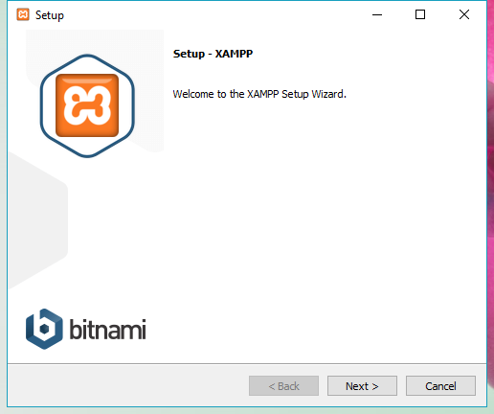
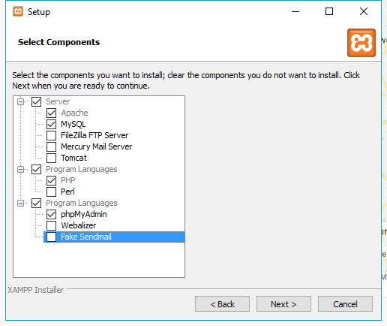
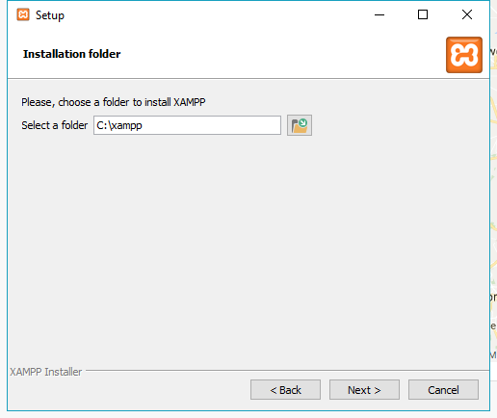
Install XAMPP
open installer.exe
select required components
unless you are running a live web server, you only need Apache, MySQL, PHP and phpMyAdmin
select directory for installation
usually left as default

Slide 9
Package Components
Apache web server application
MySQL database management system
FileZilla FTP Server File Transfer Protocol server for file transfers
Mercury Mail Server open-source mail server
Tomcat Java servlet for serving Java applications
PHP server-side, general purpose programming language
Perl similar to PHP, but less popular
phpMyAdmin admin tool for working with MySQL / MariaDB
Webalizer analytics tool to generate logs and usage metrics
Fake Sendmail simulated mail server

Slide 10
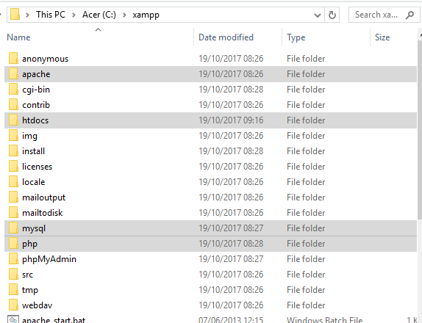
File Structure
when downloaded, everything is stored in xampp folder
htdocs folder: stores php files
apache folder
MySQL folder: data folder holds a separate folder for each database
php folder
and lots of other stuff...
DO NOT EDIT / DELETE!!

Slide 11
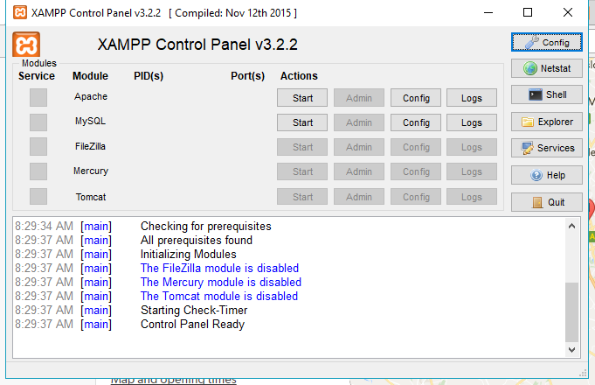
XAMPP Control Panel
used to work with XAMPP components
Explore button will open Windows Explorer showing file structure

Slide 12
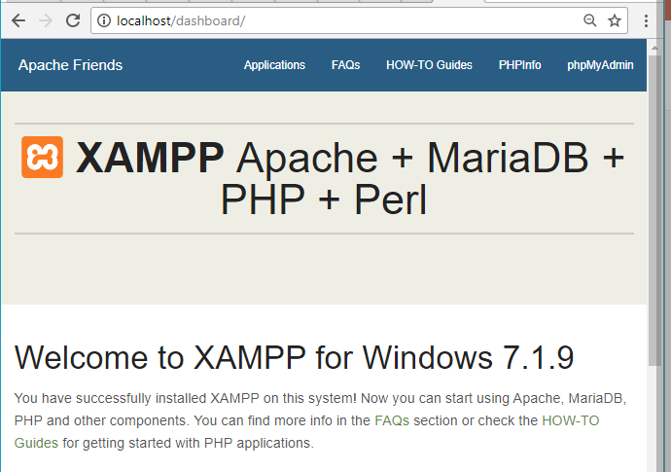
Run Apache, Test if it runs
Start webserver by clicking Start next to Apache module
Open browser and type localhost
server displays root level (htdocs) index.html file as default page
Select Menu item PHPinfo, Should display info on php
can overwrite index.php to display custom page
if server not running,
message stating server not reachable is output

