Slide 1
APPLIANCES ENERGY PREDICTION ANALYSIS
"Harnessing Data for Smarter Energy Management in Homes"

Slide 2
TABLE OF CONTENTS
01
02
03
PROBLEM & SOLUTION
OUR PROCESS
TARGET
"Identifying Challenges, Designing Smarter Solutions"
"Data-Driven Approach to Optimizing Energy Use"
"Accurate Energy Predictions for a Sustainable Future"

Slide 3
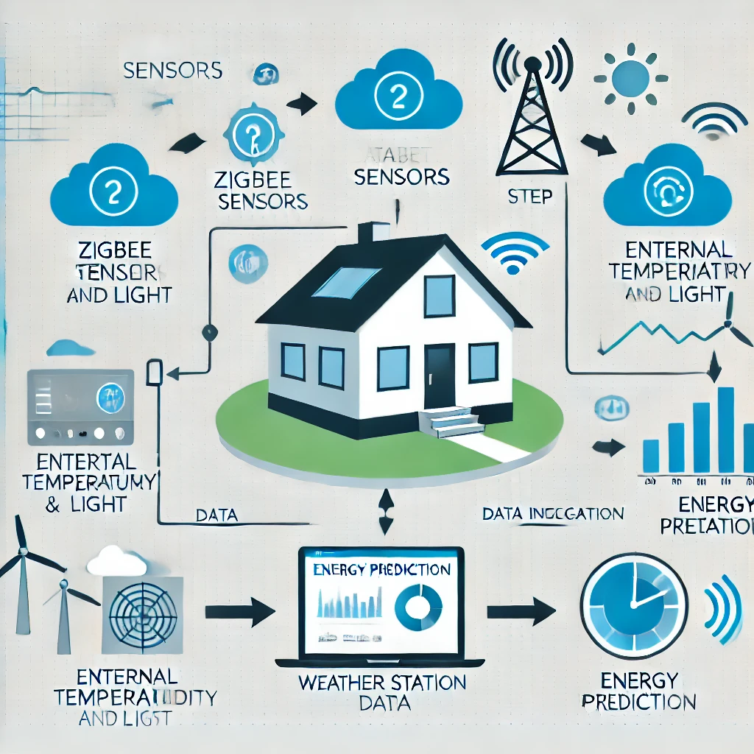
Objective of the Study
Objective:
"The objective of this study is to build a predictive model that estimates household energy consumption using environmental data. The goal is to create a tool that helps in designing smarter energy systems that can adjust automatically based on predictions."

Slide 4
OUR SOLUTIONS
Dataset overview
Problem statement
Feature selection
Model selection
Model results
Insights & applications
Concluxion
Future work
[Dataset Overview] → [Problem Statement] → [Feature Selection] → [Model Selection]
↓ ↓ ↓ ↓
[Model Results] → [Insights & Applications] → [Conclusion & Future Work]

Slide 5
Dataset Overview
Dataset Size and Features:
"The dataset contains 19,735 instances with 28 features, including temperature,
humidity, light levels, and external weather data."
"Data was collected using ZigBee sensors and external weather data from
Chievres Airport, Belgium, over a period of 4.5 months.“
Target Variable:
"The target variable is energy use in watt-hours (Wh) by household appliances.”

Slide 6
Dataset Overview
ZigBee Sensors (Temperature, Humidity, Light) →
Weather Station Data (External Temperature, Humidity, Wind Speed) →
Data Storage/Integration (Data from all sources combined into a dataset) →
Energy Prediction Model (Using collected data to predict energy consumption)
Data Sources
ZigBee Sensors: Temperature, Humidity, Light
Weather Data:External temperature, Wind Speed
Data Flow
Arrows or lines: Data from sensors to storage system
Data Integration:Integrated dataset for next procedure
Modelling Process
Energy prediction: The data is used to train a predictive model or energy consumption

Slide 7
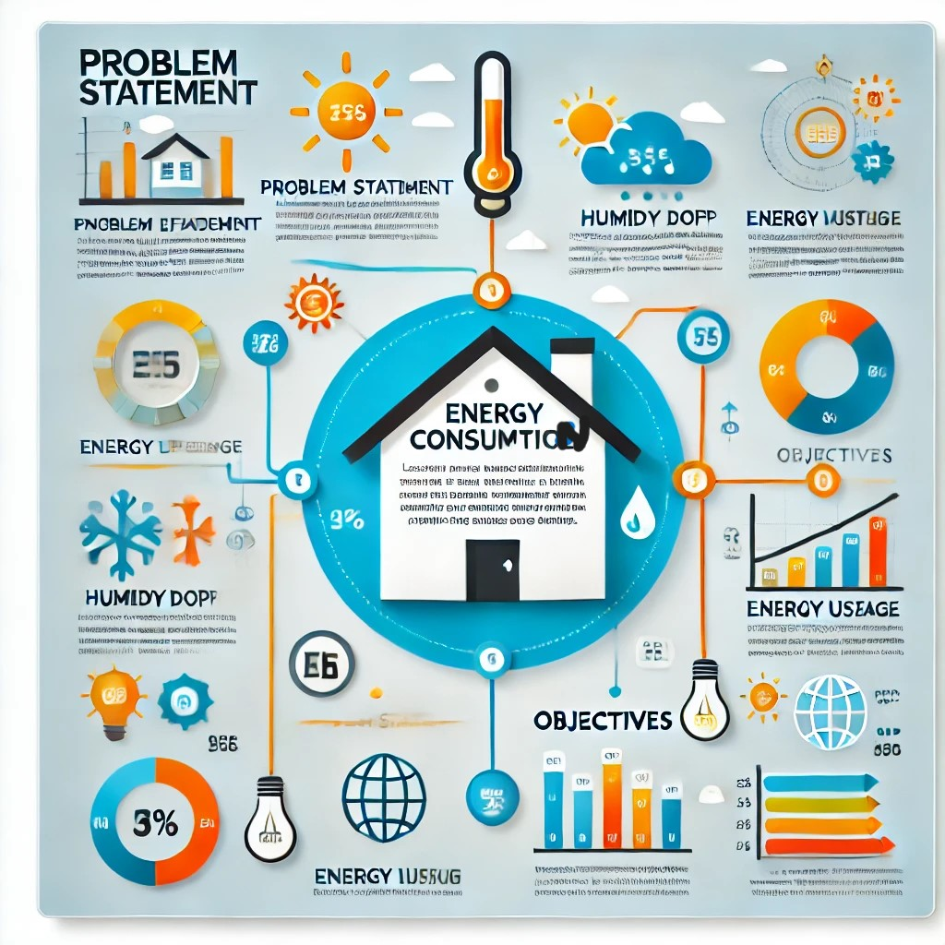
Problem Statement
Challenges in Predicting Energy Use:
Problem Statement:"Energy consumption in homes is influenced by multiple factors such as temperature, humidity, and occupancy patterns. Predicting energy use based on these variables can help optimize energy consumption, reduce costs, and promote sustainability."
"However, predicting energy use is a complex task due to variable factors like weather, occupant behavior, and equipment efficiency.“
Optimizing energy consumption in homes can lead to reduced energy
bills, enhance sustainability, and promote energy-efficient practices."

Slide 8
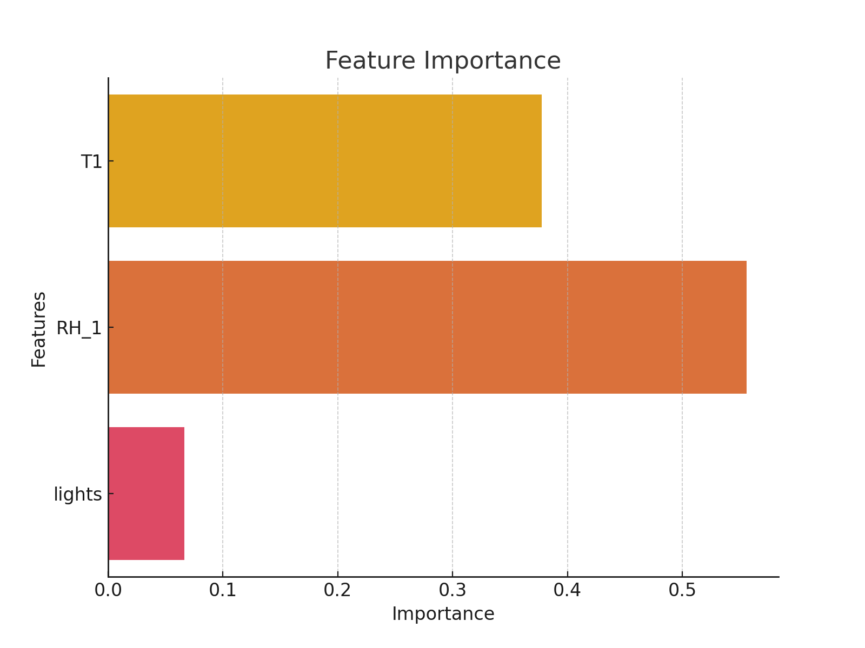
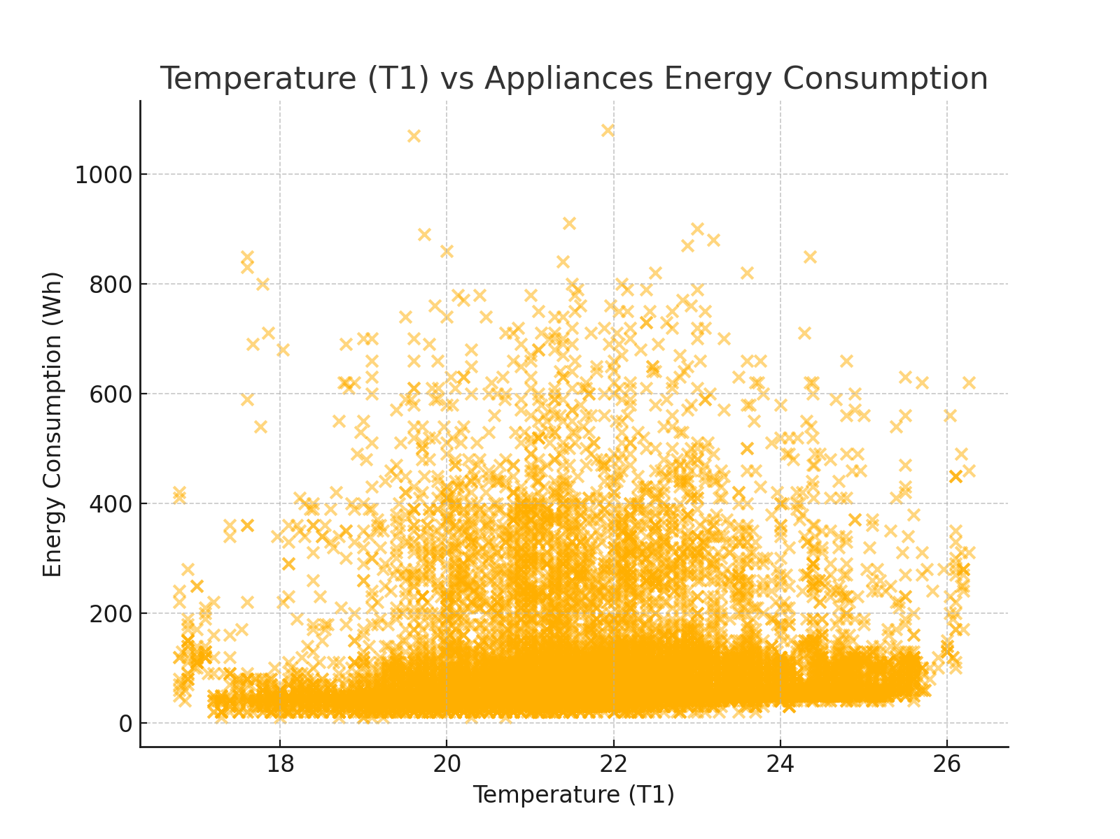
Feature Selection
Selected Features for Model:"Temperature (T1-T6), Humidity (RH_1-RH_6), and Light levels (lights) were chosen based on their expected influence on energy use."
"These features were selected through correlation analysis to focus on the most relevant variables."

Slide 9
Model Selection
Model Chosen:
"A Linear Regression model was used to predict energy consumption. This was selected for its simplicity and interpretability."
"In future iterations, more complex models like Random Forests or Neural Networks could be tested.“
Data Preprocessing:
"The dataset was cleaned by removing missing values, and feature scaling was considered for certain models."

Slide 10
Model Results
Model Performance Metrics:
"The model's Mean Squared Error (MSE) was 9366.9, indicating room for improvement."
"The R-squared value provides an idea of how well the model fits the data. A higher R-squared would suggest a better model fit.“
Evaluation:
"Although the model performs reasonably well, additional features or more complex models could improve its accuracy.“

Slide 11
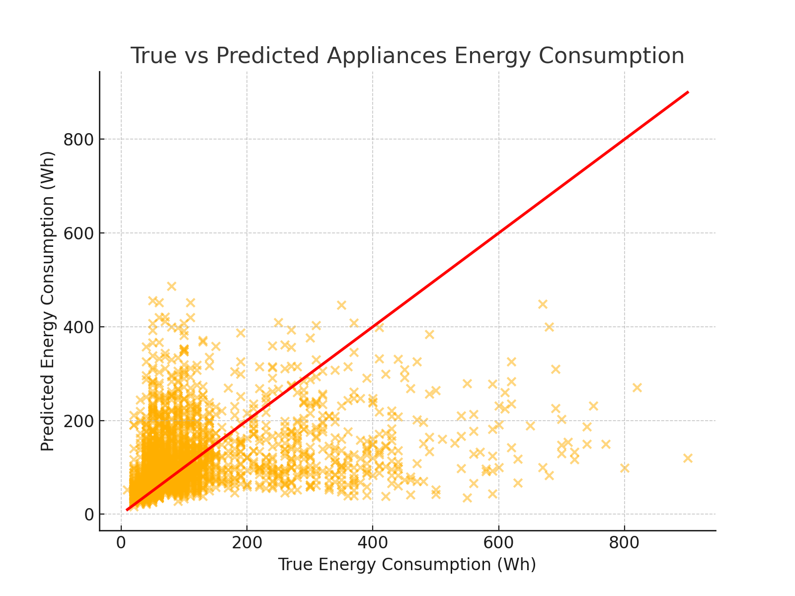
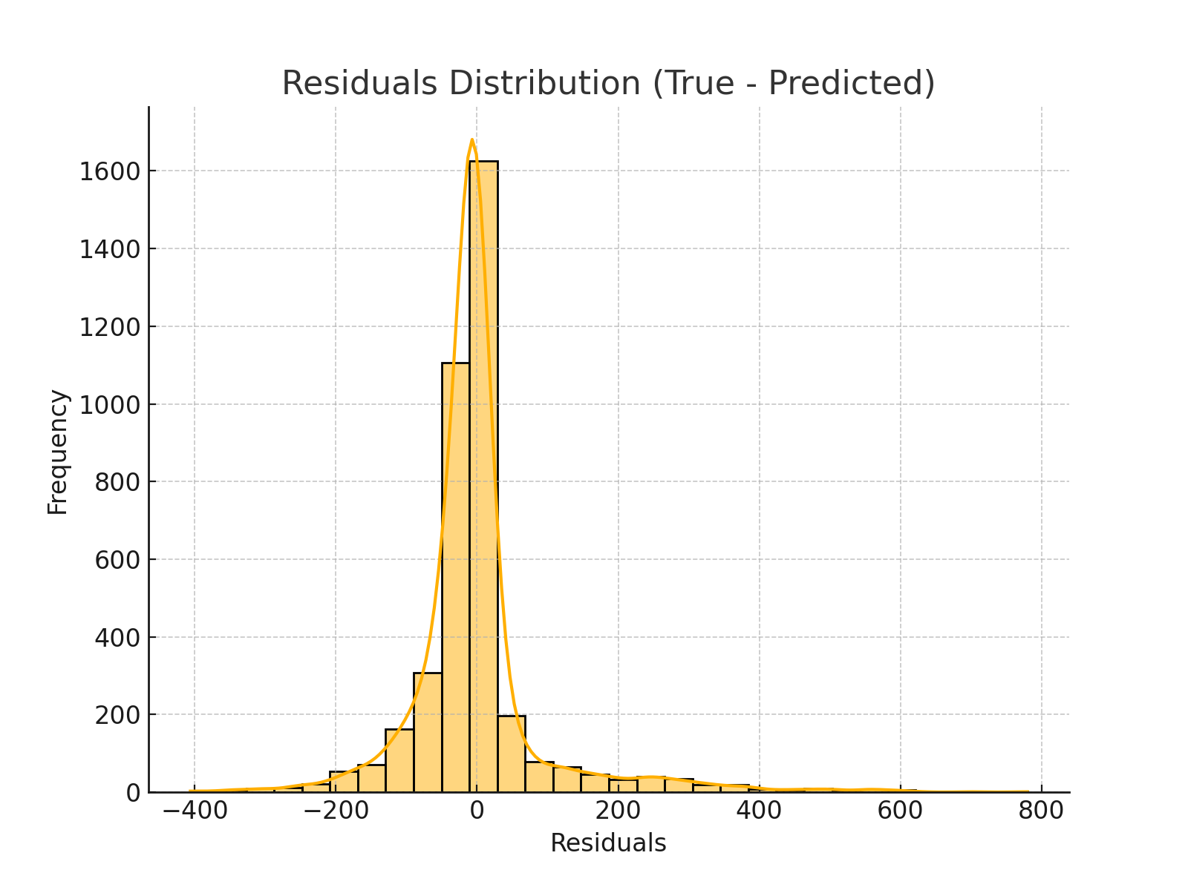
Model Results
Ideal for understanding the accuracy of the model’s predictionsIt provides insight into whether your model is producing accurate results.
The model is performing by showing how evenly the errors (residuals) are distributed. It helps check for biases or patterns in prediction errors.

Slide 12
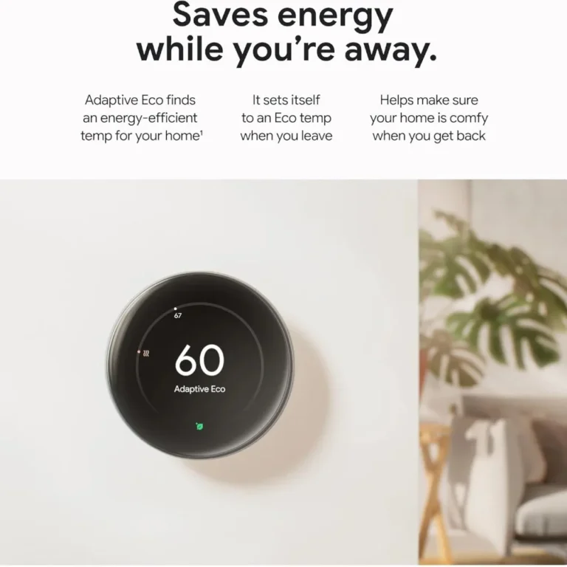
Insights & Applications
"Temperature and humidity play a significant role in energy consumption predictions."
"The model highlights the potential for predicting energy use based on environmental
factors.“
Real-World Applications:
"This model can be used in smart home systems to optimize energy use, potentially
saving money on electricity bills and contributing to sustainability."
"Future systems could adjust heating and cooling based on predicted energy use."
Nest Thermostat

Slide 13
Conclusion and Future Work
"In this project, a Linear Regression model was developed to predict energy
consumption based on environmental data. While the model is accurate, there’s room
for improvement.“
Future Directions:
"Exploring more complex models such as Random Forests or Neural Networks
could improve prediction accuracy."
"Additional features, like occupancy data or longer time periods, could further
enhance the model."
"Further research could incorporate external weather conditions for better energy
forecasting."

Slide 14
THANK YOU

