Slide 1
SCALE INVARIANT FEATURE
TRANSFORM(SIFT)
PRESENTED BY SANDRA KUMI(20185122)

Slide 2
OUTLINE
Self Introduction
Introduction to SIFT
Overview of SIFT Algorithm
Scale Space Extrema Detection
Keypoint Localization
Orientation Assignment
Keypoint Descriptor
Keypoint Matching
Implementing Sift in OpenCV PYTHON

Slide 3
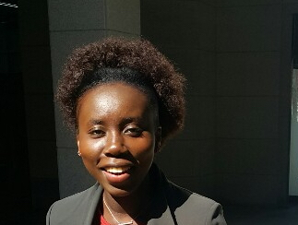
SELF INTRODUCTION/SANDRA KUMI
NATIONALITY: GHANA
EDUCATIONAL BACKGROUND:
M.Sc. in Computer Engineering,Dongseo University,South Korea(Busan)
B.Sc. in Computer Science,Kwame Nkrumah University of Science and Technology,Ghana(Kumasi)
Yaa Asantewaa Girls’ Senior High School,Ghana(Kumasi)
BOPP School Complex,Ghana(Takoradi)
RESEARCH INTEREST:
Software Defined Networking
Industrial Control Systems
HOBBIES:
Listening to music, Watching Movies

Slide 4
INTRODUCTION TO SIFT
Scale Invariant Feature Transform (SIFT) is an algorithm in computer vision to detect and describe local features in images. This algorithm was published by David Lowe.
Application of SIFT include object recognition,gesture recognition,image stitching and 3D modeling.
Advantages of SIFT:
Distinctiveness: individual features can be matched to large database of objects
Quantity: many features can be generated for even small objects
Efficiency: close to real-time performance
Extensibility: can be extended to wide range of differing feature types, with each adding robustness

Slide 5

SIFT ALGORITHM
Scale Space Extrema Detection: SIFT interest point locations are found using difference-of-Gaussian functions
Where is the Gaussian 2D kernel, is the Gaussian blurred grayscale image, and k is a constant factor determining the separation in scale. Interest points are the maxima and minima of across both image location and scale.
Keypoint Localization: When interest points(keypoints) are found, they have to be refined to get more accurate results. To do this, you locate the maxima and minima of the difference if Gaussians images and find subpixel maxima/minima.

Slide 6
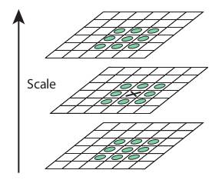
SIFT ALGORITHM-KEYPOINT LOCALIZATION
Sub-pixel are generated using Taylor expansion of image around the keypoint found. Eliminating bad keypoints:
Remove low Contrast features: if magnitude at current pixel is less than a threshold value(0.03) , it is rejected.
Remove edges: DoG has higher response for edges, so edges also need to be removed. Hessian matrix is used to determine edges.
Locate maxima/minima

Slide 7
SIFT ALGORITHM
Orientation Assignment: an orientation is assigned to each keypoint to achieve invariance to image rotation. A neighborhood is taken around the keypoint location depending on the scale, and the gradient magnitude and direction is calculated in that region. An orientation histogram with 36 bins covering 360 degrees is created.
Keypoint Descriptor: To obtain robustness against image intensity, the SIFT descriptor uses image gradients. A 16x16 neighbourhood around the keypoint is taken. It is divided into 16 sub-blocks of 4x4 size. For each sub-block, 8 bin orientation histogram is created, resulting in a 128 bin histogram (4*4*8=128).

Slide 8
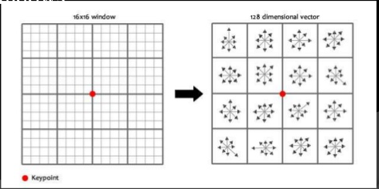
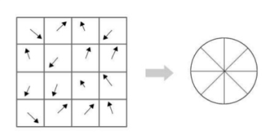
SIFT ALGORITHM
Keypoint Matching: Keypoints between two images are matched by identifying their nearest neighbours. Matching a feature in one image to a feature in another image is to use the ratio of the distance to the two closest matching features.

Slide 9
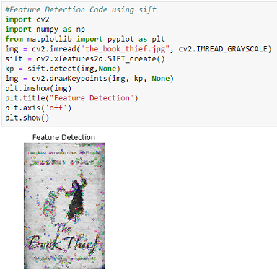
IMPLEMENTING SIFT IN OPENCV PYTHON
Feature detection

Slide 10
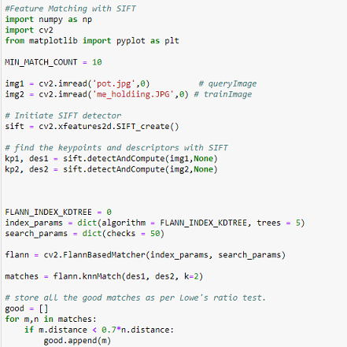
IMPLEMENTING SIFT IN OPENCV PYTHON
Feature Matching

Slide 11
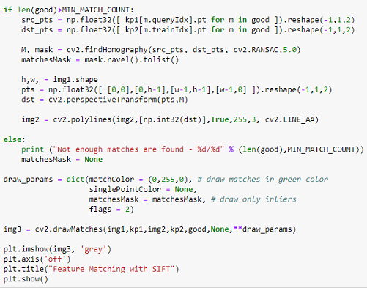
IMPLEMENTING SIFT IN OPENCV PYTHON
Feature Matching

Slide 12
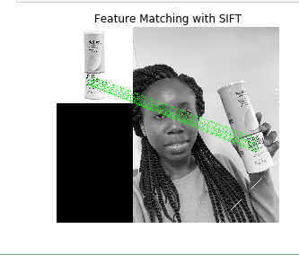
IMPLEMENTING SIFT IN OPENCV PYTHON
Feature Matching
SIFT Feature matching with camera

Slide 13
REFERENCES
https://opencv-python-tutroals.readthedocs.io/en/latest/py_tutorials/py_feature2d/py_sift_intro/py_sift_intro.html
https://en.wikipedia.org/wiki/Scale-invariant_feature_transform
Programming Computer Vision with Python, Jan Erik Solem

