Slide 1
SANTHOSH D
Naan Mudhalvan Project

Slide 2
PROJECT TITLE
MaskGuard:Face Mask Detection using Convolutional Neural Networks

Slide 3
AGENDA
The project agenda for the Face Mask Detection initiative involves five key stages. Firstly, data collection and preprocessing are prioritized, ensuring the acquisition of diverse datasets and their preparation for model training. Next, the focus shifts to model selection and design, where appropriate Convolutional Neural Network (CNN) architectures are chosen and tailored to suit the project's requirements. Subsequently, model training and evaluation take precedence, optimizing hyperparameters and assessing performance metrics to guarantee accuracy and reliability. The penultimate phase centers on deployment and integration, emphasizing seamless implementation into real-world scenarios for effective enforcement of mask-wearing protocols. Lastly, continuous monitoring and refinement ensure scalability, adaptability, and user satisfaction, cementing the project's impact on public health and safety.

Slide 4
PROBLEM STATEMENT
Amidst the COVID-19 pandemic, enforcing the usage of face masks has emerged as a critical aspect of public health and safety. However, ensuring adherence to mask-wearing regulations in public settings poses a significant challenge. To tackle this issue, the project endeavors to develop an AI-driven solution for automatic face mask detection. Leveraging computer vision techniques, particularly Convolutional Neural Networks (CNNs), the system aims to accurately identify individuals not wearing masks in real-time. By automating this detection process, the solution seeks to bolster public safety by enabling proactive enforcement of mask-wearing mandates across diverse environments such as shopping centers, theaters, and transportation hubs.

Slide 5
PROJECT OVERVIEW
This project is a response to the pressing need for widespread compliance with face mask mandates amid the ongoing COVID-19 pandemic. Leveraging my expertise in computer vision and deep learning, the innovative solution utilizes Convolutional Neural Networks (CNNs) to swiftly and accurately detect individuals not wearing masks in real-time. By automating this critical process, the project aims to bolster public health and safety by enabling proactive enforcement of mask-wearing protocols across diverse public settings.

Slide 6
END USERS OF MY PROJECT
Government agencies
Business owners
Transportation authorities
Educational institutions
Event organizers
Common people

Slide 7
MY SOLUTION AND ITS VALUE PROPOSITION
The solution is an AI-powered face mask detection system employing Convolutional Neural Networks (CNNs) to analyze live video streams and accurately identify individuals wearing masks.
Value Proposition:
Enhanced Safety: Automated detection of mask compliance minimizes virus transmission risks, bolstering public safety.
Efficiency: Eliminates manual monitoring, saving time and resources for businesses and authorities.
Scalability: Versatile deployment across diverse settings, from shopping malls to transportation hubs.
Proactive Intervention: Prompt identification allows for proactive measures to prevent virus spread.
Data Insights: Generates valuable data for informed decision-making on compliance measures.

Slide 8
THE WOW IN MY SOLUTION
Instant Mask Detection: My AI system swiftly identifies mask usage in real-time, ensuring immediate action.
Pinpoint Accuracy: With advanced CNN technology, expect precise identification of mask-wearing individuals.
Effortless Enforcement: Automate mask compliance monitoring, streamlining operations effortlessly.
Flexible Deployment: From malls to schools, My solution adapts to diverse environments seamlessly.
Scalable Solution: Tailored to accommodate varying foot traffic and evolving needs with ease.
Custom Alerts: Personalize alerts for proactive intervention, ensuring adherence to mask mandates.

Slide 9
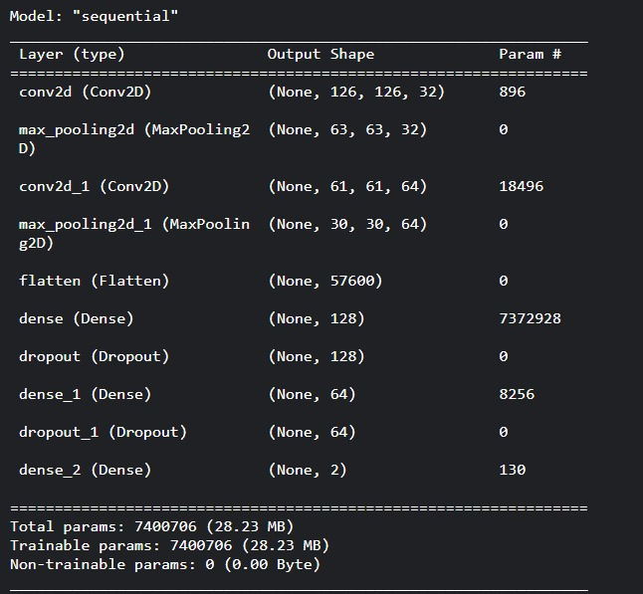
MODELLING

Slide 10
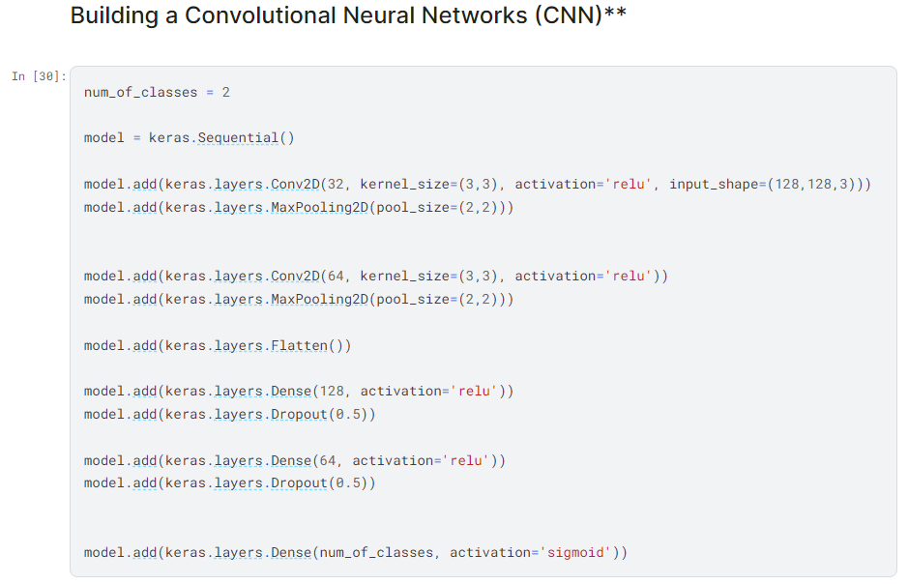
MODELLING

Slide 11
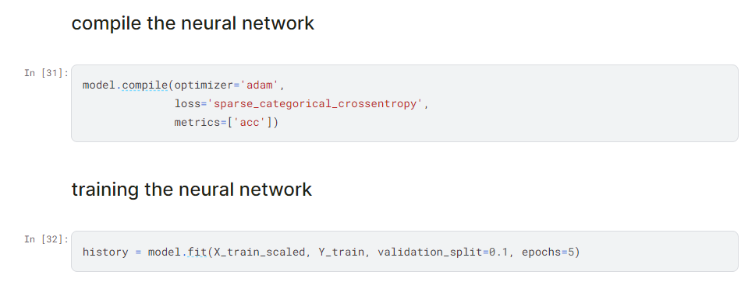
MODELLING

Slide 12
RESULT
The project yields a highly accurate and efficient AI system for real-time detection of mask compliance. By automating the monitoring process, it ensures swift identification of individuals wearing or not wearing masks, enhancing public safety. Scalable and adaptable, the system caters to diverse environments and varying foot traffic levels. Insights from the system's data aid in informed decision-making for intervention strategies, contributing to effective enforcement of mask-wearing protocols.
LINK:https://drive.google.com/file/d/1SqCkudgxiVgXJvwQbc1svLRTppzLWh7g/view?usp=sharing

Slide 13
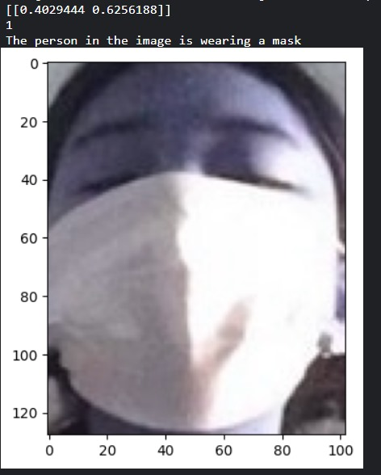
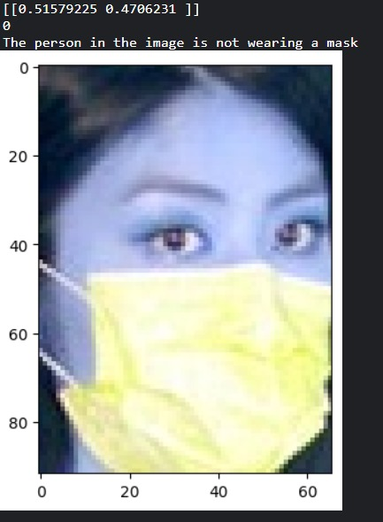
Output Images
Image showing the correct detection of face mask
Image showing the incorrect detection of face mask

