Slide 1
AUTOMATED ATTENDANCE SYSTEM BY FACE DETECTION AND EMOTION BASED MUSIC PLAYING AND WALLPAPER CHANGING SYSTEM
Md. Asaduzzaman Adil
ID: 141-15-3214
Protik Hosen ID: 141-15-3380
Md. Nuruzzaman ID: 141-15-3375
Ms. Nazmun Nessa Moon
Assistant Professor
Department of CSE
Daffodil International University
Dhaka
Tuesday 25 July 2017

Slide 2
Content
Introduction
Objectives
Motivation
Comparative Studies
Software Requirements
Different Approaches to Face Analysis
Video Presentation
Limitations
Scope of Future Development
Conclusion
References

Slide 3
Introduction
In our research project we implement three useful systems based on face detection and recognition.
Automated attendance system, emotion based music playing and changing wallpaper.
Our attendance system takes spontaneously attendance of students by detecting and recognizing of their faces and music playing system can play songs fitting to our mood and wallpaper changing system changes our desktop wallpaper based on our emotion state.

Slide 4
Motivation
Image processing plays a unique role in the advent of technological advancements and at present for image processing is very easy for available data collection for which we can proper utilize face detection and make new innovative applications.
The main motivation is to build our project comes, education system has been upgraded day by day, but some traditional system are not upgrading like attendance system which is taken by roll calling by teachers in a sheet.
Our existing music player system only play user’s mixed playlist songs therefore, user’s need not to skip songs to listen his favorite songs based on his/her mood.

Slide 5
Objectives
Need to analysis the related works and decide the overall architecture of our system.
To implement and test different techniques for each module .
To find the best method by comparing accuracy, speed, and robustness.
To focus on the classifier which is the core of a recognition system.
To design new algorithms which hopefully have better performance compared to an existing system.

Slide 6
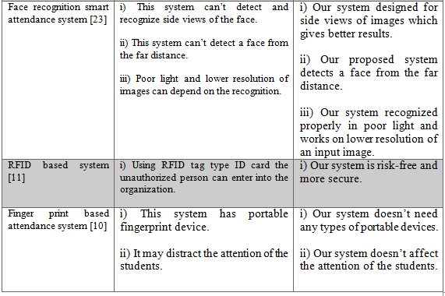
Comparative Studies

Slide 7
Software Requirements
Python Version 2.7.13
Windows XP or higher
Ubuntu 16.x.x or higher
Pycharm
Notepad++
SQLite database tools

Slide 8
Different Approach
Face Analysis include -
  Face Detection : Where is the face??
  Face Recognition : Who’s face is this??
  Main approaches
  PCA(Principle component Analysis)
  Appearance based ( learning based)
  Edge orientation matching.
  Viola-jones algorithm based on Haar Cascade.
  Facial landmark.
  Face API

Slide 9
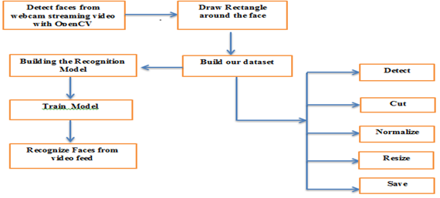
Development Approach for Face Detection

Slide 10
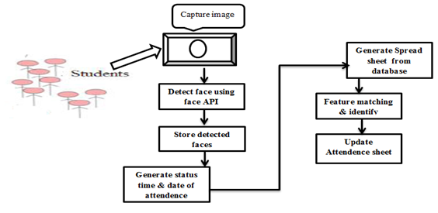
Attendance System Based on Face Detection Using Cognitive Face API

Slide 11
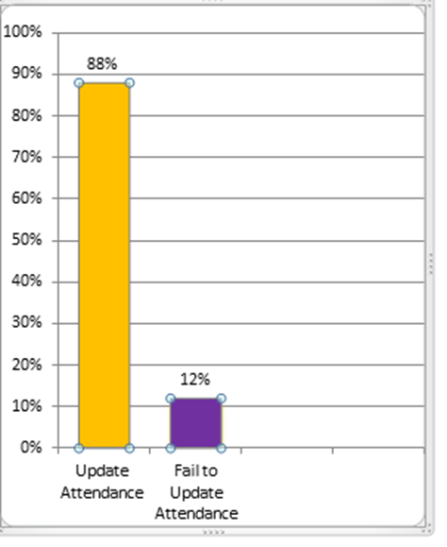
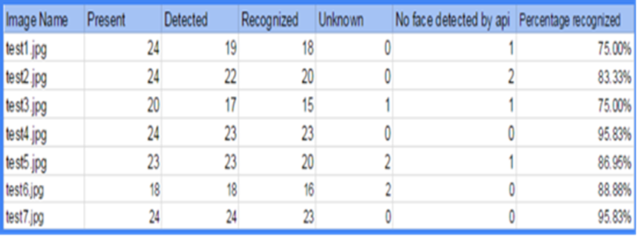
Accuracy Details of Attendance System

Slide 12
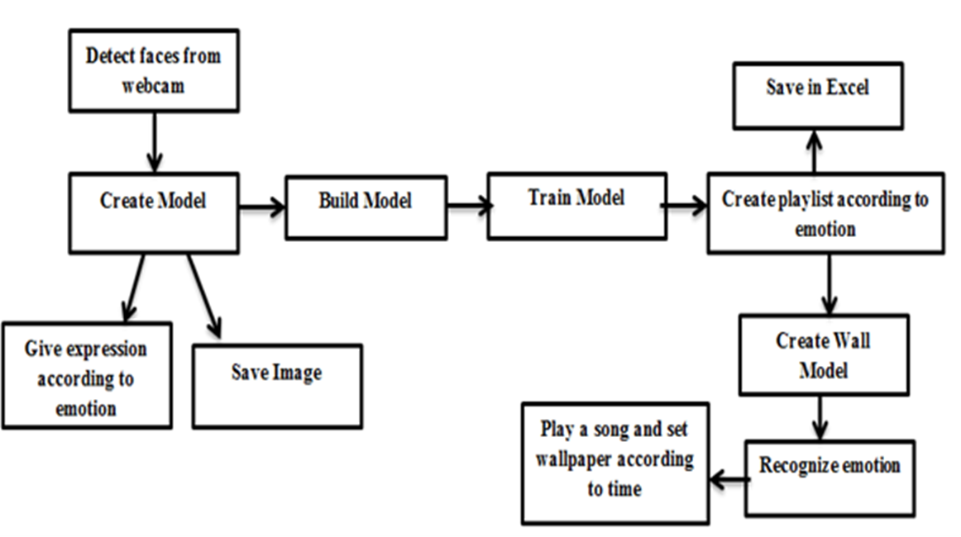
Emotion Based Music Playing and Wallpaper Changing System

Slide 13
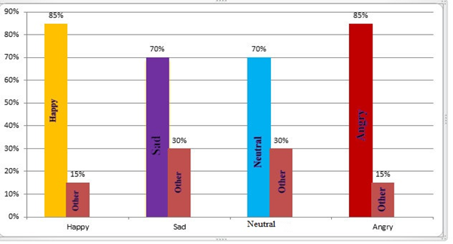
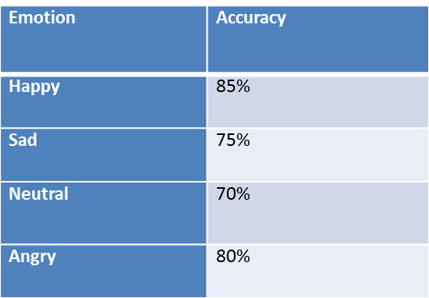
Descriptive Analysis for Different Categories of Emotions

Slide 14
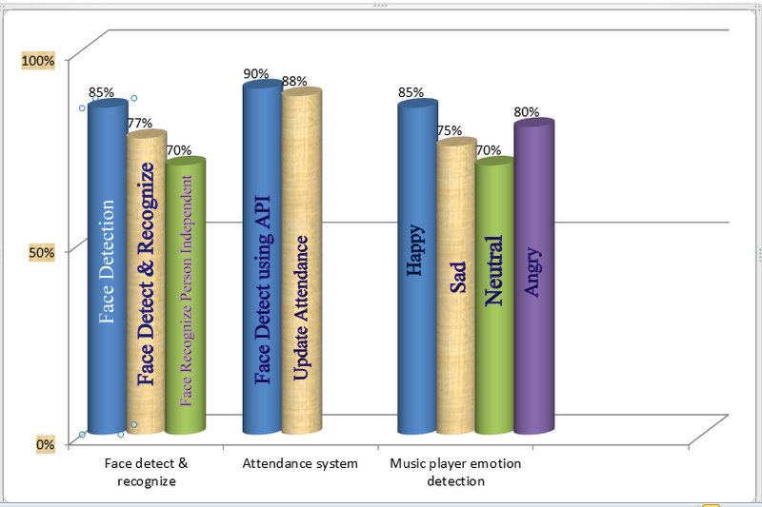
Overall Analysis

Slide 15
Limitations
Need windows based operating system platform.
We just implement logical part but we don’t create any graphical user interface.
To run this system we use Command Prompt.
We use free version API key which limitation only 4 month.
In case of music player and wallpaper changing system, windows based platform and webcam must be needed.
As we live in a Muslim country most of school, college and varsity girls using veil in that case our system fail to detect and recognize their faces.

Slide 16
Scope for Future Developments
Calculate attendance mark of students and generate a mark sheet which will direct send over email to course teacher.
As we use android phone available so our future step to build our emotion based music player and wallpaper system in android platform.
Using this method our further work is face detection based login system.

Slide 17
Conclusion
Our Automated Attendance Systems can be identified and recognized a face even in poor light condition and low resolution. It gives better accuracy. It can be detected and recognized a face from the side view of the face, wear glass and bread in student’s face. This system provides us better results to the management of attendance and leaves. Which saves class times and uses of stationery material, and manpower. This system is a great opportunity for music listeners which reduce the searching time and unnecessary computational time, with better accuracy and efficiency. It also acts as the therapy system when our mood is in adversely situation.

Slide 18
References
[23] Nikhil Zaware, Tejas Rajgure, Amey Bhadang and D. D. Sapkal, “Emotion based Music Player,” Int. J. Of Innovative Research & Develop., Vol. 3 , Issue 3, pp. 182-186, March 2014.
[11] T. Lim, S. Sim, and M. Mansor, “Rfid based attendance system,” in Industrial Electronics & Applications, 2009. ISIEA 2009. IEEE Symposium on, vol. 2. IEEE, 2009, pp. 778–782.
[10] B.K. Mohamed and C. Raghu, “Fingerprint attendance system for classroom needs,” in India Conference (INDICON), 2012 Annual IEEE. IEEE, 2012, pp. 433–438

Slide 19
References
[7] P. Lucey, J. Cohn, T. Kanade, J. Saragih, Z. Ambadar, and I. Matthews, “The extended cohn-kanade dataset (CK+): A complete dataset for action unit and emotion-specified expression,” in 2010 IEEE Computer Society Conference on Computer Vision and Pattern Recognition Workshops (CVPRW), 2010,
pp. 94–101.
[8] M. Lyons, S. Akamatsu, M. Kamachi, and J. Gyoba, “Coding facial expressions with gabor wavelets,” in Third IEEE International Conference on Automatic Face and Gesture Recognition, 1998. Proceedings, 1998, pp. 200–205.

