Slide 1
Project Group S13
Ankur Garg & Sanket Shahane

Slide 2
Classification of Brain Wave (EEG) Data
Background
Objective – Classification of signal into one of the three classes:
Thinking of moving left arm,
Thinking of moving right arm,
Generation of words beginning with same random letter.
Part of the BCI III Competition

Slide 3
Dataset
3 Subjects. 4 Sessions.
9 sessions used for training and 3 sessions for testing.
Approximately 3500 data samples for each session
Training samples for
Subject 1: 10528
Subject 2: 10400
Subject 3: 10288
Testing samples: 3504, 3472, 3488 respectively.

Slide 4
Dataset
No Class Imbalance problem in the dataset.

Slide 5
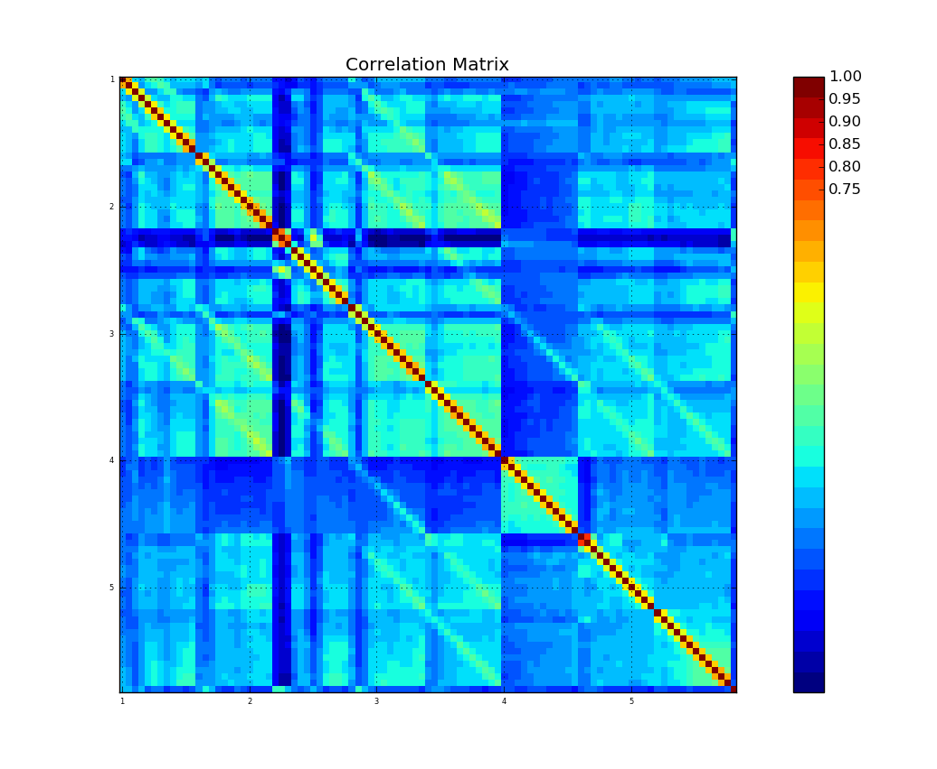
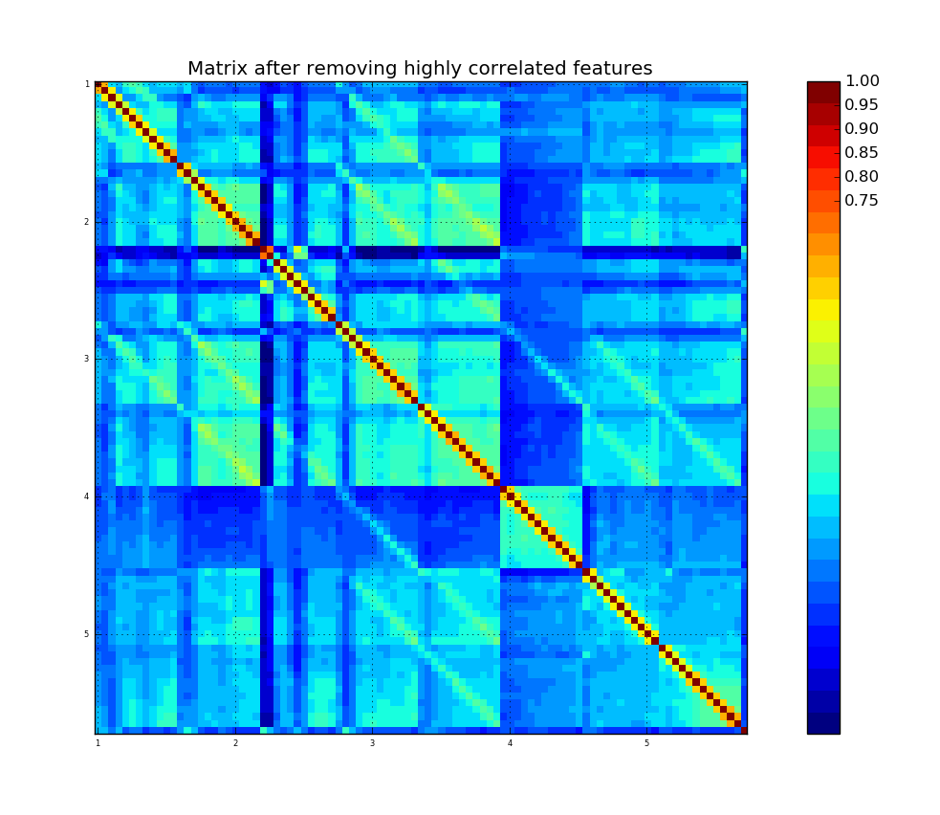
Dataset – Correlation among attributes

Slide 6
Dataset - Dimensionality
High dimensional – 96 features
Used Principal component Analysis to reduce dimensionality.
40 components for Subject 1
50 components for Subject 2
60 components for Subject 3

Slide 7
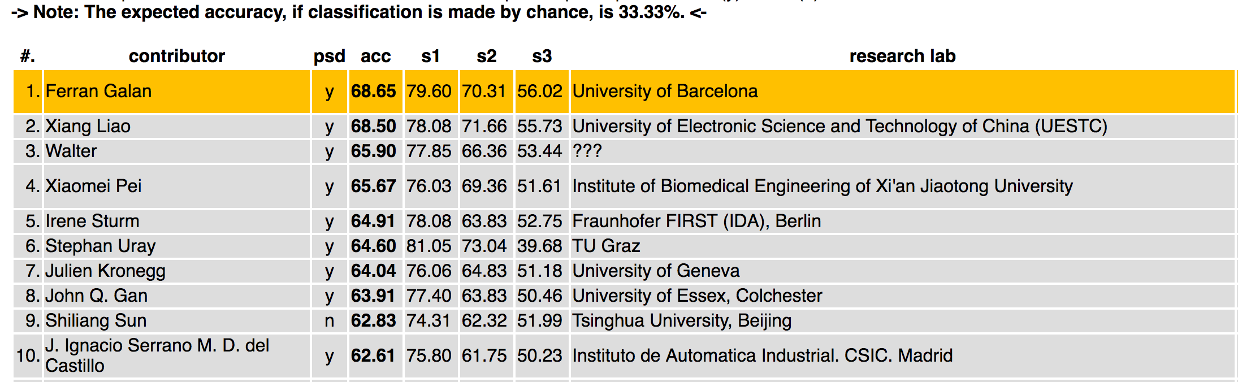
Methodology
Baseline: Results from the competition.
http://bbci.de/competition/iii/results/index.html#martigny

Slide 8
Methodology
Initial set of Classifiers:
Random Forest Classifier
Support Vector Machines
Linear Discriminant Analysis
Next we compare the accuracies of these models on raw data and after using PCA

Slide 9
Initial Results
LDA
LDA gives better performance compared to RF and SVM.
Using PCA further improves the accuracies.
Subject | Raw Data | After PCA
Subject 1 | 71.46% | 73.26%
Subject 2 | 58.12% | 61.34%
Subject 3 | 49.17% | 50.54%
SVM
Random Forest
Subject | After PCA
Subject 1 | 73.11%
Subject 2 | 56.13%
Subject 3 | 49.60%
Subject | After PCA
Subject 1 | 73.14%
Subject 2 | 60.88%
Subject 3 | 47.70%

Slide 10
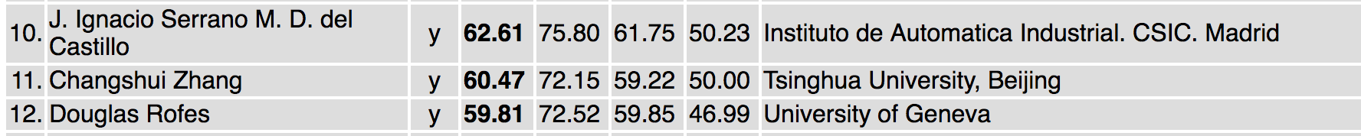
Initial Results
We stand 11th as of now
Subject 1: 73.26 Subject 2: 61.34 Subject 3: 50.54

Slide 11
Methodology Contd.
Data samples are not independent.
Sequential relationship exists among the samples.
Initial classification approaches don’t model this relationship.

Slide 12
Methodology
Sequential relationship motivated us to consider methods like:
Hidden Markov Model
Feed Forward Neural Network
Structured Perceptron
LSTM

Slide 13
Hidden Markov Model
Approach for training HMM:
Number of states = 3 (from data).
Transition Probabilities – Calculated from data
Emission Probabilities – Gaussian distribution on features.
Use Viterbi algorithm For predicting class for test sample
Package: hmmlearn

Slide 14
Surprise by HMM !
Accuracy for HMM:
Subject 1: 51.38
Subject 2: 50.49
Subject 3: 38.46
Even lower than non-sequential methods we tried earlier.

Slide 15
Feed Forward Neural Network
Feed forward network does not remember previous inputs and results.
However, we design our problem and the network in such a way that it considers data from previous 8 time steps.
Regenerated training data by horizontally stacking previous 8 samples to the current sample and pass it to the NN.

Slide 16
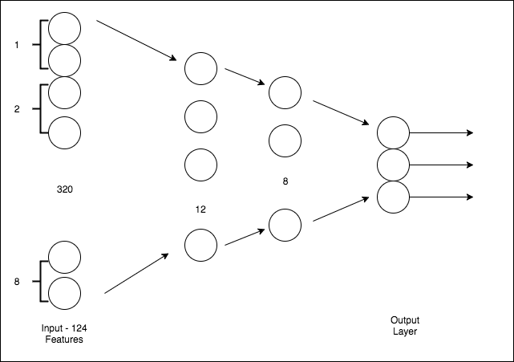
Feed Forward NN – Stacked Vector Approach
Design and parameters:
Number of epochs = 500,
Batch Size = 150,
Layers sizes = [12, 8, 3]

Slide 17
Feed Forward NN - Results
Accuracy:
Subject 1: 76.2%
Subject 2: 63.56%
Subject 3: 47.21%
Rank improved by couple of places.
To avoid overfitting, parameters chosen by observing elbow plot of training error.

Slide 18
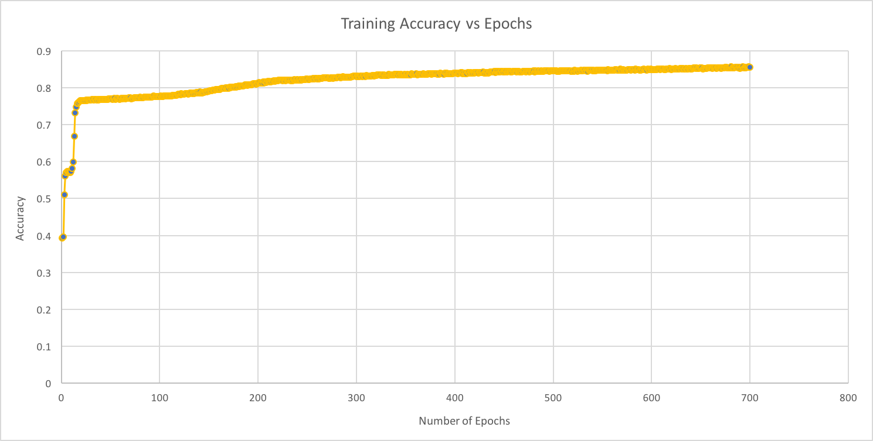
Feed Forward NN - Overfitting

Slide 19
Structured Perceptron
Discriminative Training Method for HMM
Uses the perceptron algorithm to estimate the parameters of HMM
Reference: Michael Collins. Discriminative Training Methods for Hidden Markov Models: Theory and Experiments with Perceptron Algorithms. 2002
Package: seqlearn

Slide 20
Structured Perceptron - Results
Accuracies:
Subject 1: 88.27 %
Subject 2: 80.21 %
Subject 3: 57.97 %
This approach gave us the best results.

Slide 21
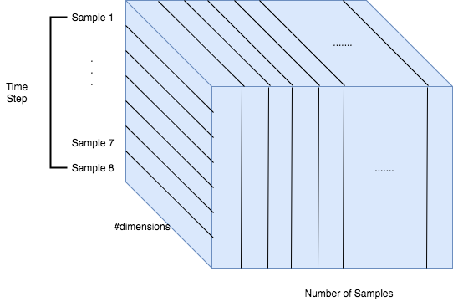
LSTM Neural Network
Represent data into #rows X 8 X #dimensions

Slide 22
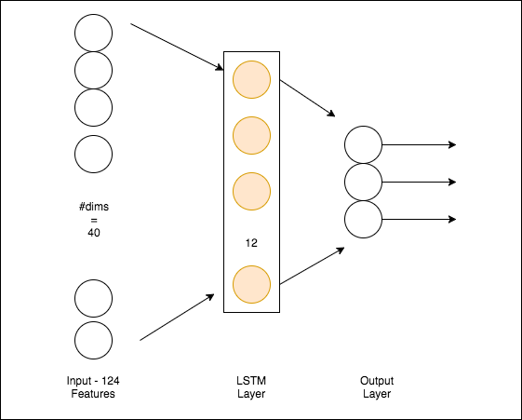
LSTM Neural Network - Design
Parameters:
Number of Epochs = 50
Batch Size = 150
Results:
Subject 1: 75.99%
Subject 2: 63.2 %
Subject 3: 45.31%

Slide 23
Post Processing
Smoothening: Predictions by the models were smoothened to remove noise.
Marginal improvement in accuracy

Slide 24
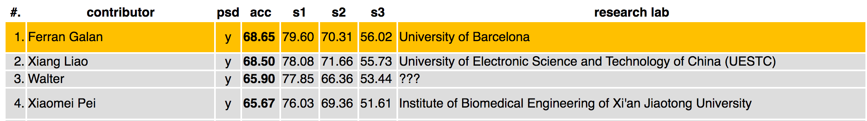
Final Results
Best accuracy by Structured Perceptron:
Subject 1: 88.27 %
Subject 2: 80.21 %
Subject 3: 57.97 %
Comparison with Competition results: Better accuracies than all submissions.
88.27, 80.21, 57.97

Slide 25
Conclusions
Hidden Markov Models and LSTM networks perform better than algorithms like Random Forest, SVM, which do not capture sequential relationship.
Using PCA to reduce dimensionality helped improve accuracy.
Subject 3 data contains some noise as most models perform worst on it.
LSTM Networks require large amounts of data to train nicely.
Perceptron preferred if large amount of training data not available.

Slide 26
Challenges
Designing feed forward network to handle sequential relationships.
Formatting the data to be usable in LSTM

Slide 27
Thank You

