Slide 1
Manish Shukla & Shubham Gupta
Problem Solving-201
Nov 2018

Slide 2
Collections strategy

Slide 3
Case – 3 | Collections strategy
Client & background
ABC bank has been experiencing high credit losses and wants to optimize it’s collection efforts to recover delinquent payments. The bank wants to build a framework for channelizing collection efforts before and after charge off’s.

Slide 4
Industry Research
DEFINITION of 'Delinquent’:
The term "delinquent" commonly refers to a situation where a borrower is late or overdue on a payment, such as income taxes, a mortgage, an automobile loan or a credit card account. Also refers to the failure to perform a duty or act in a manner expected of a person in a particular profession or situation.
'Charge-Off’:
A charge-off or chargeoff is the declaration by a creditor (usually a credit card account) that an amount of debt is unlikely to be collected. This occurs when a consumer becomes severely delinquent on a debt. Traditionally, creditors will make this declaration at the point of six months without payment.

Slide 5
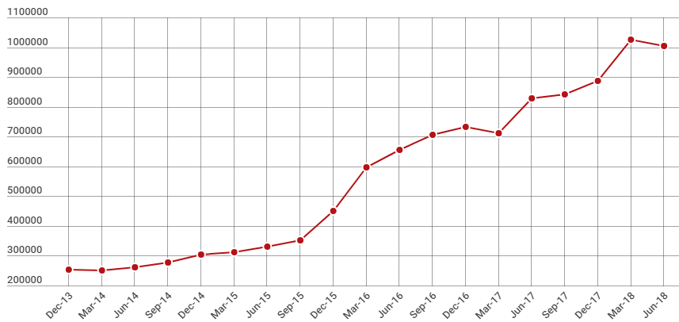
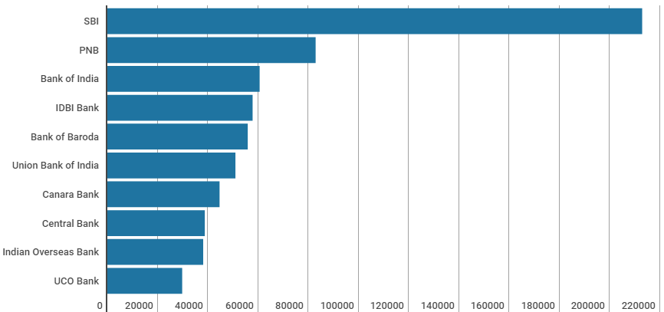
Bank’s bad loans Trends in India
According to RBI report, bad loans as a percentage of total loans — of the Indian banking system could reach 12.2% by March 2019.
For public sector banks (PSBs) gross NPA ratio may increase from 15.6% in March 2018 to 17.3% by March 2019.
Gross NPAs in Rs cr
PSBs with higher gross NPAs in Rs cr
Sources:
RBI financial stability report (FSR)
https://www.financialexpress.com/industry/rbi-sees-gross-npas-at-12-by-march/1221734/

Slide 6
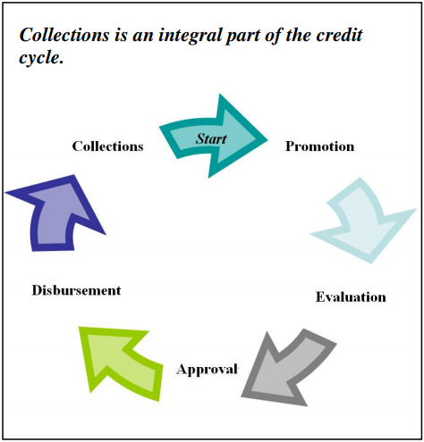
The Role of Collections
Final step in the lending cycle, collections actually plays a much more integral role in the overall process.
Collections is an important service that helps to both maintain clients and free up money for lending again.
It is a strategic process that is key to generating good habits and a payment culture among clients.
It can also be seen as a business activity whose primary objective is to generate returns for the institution, converting losses into income.

Slide 7
Why is there delinquency in Banks?
Many delinquency problems would be avoided if MFIs ensured that the earlier lending processes were conducted correctly.
Promotion:
The product does not meet clients’ real needs;
There is no clear definition of the target client;
Clients’ use of the loan does not match foreseen uses of the loan funds included in the product definition;
There is no emphasis on a “long-term lending relationship” based on punctual payment;
loan officers, credit agents, promotion officers, etc., lack necessary training.
Evaluation:
Failure in calculating loan amounts that exceed clients’ capacity to pay and over-indebtedness
Client has poor references or a poor attitude towards paying on time
There is no cross-checking of information to verify consistency, or documentation control;
Lack of risk-management tools to improve the understanding of default probability of the client, to identify the environmental causes that may affect the proper collections of the disbursed loan.

Slide 8
Contd…
Approval:
Decisions are influenced by pressure to meet goals
Decisions are subjective, based on the level of trust in the loan officer and lacking an objective credit analysis
Disbursement:
Failure to conduct objective analysis to determine best loan conditions, such as loan amount, term and installment amount, and selection of the repayment date
Clients lack motivation to pay on time due to unclear payment instructions and expectations at the point of loan disbursement
Few alternative payment channels, such as the Internet-payment options and third-party agents, that could reduce transaction costs for clients
Operating errors, such as failure to identify the account holder or a lack of signatures on contracts and loan documents, as well as delays in disbursement preventing the client from making use of the loan as intended (e.g. a lost investment opportunity results in the loan being used instead for consumption purposes).

Slide 9
PSW Question - How can we build a framework to optimize collection efforts to reduce Gross NPA as 10% of total loan in 1 year for India region?
1. Background
4. Constraints
According to annual report of ABC bank, bad loans as a percentage of total loans have reached 10% for March 2018 and same could reach 12% by March 2019.
Bank wants to collect as much as of delayed payments so that they will not incur more losses
The cost of collection efforts cannot increase $2m.
2. Desired outcome
5. Stakeholders
Optimize collection efforts to recover delinquent payments so that gross NPA will not be more than 10% of total loan.
Governor of RBI
Service Delivery Lead – loan department
3. Scope
6. Resources
Identify measures to optimize collection efforts.
Identify action plan in case client is unable to pay money back
Credit score report.
Financial statements of customer.(ABC internal)
Terms and condition records for various loan plans
Personal Guarantee records for each customer

Slide 10
Issue Tree
C1
Optimize collection effort Before Charge-off
How to optimize collection efforts to recover delinquent payments to 10%
Optimize collection efforts once account is charged-off
C2

Slide 11
Issue Tree
Optimize collection effort Before Charge-off
Contact the client
Successful contact
Ready to pay immediately
Refuses to pay
No capacity to pay
Unsuccessful contact
Write account as charged-off
Securing payment commitments
Meets commitment
Doesn't meet commitment
No willingness to pay
Take legal actions
Take legal Action
Negotiate to change loan conditions (restructuring, refinancing, etc)
C1

Slide 12
Issue Tree
Optimize collection efforts once account is charged-off
Don’t sell debt to collection agency
Sell debt to Collection agency
Work with the original lender to pay back the debt
Willing to pay
Not willing to pay
File a lawsuit against client for property or asset seizure
Workout on payment plan for remaining balance
Negotiate a settlement and accepts less money than originally agreed
C2

Slide 13
Collections strategy

Slide 14
Philips: Case –13 | Collection strategy
Your client ABC is a leading technology company in various sectors like medical devices, Consumer Lifestyle and Lighting. ABC has recently witnessed increase in account receivable overdue. They want to build a framework to optimize collection efforts and reduce account receivable overdue.

Slide 15
Industry research
A smarter account receivable collection strategy can improve collection rate by more than 15%
Account receivable is the amount owed to a business by its customers, and comprises potentially large number of invoiced accounts
It constitutes the primary source of incoming cash flow which can be diverted into crucial business functions
By the time the receivables are 90 days overdue, they could be worth only 20% of their original value [2]
On an average, companies write off 1.5% of their receivables as bad debt[1]
93% of businesses experience late payments from customers[2]
Lighting, Diagnostics and personal health equipment account 85% of net account receivable
[1] [Included in above balances as per December 31, 2017
[2] https://canovabancorp.com/how-accounts-receivables-lose-value-over-time/

Slide 16
Process of Accounts Receivable
Step4: Accounting for Accounts Receivable
Step3: Tracking Accounts Receivable
Step2: Invoicing Customers
Record a sale of goods on credit.
Account for early payment discounts.
Account for bad debt.
Prepare an accounts receivable aging report
Step1: Establishing Credit Practices
Manual/Automatic accounts receivable tracking system.
Issue monthly statements to customers.
Preparation of Invoice.
Choose channel through which you send invoice to customers.
Include all relevant information on the invoice.
Develop a credit application process.
Establish the terms and conditions of sale
Comply with consumer credit laws.

Slide 17
PSW Question - How can we optimize collection efforts and reduce account receivable overdue
Background
Desired outcome
According to balance report of ABC, 2.4% YoY increment of account receivable overdue, which might lead to cash crunch and sales to get locked up
There is a negative impact on the worth of receivables as the numbers of days overdue increases
Identify measures to reduce account receivable overdue for ABC and come up with effective collection efforts
Constraints
Stakeholders
The cost of collection optimization efforts cannot exceed 10% of overdue amount
Have to comply with the existing clients agreements
CFO at ABC
Finance department at ABC
Scope
Any alteration to the existing client contracts is out of scope
Resources
General ledger report
Invoice & Sale data
CRM data

Slide 18
Issue Tree
Regular reviews of the credit approval process
Establish a clear, concise credit approval process
Improve the credit approval process
Negotiate Payment Terms based on working cash flow for new customer
Improve Credit Practices
Set the optimal payment terms
Set the discount for early pay, within permissible limits
How can we reduce the account receivable overdue?
Maintain accurate customer data
Regularly update customer data
Automated the process to reduce the risk of error
B1
Detect anomalies in customer data
Regularly audit the database
Improve Collection Strategies
Implement controls to ensure data accuracy
Properly document the changes to customer data

Slide 19
Issue Tree
Invoices in a timely manner
Automate the Invoice preparation process to avoid human error
Improve Invoicing/Billing Process
Improve Customer Communications
Set the Checkpoints to send out reminders to customers using Aging report
Proactive in Invoicing/ Advance follow up with client financial team
Insure error free Invoice
Plan regular audits of Invoice Process
B1
Help customer with tax liabilities
Improve payment Process
Provide more payment options
Improve Collection Strategies?
Provided Assistance to customers having payment issues
Alert customers of late payment fee
Set Recovery process in motion for overdue accounts
Provide staff with appropriate training on how to deal with late paying client
Determine which accounts are at risk of going into default
Offering Past-Due Clients a Payment Plan
Segregate customers who have receivable overdue past aging schedule, termed as bad debt
Hiring Agent to for training/Speed up the Collection process
Take some legal action/Firmer Communications

