Slide 1

June 16th, 2019
Safety: Driver Behaviour Analysis Using Telematics Data
Shubham Gupta

Slide 2
Executive Summary
Executive Summary | Data Understanding | Feature Engineering | Modeling | Performance | Insights | Conclusion
End-to-end overview of analytical framework
Problem Statement
Goal: Given the telematics data for each trip and the label if the trip is tagged as dangerous driving, derive a model that can detect dangerous driving trips Solution approach: Build model that accurately predicts the dangerous driving at trip level Produce empirical, model-derived insights into the factors that drive dangerous behaviour (Harsh Brake, Harsh Acceleration, Sharp Turns, Cornering
Data Preparation and Feature Engineering
Extensive feature engineering to distill time-series data into a set of representative characteristics of the trip Features created at trip level (average speed, average acceleration, trip duration, count of stops, duration of stop) Driving events (moving, stopping, sudden braking, fast u-turn) using sliding window of 10s with overlap of 5s Data cleaning included minor data imputation and outlier in data
Modeling
Ensembles of two models, one tree based approach build on metadata and second sequence model on series of events LightGBM boosted tree model – based on trip details and count of events LSTM Sequence model – based on sequence of events (accelerate, brake and then again harsh accelerate Training/validation splits to 80/20 ratio and tested performance on 5-CV folds
Performance and Insights
Best AUC on holdout validation data (20% ): 0.77 Model-driven insights derived using events detection and SHAP (Shapley Additive Explanations) Primary factor that influences the dangerous trip – Speed Additional key factors:
1

Slide 3
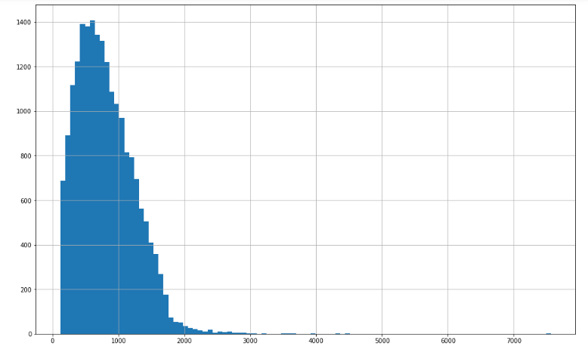
Data Understanding
Executive Summary | Data Understanding | Feature Engineering | Modeling | Performance | Insights | Conclusion
Telematics Data - four-wheel driver's smartphone
Snapshot of Data
Total number of trip – 20K Thousands of telematics data points per trip with acceleration (3-axis), gyro (3-axis), Speed, Bearing and Accuracy information available at every 1s Target Label per trip (1-indicate dangerous driving) – Slightly unbalanced 25% positive points Trip duration varies from 2min to 2.5 hrs; on the average of 15 mins*
Cleaning of Data
Removed outlier data points – Trip duration greater than 2.5 hrs Data Missing during the trip (removed if % of missing data is more than 90%) Received signal data is weak – indicated by speed value of -1 and higher accuracy value trip (removed if % of weak signal data is more than 90%) Used Special treatment of data missing and weak signal at feature engineering process
Outliers
*After Data Cleaning

Slide 4
Feature Engineering
Executive Summary | Data Understanding | Feature Engineering | Modeling | Performance | Insights | Conclusion
Characteristics of the Trip
Overall Trip Level Features
Trip Duration, Missing data%, Average Speed, Number of stops, longest streak of stop Statistical Features (Min, Max, Std, Mean , Quantile) – Accuracy , Speed, Gyro, Acceleration, Bearing, Acceleration Calculated using speed Detection of Events – Turns, Braking, Accelerator, Long Stop Detection, Quick Acceleration, Speeding, Harsh Braking, Cornering Calibration of data – While detecting events include missing data and weak signals duration Fraction of braking events exceeds over 2 m/s2 Fraction of acceleration exceeds over 3m/s2
Interaction between the Events
Sometime only detection of events would not fully characteristics of the trip. Turn with high speed (combination of turn and speed) Sequence of events add significant value of the driver behaviour Example: Turn, accelerator and then sudden break – Danger Behaviour Stop may be in traffic and then sudden acceleration
For Trip Id 130

Slide 5
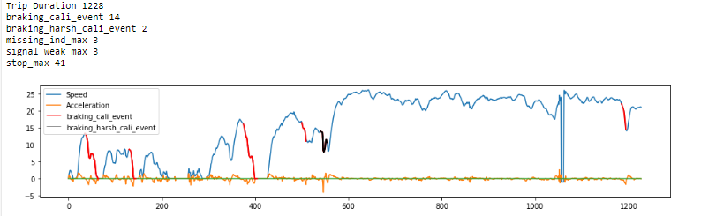
Feature Engineering – Events Detection
Executive Summary | Data Understanding | Feature Engineering | Modeling | Performance | Insights | Conclusion
For Trip Id 130

Slide 6
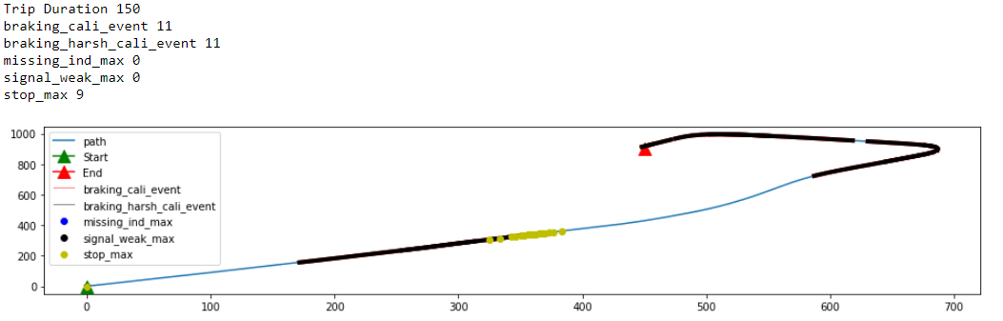
Feature Engineering – Interaction between Events
Executive Summary | Data Understanding | Feature Engineering | Modeling | Performance | Insights | Conclusion
For Trip Id 130

Slide 7
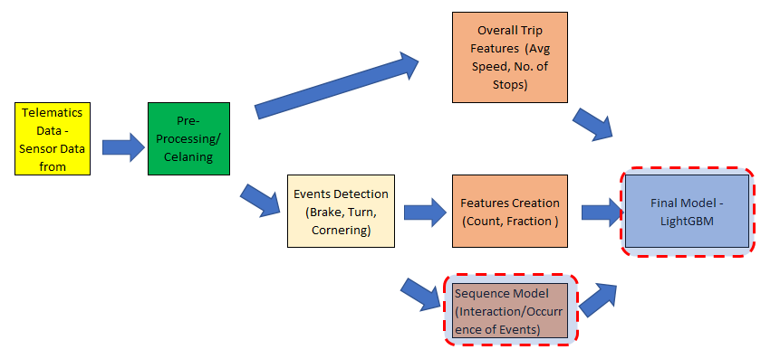
Modeling
Executive Summary | Data Understanding | Feature Engineering | Modeling | Performance | Insights | Conclusion
Modeling and validation techniques
Primary Modeling Technique: Gradient Boosted Trees (LightGBM)
A state-of-the-art implementation of gradient-boosted decision trees with several attractive features: Training/Validation – 80/20 ratio at trip level Used 5 CV folds to insure model stability and performance Used Bayesian approach for Hyper parameters tuning Ensemble the sequence model score in LightGBM model
Sequence Model - LSTM
Used LSTM model to captured interaction/sequence between events Considered 6 events - Braking, Acceleration, Accuracy, Stop, Missing and Signal weak events for sequence model Built 3 layers deep model; with [8,5,1] neurons

Slide 8
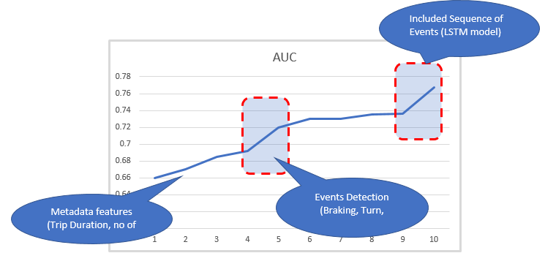
Performance
Executive Summary | Data Understanding | Feature Engineering | Modeling | Performance | Insights | Conclusion
Prediction accuracy
Best Model Accuracy → 0.767
Total Features included in LightGBM model – 47
Total Events Included in LSTM Model – 6 Features and maximum 200 timestamp data points

Slide 9
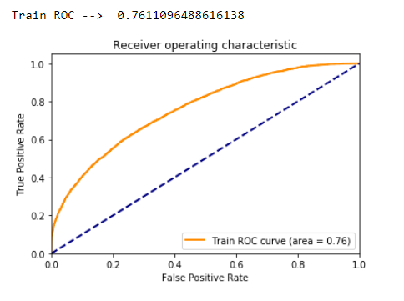
Performance
Executive Summary | Data Understanding | Feature Engineering | Modeling | Performance | Insights | Conclusion
Prediction accuracy
Best Model Accuracy → 0.761
Total Features included in LightGBM model – 47
Total Events Included in LSTM Model – 6 Features and maximum 200 timestamp data points

Slide 10
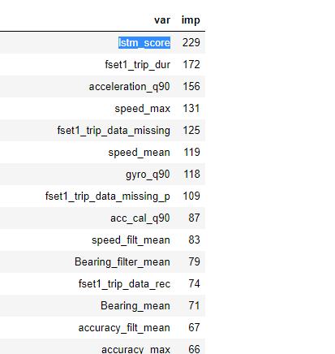
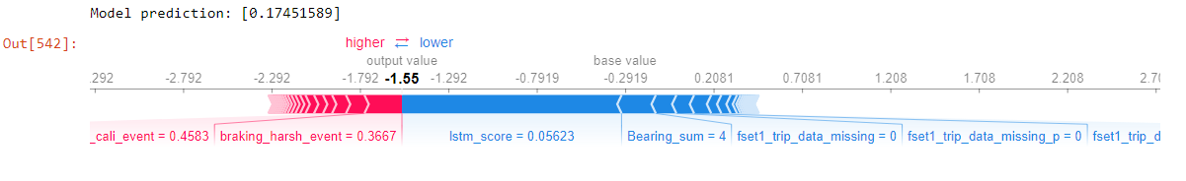
Insights
Executive Summary | Data Understanding | Feature Engineering | Modeling | Performance | Insights | Conclusion
SHAP overview, most important predictor
Primary model interpretation technique: SHAP (Shapley Additive Explanations)
Variable importance – no. of times variable used for data split in tree based modelling approach
For Trip Id 130

Slide 11
Conclusion
Executive Summary | Data Understanding | Feature Engineering | Modeling | Performance | Insights | Conclusion
Drivers and Future work
Drivers
Speed
Average and Max Speed are significant drivers – Higher speed more incline to accident
Future Work
Calibration of Sensor Data
Aligned acceleration and gyro direction with vehicle direction to accurate prediction of events (braking, turn)
Number/Duration of Stop
Fraction of time drive leas than 0.55m/s (consider vehicle stop or in traffic) plays a good role in driver behaviour
Additional Data
Use Map data for location identification which in turn helps to find the event of interest (Stop events )
Events
Harsh Braking and harsh Acceleration
Sequence of events (LSTM Score)
Alternative Modeling Approaches
Use deep learning model – sequence model to capture better interaction/occurrence between the events (turn, acceleration)
10

