Slide 1

June 16th, 2019
Safety: Driver Behaviour Analysis Using Telematics Data
Shubham Gupta

Slide 2
Executive Summary
Executive Summary | Data Understanding | Feature Engineering | Modeling | Performance | Insights | Conclusion
End-to-end overview of analytical framework
Problem Statement
Goal: Given the telematics data for each trip and the label if the trip is tagged as dangerous driving, derive a model that can detect dangerous driving trips Solution approach: Build model that accurately predicts the dangerous driving trip Produce empirical, model-derived insights into the factors that drive dangerous behaviour (Harsh Brake, Harsh Acceleration, Sharp Turns, Cornering
Data Preparation and Feature Engineering
Extensive feature engineering to distill time-series data into a set of representative characteristics of the trip Features created at trip level (average speed, average acceleration, trip duration, count of stops, duration of stop) Detecting driving events (speeding stopping, sudden braking, fast u-turn) using sliding window of 10s with overlap of 5s Data cleaning included minor data imputation and outlier removal
Modeling
Ensembles of two models, first model based on tree approach build on metadata, no. of driving events and second model based on sequence approach build on sequence/occurrence of danger driving event LightGBM boosted tree model – based on trip details and count of events LSTM Sequence model – based on sequence of events (accelerate, brake and then again harsh accelerate Training/validation splits to 80/20 ratio and performance tested on 5-CV folds
Performance and Insights
Best AUC on holdout validation data (20%): 0.761 Model-driven insights derived using driving events detection and SHAP (Shapley Additive Explanations) Primary factor that influences the dangerous trip – Occurrence of events Additional key factors: Maximum Speed, Stop duration, fraction of harsh braking
1

Slide 3
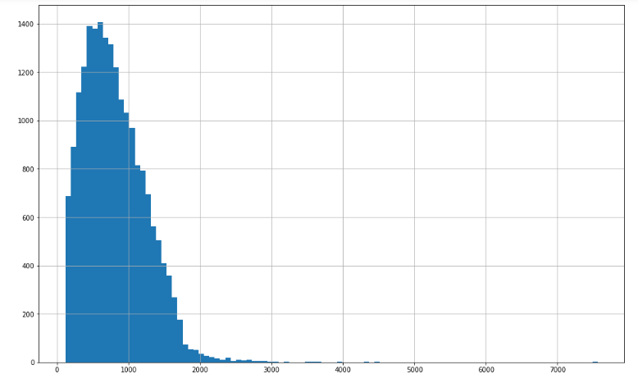
Data Understanding
Executive Summary | Data Understanding | Feature Engineering | Modeling | Performance | Insights | Conclusion
Telematics Data - four-wheel driver's smartphone
Snapshot of Data
Total number of trip – 20K Thousands of telematics data points per trip have acceleration (3-axis), gyro (3-axis), Speed, Bearing and Accuracy information available at every 1s interval Target Label per trip (1-indicate dangerous driving) – Slightly unbalanced 25% positive points Trip duration varies from 2min to 2.5 hrs; on the average of 15 mins* (figure on right)
Cleaning of Data
Removed outlier data points – Trip duration greater than 2.5 hrs Data Missing during the trip (removed if % of missing data is more than 90%) Received signal data is weak – indicated by speed value of -1 and higher accuracy value trip (removed if % of weak signal data is more than 90%) Applied special treatment of data missing and weak signal at feature engineering process
Outliers
*After Data Cleaning; Driver forgot to end the trip

Slide 4
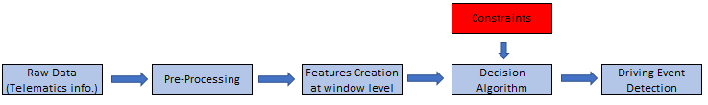
Feature Engineering
Executive Summary | Data Understanding | Feature Engineering | Modeling | Performance | Insights | Conclusion
Characteristics of the Trip
Overall Trip Level Features
Statistical Features (Min, Max, Std, Mean , Quantile) – Accuracy , Speed, Gyro, Acceleration, Bearing, Acceleration Calculated using speed Trip Duration, Missing data%, Average Speed, Number of stops, longest streak of stop Detection of Events – Turns, Braking, Accelerator, Long Stop Detection, Quick Acceleration, Speeding, Harsh Braking, Cornering Calibration of data – While removing impact of irrelevant events (missing data and weak signals) on interested events interested events (brake, stop , turn) Fraction of braking events exceeds over 2m/s2 Fraction of acceleration exceeds over 3m/s2
Interaction between the Driving Events
Sometime only detection of events would not fully characteristics the trip. There are lot of cross events possibility and impossible to detect using Decision Algorithm. Hence using sequence model (LSTM model) to capture such scenario Combination of events - Turn with high speed (combination of turn and speed event) Sequence/occurrence of events add significant value of the driver behaviour Example: Turn, accelerator and then sudden break – Danger Behaviour Stop may be in traffic and then sudden acceleration – Danger Behaviour
For Trip Id 130

Slide 5
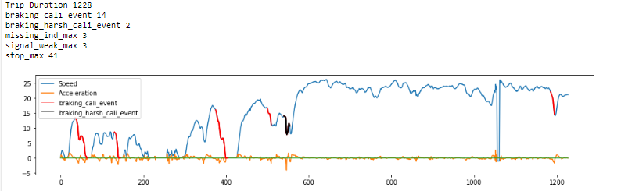
Feature Engineering – Driving Events Detection
Executive Summary | Data Understanding | Feature Engineering | Modeling | Performance | Insights | Conclusion
Danger Event Detection - Harsh Braking
Event Detection - Braking
No Event Detection
For Trip Id 13 Refer (06_Visualization Script)

Slide 6
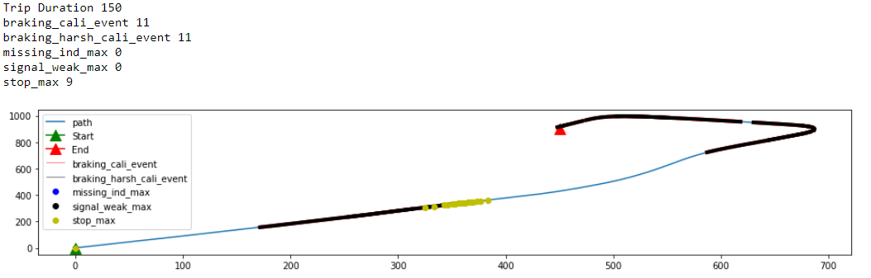
Feature Engineering – Interaction/Sequence of Events
Executive Summary | Data Understanding | Feature Engineering | Modeling | Performance | Insights | Conclusion
Danger Event Detection –
Harsh Braking and turning
Danger Event Detection –
Harsh Braking and then significant stop
For Trip Id 130 (Refer 06_Visualization Script)

Slide 7
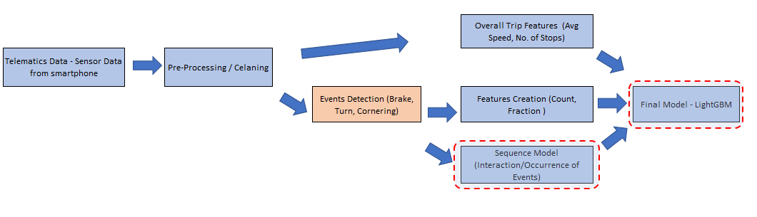
Modeling
Executive Summary | Data Understanding | Feature Engineering | Modeling | Performance | Insights | Conclusion
Modeling and validation techniques
Primary Modeling Technique: Gradient Boosted Trees (LightGBM)
A state-of-the-art implementation of gradient-boosted decision trees with several attractive features: Training/Validation – 80/20 ratio at trip level Used 5-CV folds to insure model stability and performance Used Bayesian approach for Hyper parameters tuning Ensemble the sequence model score in LightGBM model
Sequence Model - LSTM
Used LSTM model to captured interaction/sequence between events Considered 6 events - Braking, Acceleration, Accuracy, Stop, Missing and Signal weak events for sequence model Built deep model of 3 layers; with [8,5,1] neurons configuration

Slide 8
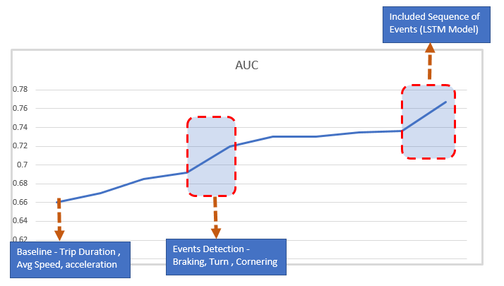
Performance
Executive Summary | Data Understanding | Feature Engineering | Modeling | Performance | Insights | Conclusion
Prediction accuracy
Best Model Accuracy → 0.761
Total Features included in LightGBM model – 47
Total Events Included in LSTM Model – 6 Features and maximum 200 timestamp data points
Starting with the simple baseline model , using events detection features , sequence of events score and ending up with a complex ensemble model of LightGBM and LSTM

Slide 9
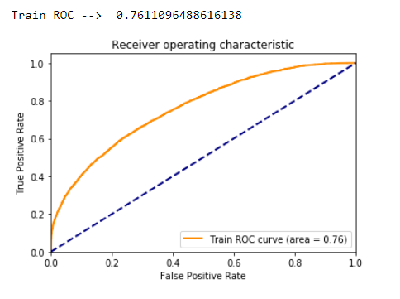
Performance
Executive Summary | Data Understanding | Feature Engineering | Modeling | Performance | Insights | Conclusion
Prediction accuracy
Best Model Accuracy → 0.761
Total Features included in LightGBM model – 47
Total Events Included in LSTM Model – 6 Features and maximum 200 timestamp data points

Slide 10
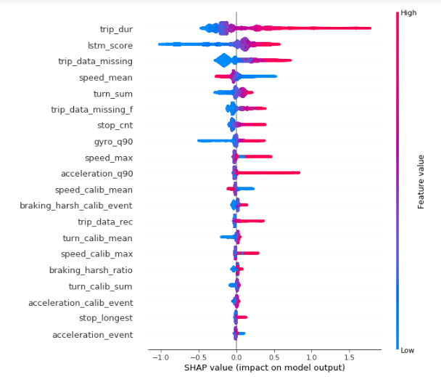
Insights
Executive Summary | Data Understanding | Feature Engineering | Modeling | Performance | Insights | Conclusion
SHAP overview, most important predictor
Primary model interpretation technique: SHAP (Shapley Additive Explanations)
Top Factors that characteristics danger trip
trip-dur: higher the duration, more data points, more danger driving event and higher chance of dangerous driving
lstm_score: lower the value indicate less chance of dangerous driving events
trip_data_missing: Indicates some abnormal events, example accident
turn_sum: lower the number of turns, lower the possibilities of dangerous events
stop_cnt: higher the value; higher the chance of abnormal events
https://github.com/slundberg/shap

Slide 11
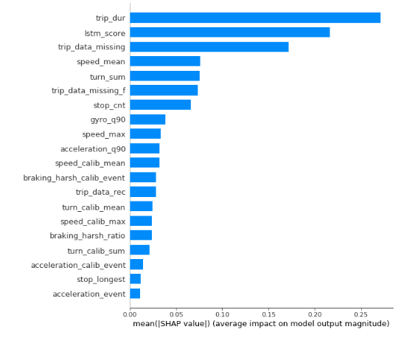
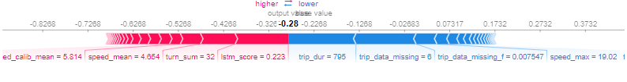
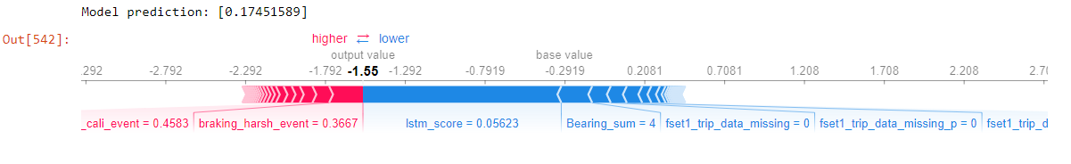
Insights
Executive Summary | Data Understanding | Feature Engineering | Modeling | Performance | Insights | Conclusion
We can visualization Impact of factors at trip level and overall score of features
https://github.com/slundberg/shap

Slide 12
Conclusion
Executive Summary | Data Understanding | Feature Engineering | Modeling | Performance | Insights | Conclusion
Future work
Calibration of Sensor Data
Aligned acceleration and gyro direction with vehicle direction to accurate prediction of events (braking, turn)
We can leverage acceleration, gyro 3-axis data if we aligned vehicle data with sensor direction
Additional Data
Map data
Use for location identification which in turn helps to find the event of interest (Stop events )
Example : Detect whether stop events are normal event i.e. area where vehicle stop
Determine the quality of area (road quality; urban/rural area)
Driver Information
If we get driver information also, we can build model at driver level and calculate driver driving score
Identify area where driver needs to improve
Alternative Modeling Approaches
Use deep learning model – sequence model to capture better interaction/occurrence between the events (turn, acceleration)
10

