Slide 1


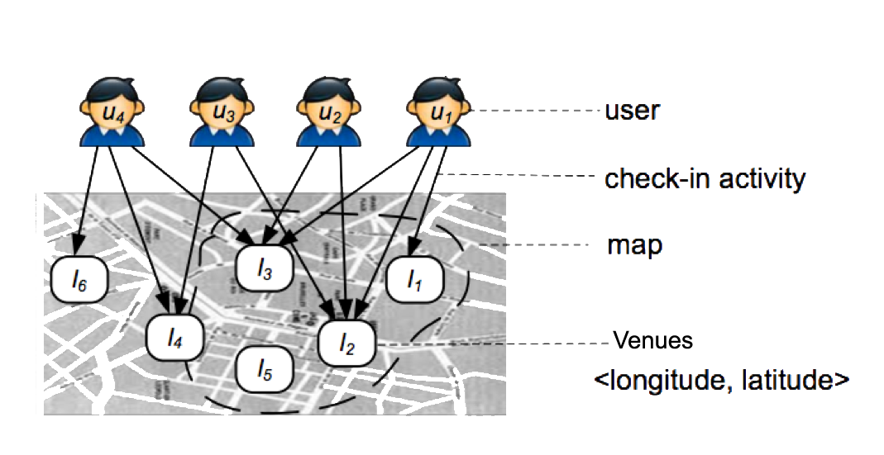
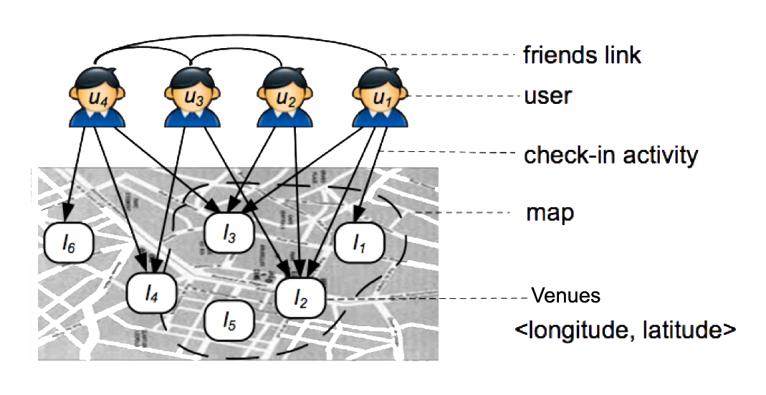
User Check-In History Based Venue Recommendation
Boya Yu Jiamin Xuan Yuxiang Zhang New York University, CUSP
Contribution
We present an application of collabor-ative filtering for the venue recom-mendation in New York City. In the first part, we implement traditional memory-based collaborative filtering method to recommend venues when we train on user check-in history. Next, we combine with user relation-ship or clustering labels as weighting function that surpasses traditional memory based collaborative filtering method.
Memory-Based Collaborative Filtering
Add text here
Trust-Based Collaborative Filtering
Data
Check-In Dataset
We get data indirectly from Four-square check-in records shared on Twitter. The data were a sample of record from Feb. 2014 to Feb. 2015, parsed using PySpark from 113 GB geotagged tweets around NYC. Next we used the Foursquare Venue Search API to scrape venue infor-mation denoted by latitude and long-itude. After preprocessing, we got 838 venues in which 4,365 users have checked-in 54,017 times in total.
Venue Similarity
For all the venues, we use Cosine Similarity and Jaccard Distance Sim-ilarity to transform the sparse matrix of user-venue check-in history into venue similarity scores.
User Relationship
From a social media user’s stand-point, following certain users may indicate a tendency of referring to their online activities. We scraped all the Twitter IDs that each of our users follows and discarded those IDs which are not in our set of 4,365 users.
Results
Next Steps
There are a few areas worth exploring on top of what we have accomplished. First, there are certain fea-tures in our data that we did not incorporate into the analysis, such as check-in time, venue category, and user bio. Furthermore, matrix factorization is an arguably more sophisticated approach than memory-based and trust-based CF, because it ideally allows us to discover the latent features underly-ing the interaction between users and venues.
Acknowledgments
Ye, Mao, et al. “Exploiting geographical influence for collaborative point-of-interest recommendation.” Proceedings of the 34th international ACM SIGIR conference on Research and development in Information Retrieval, 2011, pp. 325-334.
Luxburg, Ulrike von. “A Tutorial on Spectral Clustering.” Springer, 17 (4), 2007.

