Slide 1
Travelers Use Casde Review
Innovate at the Core
December 2016

Slide 2
Agenda
Ingestion
Ingest XML source files
Ingest free text log files
Perform real-time, batch, microbatch data evaluation
Perform real-time data re-coding
Duplicate record check
Data Preparation / Governance
Assign Atlas Tagging
Security Policies
Data Analytics
Visualizations
Data Queries
Advanced Analytics (time permitting)

Slide 3
Ingestion

Slide 4
Ingestion – Use Case Overview
Data Sources:
Claims submissions: XML Document
LOG source document: syslog format
Ideas Covered:
XML Parsing in Apache Nifi
Batching (batch size=large row count) and micro-batches (batch size = 1 row)
Reference data validation
Missing value checks
Supporting generic data feeds
Configurable Data landing zones

Slide 5
Claims MicroBatch Example

Slide 6
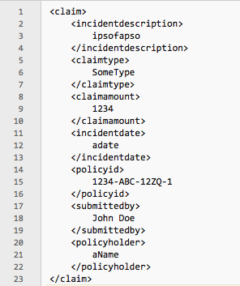
Claims.xml
Sample Data Randomly generated
~10% of rows will have a missing element
~ 5% of rows will have bad reference codes
Undetermined number of rows postings will be duplicated
Claims submitted to a monitored directory (all sorts of other source options exist)

Slide 7
Claims Processing Requirements
Convert XML file to a structured Hive file (schema on write) posted to a landing zone. Only send required fields on to Hive.
Post raw XML files to HDFS (schema on read) posted to a reporting zone
Do not post Claims submissions containing errors. Instead place erroneous submissions in a holding directory for review and possible reprocessing
Do not post duplicates
Post Claims submissions to Hadoop in large file batches

Slide 8
Initial Claims Flow Definition

Slide 9
Nifi Details to read in each Claims Submission

Slide 10
Extract Key elements from XML document

Slide 11
Validate Claims Submission

Slide 12
Check for duplicates

Slide 13
Batch Submissions into a larger group

Slide 14
Write to Hive

Slide 15
Write full XML to HDFS

Slide 16
Log Processing Example

Slide 17
Read Log file and break into log entries

Slide 18
Parse log entry into component attributes

Slide 19
Write Log file to HDFS

Slide 20
Security Enablement

Slide 21
Review Claims and Customer database security

Slide 22
Row level security to control Analyst access to data

Slide 23
Data Discovery

Slide 24
Search for Hive tables containing Claims data

Slide 25
Search for hive tables containing Group and Customer info

Slide 26
Claims Submissions Analytics

Slide 27
Link Customer, Group and total Claims Submissions

Slide 28
Explore Data Visualizations

Slide 29
Perform Statistical Analysis

Slide 30
Q&A…
Discussion

