Slide 1
Food Price and Social Unrest
Data analysis behind it

Slide 2
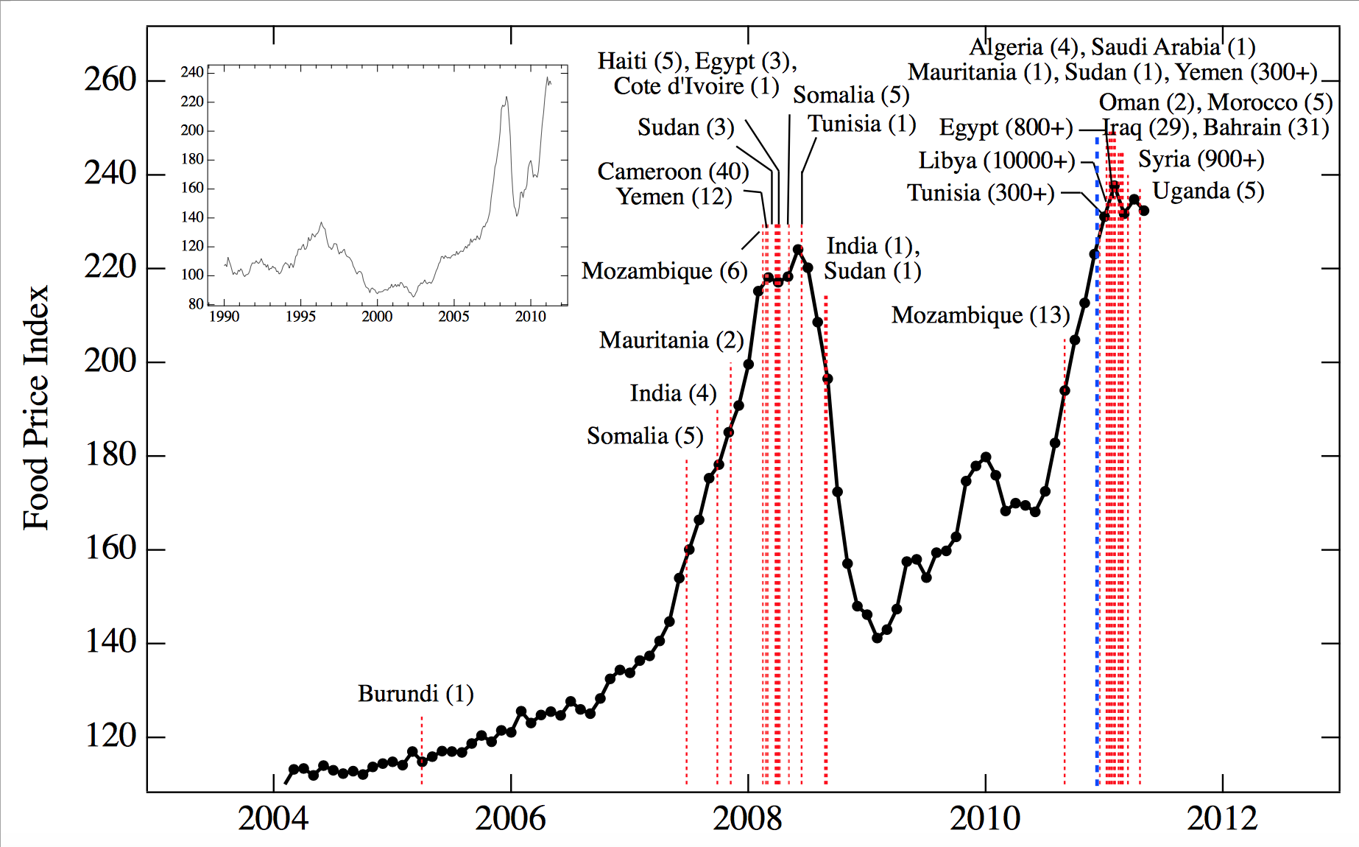
Background
Notes:
Social unrest may reflect a variety of factors such as poverty, unemployment, and social injustice.
A study in 2011 from the New England Complex System Institute found that despite the many possible contributing factors, the timing of violent protests in North Africa and the Middle East in 2011 as well as earlier riots in 2008 coincides with large peaks in global food prices. The article identifies a specific food price threshold above which protests become likely.
The overall death toll is reported in parentheses [26–55].

Slide 3
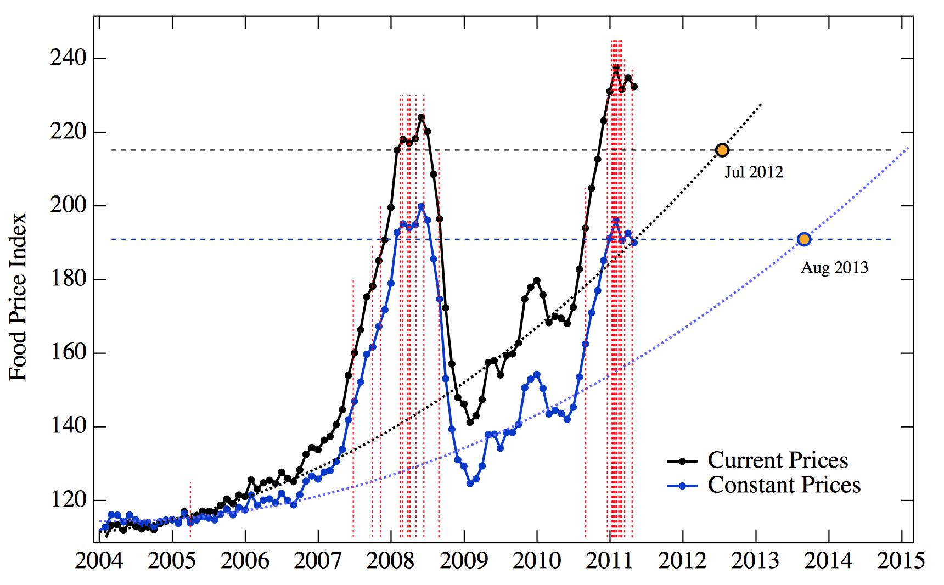
Notes:
Time dependence of FAO Price Index at current prices (upper black curve) and constant prices (corrected for inflation, lower blue curve) from January 2004 to May 2011. Red dashed vertical lines correspond to beginning dates of food riots and events associated with the major recent unrest in North Africa and the Middle East. Black and blue horizontal lines represent the price threshold above which riots are ignited in current and constant prices respectively. Index backgrounds are fitted with a third-order polynomial; intersection with the threshold (July 2012 at current prices, August 2013 at prices corrected for world inflation, [65]) represents the point of instability.

Slide 4
Data Source
Food related social unrest:
News stories search, key words, number of occurrences.
FAO’s food price index
Natural disaster
Notes:
LexiNexis Adamy’s food related riots data from: news stories in English between January 1990 and December 2011 containing at least five occurrences of the terms “cereal,” “commodity,” “food,” “grain,” or “staple,” and their plural forms and at least five occurrences of the terms “demonstration,” “mob,” “protest,” “riot,” “strike,” “unrest” or “violence” and their plural forms. The “at least five occurrences” criterion was applied to each component of the search for two reasons.
The FAO’s food price index is a monthly indicator of the price of food worldwide that covers five food groups (meat, dairy, cereals, oils and fats, and sugar) representing 55 commodities. To come up with an aggregate food price index, the FAO takes the average of the five food groups and weights them using group-specific export shares for the period 2002-2004. The size of the sample used for analysis in this article – 264 monthly observations from January 1990 to December 2011 inclusively – was ultimately determined by the fact that the FAO only started recording food prices in January 1990.

Slide 5
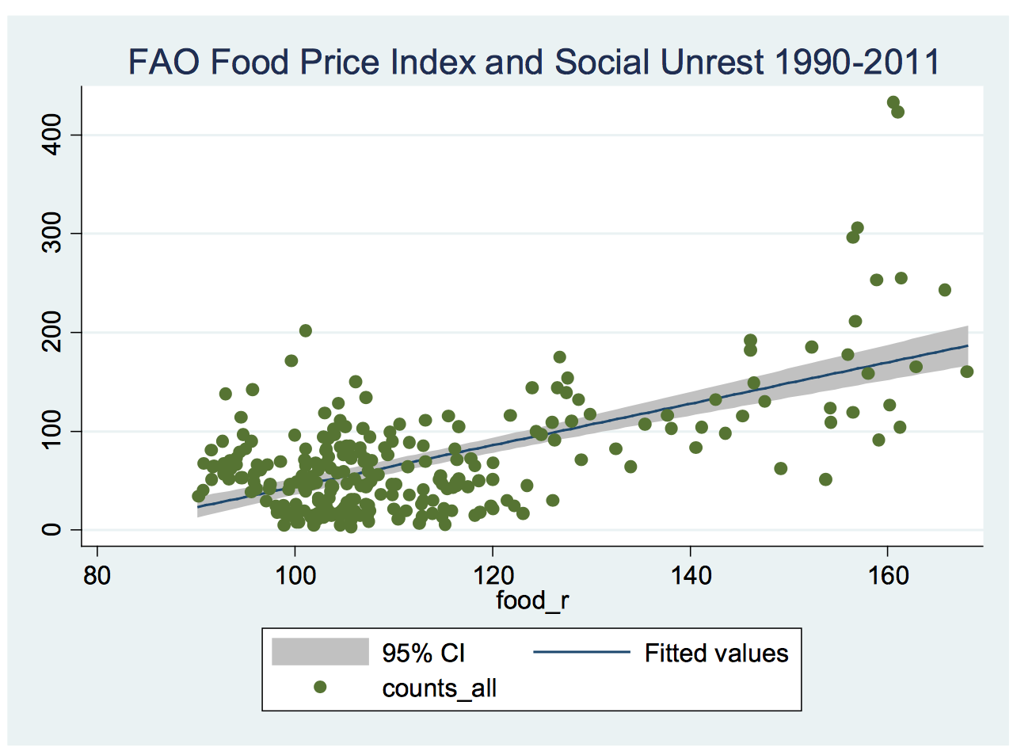
Marc F. Bellemare, 2014

Slide 6
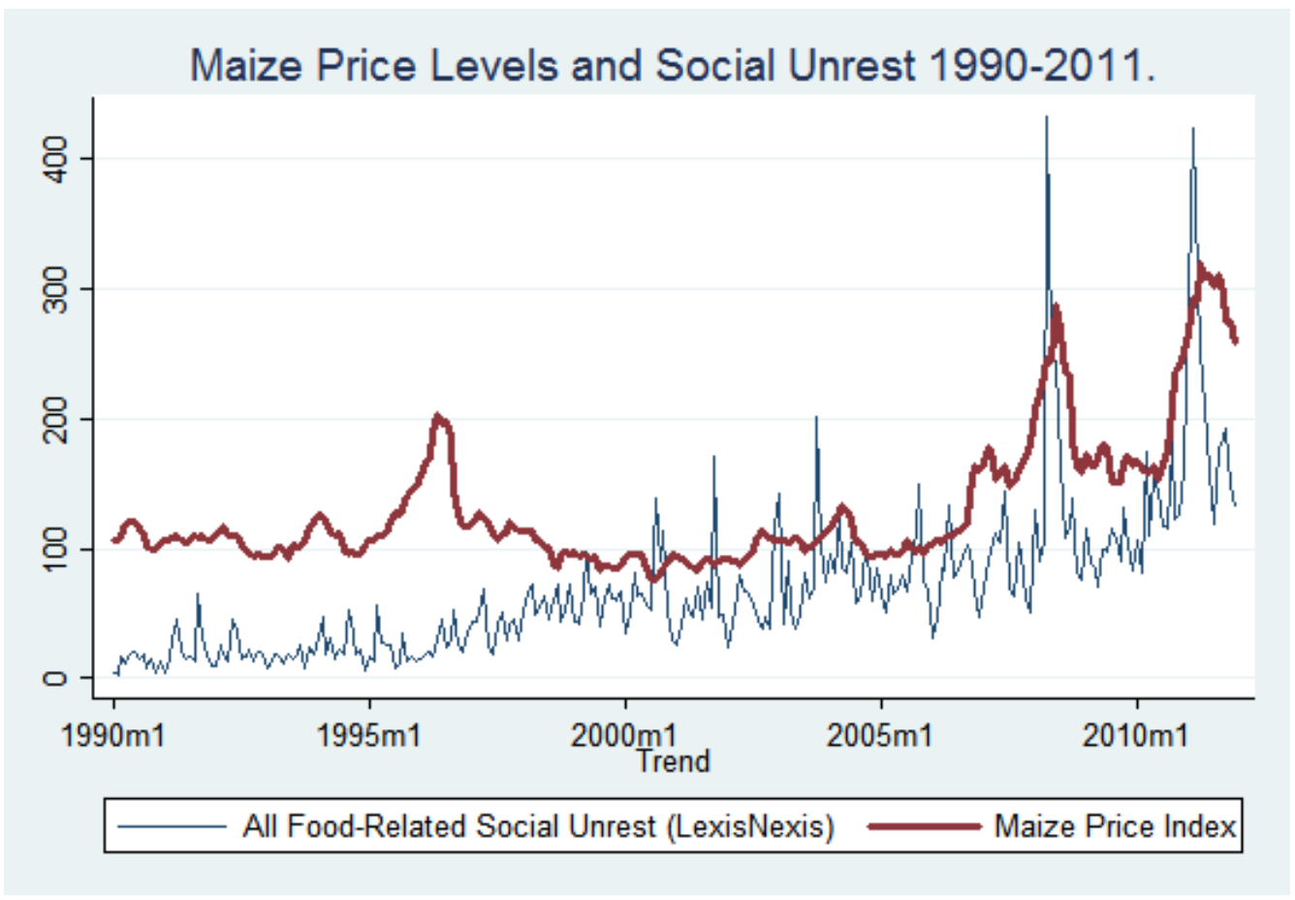
Marc F. Bellemare, 2014

Slide 7
Many factors, lack of clarity
Investor speculation (07/08 peak and 10/11 peak
Adverse weather
Consumptions growing
Ethanol as alternative fuel from corn…

