Slide 1
GeoPandas

Slide 2
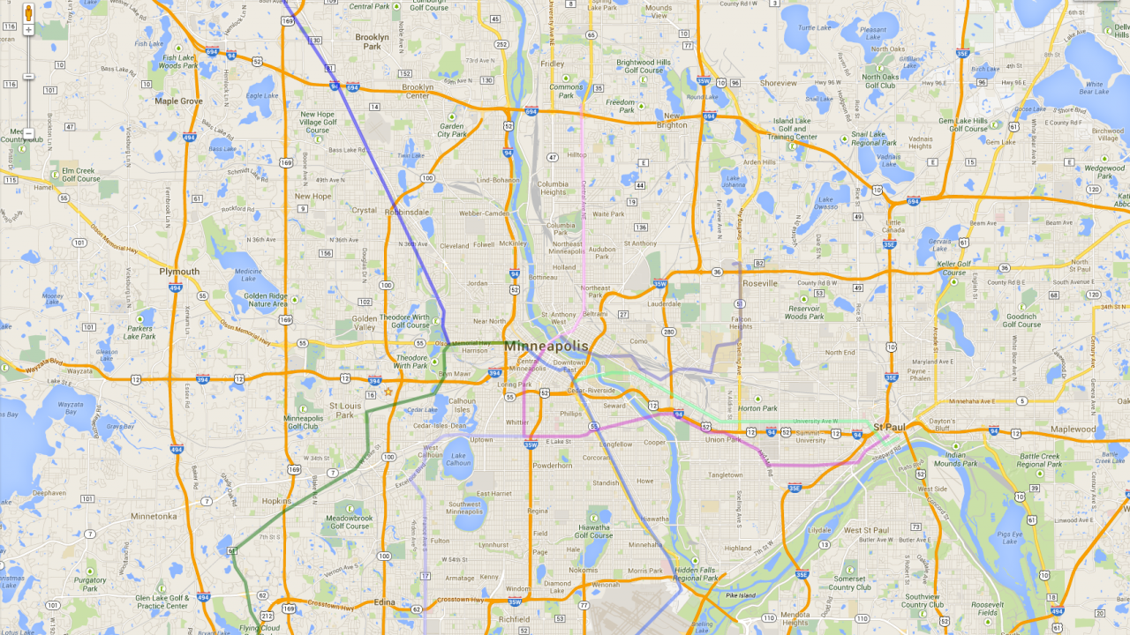
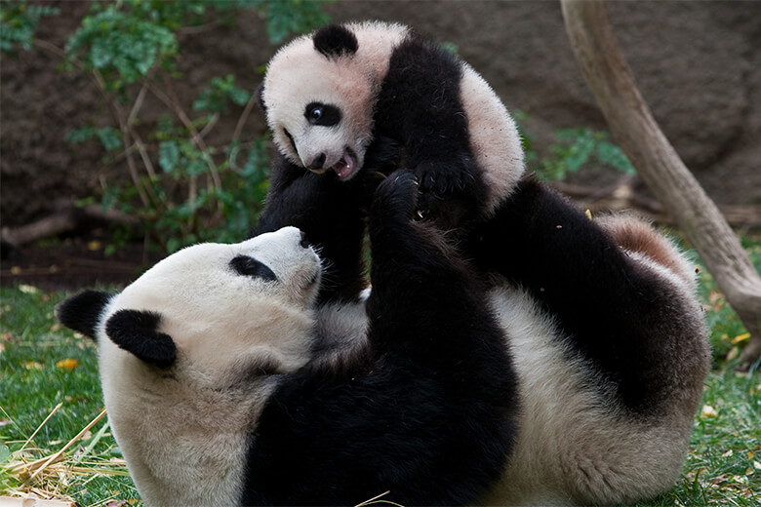
Geo + Pandas
Geo-spacial data + pandas data structures

Slide 3
Dependencies
Pandas
Shapely
Fiona
Matplotlib
Pyproj
Notes:
Pyproj - performs geodetic computations and cartographic transformations

Slide 4
Features
Geometric operations
Coordinate transformations
Read/write geospacial data files GIS format
Read/write objects with PostGIS
Pandas data features
Plotting
Notes:
GIS - geographic information system
PostGIS - PostGRES for geospatial data

Slide 5
Data Structures
Pandas
Series (1-D)
DataFrame (2-D)
Panel
GeoPandas
GeoSeries(1-D)
GeoDataFrame(2-D)

Slide 6
Demo
Enough chatter, let’s see it.

