Slide 1

Document Validation
Aka : SQL style check constraints

Slide 2
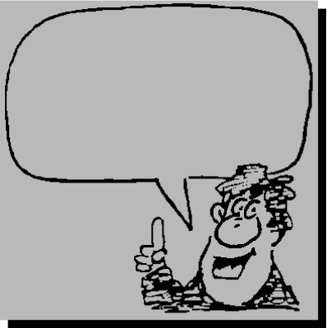
Daily stand up
Name – Company
Something about Mongo admin/coding you know that no one else here knows
Something about Mongo you wish you knew
Your next major Mongo project
Start at
the end

Slide 3
Something I know
db.t6.drop()
db.t6.createIndex( { m : 1 } )
db.t6.update( { a : 8 , b : { $gt : 9 } },
{ $set : { c : 1 }, $setOnInsert : { d : 2 } },
{ upsert : true } )
db.t6.find()

Slide 4
Something I know
db.t6.drop()
db.t6.createIndex( { m : 1 } )
db.t6.update( { a : 8 , b : { $gt : 9 } },
{ $set : { c : 1 }, $setOnInsert : { d : 2 } },
{ upsert : true } )
db.t6.find()
{ "_id" : ObjectId("571008d692917fa0cd12bdf3"),
"a" : 8, "c" : 1, "d" : 2 }

Slide 5
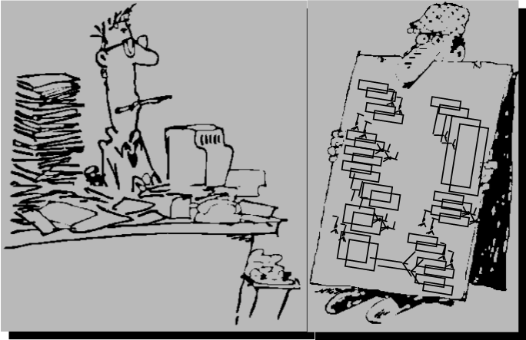
I get that MongoDB offers a polymorphic schema, and that part of the appeal of MongoDB is the “no schema migration” capability as new application requirements roll in.
Still, I come from SQL and really miss SQL style data integrity check constraints.
What can I do ?

Slide 6
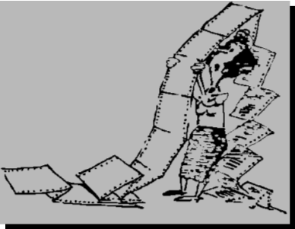
Rules of Engagement
Like reading ahead ?
https://github.com/farrell0/MongoDB-Developers-Notebook
Document validation, not validate
https://docs.mongodb.org/manual/core/document-validation/
https://docs.mongodb.org/manual/reference/command/validate/
We will cover most, not all
Questions throughout, me and you
Start ups would not exist except for the fundamental challenges of big companies.
Notes:
The validate command checks the structures within a namespace for correctness by scanning the collection’s data and indexes.
The command returns information regarding the on-disk representation of the collection.

Slide 7
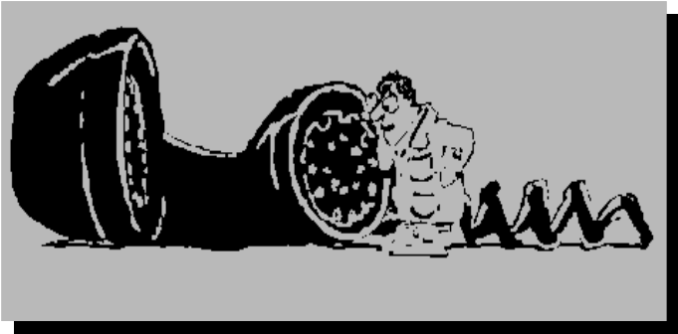
Your SQL experience ?
Your check constraint experience ?
Client or server side: which is best ?

Slide 8
Schema
Schema on write benefits:
In traditional data ecosystems, most tools (and people) expect schemas and can get right to work once the schema is described.
The approach is extremely useful in expressing relationships between data points.
It can be a very efficient way to store “dense” data.
Schema on write consequences:
Schemas are typically purpose-built and hard to change.
Generally loses the raw/atomic data as a source.
Requires considerable modeling/implementation effort before being able to work with the data.
If a certain type of data can’t be confined in the schema, you can’t effectively store or use it (if you can store it at all).
Unstructured and semi-structured (text, images, documents, other) data sources tend not to be a native fit.
Schema on read
Schema on write
Polymorphic schema
Source: http://www.ibmbigdatahub.com/blog/why-schema-read-so-useful
Notes:
Civil engineer, add a second railroad track to the bridge

Slide 9
Schema
Schema on read benefits:
Gives you massive flexibility over how the data can be consumed.
Your raw/atomic data can be stored for reference and consumption years into the future.
The approach promotes experimentation, since the cost of getting it “wrong” is so low.
Helps speed the time from data generation to availability.
Gives you flexibility to store unstructured, semi-structured, and/or loosely or unorganized data.
Schema on read consequences:
Can be “expensive” in terms of compute resources (then again, these big data engines were built to handle that).
The data is not self-documenting (i.e., you can't look at a schema to figure out what the data is).
You have to spend time creating the jobs that create the schema on read.
Schema on read
Schema on write
Polymorphic schema
Source: http://www.ibmbigdatahub.com/blog/why-schema-read-so-useful

Slide 10
Schema
MongoDB is a cross-platform document-oriented database. Classified as a NoSQL database, MongoDB eschews the traditional table-based relational database structure in favor of JSON-like documents with dynamic schemas (MongoDB calls the format BSON), making the integration of data in certain types of applications easier and faster.
Schema on read
Schema on write
Polymorphic schema
Source: https://en.wikipedia.org/wiki/MongoDB

Slide 11

Trends
Uber, the world’s largest taxi company, owns no vehicles.
Facebook, the world’s most popular media owner, creates no content.
Alibaba, the most valuable retailer, has no inventory.
Airbnb, the world’s largest accommodation provider, owns no real estate.
Source http://techcrunch.com/2015/03/03/in-the-age-of-disintermediation-the-battle-is-all-for-the-customer-interface/

Slide 12
Trends
What are the biggest drivers of application change?
There are two main factors – digital business and the rapid pace of IT change – which largely go hand in hand. The digital world is forcing organizations to evolve and change at a much faster rate than ever before. If an organization is moving at a certain pace or level, the IT organization has to match that rhythm.
Mobile is a huge factor in this, particularly as we continue to see growth in a range of different devices.
How do applications strategies need to evolve to give businesses a competitive edge?
To stay ahead, businesses need agile, dynamic, iterative, continuously evolving, ecosystem-based delivery methods. In the digital economy, businesses will live or die based on how they handle complex application strategies, including packaged applications, analytics, customer applications, cloud-based applications and mobile apps.
Source http://www.gartner.com/newsroom/id/3079718

Slide 13
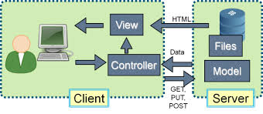
Trends
A single-page application (SPA) is a web application or web site that fits on a single web page with the goal of providing a more fluid user experience similar to a desktop application.
In a SPA, either all necessary code, HTML, JavaScript, and CSS, is retrieved with a single page load, or the appropriate resources are dynamically loaded and added to the page as necessary, usually in response to user actions.
The page does not reload at any point in the process, nor does the page control transfer to another page, although the location hash can be used to provide the perception and navigability of separate logical pages in the application, as can the HTML5 pushState() API.
Source: https://en.wikipedia.org/wiki/Single-page_application
Notes:
In effect, the only traffic between the end user application and application server and database after the initial page load, is data. Data validation rules are best enforced on the client, providing an immediate and optimal end user application experience. Client side data integrity checking or server side; the current trend places more checking on the client side.

Slide 14


Slide 15
First end to end example
Not allowed:
admin database
local database
config database
Any system.* collection in any database
4 (DML) command verbs:
find()
insert()
remove()
update()
How-
db.createCollection()
db.runCommand( { “collMod” : .. } )
Authorization:
bypassDocumentValidation
dbAdmin and restore
validationLevel
off, strict or moderate.
validationAction
warn or error
db.getCollectionInfos()
db.getCollectionInfos( { “name” : “ <collection name> “ } )
Notes:
validationLevel, either off, strict or moderate.
strict applies all document validation rules to all document inserts and updates.
moderate applies all document validation rules to document inserts only. In effect, if a bad document existed that you now update, any inherited violations will pass validation.
validationAction, either warn or error.
error returns an error to the end user application, expecting that the end user application will take corrective action.
warn allows the given data manipulation method, and places an entry in the MongoDB write operation log.

Slide 16
First end to end example
db.my_coll.drop()
vc = { "$and" :
[
{ "k1" : { "$exists" : "true" } },
{ "k1" : { "$eq" : 17 } }
] }
db.createCollection( "my_coll",
validator = vc, validationAction = "error" )
db.my_coll.insert( { "k1" : 17 } )
# db.my_coll.insert( { "k2" : 30 } )
# db.my_coll.insert( { "k1" : 32 } )
# db.my_coll.insert( { "k1" : "aaa" } )
db.my_coll.drop()
vc = { "$and" :
[
{ "k1" : { "$eq" : 17 } }
] }
db.createCollection( "my_coll",
validator = vc, validationAction = "error" )
db.my_coll.insert( { "k1" : 17 } )
# db.my_coll.insert( { "k2" : 30 } )

Slide 17
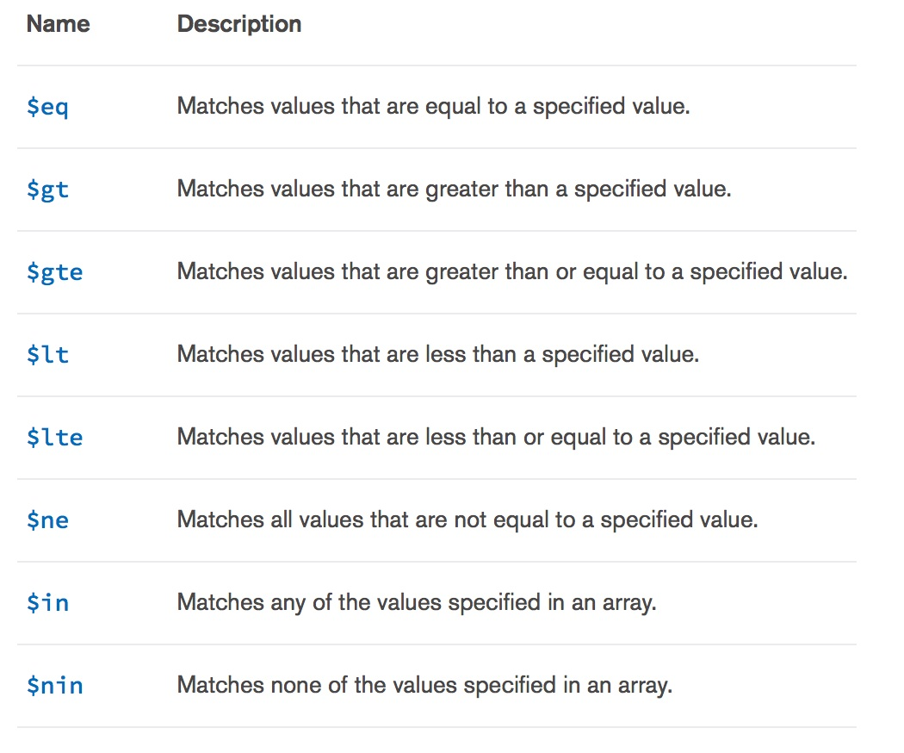
Specify the expressions using any query operators, with the exception of $near, $nearSphere, $text, and $where.
Source: https://docs.mongodb.org/manual/reference/operator/query/#query-selectors

Slide 18
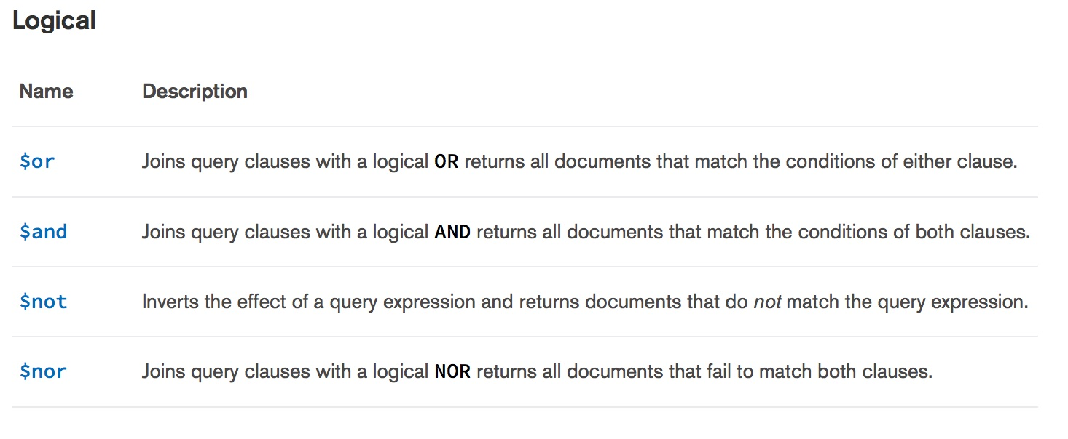

Slide 19
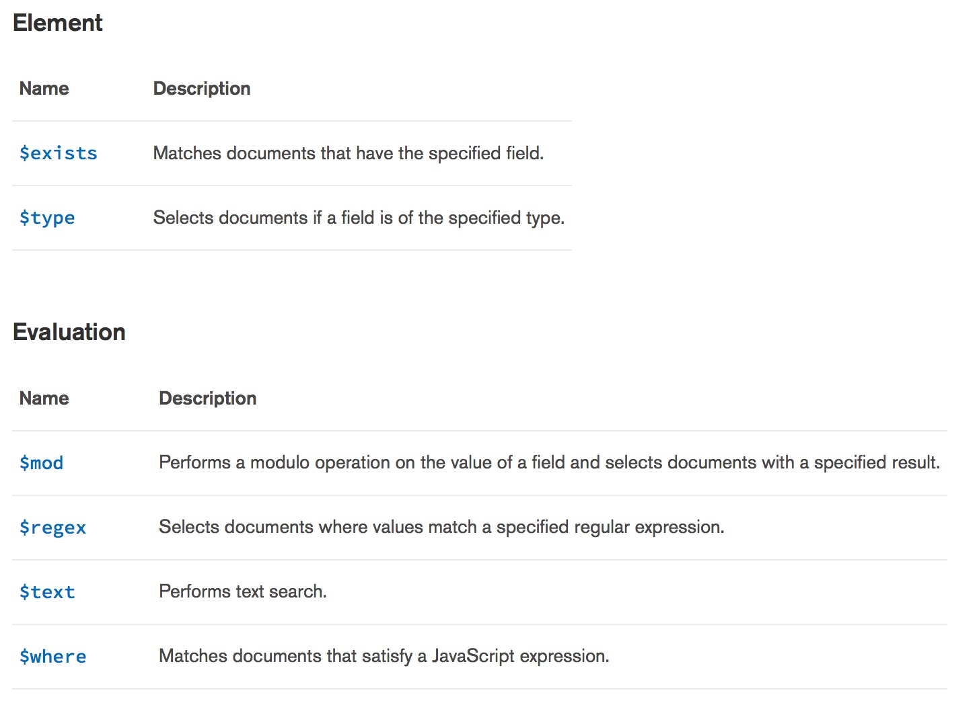

Slide 20
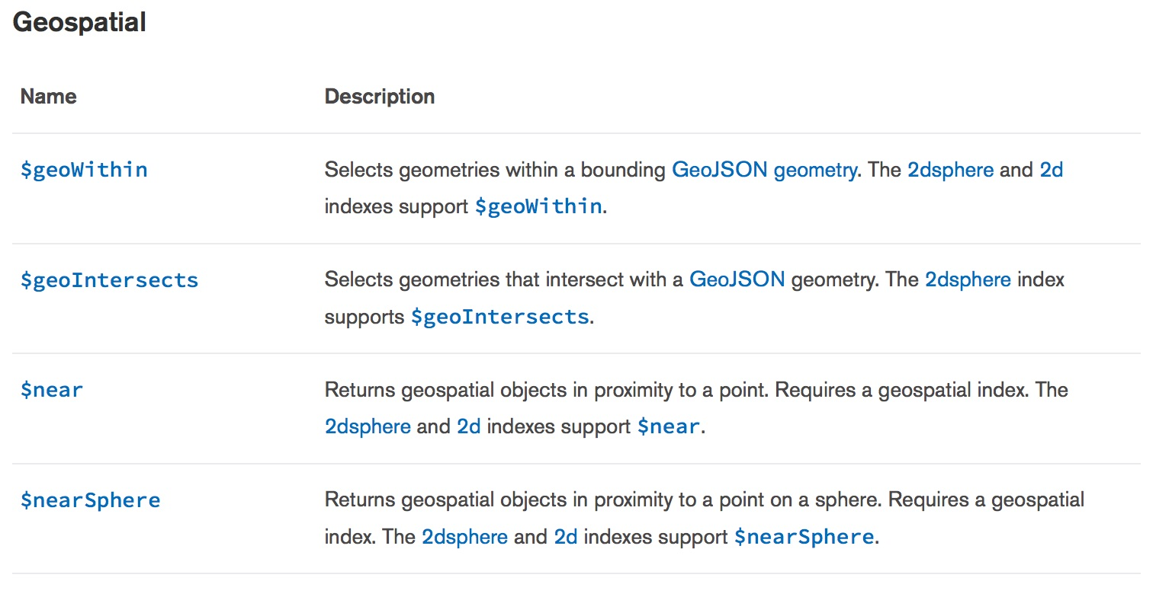

Slide 21
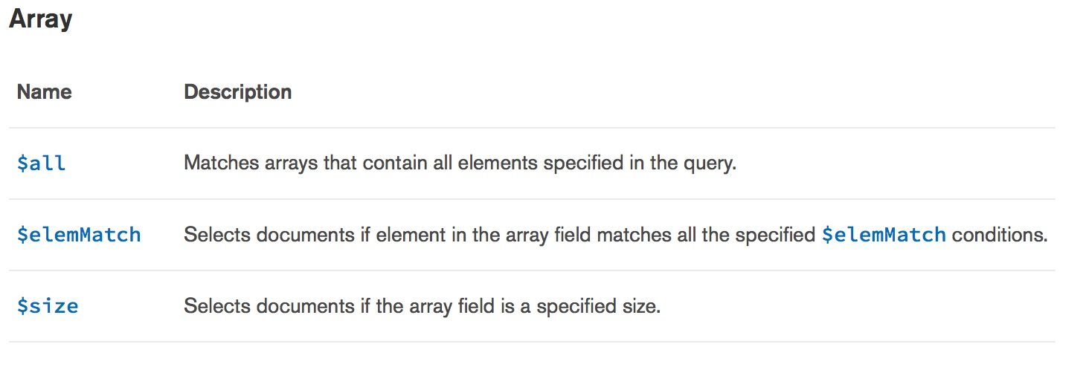

Slide 22
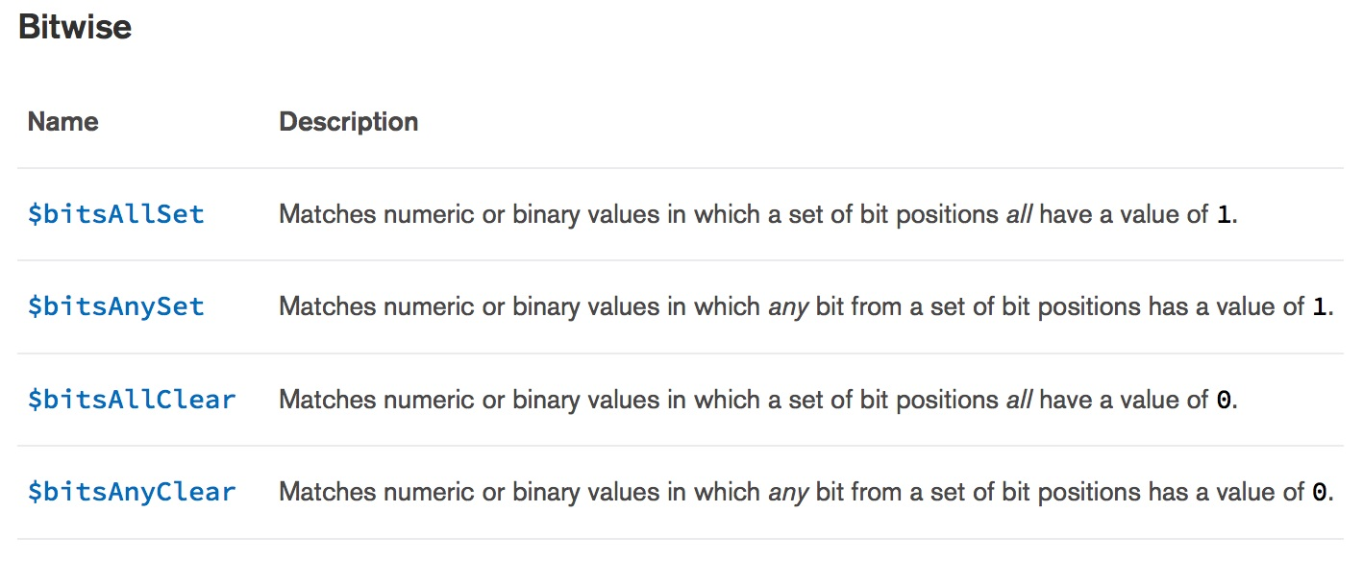

Slide 24
SQL style IS NULL, IS NOT NULL, MongoDB $exists
db.my_coll.drop()
vc = { "$and" :
[
{ "k1" : { "$exists" : "true" } }
] }
db.createCollection( "my_coll",
validator = vc, validationAction = "error" )
db.my_coll.insert( { "k1" : 17 } )
# db.my_coll.insert( { "k2" : 17 } )
db.t1.drop()
db.t1.createIndex( { a : 1 }, { unique : true } )
db.t1.insert( { a : null } ) # this insert succeeds
db.t1.insert( { a : null } ) # this insert fails

Slide 25
SQL style IS NULL, IS NOT NULL, MongoDB $exists
>>> db.t4.insert({a:4})
>>> db.t4.insert({b:4})
>>> db.t4.insert({a:null})
>>>
>>> db.t4.find({ $or : [ { a : { $exists : 0 } } , { a: null } ] } )
>>>
>>>
>>> { "_id" : ObjectId("570e2a869c14239cfc8f4659"), "b" : 4 }
>>> { "_id" : ObjectId("570e2a8b9c14239cfc8f465a"), "a" : null }

Slide 26
SQL style IN LIST, MongoDB $in
db.my_coll.drop()
vc = { "$and" :
[
{ "k1" : { "$in" : [ 1 , 2 ] } }
] }
#
db.createCollection( "my_coll",
validator = vc, validationAction = "error" )
db.my_coll.insert( { "k1" : 1, "k2" : 2 } )
# db.my_coll.insert( { "k1" : 3, "k2" : 2 } )
# db.my_coll.update( { "k1" : 2 }, { "k2" : 3 } )
db.my_coll.drop()
#
vc = { "$and" :
[
{ "k1" : { "$in" : [ 1 , 2 ] } },
{ "k2" : { "$nin" : [ 5 , 6 ] } }
] }
#
db.createCollection( "my_coll",
validator = vc, validationAction = "error" )
db.my_coll.insert( { "k1" : 1, "k2" : 8 } )
# db.my_coll.insert( { "k1" : 1, "k2" : 6 } )
# db.my_coll.insert( { "k1" : 3, "k2" : 8 } )
# db.my_coll.insert( { "k1" : 3, "k2" : 6 } )

Slide 27
SQL Ship_Date >= Order_Date, MongoDB $where
db.my_coll.drop()
# The following block is not supported, and would fail
# vc = { "$and" :
# [
# { "$where" : "this.ship_date >= this.order_date" }
# ] }
# db.createCollection( "my_coll",
# validator = vc, validationAction = "error" )
db.my_coll.insert( { "order_date" : 18, “ship_date” : 19} )
db.my_coll.insert( { "order_date" : 18, “ship_date” : 10} )
db.my_coll.find( { "$where" : "this.ship_date >= this.order_date" } )
# Only the first document above is returned.
https://jira.mongodb.org/browse/SERVER-2702

Slide 28
$lookup
Note: $lookup is also currently excluded from being a MongoDB clause in a document validation constraint.
$lookup is not a query operator, and is instead a MongoDB aggregation framework stage.
At this time, no aggregation framework stages may be used as document validation constraint clauses.

Slide 29
$lookup example
db.my_col1.drop()
db.my_col2.drop()
db.my_col1.insert( { "abbr" : "WI", "name" : "Wisconsin" } )
db.my_col2.insert( { "city" : "Madison", "st" : "WI" } )
db.my_col2.aggregate(
[
{
"$lookup" :
{
"from" : "my_col1",
"localField" : "st",
"foreignField" : "abbr",
"as" : "state"
}
},
{
"$project" :
{
"_id" : 0,
"city" : 1,
"state" : "$state.name"
}
}
] )
[{u'city': u'Madison', u'state': [u'Wisconsin']}]

Slide 30
Semantic data integrity, MongoDB key value types
db.my_coll.drop()
vc = { "$and" :
[
{ "k1" : { "$type" : "int" } },
{ "k2" : { "$type" : "string" } }
] }
db.createCollection( "my_coll",
validator = vc, validationAction = "error" )
db.my_coll.insert( { "k1" : 1, "k2" : "aaa" } )
# db.my_coll.insert( { "k1" : "aaa", "k2" : "aaa" } )
# db.my_coll.insert( { "k1" : 1, "k2" : 11 } )
https://docs.mongodb.org/manual/reference/operator/query/type/

Slide 31
Complex constraint checking, length, other, MongoDB $regex
import pymongo
#
my_conn = pymongo.MongoClient("mongodb://localhost")
db = my_conn.cc_db
###################################################
###################################################
db.my_coll.drop()
vc = { "$and" :
[
{ "k1" : { "$type" : "string" } },
{ "k1" : { "$regex" : "([a-zA-Z]){8,8}" } }
] }
db.create_collection( "my_coll",
validator = vc, validationAction = "error" )
db.my_coll.insert( { "k1" : "dddddddd" } )
# db.my_coll.insert( { "k1" : "dddddd" } )

Slide 32
https://docs.mongodb.org/manual/reference/operator/query/regex/
MongoDB uses Perl compatible regular expressions
(i.e. “PCRE” ) version 8.38 with UTF-8 support.

Slide 33
MongoDB key value defaults
If you supply SQL a value for a given column, then that is the value you write.
If you omit the column from the SQL INSERT statement column list, then you write a default value.
To have default constraints on non _id key values, you must call the MongoDB update method when inserting, and call it with an $upsert parameter.

Slide 34
MongoDB key value defaults
db.my_coll.drop()
db.my_coll.insert( { "_id" : 10 , "k1" : 5, "k2" : 10 } )
db.my_coll.update( { "_id" : ObjectId() }, { "$set" :
{ "k1" : 10 } , "$setOnInsert" : { "k2" : 20 } }, { upsert : true } )
db.my_coll.update( { "_id" : 10 }, { "$set" :
{ "k1" : 10 } , "$setOnInsert" : { "k2" : 20 } }, { upsert : true } )
db.my_coll.find()
# { "_id" : 10, "k1" : 10, "k2" : 10 }
# { "_id" : ObjectId("56fca4b43de3c3c87e2ee4ae"), "k1" : 10, "k2" : 20 }

Slide 35
Remaining
MongoDB unique key value constraints
Shards, MPP
SQL stored procedures, triggers, MongoDB server side

Slide 36
Additional resources:
Free MongoDB training courses,
https://university.mongodb.com/
A really good two part tutorial blob post on this topic is available here,
https://www.mongodb.com/blog/post/document-validation-part-1-adding-just-the-right-amount-of-control-over-your-documents
https://www.mongodb.com/blog/post/document-validation-part-2-putting-it-all-together-a-tutorial
Shameless plug
https://github.com/farrell0/MongoDB-Developers-Notebook
https://www.mongodb.com/webinar/index-tuning-and-evaluation-using-mongodb
Put MongoDB
On your LinkedIn

