Slide 1
Netflix 2006 Sample tabulation & basic stats
Thanh Doan

Slide 2

Recap of the problem
Predict whether someone will enjoy a movie
based on how did he/she rated other movies in the past

Slide 3
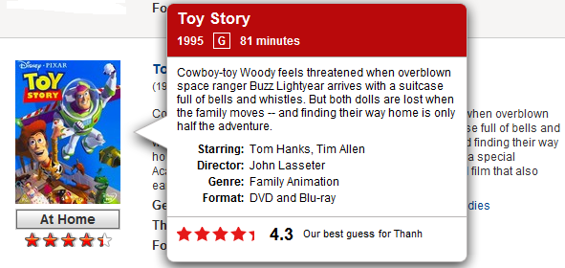
Netflix own movie recommender
Netflix recommender
has an RMSE
of 0.95
Has an RMSE of 0.95
I.e. a typical rating would be off by almost one full star

Slide 4
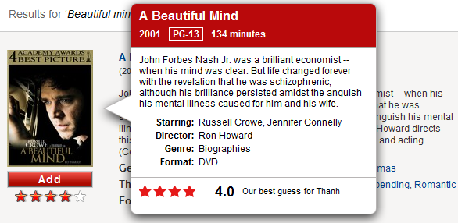
Netflix Prize
Netflix prediction has an RMSE of 0.95
Winning team developed a system that beat Netflix recommendation algorithm 10.6 % in 2009
I.e. Their RMSE is 0.857

Slide 5
Scope of research
Develop a recommendation system that beat Netflix recommender
By implementing statistical models published by Netflix Prize winners
And/Or
Invent a new (better) recommendation algorithm and implement on Hadoop

Slide 6
Netflix datasets
100 millions ratings sample from 1998 to 2005, 480,189 users, 17,770 movies
Training data form:
<user, movie, rating date, rating star>
For each movie, title and year of release are provided in 2nd dataset

Slide 7
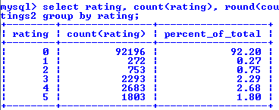
2006 sample
A sample of 100,000 data points
Each point is a record of a customer watched a particular movie in 2006.
In 100,000 watched times, the ratings are

Slide 8
2006 sample
There are 6,822 customers in the sample
watched 807 movies
Thus, on average…
Each person watched 6,822/708 = 9.6 movies in 2006
Each person watched 100,000/6,822= 14.6 times in 2006
Some people watched a movie more than once?
Each movie is watched 100,000/807= 123.9 times in 2006

Slide 9
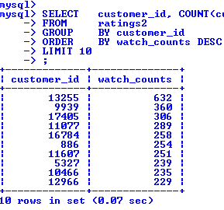
With in 6,822 customers
on average…
Each person watched 6,822/708 = 9.6 movies in 2006
Each person watched 100,000/6,822= 14.6 times in 2006
Top 10 watchers

Slide 10
How many customer did rate? (1)
Within 6,822 customers:
 | Number of customers | Percent
Rated | 1,250 | 18.32
Did not rate | 5,572 | 81.68
Total | 6,822 | 100

Slide 11
How many customer did rate? (2)
Within 1,250 customers who gave ratings:
Rated | # customers | Percent
1 to 5 times | 27 | 2.16
6 to 10 times | 69 | 5.52
11 to 20 times | 151 | 12.08
21 to 30 times | 178 | 14.24
31 to 50 times | 279 | 22.32
Over 50 times | 546 | 43.68
Total | 1,250 | 100

Slide 12
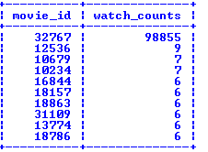
Within 807 movies in the sample
on average…
Each movie is watched 100,000/807= 123.9 times in 2006
Most watched movies
Movie 32767 is susceptive

Slide 13
If we don’t count movie 32767
How many customer did rate?
 | Number of customers | Percent
Rated | 343 | 41
Did not rate | 494 | 59
Total | 837 | 100

Slide 14
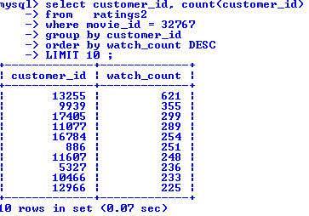
Investigate movie 32767
The most watched movie (movie_id=32767)
watched 98,855 times in 2006?
Potentially an outlier
How many of times this movie was watched by each person?
Someone watched this movie 225 , 355 or 621 times???
Potentially an outlier

Slide 15
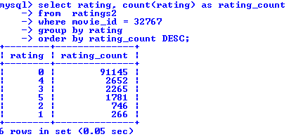
Investigate movie 32767 (2)
# of ratings for this movie is on the below table
Neflix said: To prevent inferences being drawn about customers… some ratings were deliberately perturbed:
deleting ratings;
inserting alternative ratings and dates;
modifying rating dates.

Slide 16
With in 6,822 customers
1,250 customers rated
5,572 did not bother to rate
What happen if not accounting for movie 32767?
 | Number of customers | Not counting movie 32767
Rated | 1,250 | 343
Did not rate | 5,572 | 494
Total | 6,822 | 837

Slide 17
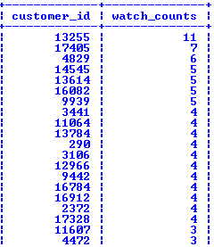
With in 343 customers who rated
List top watchers in 2006…
This doesn’t account for movie 32767 ratings

Slide 18
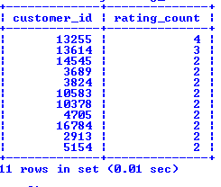
With in 343 customers who rated
Top raters in 2006…
This doesn’t account for movie 32767 ratings

Slide 19
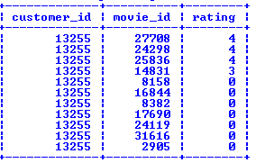
Study a specific customer
what did customer 13255 rate?
This list do NOT include ratings for movie 32767

Slide 20
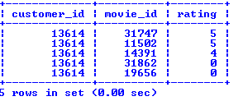
Study another customer
what did customer 13614 rate?
This list do NOT include ratings for movie 32767

Slide 21
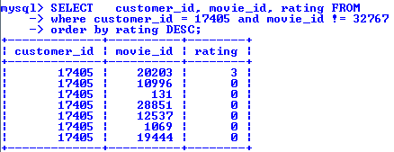
Study a random customer ratings
what did customer 17405 rate?
This list do NOT include ratings for movie 32767

Slide 22
807 movies watched in sample
78 movies were rated in 2006 sample
About 9.67%
78 movies rated by 1,250 viewers
If we don’t count movie 32767, we have…
77 movies rated by 80 viewers

Slide 23
Within 807 movies in the sample
Most watched movies
Movie 32767 is susceptive

Slide 24
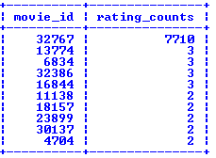
Within 807 movies in the sample
Most rated movies in 2006 sample
Movie 32767 is susceptive

Slide 25
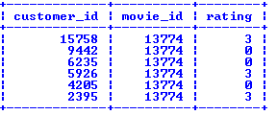
Study a specific movie
Who watched and rated movie 13774?

Slide 26
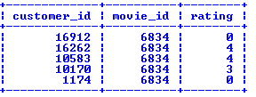
Study another movie
Who watched and rated movie 6834?

Slide 27
References
http://www.netflixprize.com/
http://www.cs.uic.edu/~liub/Netflix-KDD-Cup-2007.html

