Slide 1
CS345 Data Mining
Recommendation Systems
Anand Rajaraman, Jeffrey D. Ullman

Slide 2
Recommendations
Search
Recommendations
Items
Products, web sites, blogs, news items, …

Slide 3
Types of recommendation systems
Content-based systems examine properties of the items recommended
if a Netflix user watched many cowboy movies, then recommend a movie classified in the database as having the “cowboy” genre
Collaborative filtering systems recommend items based on similarity measures between users and/or items
The items recommended to user A are those preferred by similar users B, C, D.
Notes:
Fundamental economic transformation wrought by the Internet

Slide 4
Why recommendation system?
Shelf space is a scarce commodity for traditional retailers
Also: TV networks, movie theaters,…
The web enables near-zero-cost dissemination of information about products
From scarcity to abundance
More choice necessitates better filters
Recommendation engines
Physical stores provide only the most popular items, while on-line stores provide the entire set as well as the popular items
Notes:
Fundamental economic transformation wrought by the Internet

Slide 5
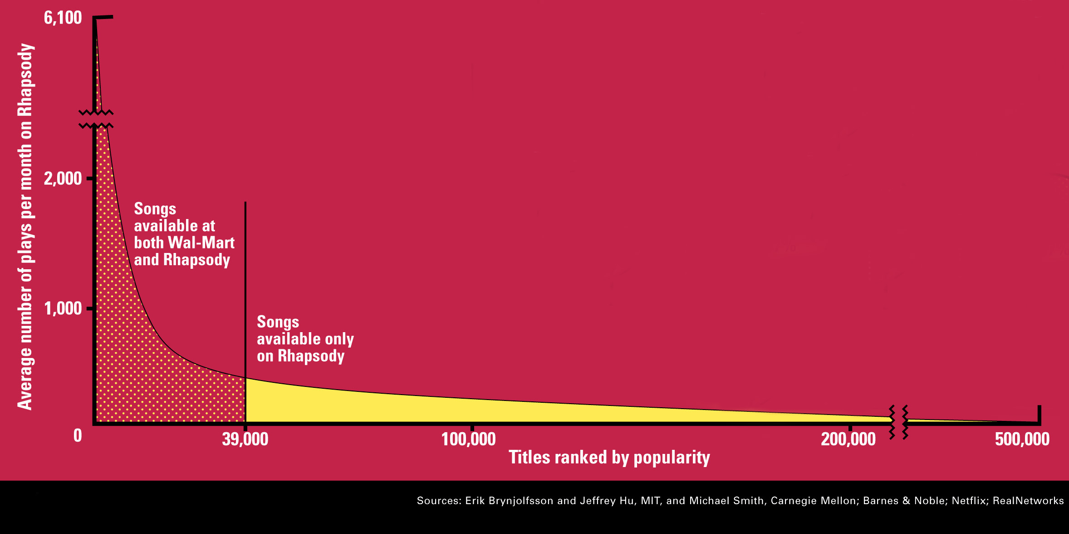
The Long Tail
Source: Chris Anderson (2004)

Slide 6
Recommendation Types
Editorial
Simple aggregates
Top 10, Most Popular, Recent Uploads
Tailored to individual users
Amazon, Netflix, …

Slide 7
Formal Model
C = set of Customers
S = set of Items
Utility function u: C x S -> R
R = set of ratings
R is a totally ordered set
e.g., 0-5 stars, real number in [0,1]

Slide 8
Utility Matrix
King Kong
LOTR
Matrix
Star Wars
Alice
Value represents
what is known about the degree of preference of that user for that item
Bob
Carol
David
unknown or zero rating implies
that we have no explicit information about the user’s preference for the item

Slide 9
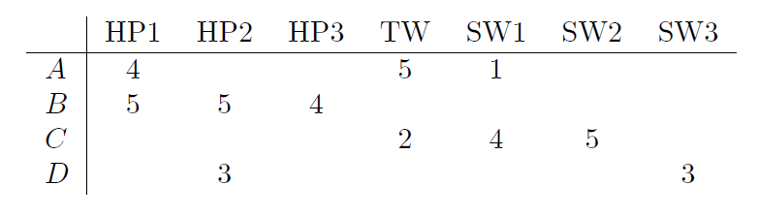
goal of recommendation system
predict the blanks in the utility matrix
Would user A like Star Wars episode II ?
there is little evidence from utility matrix…design system to take into account properties of movies, such as producer, director, stars, or even the similarity of their names.
For example, from the similarity between Star Wars I and Star Wars II, conclude that since A did not like SW1, she were unlikely to enjoy SW2 either

Slide 10
goal of recommendation system
predict the blanks in the utility matrix
Would user A like Star Wars episode II ?
With more data, we observe that people who rated both SW1 and SW2 tend to give them similar ratings.
Thus, we could conclude that A would also give SW2 a low rating, similar to A’s rating of SW1.

Slide 11
a slightly different goal
Not necessary to predict every blank entry. Rather, discover some entries in each row that are likely to be high.
Does not offer users a ranking of all items, but rather suggests a few that the user should value highly.
It may not even be necessary to find those items with highest expected ratings, but only to find a large subset of those with the highest ratings.

Slide 12
Key Problems
Gathering “known” ratings for matrix
Extrapolate unknown ratings from known ratings
Mainly interested in high unknown ratings
Evaluating extrapolation methods

Slide 13
Gathering Ratings
Explicit
Ask people to rate items
Doesn’t work well in practice – people can’t be bothered
Implicit
Learn ratings from user actions
e.g., purchase implies high rating
What about low ratings?

Slide 14
Extrapolating Utilities
Key problem: matrix U is sparse
most people have not rated most items
Three approaches
Content-based
Collaborative
Hybrid

Slide 15
Content-based recommendations
Main idea: recommend items to customer C similar to previous items rated highly by C
Movie recommendations
recommend movies with same actor(s), director, genre, …
Websites, blogs, news
recommend other sites with “similar” content

Slide 16
Plan of action
Item profiles
likes
build
recommend
match
Red
Circles
Triangles
User profile

Slide 17
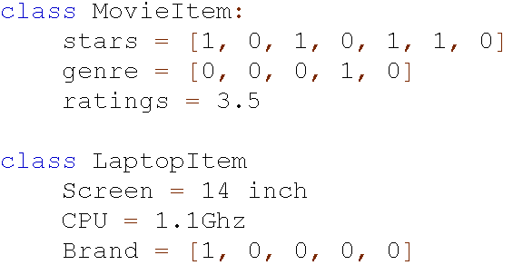
Item Profiles
For each item, create an item profile
Profile is a set of features
movies: title, stars, director,…
E.9.2 show items similarity and the effect of scaling

Slide 18
Document Item Profiles
For each item, create an item profile
Profile is a set of features
text: set of “important” words in document
How to pick important words?
Usual heuristic is TF.IDF (Term Frequency times Inverse Doc Frequency)

Slide 19
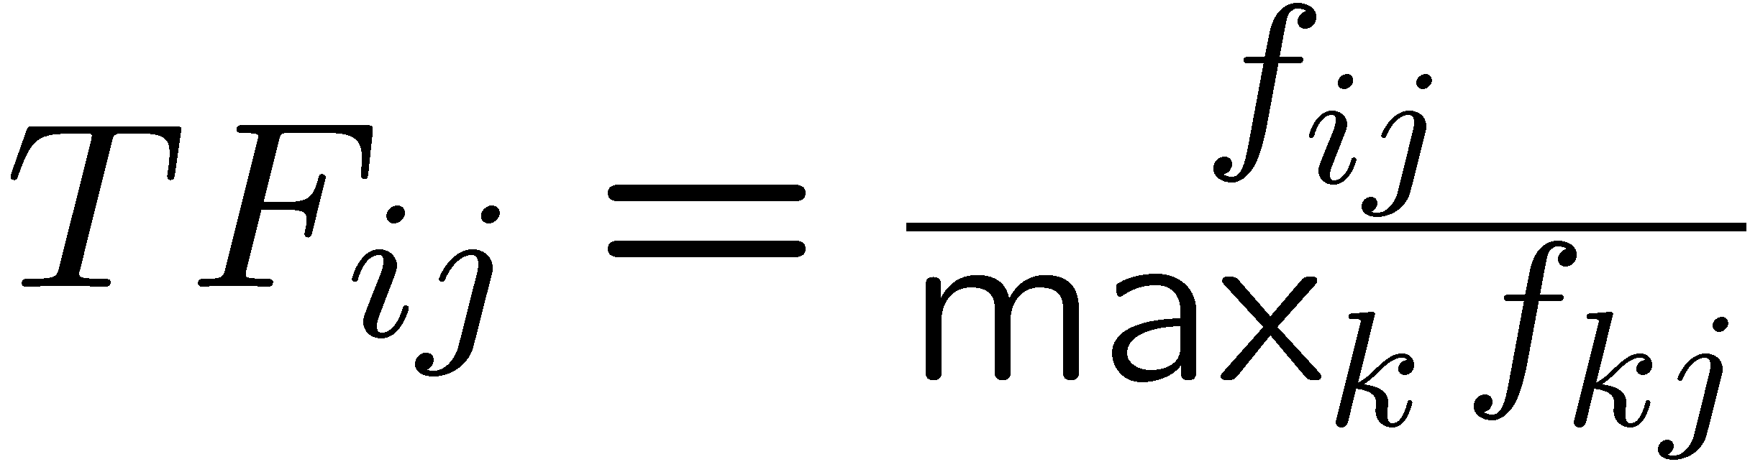
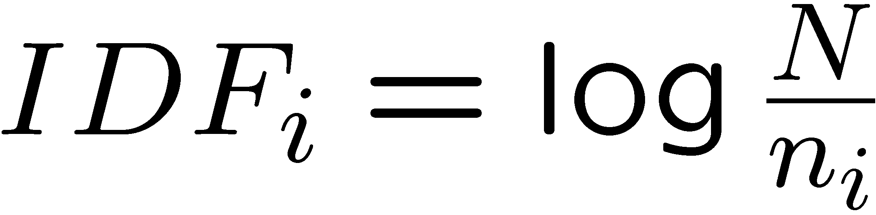
TF.IDF
f_{ij} = frequency of term t_{i} in document d_{j}
n_{i} = number of docs that mention term i
N = total number of docs
TF.IDF score w_{ij} = TF_{ij} x IDF_{i}
Doc profile = set of words with highest TF.IDF scores, together with their scores

Slide 20
User profiles
User profile
Create vectors with same components to describe user’s preferences.
An estimate of what a user likes is some aggregate of the profiles of the items the user likes.
Variation: weight by difference from average rating for item
Example 9.3
Suppose a movie, represented by boolean profiles, with components corresponding to stars. Also, the utility matrix has a 1 if the user has seen the movie and blank otherwise.
If 20% of the movies that user A likes have Julia Roberts, then the user profile for A will have 0.2 in the component for Julia Roberts

Slide 21
User profiles
Example 9.4
Consider example 9.3, but suppose the utility matrix has ratings in the 1–5 range.
Suppose user A gives an average rating of 3. There are 3 movies with Julia Roberts as star, and those movies got ratings of 3, 4, and 5.
Then in the A user profile, the component for Julia Roberts will have value [(3−3) + (4 − 3) + 5−3)]/3 = 1.
User B gives an average rating of 4, and has rated three (possible different) movies starring Julia Roberts.
B gives these three moves ratings of 2, 3, and 5.
The user profile for B has, in the component for Julia Roberts the value [(2 − 4) + (3 − 4) + (5 − 4)]/3 = −2/3

Slide 22
Recommending items to user based on content
Prediction heuristic
With profile vectors for both users and items:
Estimate the degree to which a user would prefer an item by computing the cosine distance between the user’s and item’s vectors
Given user profile c and item profile s, estimate cos(c,s) = c^{t}s/(|c||s|)
Example 9.5:
Consider E.9.3. The user profile will have components for stars proportional to the likelihood that the star appear in the movie the user like
Thus, the highest recommendation [lowest cos(c,s)] belong to the movies with lot of stars appear in many movies the user like.

Slide 23
Recommending items to user based on content
Example 9.5:
Consider E.9.3. The user profile will have components for stars proportional to the likelihood that the star appear in the movie the user like
Thus, the highest recommendation [lowest cos(c,s)] belong to the movies with lot of stars appear in many movies the user like.
Now, consider example 9.4. The user profile vector have positive numbers for stars appear in movies user like and neg numbers for stars in movies the user does not like.
Consider a movie with many stars the user likes and few stars the user does not like. The cosine of the angle between the user’s and the movie’s vectors will be a large positive number.

Slide 24
Model-based approaches
For each user, learn a classifier that classifies items into rating classes
liked by user and not liked by user
e.g., Bayesian, regression, SVM
Apply classifier to each item to find recommendation candidates
Problem: scalability
Won’t investigate further in this class

Slide 25
Limitations of content-based approach
Finding the appropriate features
e.g., images, movies, music
Overspecialization
Never recommends items outside user’s content profile
People might have multiple interests
Recommendations for new users
How to build a profile?

Slide 26
Collaborative Filtering
Consider user c
Find set D of other users whose ratings are “similar” to c’s ratings
Estimate user’s ratings based on ratings of users in D

Slide 27
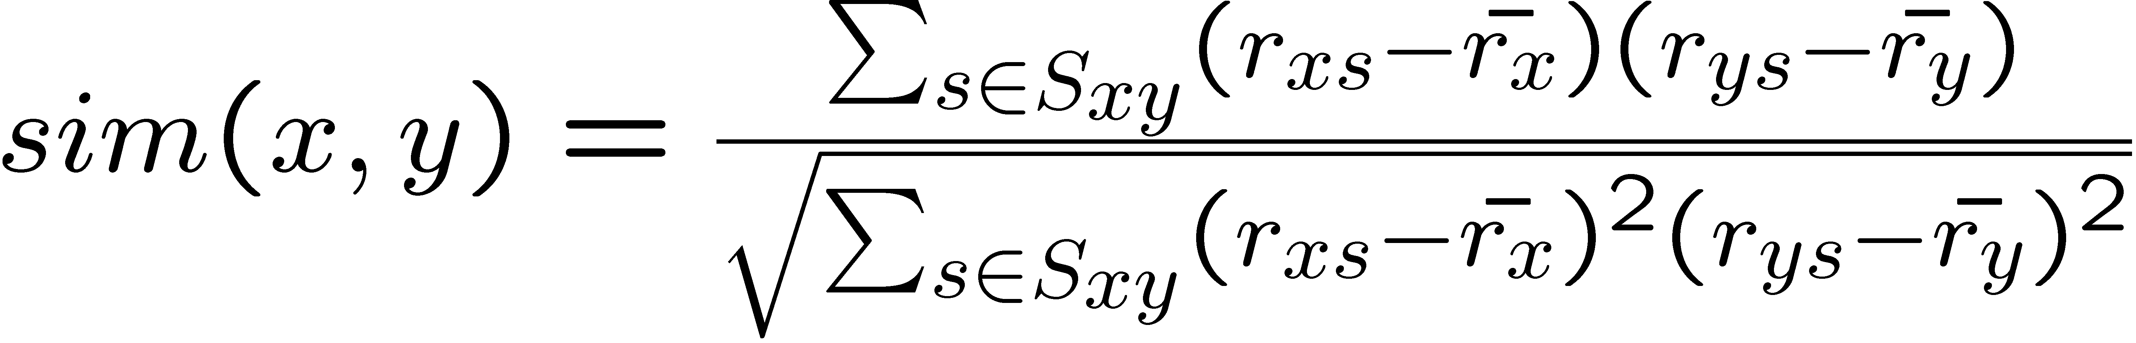
Similar users
Let r_{x} be the vector of user x’s ratings
Cosine similarity measure
sim(x,y) = cos(r_{x} , r_{y})
Pearson correlation coefficient
S_{xy} = items rated by both users x and y

Slide 28
Rating predictions
Let D be the set of k users most similar to c who have rated item s
Possibilities for prediction function (item s):
r_{cs} = 1/k ∑_{d2D} r_{ds}
r_{cs} = (∑_{d2D} sim(c,d)£ r_{ds})/(∑_{d2 D} sim(c,d))
Other options?
Many tricks possible…

Slide 29
Complexity
Expensive step is finding k most similar customers
O(|U|)
Too expensive to do at runtime
Need to pre-compute
Naïve precomputation takes time O(N|U|)
Simple trick gives some speedup
Can use clustering, partitioning as alternatives, but quality degrades

Slide 30
Item-Item Collaborative Filtering
So far: User-user collaborative filtering
Another view
For item s, find other similar items
Estimate rating for item based on ratings for similar items
Can use same similarity metrics and prediction functions as in user-user model
In practice, it has been observed that item-item often works better than user-user

Slide 31
Pros and cons of collaborative filtering
Works for any kind of item
No feature selection needed
New user problem
New item problem
Sparsity of rating matrix
Cluster-based smoothing?

Slide 32
Hybrid Methods
Implement two separate recommenders and combine predictions
Add content-based methods to collaborative filtering
item profiles for new item problem
demographics to deal with new user problem

Slide 33
Evaluating Predictions
Compare predictions with known ratings
Root-mean-square error (RMSE)
Another approach: 0/1 model
Coverage
Number of items/users for which system can make predictions
Precision
Accuracy of predictions
Receiver operating characteristic (ROC)
Tradeoff curve between false positives and false negatives

Slide 34
Problems with Measures
Narrow focus on accuracy sometimes misses the point
Prediction Diversity
Prediction Context
Order of predictions
In practice, we care only to predict high ratings
RMSE might penalize a method that does well for high ratings and badly for others

Slide 35
Tip: Add data
Leverage all the Netflix data
Don’t try to reduce data size in an effort to make fancy algorithms work
Simple methods on large data do best
Add more data
e.g., add IMDB data on genres
More Data Beats Better Algorithms
http://anand.typepad.com/datawocky/2008/03/more-data-usual.html

Slide 36
Finding similar vectors
Common problem that comes up in many settings
Given a large number N of vectors in some high-dimensional space (M dimensions), find pairs of vectors that have high cosine-similarity
e.g., user profiles, item profiles
Perfect set-up for next topic!
Near-neighbor search in high dimensions

