Slide 1
Opinion Mining & Sentiment Analysis 188.977 Grundlagen des Information Retrieval, 2016W
Navid Rekabsaz
rekabsaz@ifs.tuwien.ac.at

Slide 2
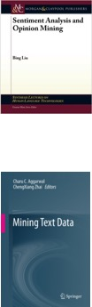
Material covered
Bing Liu, Sentiment Analysis and Opinion Mining, now Publishers, 2012. slides are adapted
Text Mining and Analytics course in coursera.org
Aggarwal, Charu C., and ChengXiang Zhai. Mining Text Data. Springer, 2012

Slide 3
Outline
What is opinion mining and sentiment analysis?
Methods and Approaches
Intro on Machine Learning
Opinion Mining in Practice

Slide 4
Outline
What is opinion mining and sentiment analysis?
Methods and Approaches
Intro on Machine Learning
Opinion Mining in Practice

Slide 5
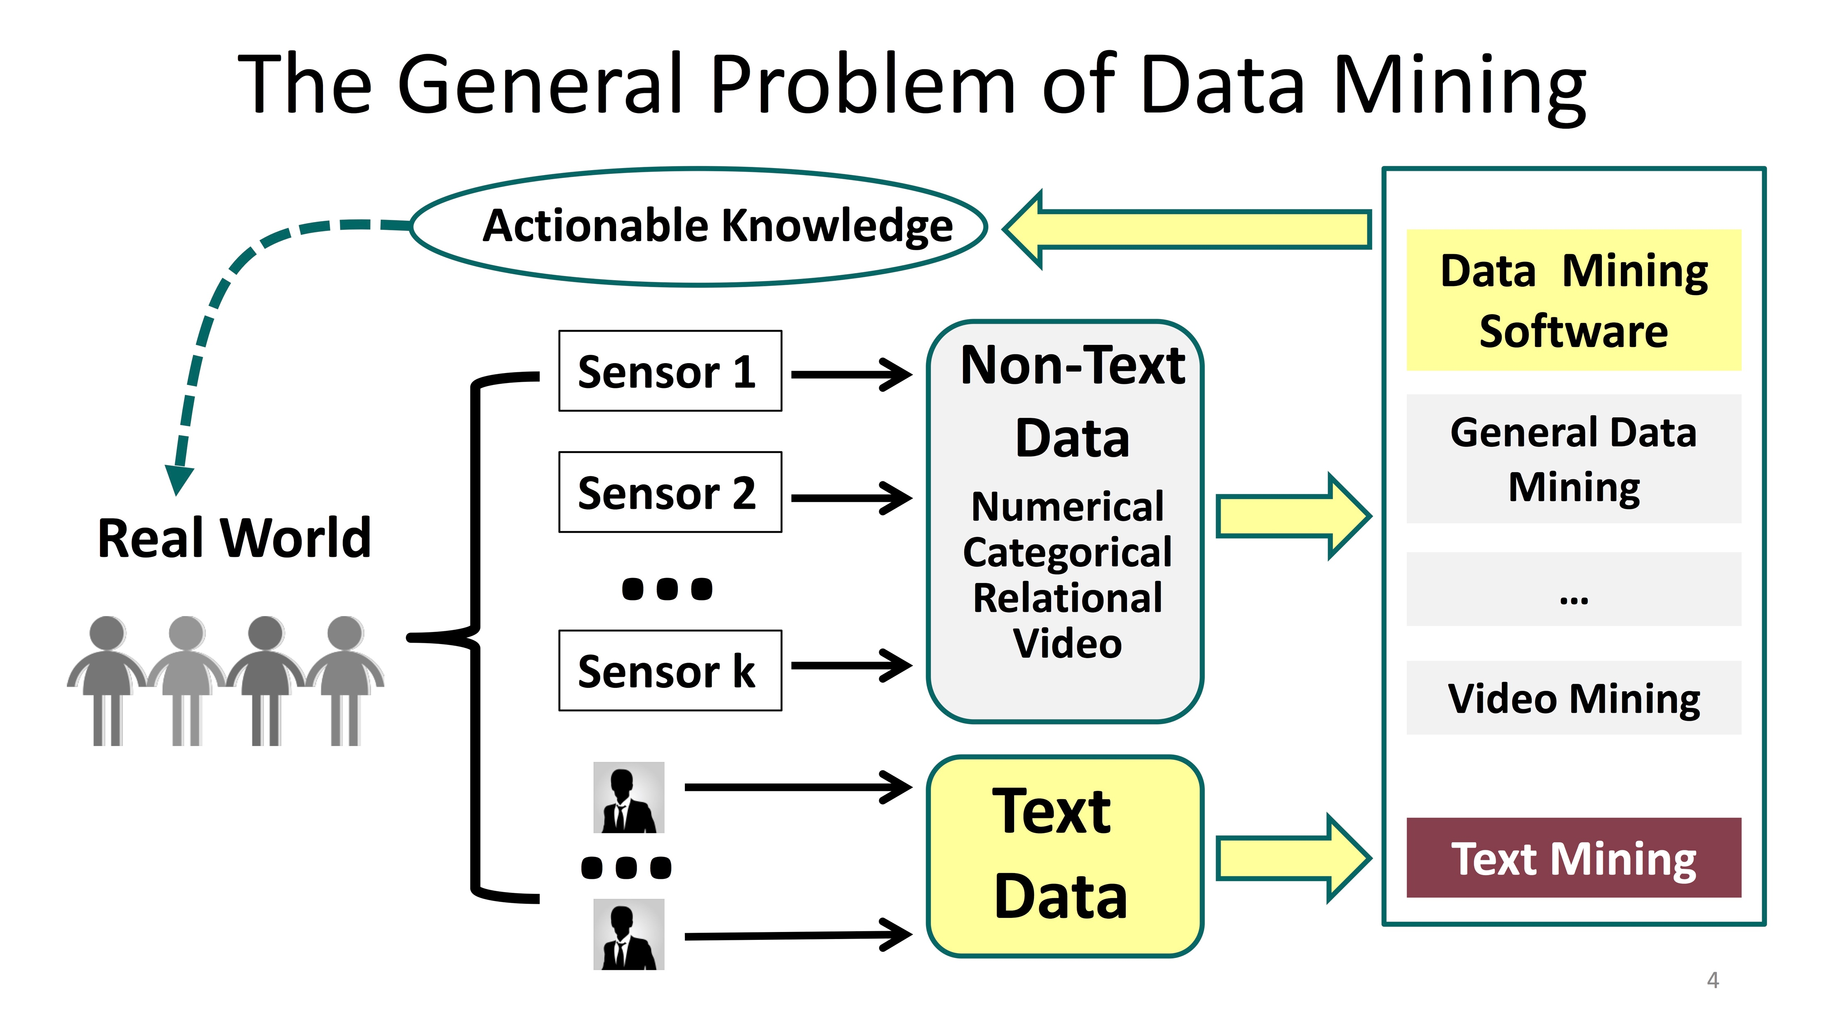
Text Mining
[2]

Slide 6
Text Mining
Data → Information → Knowledge –> …
Text mining objectives
Minimizes human effort
Discovers unseen patterns and knowledge
Knowledge for optimal decision making
Text mining ←→ text retrieval
Retrieving related data and information
Pre-processing
Evaluation

Slide 7
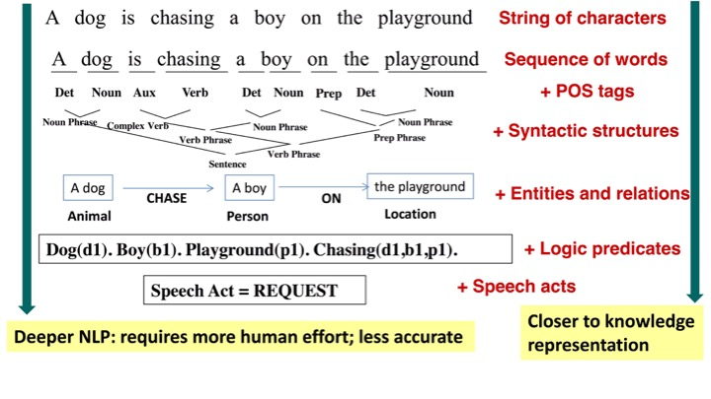
Natural Language Processing (NLP)
How machine can perceive human language
[2]

Slide 8
Scope
Information
Retrieval
Text
Mining
NLP
Opinion Mining

Slide 9
Terminology
Various names and tasks with slightly different objectives, however similar in approaches:
Opinion mining/extraction
Sentiment analysis/mining
Subjectivity analysis
Affect analysis
Emotion analysis
Review mining

Slide 10
Opinion Definition
Objective: states a fact (can be proved if wrong/right9
Subjective: related to the sentiment holder and requires the aggregation of opinions of several individuals.
Opinion is a subjective statement describing what a person believes or thinks about something [2]
Opinion holder
Opinion target
Depends on context, culture, background

Slide 11
Opinion and Subjectivity
The aim of opinion mining is to understand, predict, or quantify the subjectivity of an opinion
A common form of subjectivity is sentiment i.e. the feeling of the opinion holder regarding to the opinion
Subjectivity can also be other concepts e.g.
Affection and appreciation
Hedge and speculation
perspective, instability and risk,
agreement and disagreement,
political stance

Slide 12
Why Opinion Mining?
Understand individuals
to understand people’s preferences and behaviours e.g. to optimize a search engine
Aggregated opinions (humans as sensors)
Business intelligence and market research
Data-driven social science research
Decision support
Inform voters to decide
Help policy makers design new policy
Inform consumers about a product

Slide 13
Application Area
Wide application area
Business, sale, CRM
Finance and banking
Management science
Political science
Social science
Examples
https://www.gavagai.se/
https://unglobalpulse.carto.com/viz/96476204-3e06-11e4-aa0a-0edbca4b5057/embed_map
http://post2015.unglobalpulse.net/#

Slide 14
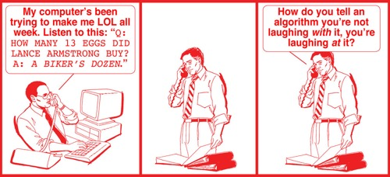
a Hard Fascinating AI Problem
NLP is hard!
Sentiment analysis inherits the challenges of NLP
However, the deeper in NLP, the more time consuming and less suitable for scaling
Shallow approaches tends to be more robust while still informative
www.nytimes.com

Slide 15
Some Challenges
Ambiguity:
“design” can be a noun or a verb (ambiguous POS)
“root” has multiple meanings (ambiguous sense)
Co-reference resolution:
“John persuaded Bill to buy a TV for himself.” (himself = John or Bill?)
Presupposition:
“He has quit smoking” implies that he smoked before.
Sarcasm
“I’m so pleased mom woke me up with vacuuming this morning.”
Negation
“I don’t like it very much”

Slide 16
Some Challenges (cont.)
Explicit opinion: a subjective statement
“the microphone works very good”
Implicit opinion: an objective statement that implies an opinion by expressing a desirable or undesirable fact.
“The earphone broke in two days.”

Slide 17
Some Challenges (cont.)
Direct opinion: directly expressed on opinion target
“the microphone works very good”
Indirect opinion: expressed indirectly based on its effect on other entities
“After taking the drug, my stomach felt worse.”

Slide 18
Outline
What is opinion mining and sentiment analysis?
Methods and Approaches
Intro on Machine Learning
Opinion Mining in Practice

Slide 19
Example
“This past Saturday, I bought a Nokia phone and my girlfriend bought a Motorola phone with Bluetooth. We called each other when we got home. The voice on my phone was clear, better than my previous Samsung phone. The battery life was however short. My girlfriend was quite happy with her phone. I wanted a phone with good sound quality. So my purchase was a real disappointment. I returned the phone yesterday.” [1]

Slide 20
Levels of Analysis
Document Level (our focus)
assumes whole the text (document, paragraph, sentence) expresses one sentiment about one opinion target
no in-depth NLP understanding i.e. sarcasm, co-reference
Negation or disambiguation might be considered as pre-processing steps but with shallow and heuristic techniques (no parsing)
Can be scaled up for bigger collections or longer texts

Slide 21
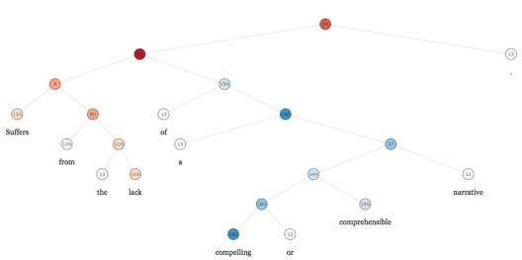
Levels of Analysis
Sentence Level
Same assumptions as document level
It benefits from sentence parsing and therefore better disambiguation, negation handling, etc.
From http://nlp.stanford.edu/sentiment/treebank.html [8] item 000151

Slide 22
Levels of Analysis
Aspect Level
finds each opinion target and all the opinion related to it
Deeper NLP
follows by an opinion summarisation task

Slide 23
Sentiment Lexicon
A List of sentiment (subjective) words, usually categorized in sub-lists.
SentiWordNet:
positive and negative scores
connected to synsets in WordNet
Bing Liu’s opinion lexicon [3]
2006 positive, 4783 negative words
SynsetTerms | NegScore | PosScore
able#1 | 0 | 0.125
unable#1 | 0.75 | 0
emerging#2 | 0 | 0

Slide 24
Sentiment Lexicon
LoughranMcDonold[4] financial sentiment dictionary
Subjective | # of words | sample
Negative | 2337 | discontinued, penalties, misconduct, noncompliance
Positive | 353 | achieve, efficient, profitable
Uncertainty | 285 | approximate, fluctuate, uncertain, variability
Litigiousness | 731 | claimant, deposition, testimony
Weak modal | 27 | could, possibly
Strong modal | 17 | always, must, highest

Slide 25
Problem Definition
Document-Level sentiment analysis: Given a set of text documents, we want to estimate/quantify their general sentiment
Sentiment target values:
[-1 (neg), 0 (neu), 1 (pos)] → classification
[-2 (very neg), -1 (neg), 0 (neu), 1 (pos) , 2 (very pos)] → classification or regression
A decimal number e.g. the financial risk of a company →regression

Slide 26
How to Estimate Sentiment
Unsupervised approach
No annotated data (set of documents with their corresponding sentiment values)
uses the contents of the documents together with a lexicon to roughly estimate their sentiments
Supervised approach
requires a set of annotated documents
applies machine learning to train a statistical model
uses the model to estimate/predict the sentiment value of real-world documents
Discussed in the 4th part of this lecture

Slide 27
Unsupervised Approach
Based on words in a lexicon and their
E.g. sum of the number of occurrences of the lexicon terms in every document
Heuristics to handle negation
E.g. if one of the three predecessors of a word is a negation word, the sentiment score will be negated [5]
Good for primitive analysis and observations
Not much effective in practice

Slide 28
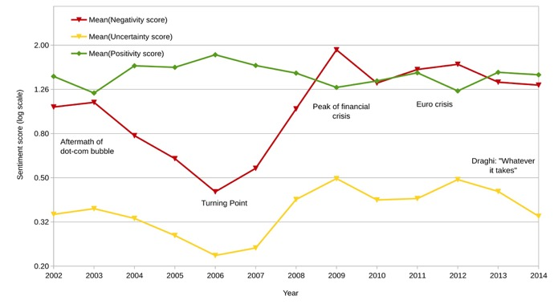
Unsupervised Approach
Ex.: estimating the attitude of reports’ banks towards risk [6]. They count the number of lexicon terms of each category in each document. The results are aggregated and normalized.

Slide 29

Outline
What is opinion mining and sentiment analysis?
Methods and Approaches
Intro on Machine Learning
Opinion Mining in Practice
In-depth learning:
184.702 Machine Learning, winter semester
Machine Learning course by Andrew Ng in coursera.org
An Introduction to Statistical Learning (available online)

Slide 30
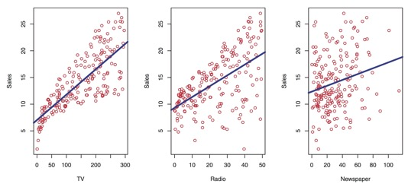
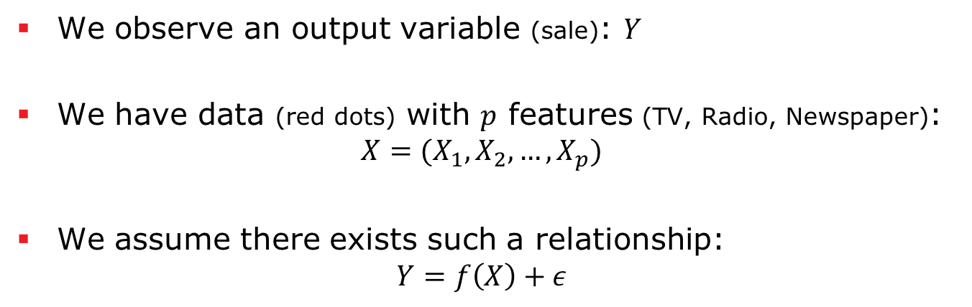
Statistical Learning Theory
We observe an output variable (sale): $Y$
We have data (red dots) with $p$ features (TV, Radio, Newspaper):
$${X=(X}_{1}, X_{2},…,X_{p})$$
We assume there exists such a relationship:
$$Y=f\left(X\right)+ε$$
[7]

Slide 31
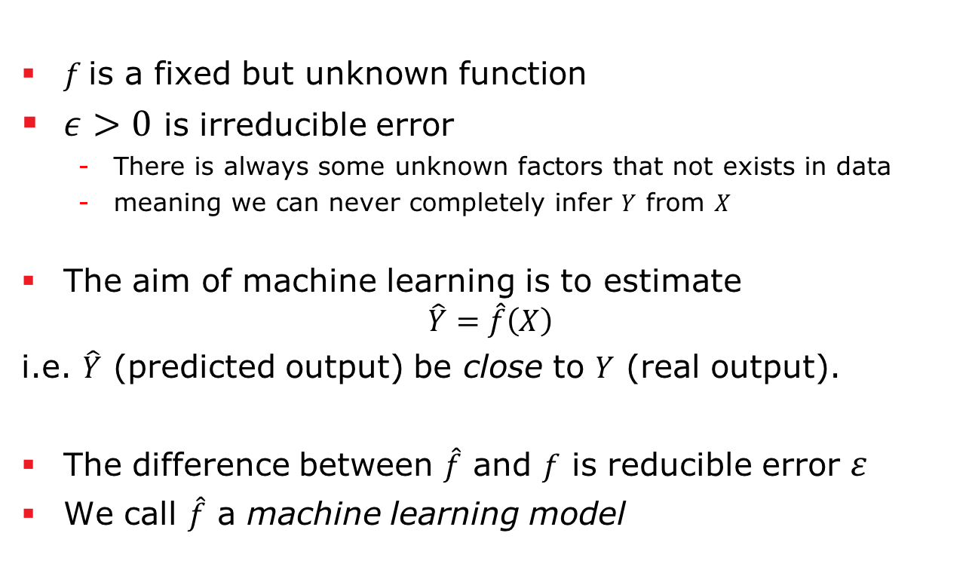
Statistical Learning Theory
$f$is a fixed but unknown function
$ε>0$ is irreducible error
There is always some unknown factors that not exists in data
meaning we can never completely infer $Y$ from $X$
The aim of machine learning is to estimate
$$\hat{Y}=\hat{f}\left(X\right)$$
i.e. $\hat{Y}$ (predicted output) be close to $Y$ (real output).
The difference between $\hat{f}$ and $f$ is reducible error $ε$
We call $\hat{f}$ a machine learning model

Slide 32
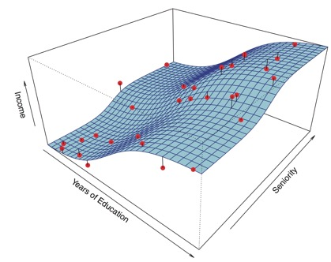
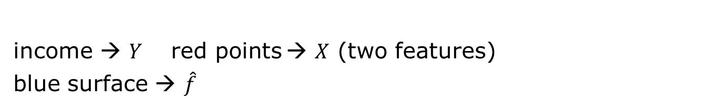
Statistical Learning Theory
[7]
income → $Y$ $\text{red} \text{points}$→ $X$ (two features)
blue surface → $\hat{f}$

Slide 33
How to estimate the model?
Training set
for training!
Validation set
for tuning hyper-parameters
Test set
for final performance check.
Test set is considered as a sample of real data that we don’t have yet.
Dataset
Training
Test
Training set
Validation set
Test set

Slide 34


How to estimate the model?
Features / Variables $(X)$
Labels / Output Variable $(Y)$
sex | age | Pstatus | romantic | Walc
F | 18 | A | no | 1
F | 17 | T | no | 1
F | 15 | T | no | 3
F | 15 | T | yes | 1
F | 16 | T | no | 2
M | 16 | T | no | 2
M | 16 | T | no | 1
F | 17 | A | no | 1
M | 15 | A | no | 1
M | 15 | T | no | 1
F | 15 | T | no | 2
F | 15 | T | no | 1
M | 15 | T | no | 3
M | 15 | T | no | 2
M | 15 | A | yes | 1
F | 16 | T | no | 2
F | 16 | T | no | 2
F | 16 | T | no | 1
M | 17 | T | no | 4
Pstatus: parent's cohabitation status ('T' - living together 'A' - apart)
Romantic: with a romantic relationship
Walc: weekend alcohol consumption (from 1 - very low to 5 - very high)
http://archive.ics.uci.edu/ml/datasets/STUDENT+ALCOHOL+CONSUMPTION#
Dataset

Slide 35
How to estimate the model?
sex | age | Pstatus | romantic | Walc
F | 18 | A | no | 1
F | 17 | T | no | 1
F | 15 | T | no | 3
F | 15 | T | yes | 1
F | 16 | T | no | 2
M | 16 | T | no | 2
M | 16 | T | no | 1
F | 17 | A | no | 1
M | 15 | A | no | 1
M | 15 | T | no | 1
F | 15 | T | no | 2
F | 15 | T | no | 1
M | 15 | T | no | 3
Train Set
M | 15 | T | no | 2
M | 15 | A | yes | 1
F | 16 | T | no | 2
F | 16 | T | no | 2
F | 16 | T | no | 1
M | 17 | T | no | 4
Test Set

Slide 36

How to estimate the model?
sex | age | Pstatus | romantic | Walc
F | 18 | A | no | 1
F | 17 | T | no | 1
F | 15 | T | no | 3
F | 15 | T | yes | 1
F | 16 | T | no | 2
M | 16 | T | no | 2
M | 16 | T | no | 1
F | 17 | A | no | 1
M | 15 | A | no | 1
M | 15 | T | no | 1
F | 15 | T | no | 2
F | 15 | T | no | 1
M | 15 | T | no | 3
Train Set
M | 15 | T | no | ?
M | 15 | A | yes | ?
F | 16 | T | no | ?
F | 16 | T | no | ?
F | 16 | T | no | ?
M | 17 | T | no | ?
2
1
2
2
1
4
Test Set
$$Y$$

Slide 37
How to estimate the model?
sex | age | Pstatus | romantic | Walc
F | 18 | A | no | 1
F | 17 | T | no | 1
F | 15 | T | no | 3
F | 15 | T | yes | 1
F | 16 | T | no | 2
M | 16 | T | no | 2
M | 16 | T | no | 1
F | 17 | A | no | 1
M | 15 | A | no | 1
M | 15 | T | no | 1
F | 15 | T | no | 2
F | 15 | T | no | 1
M | 15 | T | no | 3
ML Model
Train Set
Train
M | 15 | T | no | ?
M | 15 | A | yes | ?
F | 16 | T | no | ?
F | 16 | T | no | ?
F | 16 | T | no | ?
M | 17 | T | no | ?
2
1
2
2
1
4
Test Set
$$Y$$

Slide 38


How to estimate the model?
sex | age | Pstatus | romantic | Walc
F | 18 | A | no | 1
F | 17 | T | no | 1
F | 15 | T | no | 3
F | 15 | T | yes | 1
F | 16 | T | no | 2
M | 16 | T | no | 2
M | 16 | T | no | 1
F | 17 | A | no | 1
M | 15 | A | no | 1
M | 15 | T | no | 1
F | 15 | T | no | 2
F | 15 | T | no | 1
M | 15 | T | no | 3
ML Model
Train Set
Train
Predict
M | 15 | T | no | 1
M | 15 | A | yes | 1
F | 16 | T | no | 2
F | 16 | T | no | 2
F | 16 | T | no | 3
M | 17 | T | no | 4
2
1
2
2
1
4
Test Set
$$\hat{Y}$$
$$Y$$

Slide 39
How to estimate the model?
sex | age | Pstatus | romantic | Walc
F | 18 | A | no | 1
F | 17 | T | no | 1
F | 15 | T | no | 3
F | 15 | T | yes | 1
F | 16 | T | no | 2
M | 16 | T | no | 2
M | 16 | T | no | 1
F | 17 | A | no | 1
M | 15 | A | no | 1
M | 15 | T | no | 1
F | 15 | T | no | 2
F | 15 | T | no | 1
M | 15 | T | no | 3
ML Model
Train Set
Train
Predict
M | 15 | T | no | 1
M | 15 | A | yes | 1
F | 16 | T | no | 2
F | 16 | T | no | 2
F | 16 | T | no | 3
M | 17 | T | no | 4
2
1
2
2
1
4
Test Set
$$\hat{Y}$$
$$Y$$
compare and performance evaluation

Slide 40
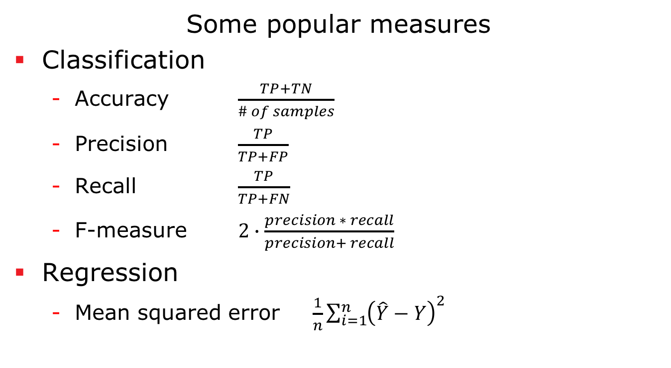
Evaluation
Some popular measures
Classification
Accuracy $\frac{TP+TN}{\# of samples}$
Precision $\frac{TP}{TP+FP}$
Recall $\frac{TP}{TP+FN}$
F-measure $2∙\frac{precision ∗ recall}{precision+ recall}$
Regression
Mean squared error $\frac{1}{n}\sum_{i=1}^{n}{{\left(\hat{Y}−Y\right)}^{2}}$

Slide 41
How to split
Split data into training and test sets
E.g. train-test 80%-20% or 66%-33%
The test may highly vary depends on the selection of test set

Slide 42
Cross Validation
n-Fold Cross validation is an alternative to simple split
Split data into n parts with equal size (usually 10)
Repeat n times:
Train a model using 9 folds
Test the model on the left-out fold
Final performance is the average of the results of the iterations
More reliable and best-practice

Slide 43
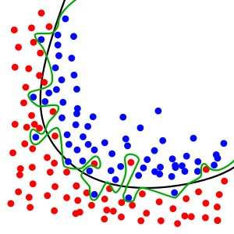
Overfitting
When the model fit exactly to train data → overfitting
A good model must perform good on unseen data
ML models use regularization to provide a reasonable generalisation
Wikipedia

Slide 44
Overfitting: Learning Curve
From Wikipedia. Training error is shown in blue, test error in red. X-axes shows various models or the number of training cycles.

Slide 45
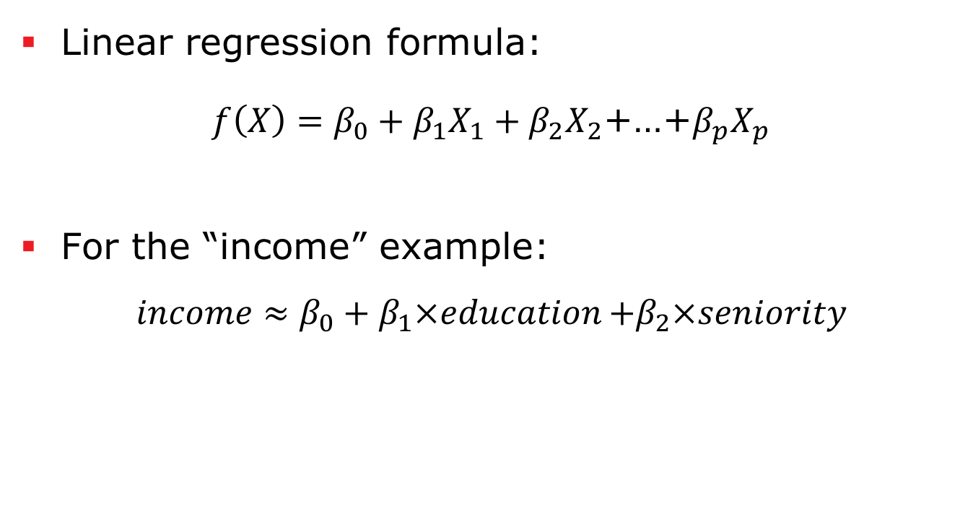
Linear Regression
Linear regression formula:
$f\left(X\right)=β_{0}+β_{1}X_{1}+β_{2}X_{2}$+…+$β_{p}X_{p}$
For the “income” example:
$$income≈β_{0}+β_{1}{×education}_{ }+β_{2}×seniority$$

Slide 46
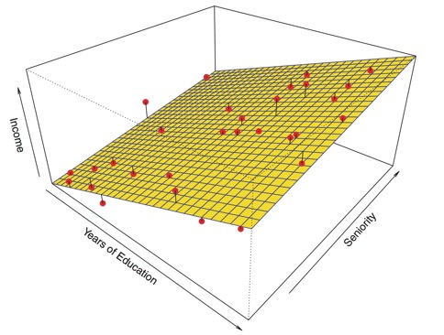
Linear Regression
[7]

Slide 47
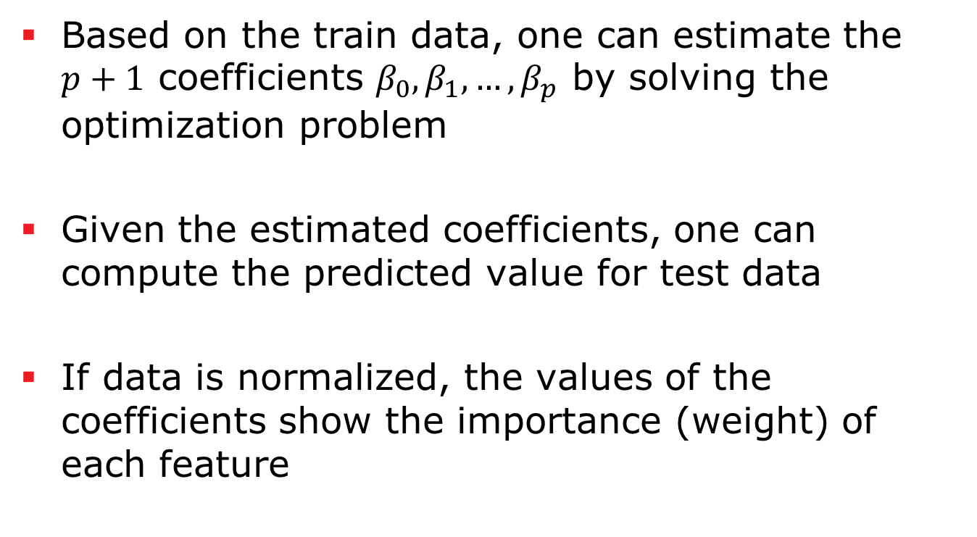
Linear Regression
Based on the train data, one can estimate the $p+1$ coefficients $β_{0},β_{1},…, β_{p}$ by solving the optimization problem
Given the estimated coefficients, one can compute the predicted value for test data
If data is normalized, the values of the coefficients show the importance (weight) of each feature

Slide 48
Outline
What is opinion mining and sentiment analysis?
Methods and Approaches
Intro on Machine Learning
Opinion Mining in Practice

Slide 49
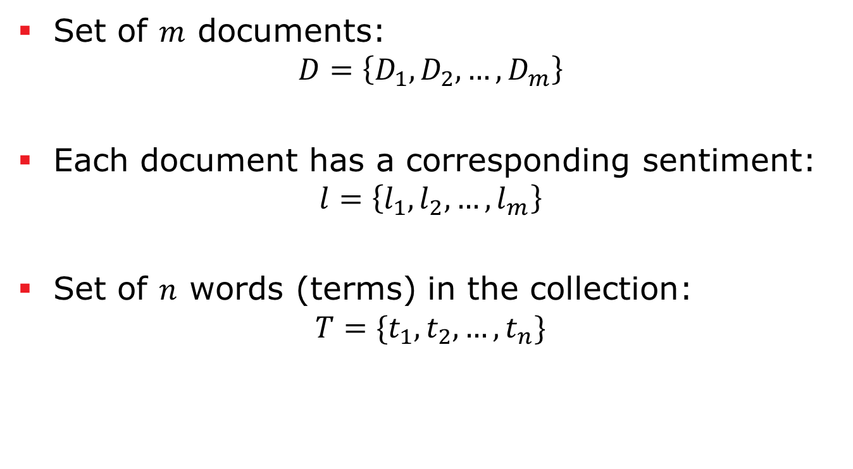
Document-Level Sentiment Analysis
Set of $m$ documents:
$$D=\left\{D_{1},D_{2},…,D_{m}\right\}$$
Each document has a corresponding sentiment:
$$l=\left\{l_{1},l_{2},…,l_{m}\right\}$$
Set of $n$ words (terms) in the collection:
$$T=\{t_{1},t_{2},…,t_{n}\}$$

Slide 50
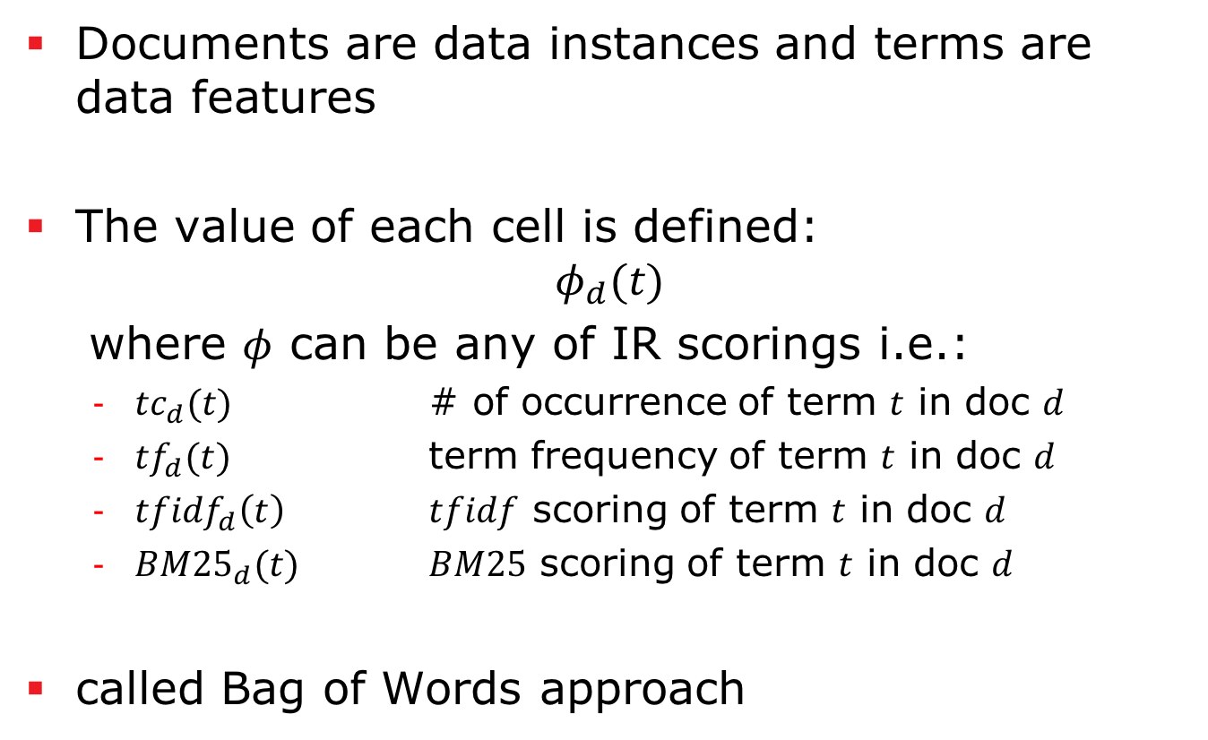
Document-Level Sentiment Analysis
Documents are data instances and terms are data features
The value of each cell is defined:
$$φ_{d}(t)$$
where $φ$ can be any of IR scorings i.e.:
$tc_{d}(t)$ # of occurrence of term $t$ in doc $d$
$tf_{d}(t)$ term frequency of term $t$ in doc $d$
$t{fidf}_{d}\left(t\right)$ $tfidf$ scoring of term $t$ in doc $d$
$BM{25}_{d}(t)$ $BM25$ scoring of term $t$ in doc $d$
called Bag of Words approach

Slide 51
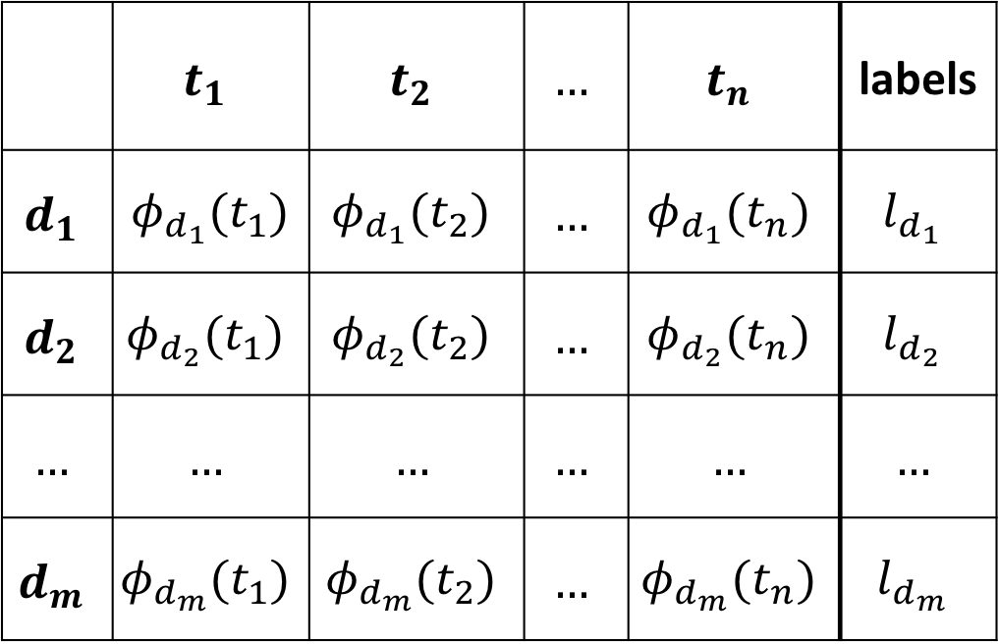
Document-Level Sentiment Analysis
 | $$t_{1}$$ | $$t_{2}$$ | $$…$$ | $$t_{n}$$ | labels
$$d_{1}$$ | $φ_{d_{1}}(t_{1})$ | $$φ_{d_{1}}(t_{2})$$ | $$…$$ | $$φ_{d_{1}}(t_{n})$$ | $$l_{d_{1}}$$
$$d_{2}$$ | $$φ_{d_{2}}(t_{1})$$ | $$φ_{d_{2}}(t_{2})$$ | $$…$$ | $$φ_{d_{2}}(t_{n})$$ | $$l_{d_{2}}$$
$$…$$ | $$…$$ | $$…$$ | $$…$$ | $$…$$ | $$…$$
$$d_{m}$$ | $$φ_{d_{m}}(t_{1})$$ | $$φ_{d_{m}}(t_{2})$$ | $$…$$ | $$φ_{d_{m}}(t_{n})$$ | $$l_{d_{m}}$$

Slide 52
Features Reduction
The feature space is very sparse (a lot zeros) and very high dimensional
Curse of dimensionality:
The amount of data does not suffice to support the sparsity in dimensionality
It degrades the performance of ML models
Need to reduce dimension
Feature selection
Dimensionality reduction

Slide 53
Features Selection
We are only interested in informative features and get rid of the others!
Simple methods
Remove stop words or very common words
TF-IDF do it in a “soft” way why?
Remove very rare words
They might be due to misspelling
Stemming
Advanced methods
Lexicon-based
Based on a measure of informativeness
Subset selection

Slide 54
Features Selection - Lexicon
Instead of all the terms, only use the lexicon term
Pros:
Considerably reduce noise as many terms are uninformative
Focus on the domain by using domain-specific lexicon
Cons:
Same word may have various orientations:
“This camera sucks” and “This vacuum cleaner really sucks”
Sentence with sentiment words but express no sentiment
“What is a good camera?”
Sentence without sentiment words, implies opinion
“This washer uses a lot of water!”
Sarcastic sentences
“What a great car! It stopped working in two days.”

Slide 55
Features Selection - Informativeness
Measure the informativeness of each feature
How to select features:
the features with value higher than a hyper-parameter threshold
A percentage of the most informative ones
A simple one: Variance
Variance of the data in the feature
Unsupervised (does not consider labels)
Not appropriate for text processing why?

Slide 56
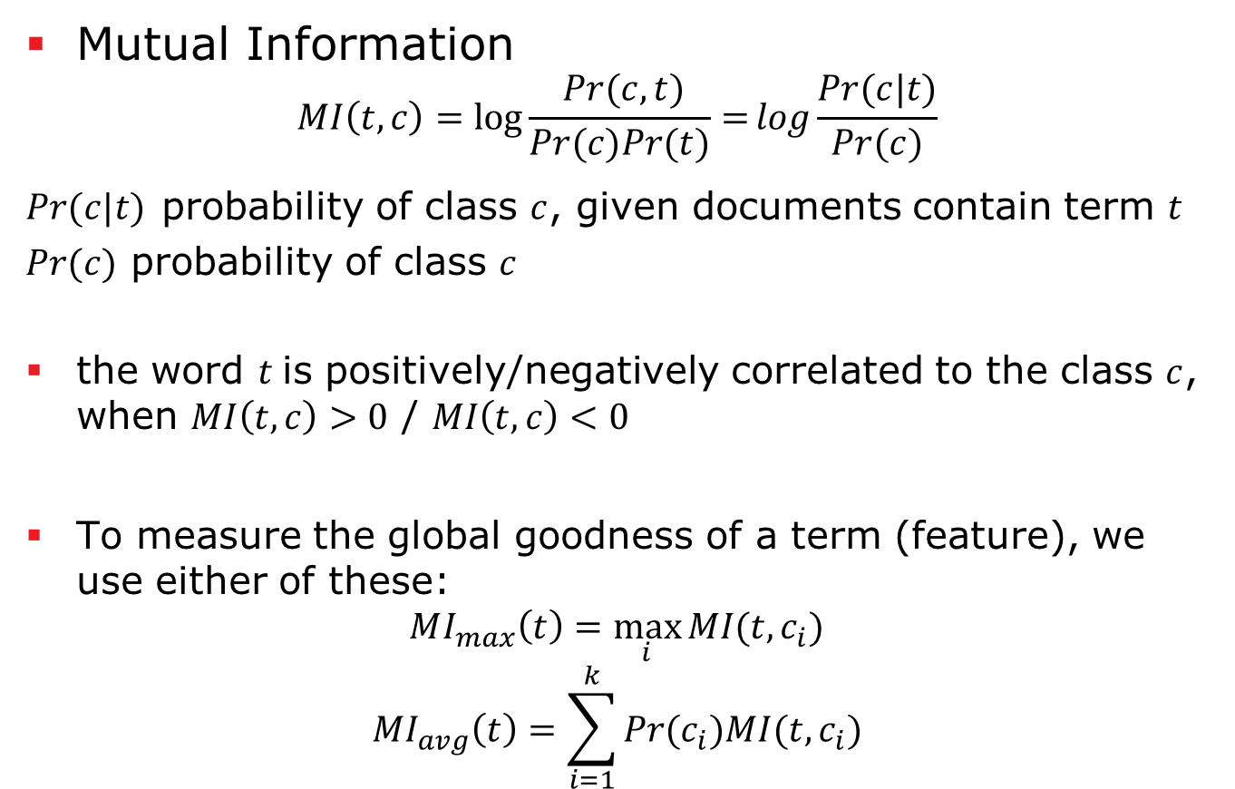
Features Selection - Informativeness
Mutual Information
$$MI\left(t,c\right)=\log{\frac{ Pr⁡(c,t)⁡}{Pr⁡(c)Pr⁡(t)}=}log\frac{Pr⁡(c|t)}{Pr⁡(c)}$$
$Pr⁡(c|t)$ probability of class $c$, given documents contain term $t$
$Pr⁡(c)$ probability of class $c$
the word $t$is positively/negatively correlated to the class $c$, when $MI\left(t,c\right)>0$ / $MI\left(t,c\right)<0$
To measure the global goodness of a term (feature), we use either of these:
$$MI_{max}\left(t\right)=\max_{i}{MI(t,c_{i})}$$
$$MI_{avg}\left(t\right)=\sum_{i=1}^{k}{Pr⁡(c_{i})MI(t,c_{i})}$$

Slide 57
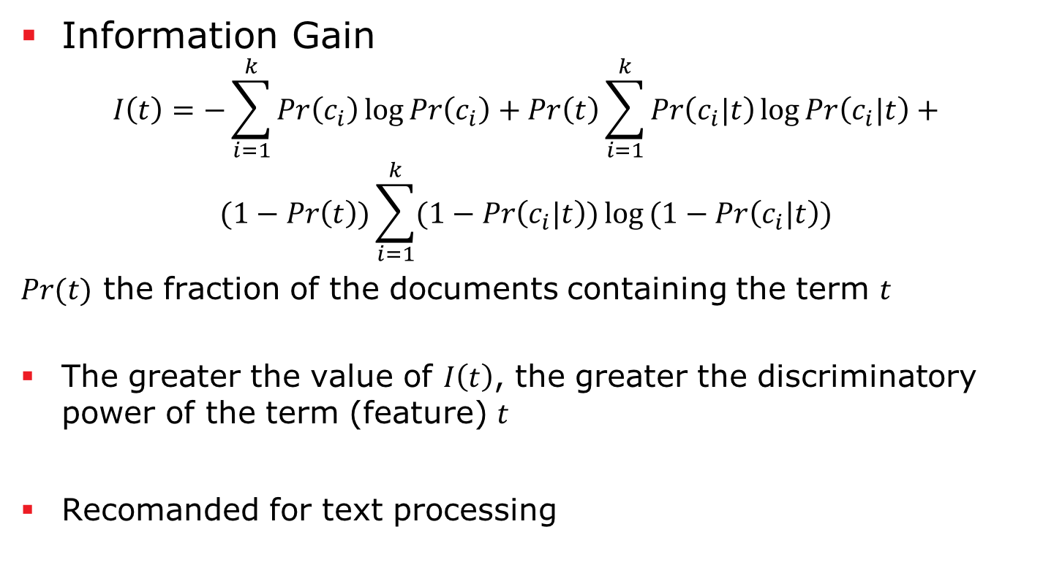
Features Selection - Informativeness
Information Gain
$$I\left(t\right)=−\sum_{i=1}^{k}{\operatorname{Pr}\left(c_{i}\right)\log{\operatorname{Pr}\left(c_{i}\right)}}+Pr\left(t\right)\sum_{i=1}^{k}{\operatorname{Pr}\left(c_{i}|t\right)\log{\operatorname{Pr}\left(c_{i}|t\right)}}+$$
$$(1−Pr\left(t\right))\sum_{i=1}^{k}{(1−\operatorname{Pr}\left(c_{i}|t\right))\log{(1−Pr\left(c_{i}|t\right))}}$$
$Pr⁡(t)$ the fraction of the documents containing the term $t$
The greater the value of $I\left(t\right)$, the greater the discriminatory power of the term (feature) $t$
Recomanded for text processing

Slide 58

Features Selection - Informativeness
Other supervised measure:
Gini Index
$χ^{2}$ statistics
All of them measure the degree of discriminatory of the feature regarding to the labels

Slide 59
Features Selection – Subset selection
We want to find the best features based on our training data
How many features should we select?
Which feature subset?
Subset selection algorithms:
Best Subset Selection
Forward Stepwise Selection
Backward Stepwise Selection
…

Slide 60
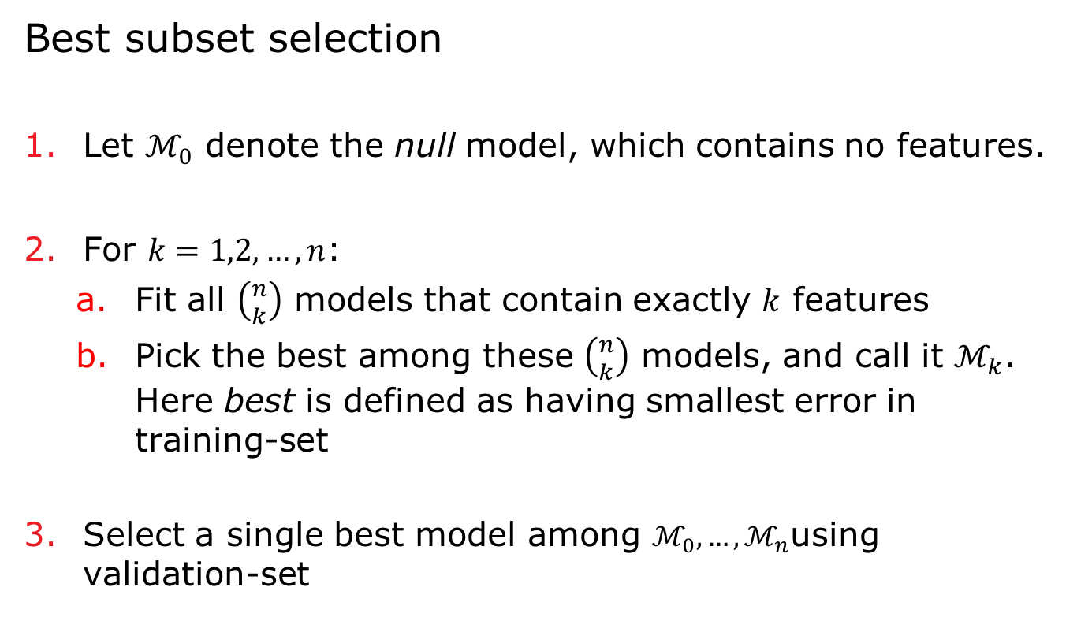
Features Selection – Subset selection
Best subset selection
Let $ℳ_{0}$ denote the null model, which contains no features.
For $k=1,2,…,n$:
Fit all $\left({n \atop k}\right)$ models that contain exactly $k$ features
Pick the best among these $\left({n \atop k}\right)$ models, and call it $ℳ_{k}$. Here best is defined as having smallest error in training-set
Select a single best model among $ℳ_{0},…,ℳ_{n}$using validation-set

Slide 61
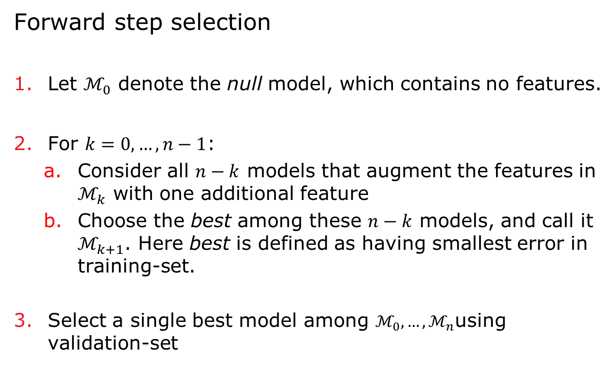
Features Selection – Subset selection
Forward step selection
Let $ℳ_{0}$ denote the null model, which contains no features.
For $k=0, …,n−1$:
Consider all $n−k$ models that augment the features in $ℳ_{k}$ with one additional feature
Choose the best among these $n−k$ models, and call it $ℳ_{k+1}$. Here best is defined as having smallest error in training-set.
Select a single best model among $ℳ_{0},…,ℳ_{n}$using validation-set

Slide 62
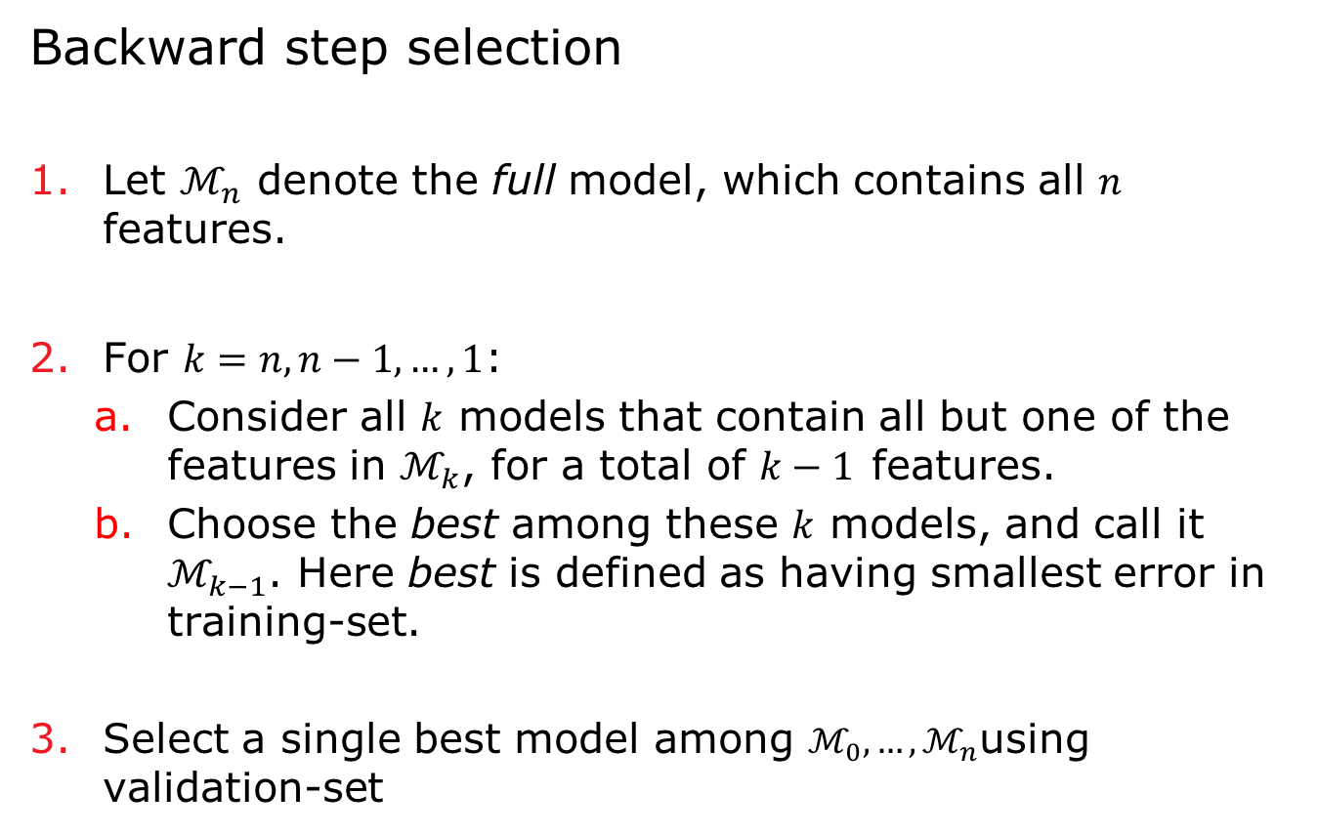
Features Selection – Subset selection
Backward step selection
Let $ℳ_{n}$ denote the full model, which contains all $n$ features.
For $k=n, n−1,…, 1$:
Consider all $k$ models that contain all but one of the features in $ℳ_{k}$, for a total of $k−1$features.
Choose the best among these $k$ models, and call it $ℳ_{k−1}$. Here best is defined as having smallest error in training-set.
Select a single best model among $ℳ_{0},…,ℳ_{n}$using validation-set

Slide 63
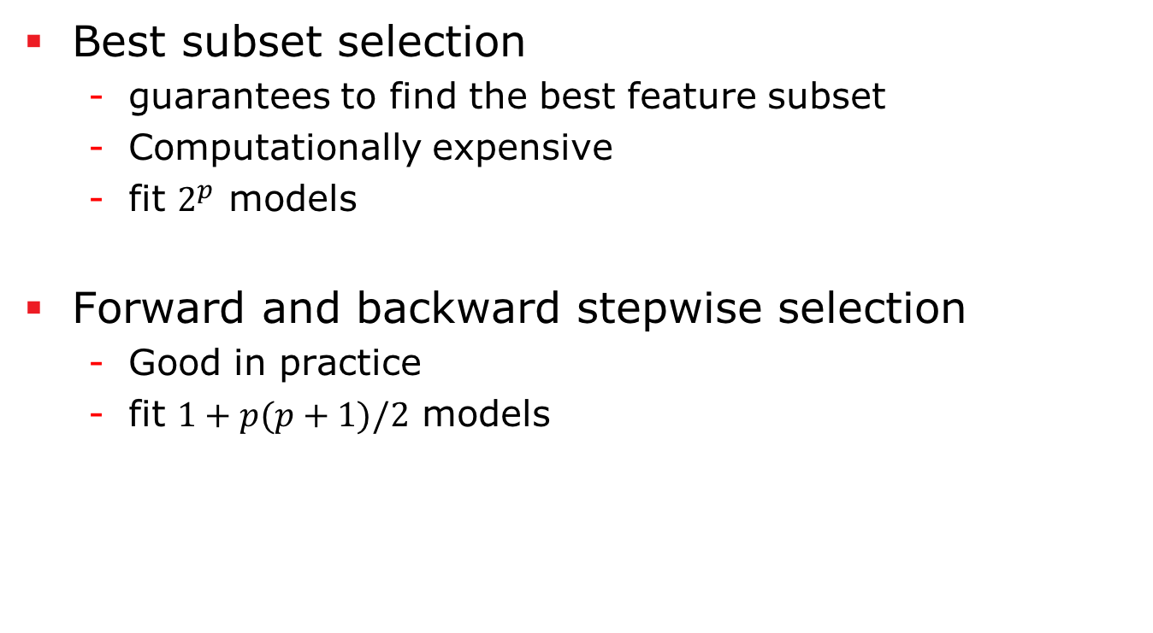
Features Selection – Subset selection
Best subset selection
guarantees to find the best feature subset
Computationally expensive
fit $2^{p}$ models
Forward and backward stepwise selection
Good in practice
fit $1+p(p+1)/2$ models

Slide 64
Dimensionality Reduction
Reducing dimension by removing noise and keeping informative data
Similar to lossy compressing
Methods:
Principle Component Analysis (PCA)
Latent Semantic Analysis (LSA)
Probabilistic Latent Semantic Analysis (pLSA)
Latent Dirichlet Allocation (LDA)
designed for text processing →
188.980 Advanced Information Retrieval, SS

Slide 65
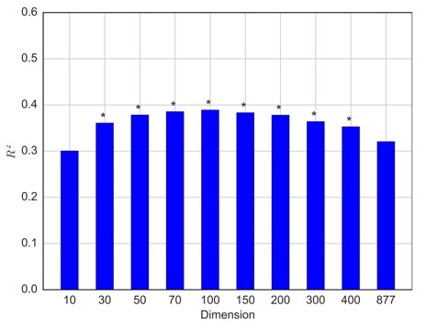
Dimensionality Reduction
Ex.: trade-off point between removing noise and keeping information [9]

Slide 66
ML and Evaluation
The rest is ML and evaluation!
Some popular ML algorithms for SA:
SVM
Naïve Bias
Regression
Textual features based on IR methods usually don’t need normalization as they are already normalized on length. Except when the algorithm expect zero-mean normalization (e.g. neural networks).

Slide 67
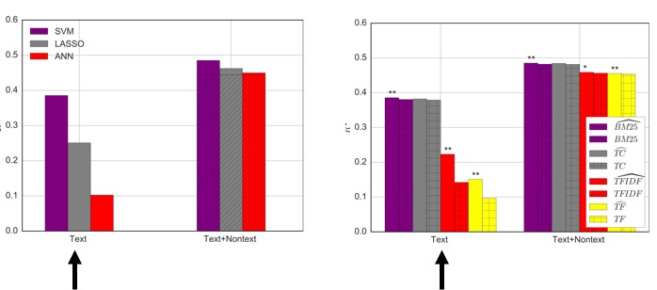
ML and Evaluation
Ex.: Text-based predicting of financial volatility using companies annual reports[9]. Performance highly varies for various scoring methods and ML algorithms.

Slide 68
Further Topics
Lexicon Generation
Chapter 6 of “Sentiment Analysis and Opinion Mining”
Domain Adaptation and Cross-domain SA
Chapter 3.4 of “Sentiment Analysis and Opinion Mining”
Challenging topic in machine learning
Sentiment Retrieval
Chapter 9 of “Sentiment Analysis and Opinion Mining”

Slide 69
References
[1] Bing Liu, Sentiment Analysis and Opinion Mining, now Publishers, 2012.
[2] Text Mining and Analytics course in coursera.org
[3] Minqing Hu and Bing Liu. Mining and summarizing customer reviews, KDD-2004
[4] Loughran, Tim, and Bill McDonald. When is a liability not a liability? Textual analysis, dictionaries, and 10‐Ks. The Journal of Finance 66.1 (2011): 35-65.
[5] Livia Polanyi and Annie Zaenen. 2006. Contextual valence shifters. In Computing Attitude and Affect in Text: Theory and Applications, volume 20 of The Information Retrieval Series, Springer.
[6] Nopp, Clemens, and Allan Hanbury. "Detecting Risks in the Banking System by Sentiment Analysis." Proceedings of the EMNLP 2015
[7] James, Gareth, et al. An introduction to statistical learning. Vol. 6. New York: springer, 2013.
[8] Socher, Richard, et al. "Recursive deep models for semantic compositionality over a sentiment treebank." Proceedings of the conference on empirical methods in natural language processing (EMNLP). Vol. 1631. 2013.
[9] Rekabsaz , Navid ”Predicting Volatility in Financial System by Sentiment Analysis of Annual Reports”, Young Scientist Summer Program (YSSP) 2016 in International Institute for Applied Systems Analysis (IIASA)

