Slide 1
Sales Performance — Last 7 Days
Theme: modern_corporate • Generated 2025-11-05 12:34

Slide 2
Key Metrics
Orders: 541
Rows: 1,787
Revenue: ₹2,679,161.87
AOV: ₹4,952.24

Slide 3
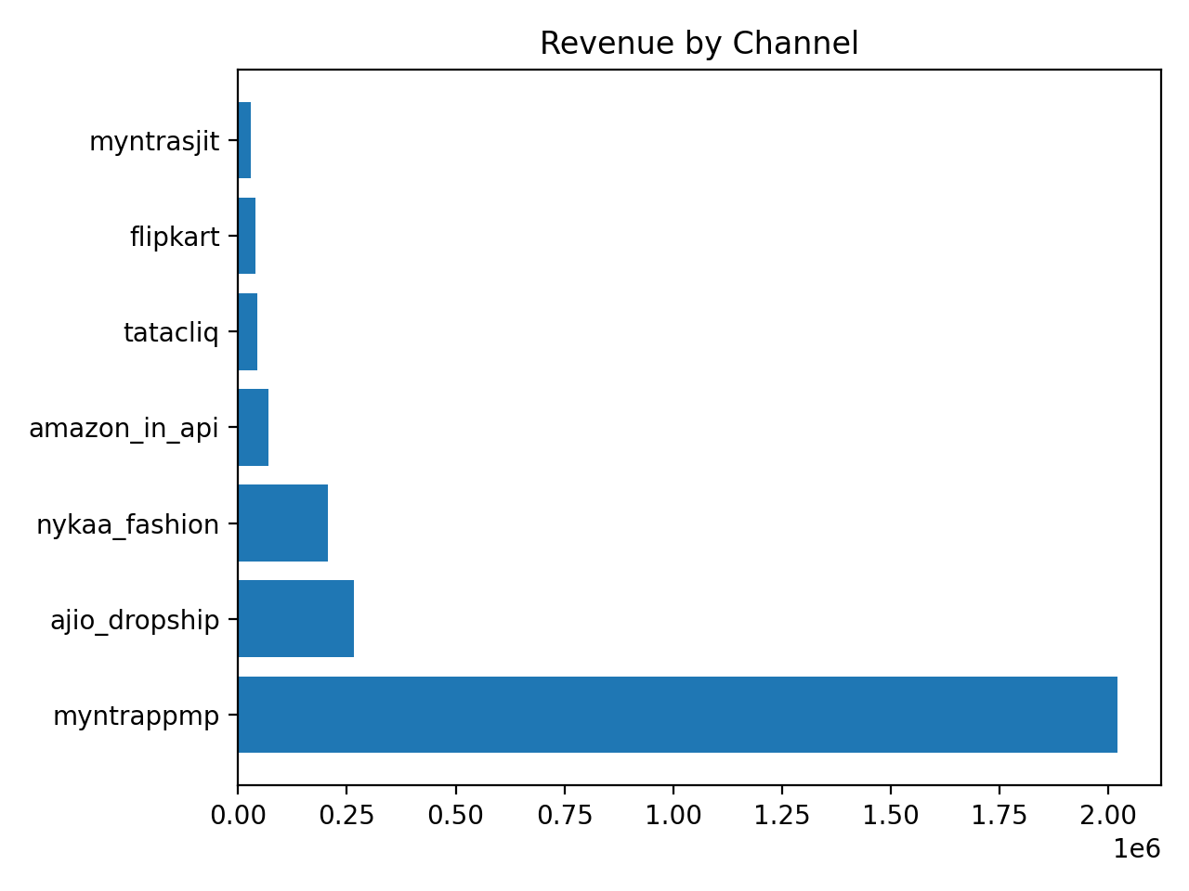
Top Channels

