Slide 1
Rheumatoid Arthritis
By
Mohammed Anter Ali
Lecturer of Orthopedic surgery

Slide 2
Content
Definition
Etiology
Pathophysiology
Clinical presentation
Sign and symptoms
Classification and progression
RA at different joints
Investigation
Complication
Management

Slide 3
Definition
it is an autoimmune disorder in which the joint lining and other tissues become inflamed as a result of over activity of body immune system.
RA is chronic, systemic, inflammatory disorder that primarily involves the joints.

Slide 4
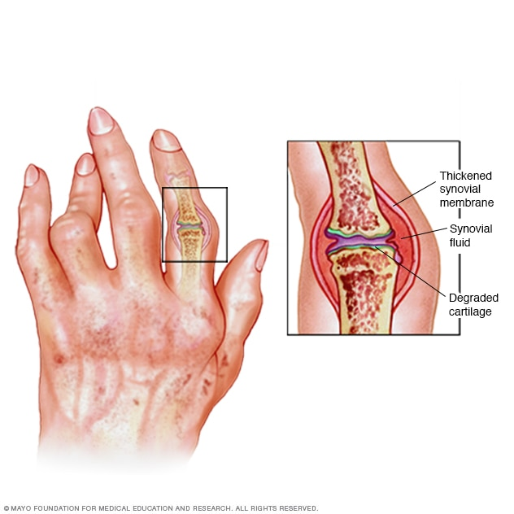

Slide 5
Epidermiology
10 cases per 1000 people or 2.1 million adults in the united states
Affects women two times more than males at all ages.
There is general increase in prevalence for both gender with increasing age.

Slide 6
Etiology
Like many other chronic disease the etiology of RA is unknown.
A specific etiological agent for RA has not been identified.
Based on the fact that individuals with RA produce antibodies to their own immunoglobulins , there is some reason to believe that RA is an autoimmune disorder
It is not clear whether this antibody production is a primary event or result as a response to a specific antigen from an external stimulus.

Slide 7
RHEMUATOID FACTOR-
RF have received considerable attention in search for a causative agent in RA because they are found in the serum of approximately 70% of all patients with RA.

Slide 8
Pathophysiology
Chronic RA is characterized by the grossly edematous appearance of the synovium with hair like projections into the joint cavity.
There are distinctive vascular changes, including venous distention, capillary obstruction, neutrophilic infiltration of the arterial walls, and areas of thrombosis and hemorrhage

Slide 9
Conti…
Pannus - synovial proliferation of vascular granulation tissue, dissolves collagen as it extends over the joint cartilage. Granulation tissue will eventually result in adhesion, fibrosis or bony ankylosis of the joint.

Slide 10
Conti…
Chronic inflammation can also weaken the joint capsule and it supporting ligamentous structures, altering structures and function.
Tendon rupture and damaged tendon sheath may produce imbalance muscle pull resulting in deformities seen in advanced RA.

Slide 11
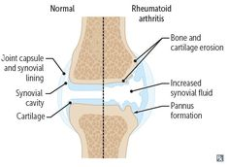

Slide 12
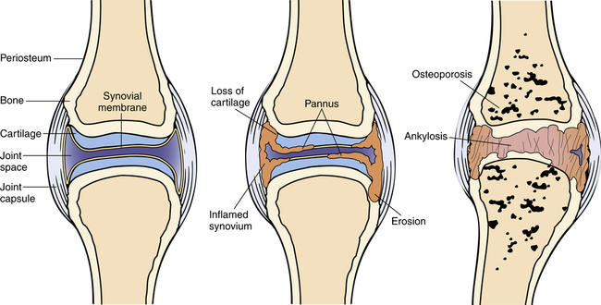

Slide 13
Clinical manifestations
Morning stiffness
Arthritis of three or more joint areas- at least three joint areas simultaneously have had soft tissues swelling or fluid.
Arthritis of hand joints ( wrist, MCP, PIP).
Symmetric arthritis
Rheumatoid nodules

Slide 14
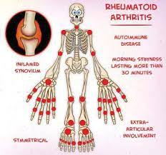
6. Serum rheumatoid factor
7. Radiographic changes- include erosion or unequivocal bony decalcification localized in or most marked adjacent to the involved joint.

Slide 15
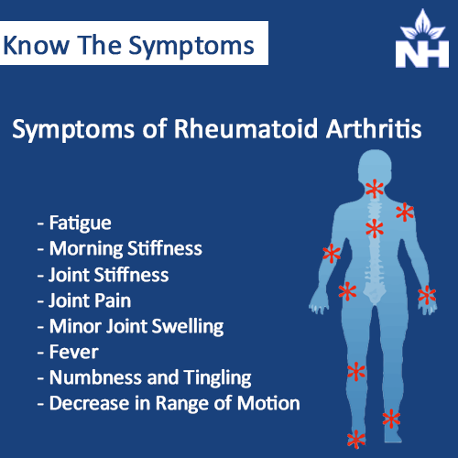
Sings and symptoms

Slide 16
Classification and progression
of rheumatoid arthritis

Slide 17
Stage – I Early
No destructive changes on radiographic examination
Radiographic evidence of osteoporosis may be present.

Slide 18
Stage –II Moderate
Radiographic evidence of osteoporosis with or without slight subchondral bone destruction , slight cartilage destruction may be present.
No joint deformities ,but limitation of ROM may be present.
Adjacent muscle atrophy
Extra – articular soft tissue lesions such as nodules and tenosynovitis may be present

Slide 19
Stage –III Severe
Radiographic evidence of cartilage and bone destruction in addition to osteoporosis.
Joint deformity such as subluxation, ulnar deviation or hyperextention , without fibrous or bony ankylosis
Extensive muscle atrophy
Extra- articular soft tissue lesion such as nodules and tenosynovitis may present

Slide 20
Stage –IV Terminal
Fibrous or bony ankylosis
Criteria of stage 3

Slide 21
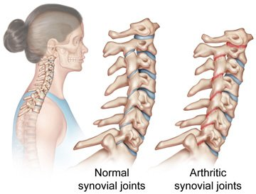
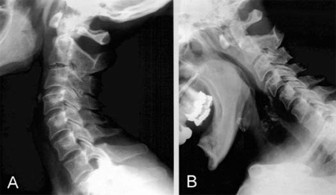
Cervical spine
50 % takes place at the atlanto-axial joint.
Ankylosing spondylitis

Slide 22
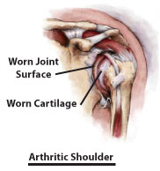
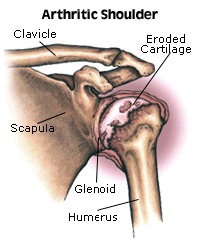
Shoulder
Involvement of GH, SC, AC joint and ST also
Degeneration , pain, low ROM.
Capsule and ligaments become distended with chronic inflamation

Slide 23
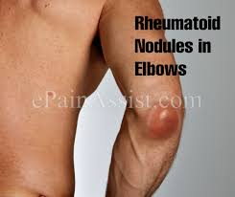
Elbow
Capsular and ligamentous distention, and joint surface erosion may lead to elbow instability.
Flexion contracture may result from persistent spasm secondary to pain.

Slide 24
Wrist
Development of flexion contractures which ultimately diminishes the ability to execute power grasp.
Volar subluxation results from chronic inflammation of the proximal carpals
Stenosing tenosynoitis may also occur

Slide 25
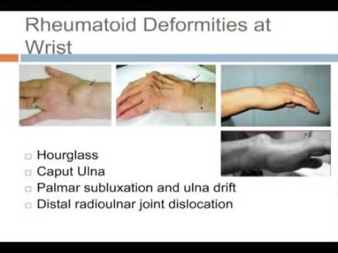

Slide 26
Hand
MCP joint- soft tissue swelling , volar subluxation , ulnar drift
PIP joint – swelling (sausage like finger)
- swan neck deformity
- boutonniere deformity
- bouchard’s nodes
DIP joint- heberden’s nodes
- mallet finger

Slide 27
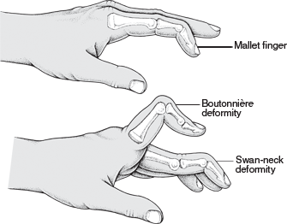

Slide 28
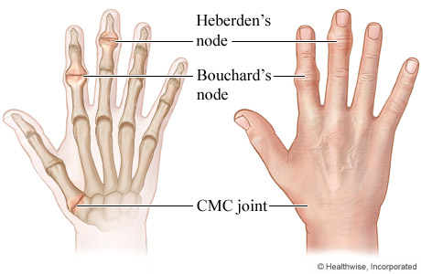

Slide 29
Thumb
Type 1 deformity- MCP flex, IP hyperextension without CMC involvement .
Type II deformity- CMC is subluxed , IP hyperextension.
Type III deformity- CMC subluxed , MCP hyperextension commonly found in RA.

Slide 30
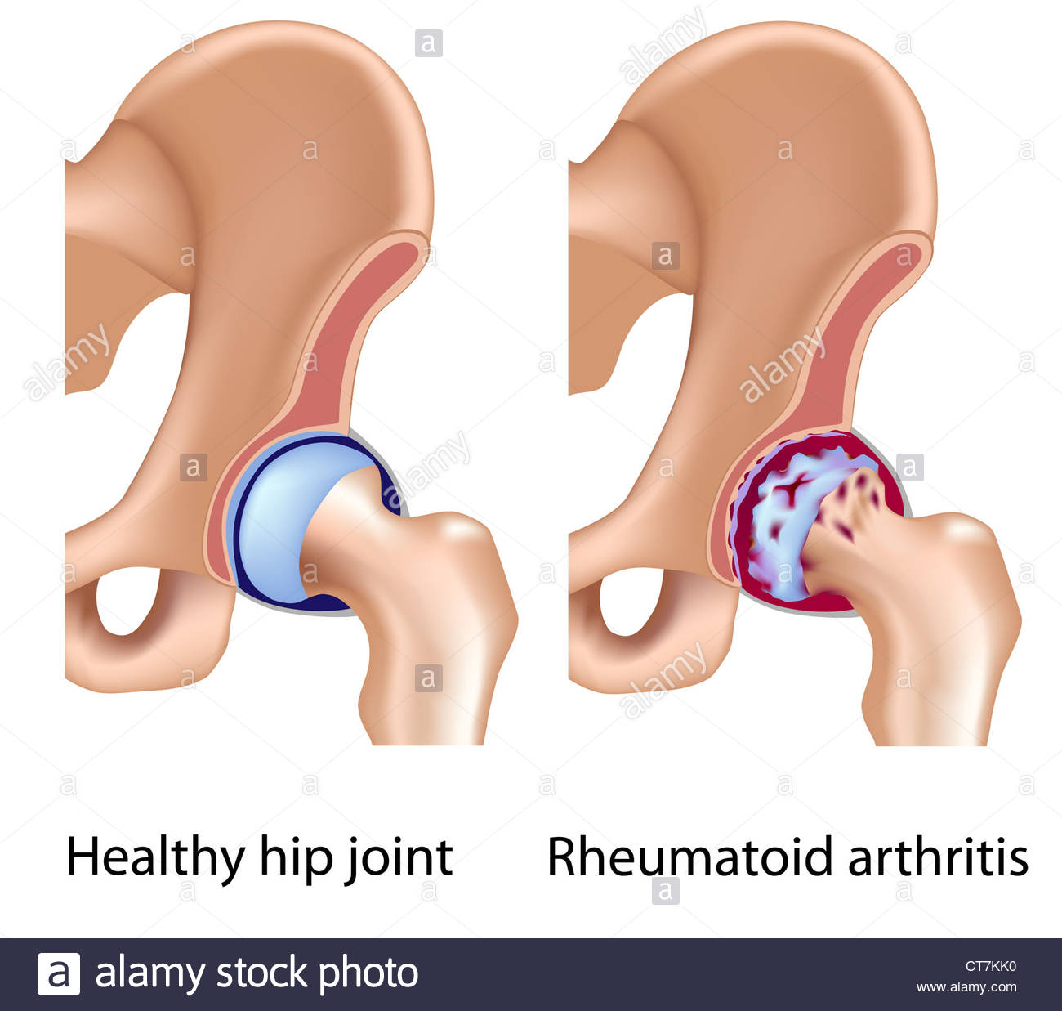
Hip
Less commonly involved in RA
Severe inflammatory destruction of the femoral head and the acetabulum into the pelvic cavity .

Slide 31
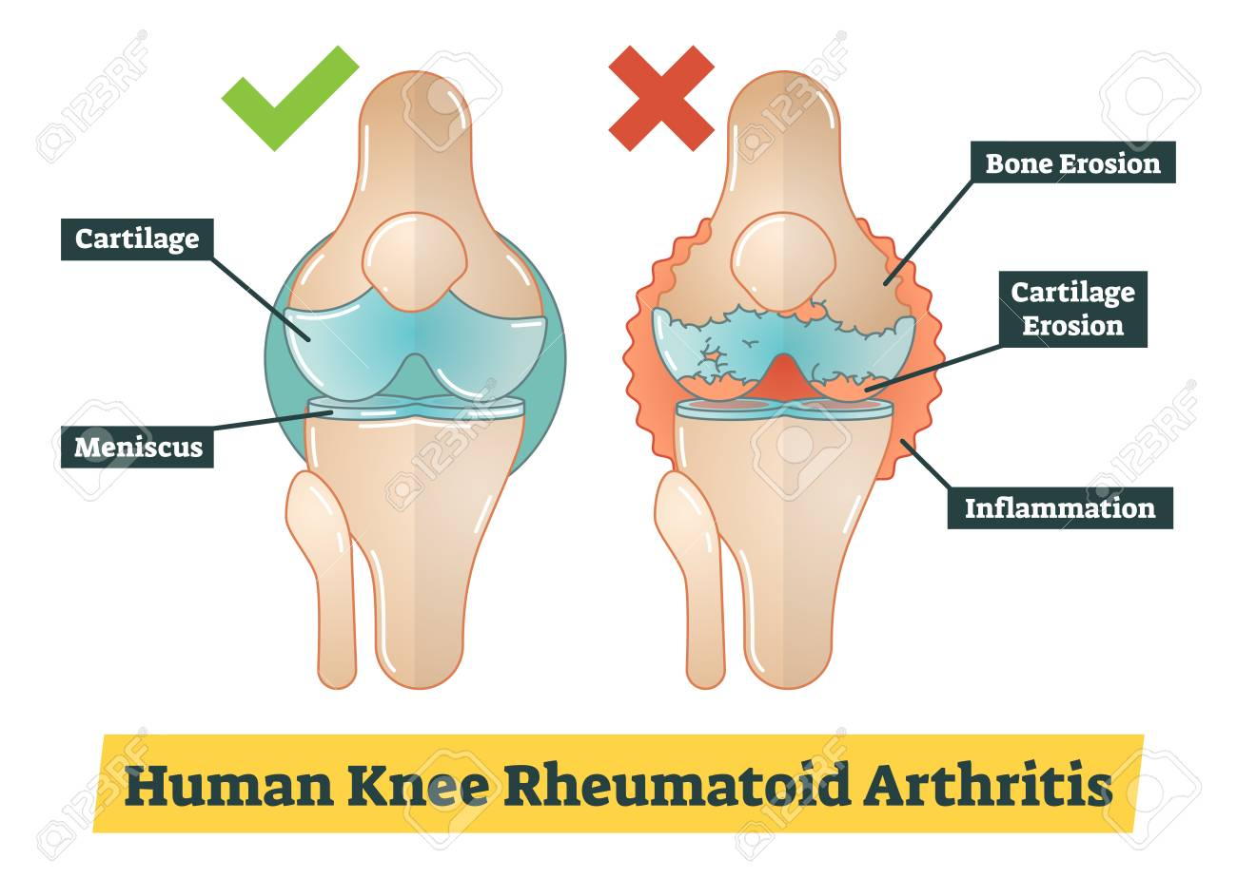
Knee
Distention of the joint capsule and attenuation of ligaments.
Painful knees may be held in slightly flexed positions, ultimately resulting to flexion contractures.

Slide 32
Ankle and feet
Hindfoot pronation
Flattening of the ML arch
Calcaneal exostoses
Splayfoot
Metatarsalgia
Hallux valgus and bunion
Hammer toes
Claw toes

Slide 33
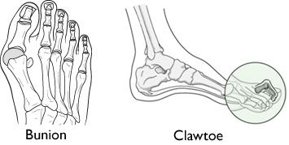
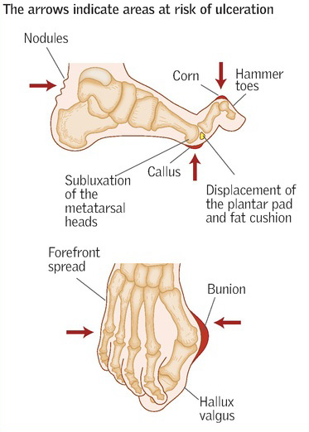

Slide 34
Investigations
ESR and CRP
Ultrasound or MRI
RH factor
X- rays
Functional assessment
CBC
Urea, creatinine , liver function test

Slide 35
RHEUNATOID FACTOR – 85% of the patient with RA are RF positive
RF (+) can be seen in other diseases such as rheumatic , viral, bacterial, parasitic, neoplasm .

Slide 36
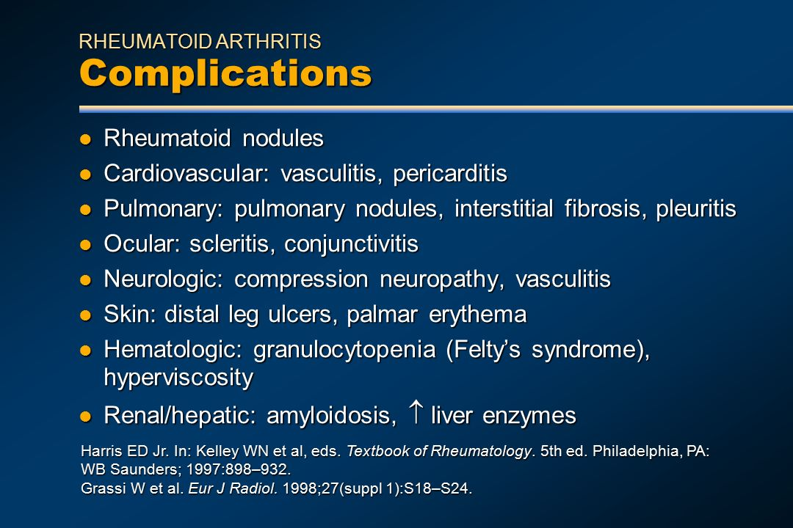

Slide 37
Medical management
Medications – DMARD’s , BRM’s , corticosteroids, NSAIDs.
Physiotherapy:
Surgery:
Synovectomy
Arthrodesis Vs Arthroplasty
Tendon reconstruction

Slide 38
Physiotherapy management
GOALS-
relief of pain
Prevention of deformities
Correction of deformity
Restoration & maintance of joint motion
Improve muscle strength & endurance
Gait training
Education on management of re-occurance

Slide 39
Acute phase 3-4 weeks
Correct bed posture & supported positioing of involved joints.
Provide supported positioing of involved joints& correct bed posture
Use firm mattress & back support to correct posture
Limb is placed in position of minimal discomfort.

Slide 40
Additional support to limbs- provide by splints and sandbags. Special attention is needed for the knee & elbow joint as they develop flexion contracture.
Improve vital capacity
Improve ROM & Muscle strength-isometrics, slow& relax isometrics
Functional mobility
Postural guidance
TENS, pulsed ultrasound
Hydrotherapy

Slide 41
Chronic phase
Thermotherapy
Active and functional therapeutic program
Stretching exercises
Active and passive resisted exercises
Gait training

Slide 42
Equipment
Adaptive for ADL
Assistive for ambulation
Appropriate footware or insoles

Slide 43
Education
Self management
Weight loss
Activity management or joint protection
Social support
Stress management / relaxation

Slide 44
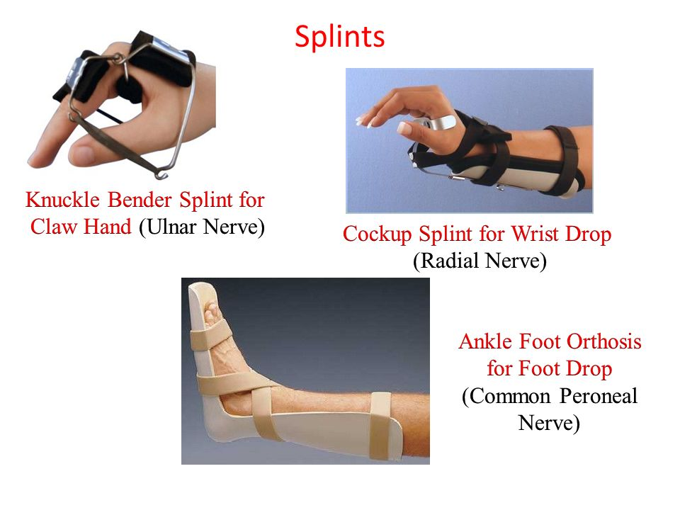
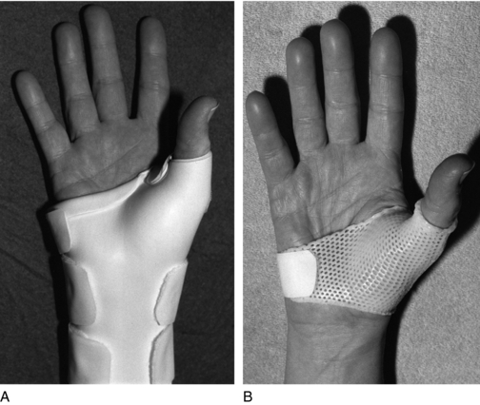

Slide 45
Surgical management
Synovectomy
Arthrodesis
Arthroplasty
Tendon reconstruction of Rupture tendons

Slide 46
Thank you

