Slide 1
Perioperative Thromboprophylaxis: A Clinical Pharmacy Perspective
Preventing DVT and PE in Surgical Patients
Ahmed M. Sayed
Assistant lecturer
Department of Orthopedics and Trauma Surgery

Slide 2
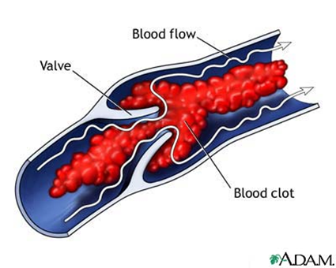
Introduction
Key Points:
  Deep venous thrombosis (DVT) is a common and preventable perioperative complication.
  Risk varies by surgery type:
    Neurosurgery: 24%
    Total Hip Replacement: 45-57%
    Total Knee Replacement: 40-84%
    Hip Fracture Surgery: 36-60%.
  Goal: Prevent DVT and pulmonary embolism (PE).

Slide 3
Pathophysiology
Virchow triad

Slide 4
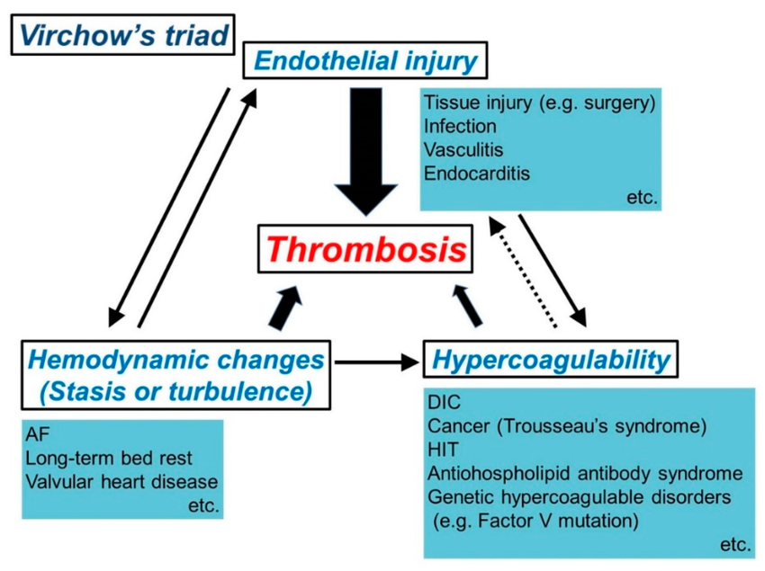
Pathophysiology of DVT
Virchow’s Triad:
  Stasis: Venous pooling due to immobility and anesthesia.
  Hypercoagulability: Increased procoagulant factors.
  Intimal Injury: Trauma to blood vessels (dt ↑VD with anesthesia, surgery)
Consequences: DVT → PE → Morbidity and mortality.

Slide 5
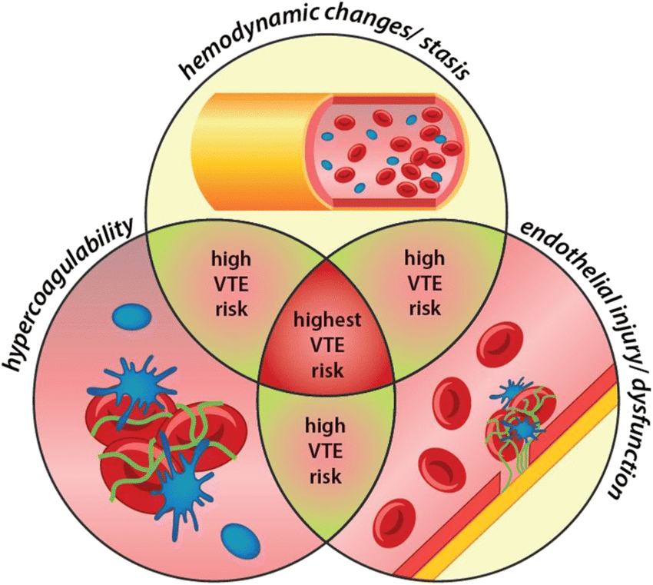
Risk Factors for DVT
Patient-Related:
  Age >50 years, obesity, history of DVT/PE, cancer, diabetes, heart failure, Immobility, varicose veins, hypercoagulable states
Surgery-Related:
  Major surgery, prolonged anesthesia, orthopedic surgery.

Slide 6
Classification
The Seventh American College of Clinical Pharmacy (ACCP) Consensus Conference recommend that patients are classified as having low, moderate, high, and very high risks for the development of DVT or PE

Slide 7
Risk Stratification (ACCP Guidelines)
Risk Level | Patient Characteristics | DVT Risk | PE Risk
Low | Minor surgery, age <40, no risk factors, GA < 30 min | 2% | 0.20%
Moderate | Major surgery, age <40, no risk factors, GA > 30 min Any surgery in age 40-60 with no risk factors minor surgery with risk factors | 10-20% | 1-2%
High | Major surgery, age >60, no risk factors Any surgery in age 40-60 with risk factors MI | 20-40% | 2-4%
Highest | prior venous thromboembolism Malignant disease Hypercoagulable state elective major lower extremity orthopedic surgery Hip fracture Stroke Polytrauma Spinal cord injury | 40-80% | 4-10%

Slide 8
Classify the surgery
High risk
Low risk
eg:
  LL arthroplasty
  osteotomy
eg:
  Knee scope
  Foot
  UL

Slide 9
Clinical picture

Slide 10
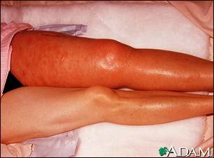
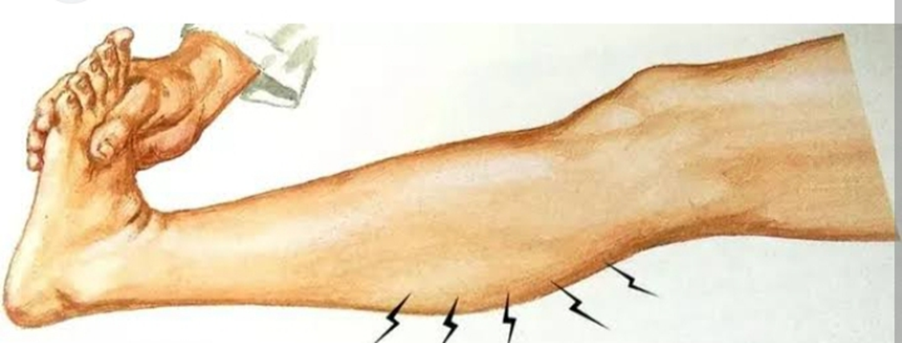
Clinical Presentation
DVT Symptoms:
  Leg pain, swelling, redness, warmth, tenderness.
  Homan’s Sign: Calf pain on dorsiflexion.
PE Symptoms:
  Small PE: Asymptomatic.
  Medium PE: Dyspnea, hemoptysis, chest pain.
  Large PE: Syncope, cardiac arrest.

Slide 11
Investigations
Diagnostic Tools:
  Doppler Ultrasound: For DVT.
  CT Pulmonary Angiography: For PE.
  D-Dimer: Elevated in thrombosis (non-specific).

Slide 12
Management

Slide 13
Goals of therapy:
Prevention of the occurrence of DVT or PE.
Prevention of the consequences of DVT or PE.
Two main strategies
Nonpharmacologic
interventions
(2) pharmacologic
interventions

Slide 14
Assess risk of VTE at pre-assessment
and/or on admission
Standard or increased risk of VTE
No increased risk of VTE
Assess risk of bleeding
No mechanical or pharmacological
thromboprophylaxis required
Review VTE risk and bleeding risk
assessments in 24 hours
High risk of bleeding
Lower risk of bleeding
Further information on
Discuss with surgeon
Prescribe thromboprophylaxis as detailed later
assessment:
whether risk of VTE
outweighs the risk of
For patients with high risk for bleeding → Do not offer pharmacological
bleeding.
If patient requires
prophylaxis
thromboprophylaxis
unless the risk of VTE outweighs the
follow recommendation
risk of bleeding.
from orthopaedic
Patients already receiving
and/or haematology
therapeutic anticoagulation do not
consultant.
need additional thromboprophylaxis.
Re-assess risk of VTE
and of bleeding
every 48 - 72 hours,
or earlier if patient
condition changes

Slide 15
Risks of bleeding
• surgery expected within the next 12 hours
• active bleeding or risk of bleeding including
• new-onset stroke
• platelet count < 75 x 109/L
• acute liver failure
• active duodenal or gastric ulcer
• concurrent use of therapeutic anticoagulant
• acute bacterial endocarditis
• any spinal intervention
  (prophylactic enoxaprin dose is contraindicated for 12 hours before spinal and epidural anaesthetics and lumbar puncture. Enoxaparin contraindicated for 4 hours after spinal and epidural anaesthetics and removal of epidural catheter)
• persistant uncontrolled hypertension (BP ≥ 230/120 mmHg)
• untreated inherited bleeding disorder (e.g. hemophilia or von Willebrand's)
• spinal surgery (seek specialist advice)
• proliferative diabetic retinopathy

Slide 16
Recommendation for thromboprophylaxis
Every patient must be risk assessed and recorded
Patients on long term antiplatelets prior to surgery:
  on one single long term antiplatelet → prescribing prophylactic LMWH for up to five weeks post orthopedic surgery is acceptable in most cases.
  on a combination of antiplatelet agents → consult hematology or cardiology.
Patients on oral anticoagulants prior to surgery:
  anticoagulants can be restarted as soon as clinically appropriate. Patients on warfarin may require LMWH until therapeutic INR has been achieved

Slide 17
ELECTIVE PROCEDURES
Procedure | Risk stratification | During admission | On discharge
Lower limb arthroplasty or other major lower limb elective surgery (inc ankle surgery and hindfoot surgery) | Standard VTE risk | Enoxaparin SC 40mg once daily ^{(*) (**)} | Continue enoxaparin SC for an overall treatment course of 5 weeks or Aspirin orally 150mg daily for overall treatment course of 5 weeks If patient requires a cast/ boot/ splint post-op, continue thromboprophylaxis for the duration of cast/ boot/ splint
 | Increased VTE risk |  | Continue enoxaparin SC for an overall treatment course of 5 weeks If patient requires a cast/ boot/ splint post-op, continue thromboprophylaxis for the duration of cast/ boot/ splint
Other elective surgery (inc upper limb, arthroscopy and forefoot surgery) | Standard VTE risk | No need for pharmacological thromboprophylaxis
 | Increased VTE risk | Follow recommendations from orthopaedic and/ or haematology consultant
Elective spinal surgery | Thromboprophylaxis assessment done on a case-by-case basis depending on the type of surgery and risk factors – follow recommendations from spinal surgeon

Slide 18
TRAUMA PROCEDURES
Procedure | Risk stratification | During admission | On discharge
Hip fracture surgery | Standard VTE risk | Enoxaparin SC 40mg once daily ^{(*) (**)} | Continue enoxaparin SC for an overall treatment course of 2 weeks or until discharge (whichever is sooner)
 | Increased VTE risk |  | Continue enoxaparin SC for an overall treatment course of 5 weeks
Lower limb fracture surgery (inc ankle fracture surgery and hindfoot surgery) | Standard VTE risk | Enoxaparin SC 40mg once daily ^{(*) (**)} | Continue enoxaparin SC for an overall treatment course of 5 weeks or Aspirin orally 150mg daily for 5 weeks If patient requires a cast/ boot/ splint post-op, continue thromboprophylaxis for the duration of cast/ boot/ splint
 | Increased VTE risk |  | Continue enoxaparin SC for an overall treatment course of 5 weeks If patient requires a cast/ boot/ splint post-op, continue thromboprophylaxis for the duration of cast/ boot/ splint
Pelvic fracture surgery | Enoxaparin SC 40mg once daily for a total of 5 weeks ^{(*) (**)}
Spinal fracture surgery | Thromboprophylaxis assessment done on a case-by-case basis depending on the type of surgery and risk factors – follow recommendations from spinal surgeon
Spinal cord injury | Enoxaparin SC 40mg once daily ^{(**)}
Multiple trauma | Thromboprophylaxis assessment done on a case-by-case basis depending on the extent of injuries – follow recommendations from orthopaedic and/ or haematology consultant

Slide 19
NO SURGICAL PROCEDURE
Orthopaedic patients who do not require surgery nor a lower limb cast, boot or splint | Enoxaparin SC 40mg once daily ^{(**)} - usually stopped at discharge or earlier if patient is no longer at high thrombotic risk when re-assessed
Lower limb casts, boots or splints | Standard VTE risk | Enoxaparin SC 40mg once daily ^{(*) (**)} | Risk assess every patient prior to discharge. Manage it case by case
 | Increased VTE risk

Slide 20
(*) Started on the day of surgery at 6pm or at least 4 hours after surgery, which ever is latest
(**) Reduce dose to 20mg if eGFR <30ml/min or if patient weighs <50Kg.

Slide 21
Timing of enoxaparin administration
For in-patients with a significant reduction in mobility ENOXAPARIN should be prescribed at 6pm the night before surgery. Otherwise it should be started after surgery at the later of: 4hrs post-operatively or 6pm. Then at 6pm on subsequent days.
For patients admitted on the day of surgery that require ENOXAPARIN thromboprophylaxis:
  Anti-embolism stockings should be considered from admission
  ENOXAPARIN started after surgery at the later of: 4hrs post-operatively or 6pm. Then at 6pm on subsequent days.
Precautions with Epidural & Spinal Anaesthetic Techniques
Epidural and spinal anaesthetic techniques should not be carried out within 12hr of a prophylactic dose of ENOXAPARIN.
Epidural catheters should not be removed within 12 hr of a prophylactic dose of ENOXAPARIN.
Wait >4h after any of these procedures before giving next dose of ENOXAPARIN.
In most cases administration of ENOXAPARIN at 6pm will avoid any difficulties here.
Monitoring platelet count
All patients prescribed heparin, including LMWH, should have a baseline platelet count assessed.
Postoperative patients receiving LMWH have a low risk of HIT and do not require routine platelet count monitoring for this purpose.

Slide 22
Antiplatelet agents
Antiplatelet agents are generally considered ineffective in preventing PE.
Some guidelines advise against the use of aspirin alone in DVT prophylaxis.

Slide 23
Nonpharmacologic measures
recommended for low-risk patients throughout the perioperative period until they are ambulatory.
Include: Graduated compression stockings (GCS), Intermittent pneumatic compression (IPC).
Inferior vena cava filters are no longer recommended in primary prevention for perioperative DVT and PE.
Early ambulation remains the most important nonpharmacologic approach to prevention of perioperative DVT and PE.

Slide 24
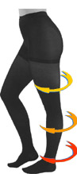
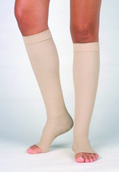
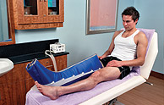
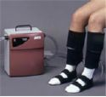

Slide 25

THANK YOU

