Slide 1
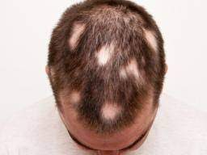
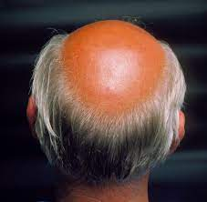
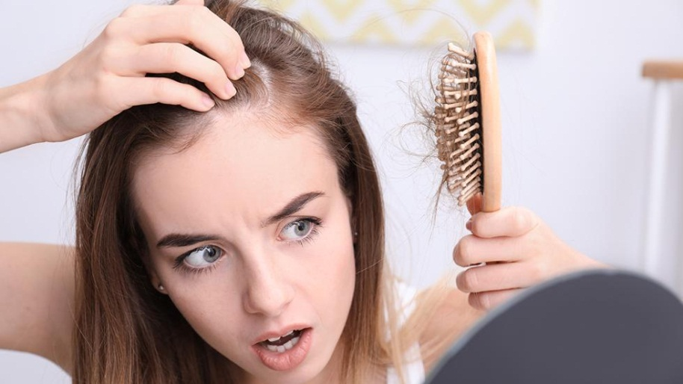
Hair Disorders
Aya Yousef Badran
Assistnt Professor Of Dermatology, Andrology And Venereology
Faculty Of Medicine -Assiut University

Slide 2
By the end of the lecture the student will be able to:
1-Mention the main hair disorders.
2-Mention the definition and clinical picture of androgenic alopecia.
3- Mention the definition and clinical picture of telogen effluvium.
4-Mention the definition and clinical picture of alopecia areata.
5-Identify the etiology and the main methods of treatment of the main hair disorders.
Source: AMBOSS Medical Learning Platform.

Slide 3
Contents:
1-Androgenetic Alopecia.
2-Alopecia Areata.
3-Telogen Effluvium .

Slide 4
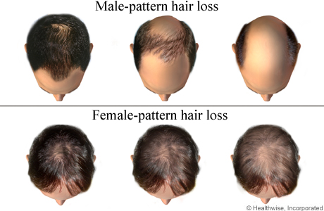
1-Androgenetic alopecia
Definition:
A progressive, non-scarring alopecia that affects the regions of the scalp with the most androgen-sensitive hair follicles, resulting in a characteristic pattern of balding (bitemporal scalp in men and vertex and frontal scalp in women).

Slide 5
Epidemiology
  Most common type of alopecia
  Prevalence: Increases with age
  Sex: ♂ > ♀ (but very common in women as well)
  Age at onset: puberty in males; menopause in females .
  Ethnicity: more common in white populations

Slide 6
Etiology
  Increased androgen sensitivity of hair follicle in genetically predisposed individuals .
  Uncommon causes:
    Congenital adrenal hyperplasia
    Androgen-producing tumors: Leydig cell tumor.

Slide 7
Differential diagnosis
Diffuse Alopecia Areata
Telogen effluvium

Slide 8
Androgenetic alopecia can be present in both men (Male pattern baldness) and women (Female pattern baldness) with minimal difference between them in clinical features and treatment.

Slide 9
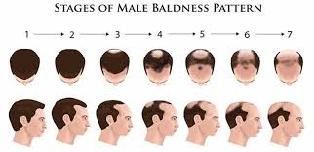
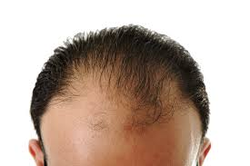
1-Male Pattern Baldness:
Clinical features:
Gradual, nonscarring hair loss
Bitemporal "M” pattern of recession
May be followed by hair loss on the vertex of the scalp

Slide 10
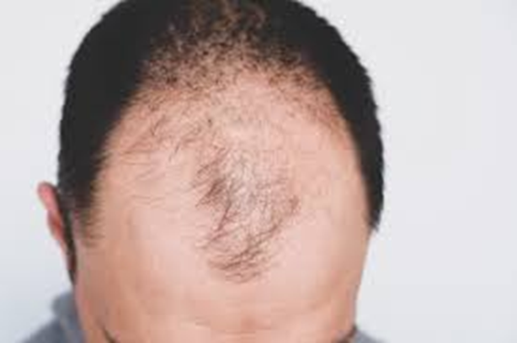
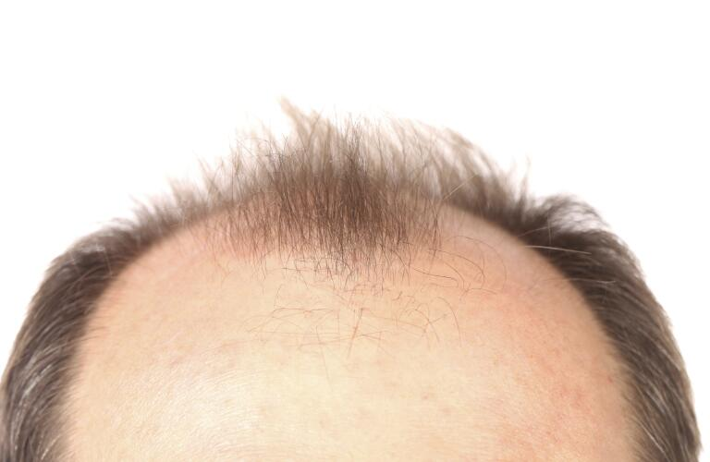


Slide 11
Treatment:
First-line treatments:
  Finasteride
  5% minoxidil (direct arteriolar vasodilator; can also be used for refractory hypertension) .
  Hair transplant surgery:
Follicular units from the occipital scalp are extracted (either as small units or as a linear strip), divided into small units, and implanted into the bald areas.
Camouflage:
Keratin fibers, hair dyes, .. etc.

Slide 12
2-Female Pattern Baldness
Clinical features:
Gradual, non-scarring hair loss.
Begins at the vertex.
Progresses to a more diffuse hair thinning of the entire scalp.
Seen mainly in post-menopausal women.
Hirsutism may also be present.
Seen also in women with hyperandrogenism (due to PCOS, androgen secreting ovarian tumors, etc.): acne, hirsutism, menstrual irregularities, infertility, etc.

Slide 13
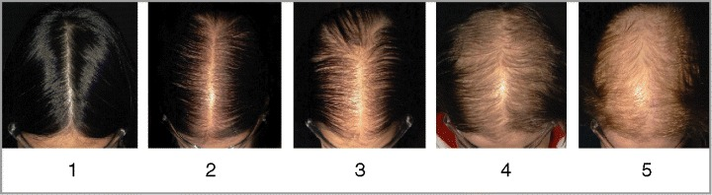

Slide 14
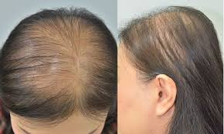

Slide 15
Treatment:
First-line Treatment:
Topical Minoxidil 2%
Oral Anti-androgens:
  Spironolactone: First choice for systemic therapy
  Finasteride
  Flutamide
  Cyproterone acetate:
Surgery and camouflage.

Slide 16
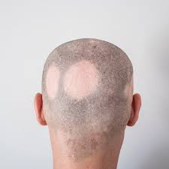
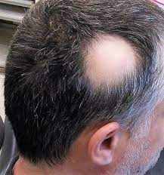
2-Alopecia areata
Definition: Hair loss in well demarcated patches due to immune-mediated inflammation of hair follicles.
Epidemiology
  Prevalence: 1 in 1000 people
  Age: mostly in people < 30 years
  Sex: ♂ = ♀

Slide 17
Etiology:
  Immune mediated inflammation and disruption of anagen phase hair follicles → well-defined patches of nonscarring hair loss
  A trigger factor (emotional stress, infections, pregnancy, etc.) may precede some cases
  Family history in up to 20% of cases

Slide 18
Clinical features :
  Abrupt onset (within weeks).
  Smooth, circular, well defined patches of hair loss without scarring .
  Various patterns of distribution :
    Extensive alopecia areata: hair loss affecting > 50% of the scalp
    Alopecia universalis : All hair-bearing sites are affected.
    Alopecia totalis: Complete baldness .
    Nail involvement (up to 40% of cases): nail pitting, onycholysis, etc.
    Other autoimmune disorders may be present (e.g., vitiligo, autoimmune disorders of the thryoid, etc.)

Slide 19
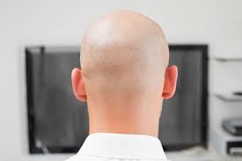
Alopecia Totalis

Slide 20
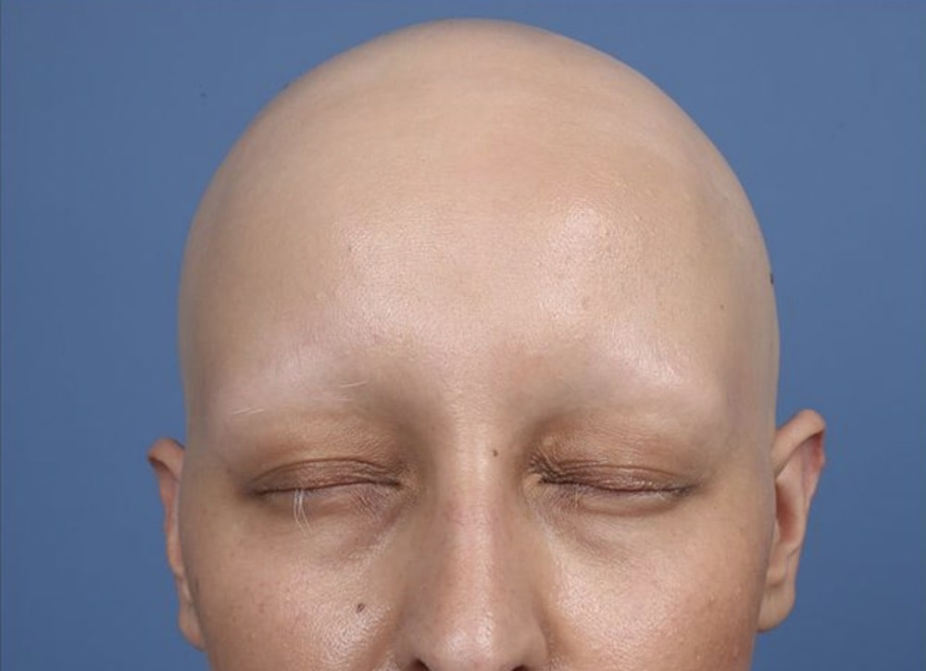
Alopecia Universalis

Slide 21
Differential diagnosis
Trichotillomania: Compulsive pulling out of one's own hair → ill-defined patchy hair loss and hairs of different lengths.
  Tinea capitis: The affected areas of scalp are scaly compared to the smooth hair loss of alopecia.
  Secondary syphilis: patchy hair loss → moth-eaten appearance of scalp.

Slide 22
Treatment
  Intralesional steroids (triamcinolone) .
  Topical immunotherapy (DPCP (diphenylcyclopropenone) or SADBE (squaric acid dibutyl ester)
  PUVA treatment (Psoralen + UVA)
Prognosis:
Poor for alopecia universalis and totalis

Slide 23
3-TELOGEN EFFLUVIUM
Telogen effluvium is the loss of hair in response to an overwhelming physiologic stress, such as cancer or malnutrition.
Treatment is correction of the underlying stress or disease.

Slide 24
Etiology
  1-Endocrine: hypothyroidism, hypopituitarism, hypoparathyroidism, hyperthyroidism, diabetes mellitus.
  2- Drugs: anabolic steroids, antithyroid drugs, heparin, antimetabolites (chemotherapy), oral contraceptives, etc.
3-Nutritional: hypervitaminosis A, zinc deficiency, malnutrition states.
  4-Stress: major surgery, sepsis, after childbirth (telogen gravidarum), acute or chronic illness (e.g., systemic lupus erythematosus), severe psychological stress.

Slide 25
Mechanism:
The telogen (resting) phase of hair growth predominates → premature shedding of the resting hair follicles → diffuse, nonscarring hair loss.
Clinical features :
  Hair density reduces by < 50%
  Does not progress to complete baldness.
  Treatment:
  Reassurance and manage underlying condition

Slide 26


