Slide 1
Tuberculosis
By
Moustafa hosny
Assistant lecturer- Chest Diseases &Tuberculosis
Assiut University

Slide 2
Tuberculosis is a disease that results from infection with Mycobacterium Tuberculosis, an acid-fast alcohol-fast strictly aerobic bacilli.
The cause behind the infection remained unknown until 1882, when Koch identified the tubercle bacillus and convicts it of causing tuberculosis.

Slide 3
Burden in Egypt
According to the latest WHO estimation, the incidence is 15 cases per 100,000 population in the year 2015.
According to the latest WHO estimation, the prevalence is 25 cases per 100,000 population in the year 2014.

Slide 4
Route of infection
Airborne route by
-Droplet nuclei produced during coughs or sneezes.
-Droplets from aerosol-producing investigations such as sputum induction, bronchoscopy and through manipulation of lesions or processing of tissue or secretions in the laboratory.
Extra-pulmonary cases are almost non-infectious.
Individuals with latent tuberculosis infection are not infectious, as they do not have replicating bacteria and cannot transmit the organism.

Slide 5
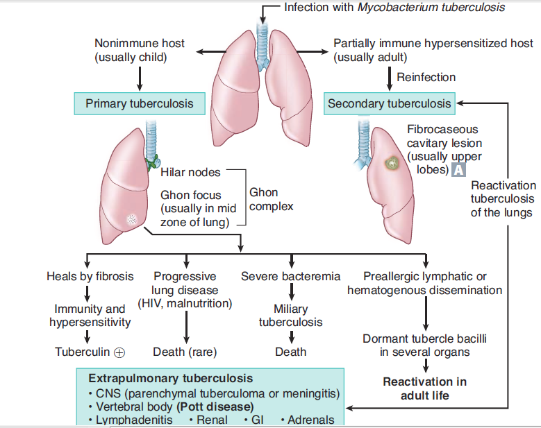
Evolution and fate of infection

Slide 6
Clinical picture: Pulmonary T.B.

Slide 7
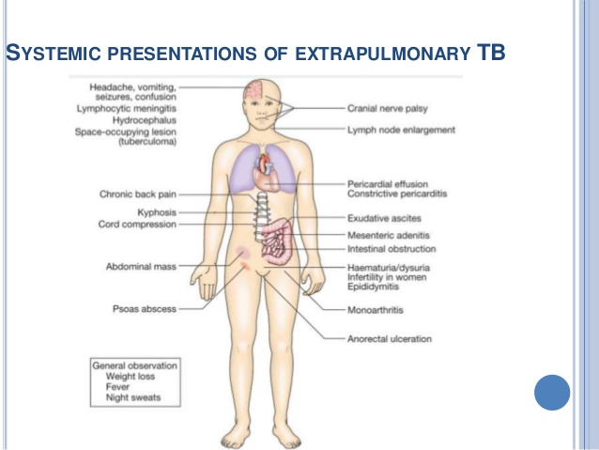
Extrapulmonary T.B.

Slide 8
Diagnosis
Clinical picture.
Direct smear: 3 repeated samples (sure diagnosis at least 2 samples(+)
Sputum culture:
Solid media (LJM): results after 4-8 Ws. Susceptibility to (R) and (H).
Liquid media (BACTEC system): results after 12 days. Susceptibility to all 1st line anti T.B. drugs.
Radiology.
Tuberculin skin test: intradermal in forearm. Measure induration after 48 hours.

Slide 9
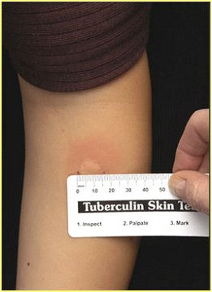

Slide 10
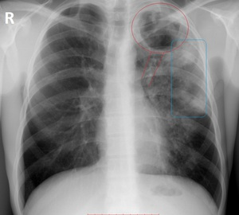
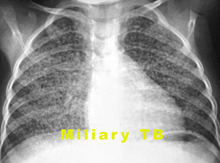
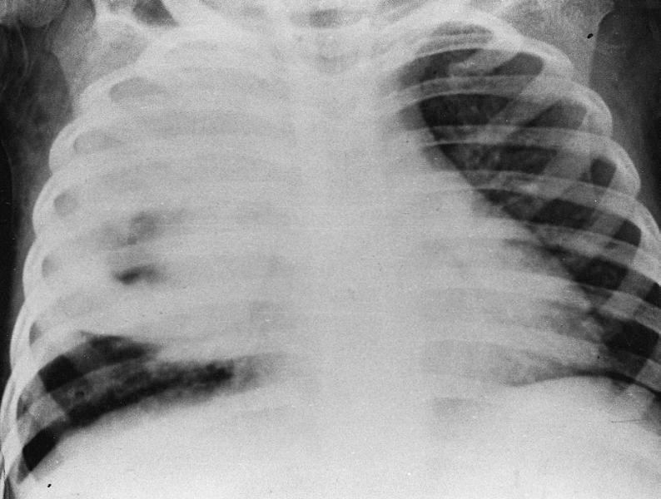

Slide 11
Diagnosis
Others:
Interferon gamma release assay (IGRA): determine infection by measuring the INF-Ɣ released by lymphocytes against specific mycobacterium antigens
GeneXpert MTB/RIF: detect DNA of MTB bacilli and rifampicin resistant strains.
Culture from blood, urine, CSF…
Histological examination of specimens (L.N., pleura….).

Slide 12
Case definitions according to history of previous treatment
New case: never received anti T.B. before (or received for less than 4 weeks) positive or negative bacteriology , at any site.
Previously treated:
Treatment after lost to follow (defaulter): have been treated and been lost to follow up at the end of their most recent course of treatment.

Slide 13
Failure: have been treated and whose treatment has failed at the end of the most recent course of treatment.
Relapse: have been treated and declared cure after completion of most recent course of treatment and present with recurrence either true or due to reinfection.
Other: unknown outcome of treatment.

Slide 14
Case definition according to bacteriological results
Smear positive pulmonary T.B.:
One or more sputum smear specimens at the start of treatment are positive for AFB.
Smear negative pulmonary T.B.:
Clinical picture and radiological picture consistent with T.B. together with two sets of negative sputum smear separated by a course of antibiotic without clinical or radiological improvement.

Slide 15
Case definitions according to anatomical site:
Pulmonary tuberculosis: involvement of lung parenchyma
Extra Pulmonary tuberculosis: involvement of any organ other than the lung (including pleura, L.N.)

Slide 16
Treatment

Slide 17
First line drugs
Isoniazid
Intra &extracellular
Bactericidal
Rifampicin
Extra/intracellular Bactericidal
sterilizing
Pyrazinamide
Intraceluular
Bactericidal
Sterilizing
Streptomycin
Extracellular
bactericidal
Ethambutol
Intra &extracellular
Bacteriostatic

Slide 18
Pharmacokinetics
 | Absorbtion | Distribution | Metabolism | Elimination
Rifampicin | Affected by food and antacids | 80% protein bound, cross BBB | Liver (enterhepatic circulation) | Faeces(60-65%), urine unchanged ≈30%
Isoniazid | Affected by food and antacids | 10-15% protein bound, cross BBB, placenta | Acetylation in liver (rapid and slow acetylators). | In urine (75-95%) and faeces
Pyrazinamide | Food has min. effect on bioavailability. Can be given with antacid | 50% protein bound, cross BBB | Liver | In urine (4%)
Ethambutol | Food has min. effect on bioavailability. Antacid ↓ bioavailability | 20-30% protein bound, cross inflammed meninges | Liver | 50%in urine, 20%faces
Streptomycin | Not absorbed from the gut. Given IM | Mainly to extracellular fluid | ----------------------------- | 90% unchanged in urine

Slide 19
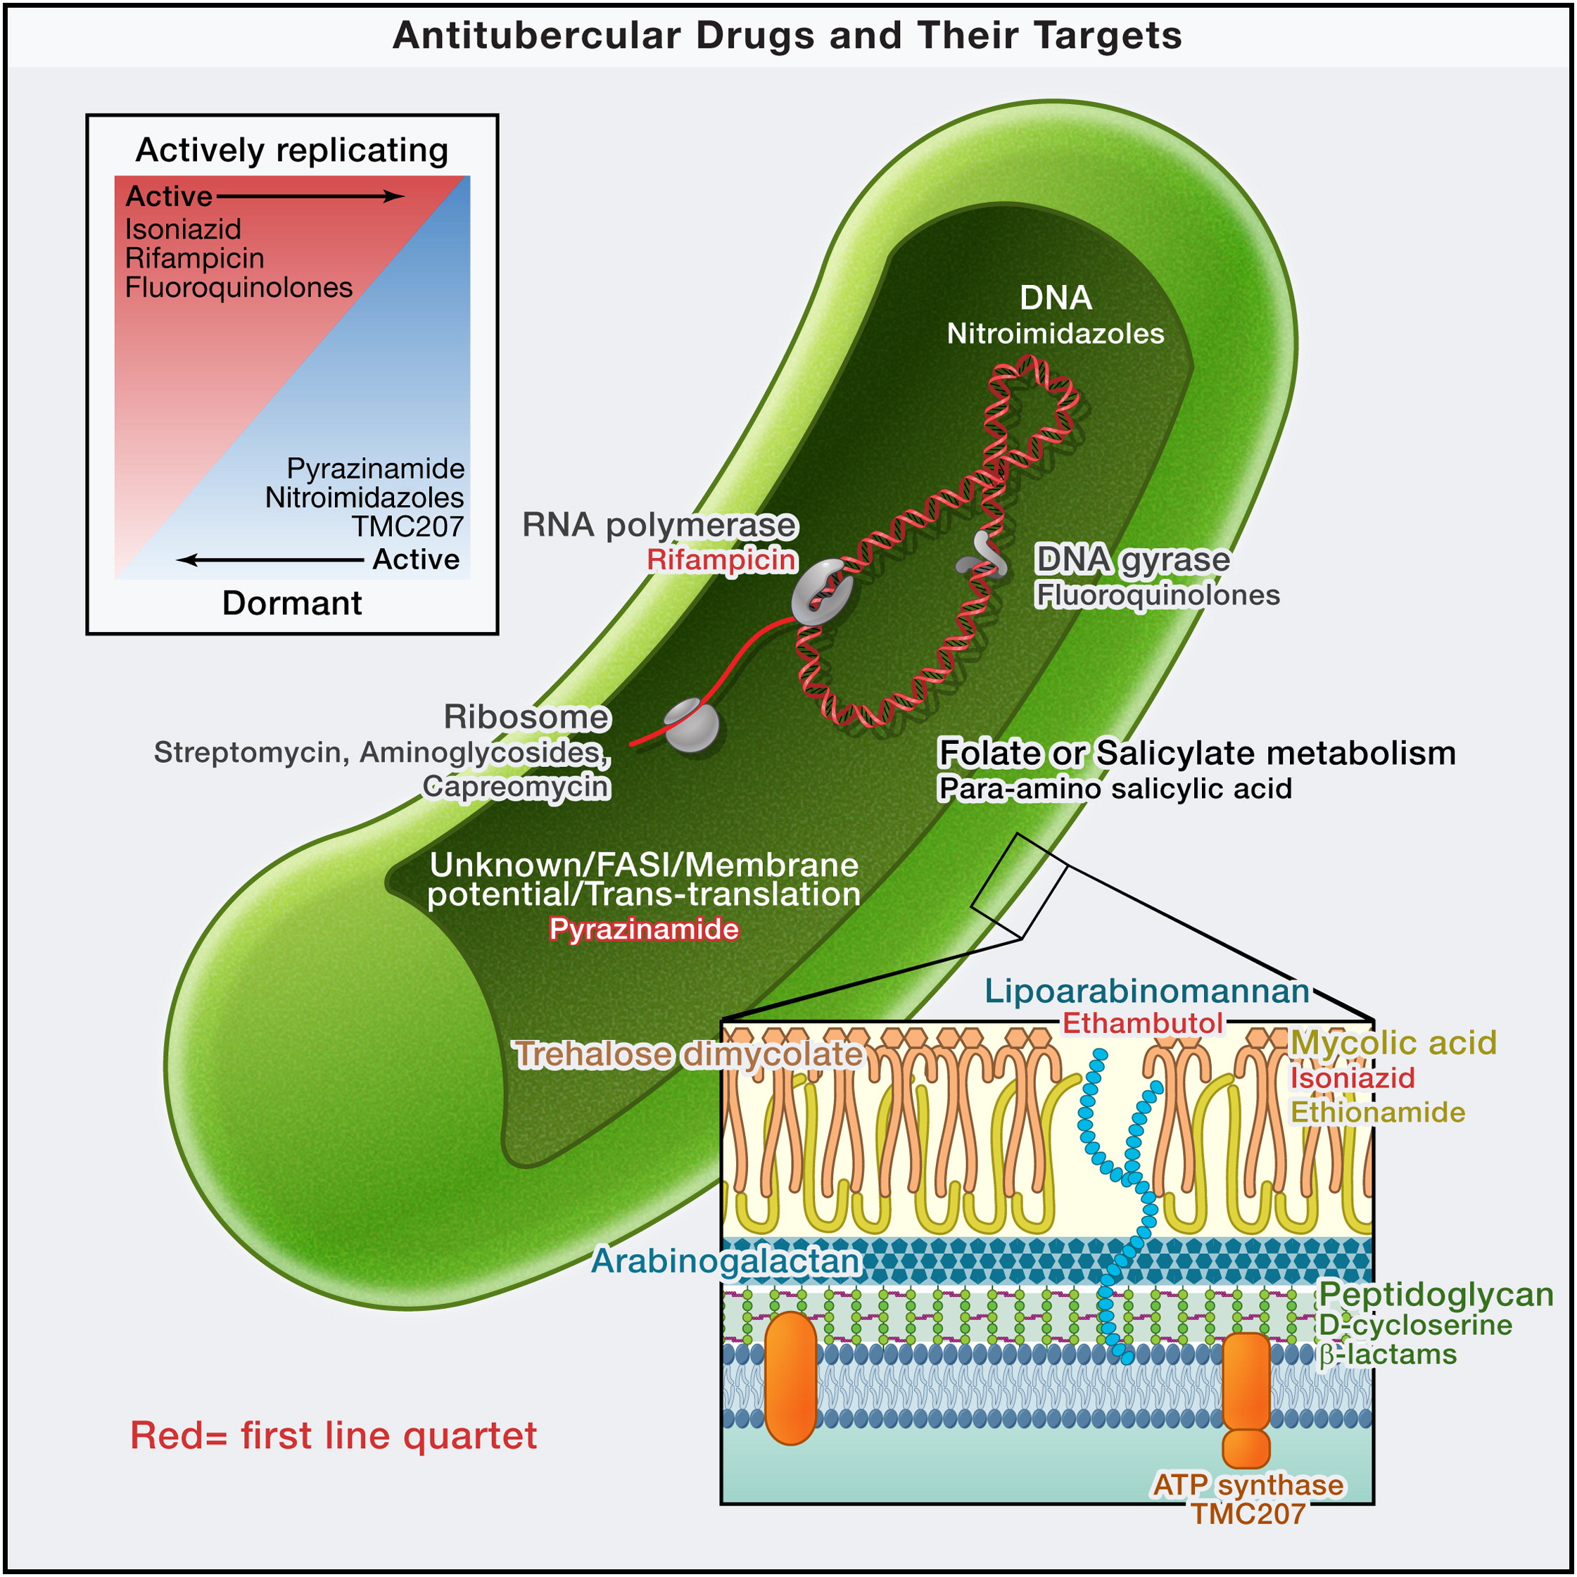

Slide 20
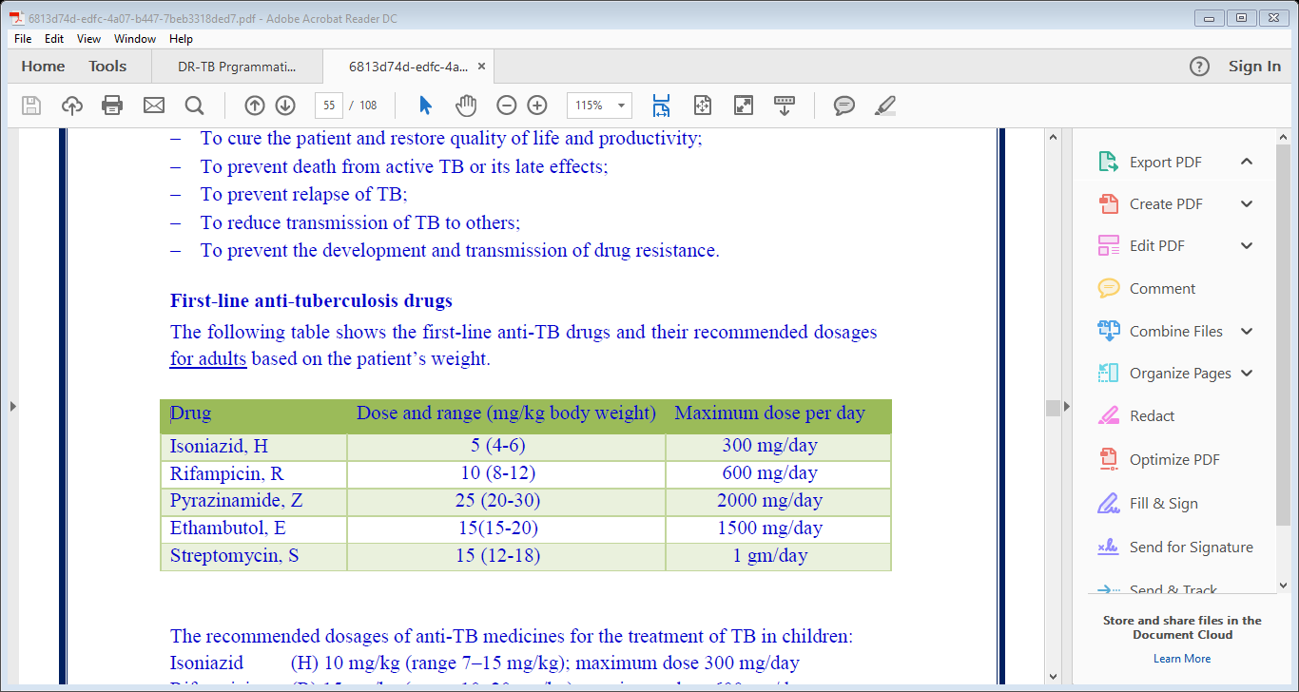
Doses

Slide 21
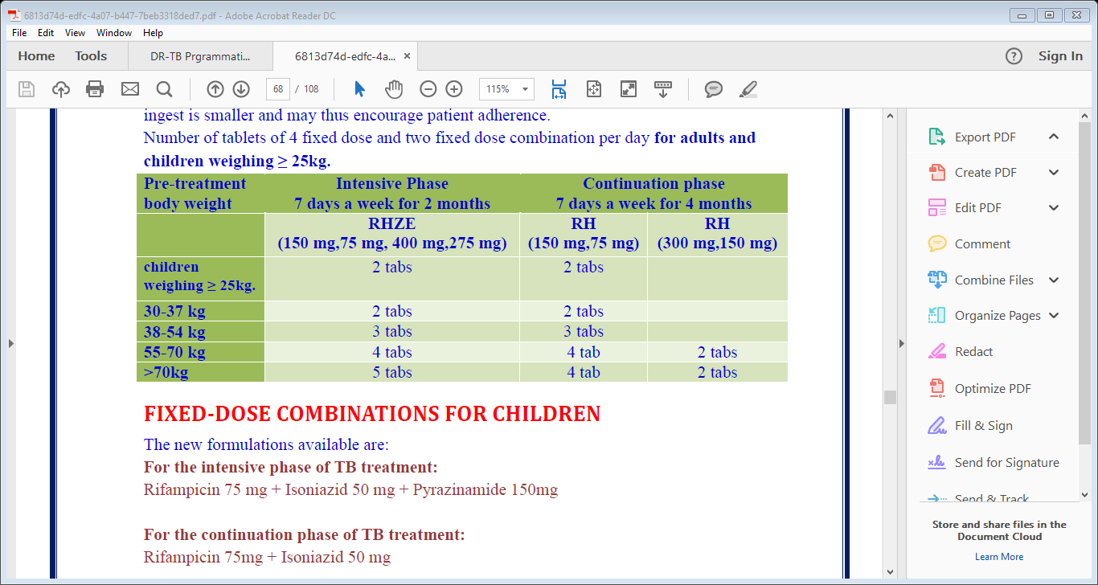
Fixed dose combination

Slide 22
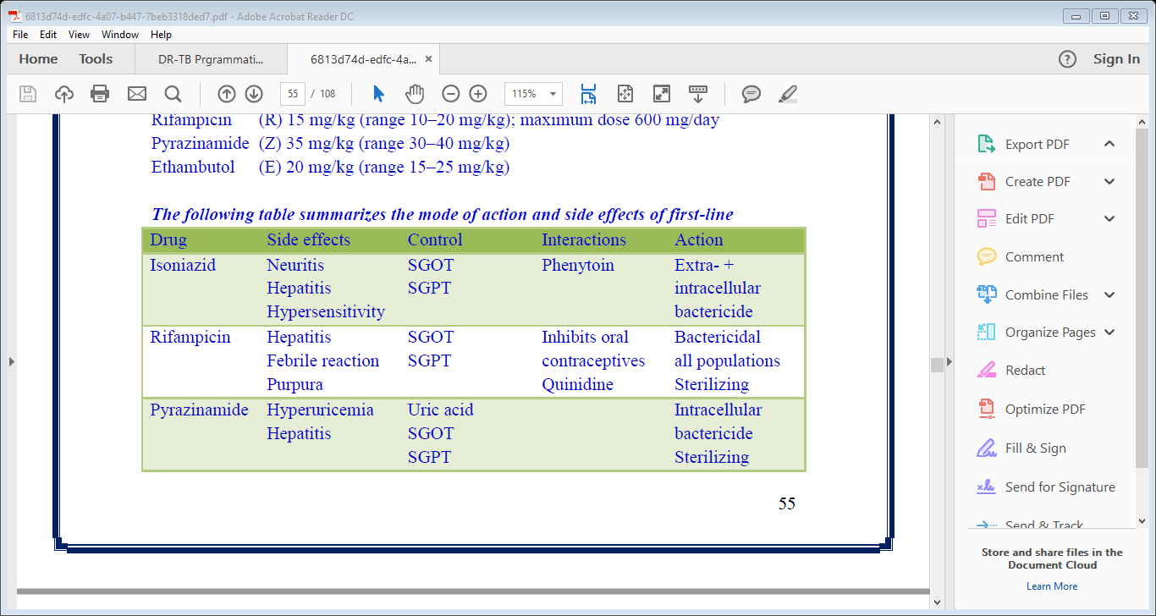
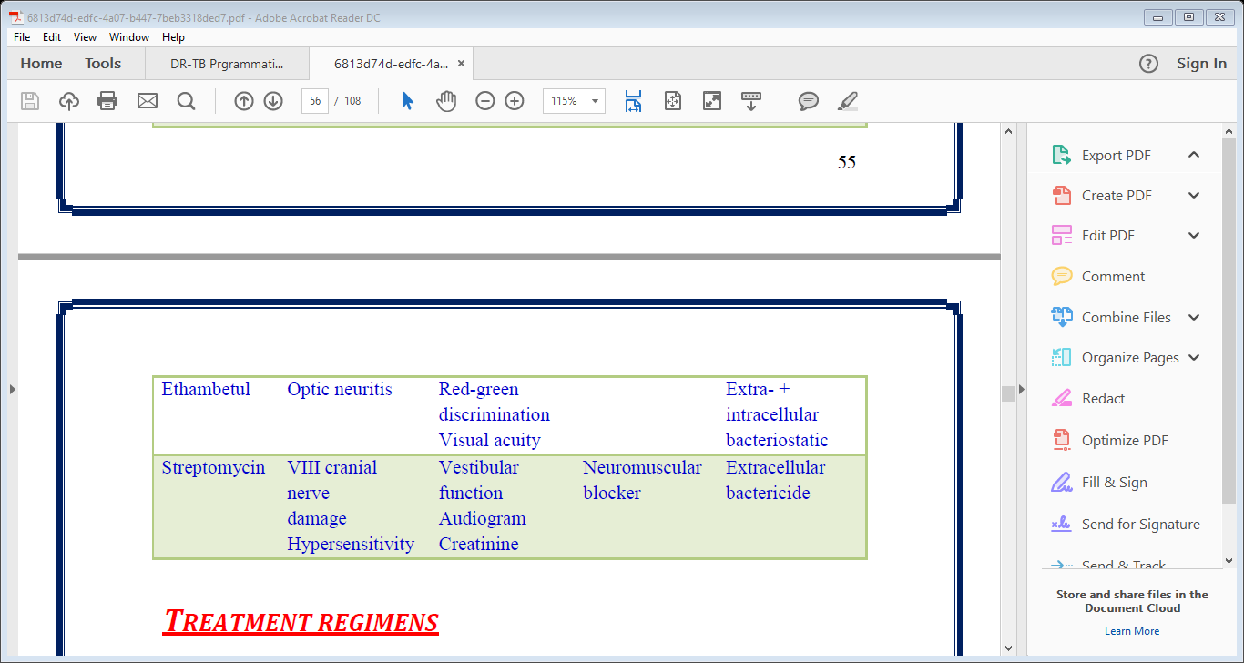

Slide 23
Rifampicin interactions
Contraindicated !!
Drug | Mechanism
BCG vaccine | Inactivate vaccine
Apixaban: | Decreased effect due to increased metabolism (hepatic enzyme inducer)

Slide 24
Rifampicin interactions
Serious
Drug | Mechanism
Clopidogrel: | Induce more metabolism to its active metabolite, increase effect.
Dabigatran, enoxaban, warfarin | Rifampicin induces metabolism of these drugs and decrease their effect.
Erythromycin, diltiazem, dexamethasone, hydrocortisone, methylprednisolone, midazolam, theophylline

Slide 25
Rifampicin interactions close monitoring
Drug | Mechanism
Azithromycin, clarithromycin, amikin, fluconazole, itraconazole, ketoconazole, | Rifampicin induce metabolism of these drugs and decrease action.
Sulfonylureas,omeprazole, pantoprazole
Phenytoin, phenobarbital,
Digoxin, propranolol: : decrease its level and effect.
Simvastatin: | increased level and effect, increased risk of myopathy.

Slide 26
Rifampicin interactions
Minor
Drug | Mechanism
Acetaminphine,Ampicillin, cimetidine, bisoprolol, enalapril, lisinopril, ramipril | Rifampicin induce their metabolism and decrease their serum level.

Slide 27
Isoniazid Interactions
Contraindicated !!
Drug | Mechanism
BCG vaccine | Inactivate vaccine
Itaconazole, ketoconazole | Decreased action by unspecified mechanism

Slide 28
Isoniazid Interactions
Serious
Drug | Metabolism
Clopidogrel: | Decreased metabolism to the active metabolite, decreased action
Erythromycin, Omeprazol, Simvastatin: | Inhibit metabolism, increase action
Linezolid: | Both increase serotonin level, CNS toxicity

Slide 29
Isoniazid Interactions
Close monitoring
Drug | Mechanism
Amiodarone,cimetidine,clarithromycin,dexamethasone,hydrocortisone, methylprednisolone, midazolam, theophylline, verapamil: | Decreased metabolism and increased action
Metformin, sulfonylureas, insulin, prednisone, prednisolone | Decreased action by unspecified mechanism.
Metronidazole | It increase INH action

Slide 30
Pyrazinamide Interactions
Contraindicated: None
Serious: Rifampicin add to hepatotoxicity
Close Monitoring: probenecid effect is decreased by unknown mechanism.
Minor: INH add to hepatotoxicity

Slide 31
Ethambutol Interactions
Contraindicated: None
Serious: BCG vaccine (decrease effect by pharmacodynamic antagonism)
Close monitoring: allopurinol and probenecid (hyperuricaemia is reported with ethambutol and effect of these drygs is lowered by unknown mechanism. Need dose adjustment)

Slide 32
Streptomycin interaction
Contraindicated: None
Serious:
Drug | Mechanism
Furosemide, torsemide, ethacrynic acid | Enhanced nephrotoxicity (synergism)
BCG vaccine | Antagonism

Slide 33
Streptomycin Interaction
Close monitoring
Drug | Mechanism
Amikacin, teicoplanin | Increased nephrotoxicity and ototoxicity
Itraconazole, ketoconazole, erythromycin, clrithromycin, verapamil, diltiazem | Increase streptomycin level through P-glycoprotein efflux transporter
Phenytoin, phenobarbital | Decrease streptomycin level through P-glycoprotein efflux transporter
Digoxin | Increase streptomycin level by altering intestinal flora
Warfarin | Streptomycin increase warfarin action by unknown mechanism.

Slide 34
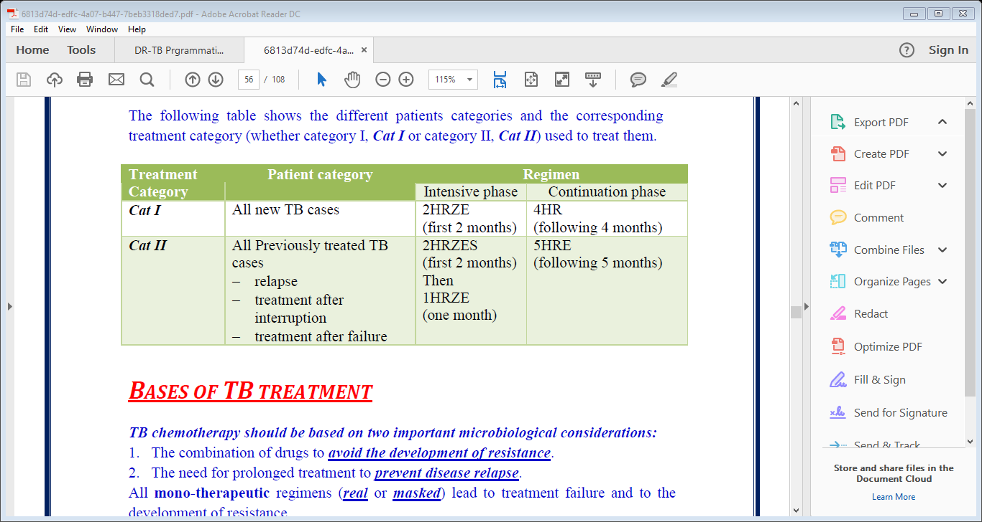
Drug regimens
*H: isoniazid, R: rifampicin, Z: pyrazinamide, E: ethambutol, S: streptomycin

Slide 35
Second line drugs
Drug | Dose | Potential side effects
Amikacin | 15 mg/kg | Nephrotoxicity, ototoxicity
Capreomycin
Kanamycin
Ciprofloxacin | 750 mg twice | GIT upset, nephrotoxicity, drug interactions
Ofloxacin | 400 mg twice
Levofloxacin | 750 mg twice
Paraminosalysalic acid | 10 mg twice | GIT upset, fever, rash, hepatitis
Thiacetazone | 150 mg | GIT upset, avoid in HIV (Steven Johnson S.)
Ethionamide | 375-500 mg twice | GIT upset, hepatitis, avoid in pregnancy
Rifabutin | 300-450 mgonce | As rifampicin
Azithromycin, clarithromycin | 500 mg | GIT upset

Slide 36
Multiple Drug Resistant T.B. ( MDR-T.B.)
Infection with bacilli resistant to the most two potent anti T.B. drugs (rifampicin and isoniazid)
Extreme Drug Resistant T.B. (XDR-T.B.)
Infection with bacilli resistant to rifampicin, isoniazid and at least three classes of second line anti T.B. drugs.

Slide 37
Special situations

Slide 38
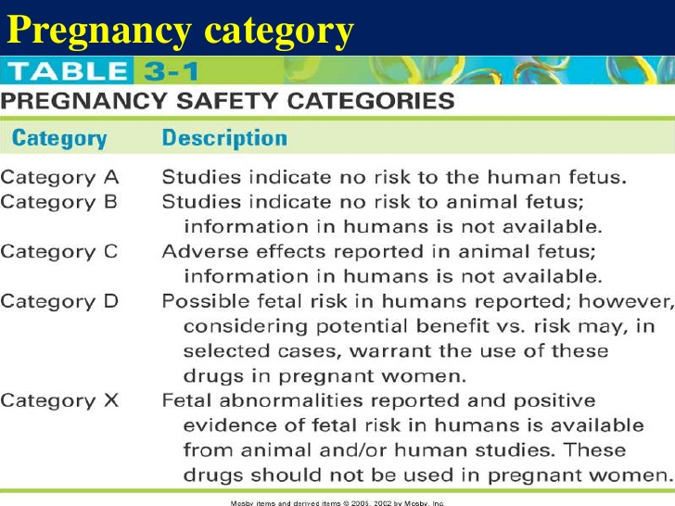
Pregnancy and lactation
Hazards of T.B. infection greatly outweighs the side effects of treatment on the foetus. So, ttt. is mandatory.
All first line anti T.B. drugs are class C except streptomycin (class D) so, it’s not used in pregnancy.
Prophylactic pyridoxine of infected mothers is by isoniazid for 6 months an is recommended (isoniazid cause neuritis and pregnancy increase risk of vitamin deficiency)
All drugs are excreted in milk in too low concntrations, so prophylaxis for babies by INH and postpone BCG vaccination till treatment is completed (avoid vaccine destruction).

Slide 39
Women using oral contraceptive pills
Rifampicin is an inducer to hepatic enzymes→ increase metabolism→ decreased efficacy . Use higher dose or convert to non-hormonal methods.
Diabetes Mellitus
The same doses.
Strict control of blood sugar.
Prophylactic pyridoxine is recommended (D.M. predispose to neuritis).

Slide 40
Liver Disease
Hepatitis virus carrier or previous acute hepatitis without evidence of chronic liver disease
Liver cirrhosis
Compensated
Decompensated
Same treatment with the same doses
2HREZ/4HR
2HRE /7HR
HE+quinolone (±aminoglycoside) 9-12 m
RE+quinolone (±aminoglycoside) 9-12 m
2HRE+quinolone/4HR
E+quinolone (±aminoglycoside) 12-24 m

Slide 41
Hepatotoxicity
Exclude Viral hepatitis first
Increase liver enzymes < 2 folds
Increase liver enzymes 5 folds/ bilirubin increase
Increase liver enzymes >2 folds
Stop Z,H,R and follow up LFTs until normal
Repeat LFTs 2 weekly until normal
Sequential re-introduction of drugs
Repeat LFTs weekly for 2 Ws then 2 weekly until normal
H: 50 mg and increase gradually to maximum dose /kg
R: 75 mg and increase gradually to maximum dose /kg
Z: 250 mg and increase gradually to maximum dose /kg

Slide 42
Renal impairment
The same regimen (2HERZ/4HR)
Isoniazid and Rifampicin need no change in dosing (excreted in bile).
For Ethambutol and Pyrazinamide (mainly excreted by kidney),doses should be adjusted:
(Three times per week administration of these two drugs at the following doses is recommended: Pyrazinamide (25 mg/kg), and Ethambutol (15 mg/kg)).

Slide 43
Pyridoxine is given to prevent peripheral neuropathy.
Because of an increased risk of nephrotoxicity and ototoxicity, Streptomycin should be avoided in patients with renal failure.
Always use creatinine clearance to adjust dose.

Slide 44
Cases

Slide 45
Case 1
A 25 year old patient, living in a slum area came to the clinic complaining of fatigue, low grade fever, cough and scanty amounts of blood while coughing of 3 months duration that didn’t improve with medications. On examination he looked pale, relatively thin, his weight was 55 kg, his Chest examination revealed presence of right sided pneumonia . CXR showed Rt. sided pneumonia, with an upper lobe cavity. Sputum smear for A.F.B. was done and was positive.

Slide 46
Q1: Which drugs should be prescribed for this patient? Mention the doses.
Q2: Are there certain considerations regarding administration of the prescribed drugs? Mention with reasons.

Slide 47
A1: A new case of pulmonary T.B. The first line drugs are recommended in the following doses:
-Rifampicin: (10mg*55kg =550mg) (Max: 600mg).
300 mg (tablet)------> 2 ×1 (600 mg/day)
-INH: (5mg*55kg =275mg) (Max: 300mg).
150 mg (tablet)-----> 2 ×1 (300mg/day).

Slide 48
-Pyrazinamide: (25mg*55kg =1375mg) (Max: 2000).
500 mg (tab.)----> 3×1 (1500 mg/day)
-Ethambutol: (15mg*55kg =825mg) (Max: 1500)
500 mg (tab.)----> 2 ×1 (1000 mg/day)
The regimen: CAT I ( The four drugs for 2 months and continue rifampicin and INH for 4 months).

Slide 49
A 2:
All these drugs should be given as single daily dose (no more frequent administration as the Mycobacteria are slow multiplier almost once every day).
All these drugs should be given together, as a single dose, to get the simultaneous synergetic effect of all drugs. Dividing the dose or spacing the drugs interfere with that effect.
Most of the drugs are affected by the presence of food in the stomach or its PH, that is why, it is necessary to give all drugs on empty stomach (as in case of FDCs).

Slide 50
Case 2
The same patient returned to outpatient clinic for follow up after 1 month. He complained of ill health. He also noticed dicolouration of urine and stool and yellowish discolouration in his sclera.
Q1: Which of the prescribed drugs may be the offending?
Q2: What investigation you Should request?

Slide 51
A1: Jaundice with discolouration of sclera, urine and stool suggest hepatatotoxicity. Hepatotoxic drugs include:
Rifampicin- Isoniazid- Pyrazinamide
A2: liver function tests (Bilirubin level, AST, ALT).

Slide 52
Case 3
Liver function tests of this patient showed 5 fold increase in liver enzymes
Q1: What is the first notion you would report?
Q2: Report your recommendations to the treating physician regarding treatment.

Slide 53
A1: Stop pyrazinamide, rifampicin and ethambutol and monitor LFTs until normal
A2: Sequential reintroduction of treatment as follows:
Isoniazid: 50mg/day then gradual increase every 2-3 days to maximum dose /kg.
Rifampicin: 75mg/day then gradual increase every 2-3 days to maximum dose /kg.
Pyrazinamide: 250mg/day then gradual increase every 2-3 days to maximum dose /kg.
If no reaction, continue chemotherapy.
If reaction occurs, exclude the offending drug and use alternative non-hepatotoxic regimen e.g. 2HRE/7HR if reaction was due to pyrazinamide

Slide 54
Case 4
A 56 year old employer on regular dialysis is recently diagnosed with pulmonary T.B.
Q1: What special investigation you should request before prescribing medications?
Q2: Write down the recommended doses.

Slide 55
A1: creatinine clearance to adjust the dose.
A2: 4 HERZ/2 HR in the following doses:
R: 10 mg/kg/day
H: 5 mg/kg/day
E: 15 mg/kg (3 times /week)
Z: 25 mg/kg (3times/week)

Slide 56
Case 5
A 28 year old pregnant lady (2 months pregnant) is referred to you from an obstetrician for adjusting the treatment for pulmonary T.B.
Q1: What is the correct regimen for this patient?
Q2: The mother is concerned about the risk of transmission of infection to her baby. What is your recommendation?

Slide 57
A1: -The standard regimen in the same doses as non pregnant:
4 HERZ/2 HR
- Prophylactic pyridoxine .
- Streptomycin is to be avoided (class D).
A2:- Concentrations of medications in milk are too low to provide protection.
- Isoniazid for the baby for 6 months.
- Postpone BCG vaccination till after ttt.

Slide 58
Thank you

