Slide 1
Pneumonia
By
Sarah Hashem
Chest Diseases & Tuberculosis- Assiut University

Slide 2
Pneumonia is inflammation of the lung parenchyma leading to consolidation of part / the whole lung due to intra-alveolar exudation.
Pneumonia is the single largest infectious cause of death in children worldwide. For US adults, pneumonia is the most common cause of hospital admissions other than women giving birth.

Slide 3
Older people have higher risk of getting pneumonia, and are more likely to die from it if they do.
Pneumonia is the most common cause of sepsis and septic shock, causing 50% of all episodes.

Slide 4
Classification
Aetiological
Empiricist's classification
Anatomical
Bacterial
Community acquired pneumonia (CAP)
Hospital acquired pneumonia (HAP)
Pneumonia (immunocom-promised)
Lobar
Atypical
Lobular
bronchopneumonia
Viral
-Str. Pneumoniae
-H.Influenza
-M. pneumoniae
-Gm. –ve (Kl. P. aeraginosa, E.coli)
-Staph. aureus
-Strept.,pneumoniae
-Anaerobes
-Pneumocystis.
-Fungal
-Atypial mycobacteria
-CMV
Segmental
Fungal
Parasitic
Interstitial
Autoimmune
Radiation, chemical

Slide 5
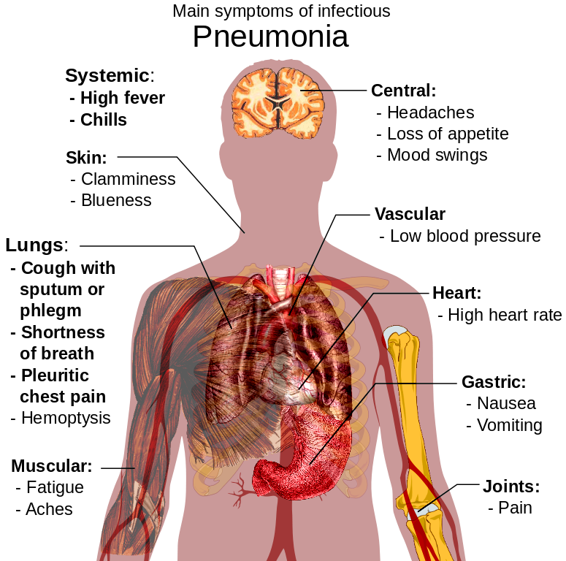
Clinical picture

Slide 6
Diagnosis
Clinical picture
Radiology
Cultures (sputum, blood..)
Others (CBC- ESR-CPR)

Slide 7
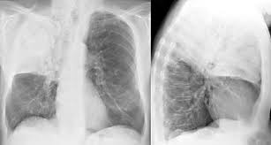
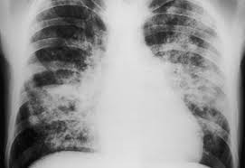

Slide 8
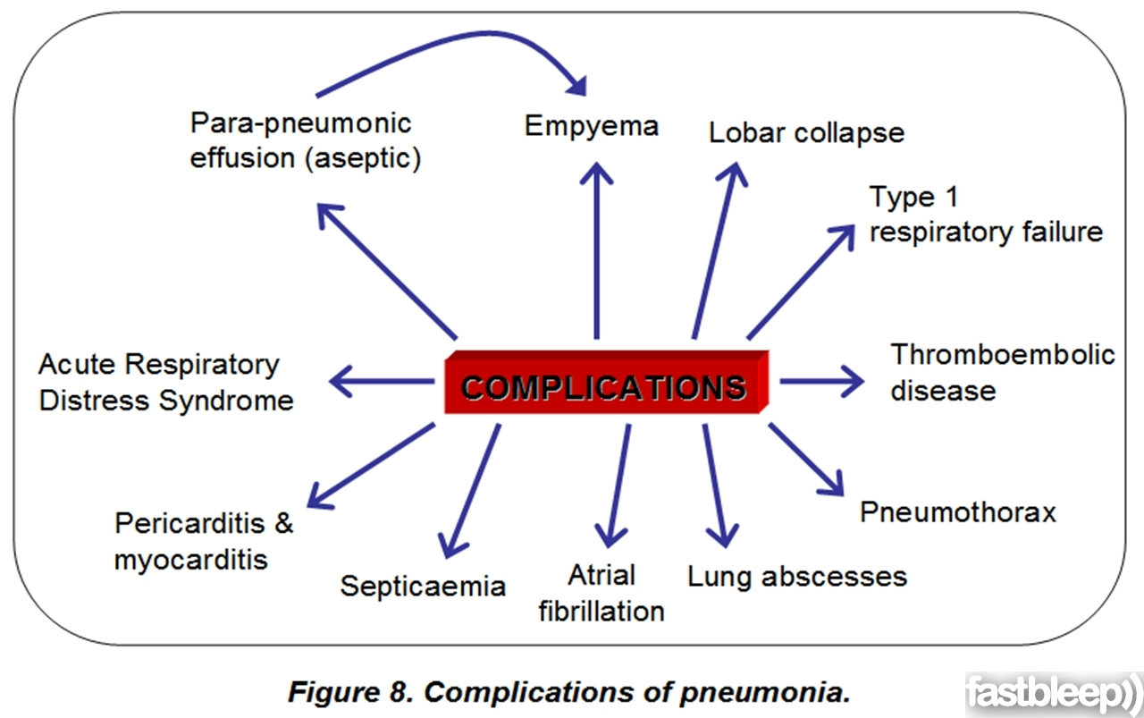
Complications

Slide 9
Treatment

Slide 10
Antibiotics
Pharmacokinetics
Liver metabolism
Elimination by kidney
Amoxicillin/clavulanic
Pipracillin
Carpabenems
Linezolid
Macrolides
Aminoglycosides
Quinolones
Cephalosporins
Glycopeptides

Slide 11
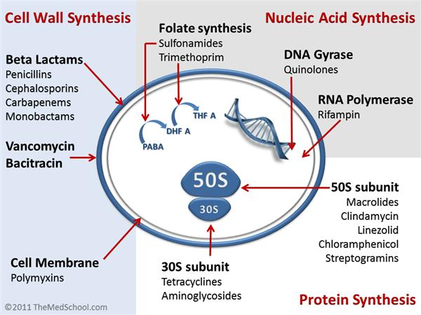
Mechanism of action

Slide 12
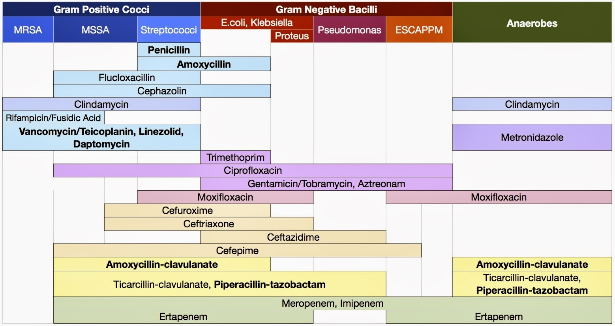
Specrtum of Antibacterial Drugs
levofloxacin
Amikacin

Slide 13
Penicillins, Cephalosporins
Rash, allergic reactions, GIT upset
Carpabenems
Diarrhea, nausea, vomiting, hepatotoxicity
Quinolones
GIT upset, dysglycaemia Nephrotoxicity fits, arrhythmia
Macrolides
Vomiting, diarrhea
Aminoglycosides
Nephrotoxicity, Ototoxicity
Side effects
Linezolid
B.M. suppression, GIT upset
Clindamycin
Pseudomembranous colitis, B.M suppression
Glycopeptides
Nephrotoxicity, B.M. suppression

Slide 14
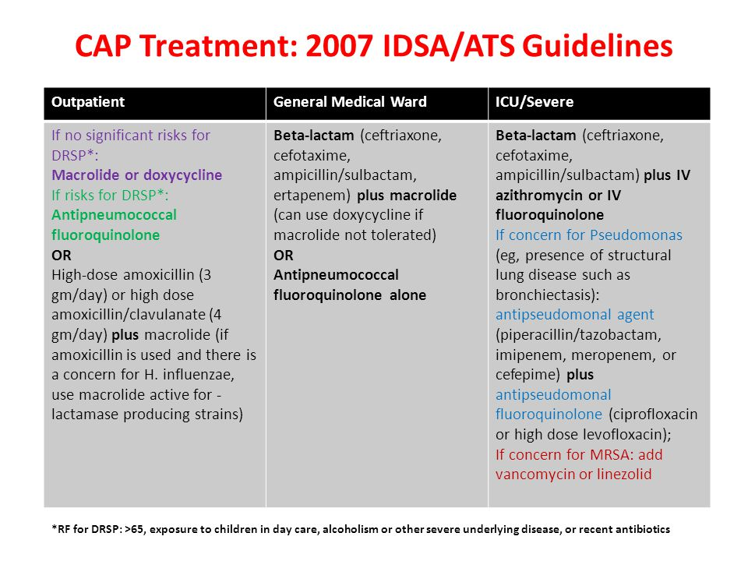

Slide 15
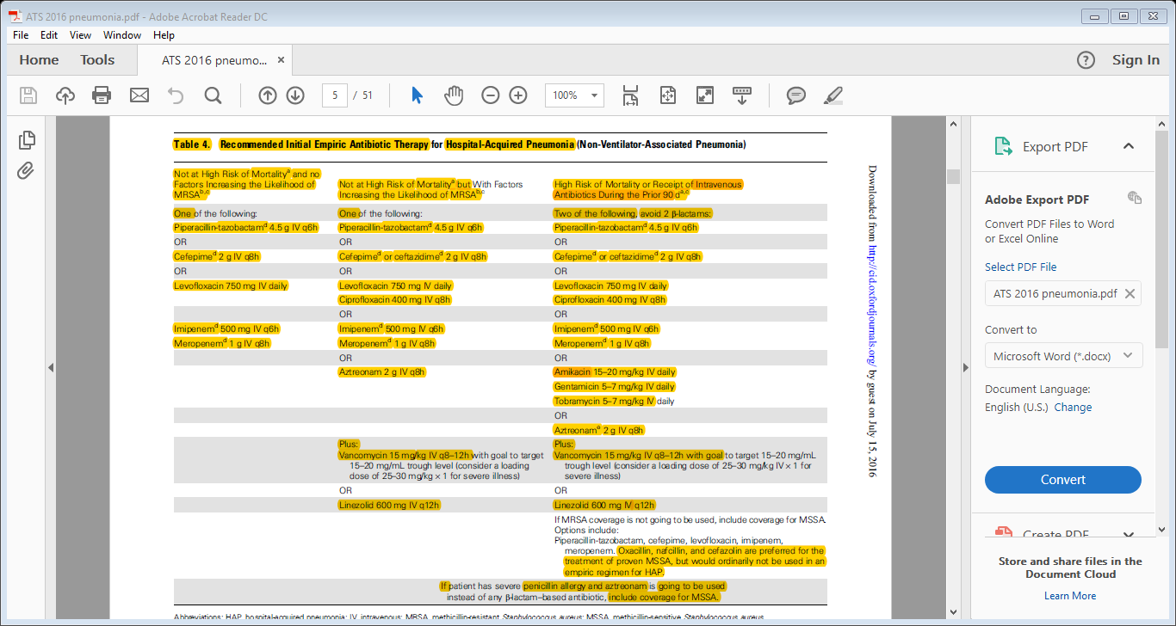

Slide 16
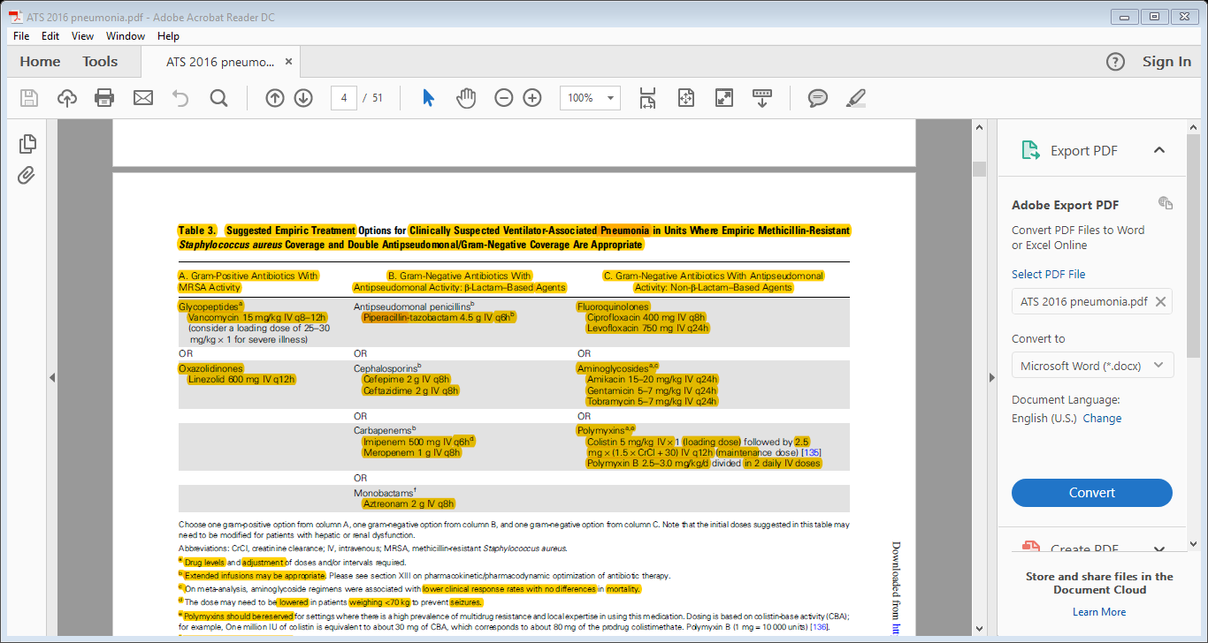

Slide 17
Antibiotics Drug Interactions
Antibiotic | Interacting drug | Mechanism
Amoxicillin-clavulaninic | BCG, Cholera, Typhoid vaccines* | Inactivation of these vaccines
 | Aspirin | Both increase serum level of the other
Cephalosporins(cefip-ime,ceftazidime) | Live att. Vaccines* | Inactivation of vaccines
 | Warfarin | ↓ vit. K forming GIT flora→↑ warfarin action
Piperacillin-Tazobactum | Heparin, warfarin* | Promote their toxicity (plt. Aggregation inhibitor)
 | Macrolides | Its bactericidal effect contradict their bacteriostatic action
Carpabenems (imipenem, meropenem) | Live att. Vaccines* | Inactivation of vaccines
 | Digoxin | Altering gut flora→ increase in digoxin level→toxicity
 | Theophylline | Increased risk of seizures (imipenem)

Slide 18
Antibiotics Drug Interactions
Antibiotic | Interacting drug | Mechanism
Quinolones | Iron supplement* | Decrease their GIT absorbtion→↓ action
 | Amiodarone | ↑ QT interval → arrythmias
 | Digoxin | ↑ digoxin level due to alteration in GIT flora
 | Macrolides, azoles | ↑ QT interval → arrythmias
 | Oral hypoglycaemic | Synergism→ dysglycaemia
 | Steroids | Increase risk of tendinitis, tendon rupture
 | warfarin | Decreased warfarin metabolism→ increased level and toxicity
Amikacin | Amphotericin | Both nephrotoxic and ototoxic
 | Loop diuretics | Synergism (more nephrotoxicity and ototoxicity)
 | Teicoplanin
 | Muscle relaxants | Synergism→ more muscle weakness
 | Warfarin | Amikin increase warfarin level by unknown mechanism

Slide 19
Antibiotics Drug Interactions
Antibiotic | Interacting drug | Mechanism
Linezolid | Dopamine, dobutamine, norepinephrine* | Synergism. May precipitate HTN crisis
 | Serotononergic drugs* | Linezolid inhibit MAO→ marked ↑ in serotonin level→ CNS toxicity
 | L-dopa, INH, lithium | CNS toxicity (increased serotonin level)
 | B 2 agonists | Synergism. May precipitate HTN crisis
Teicoplanin | Aminoglycoside * | Incompatible combination (don’t use the same IV line)
 | Other nephrotoxic drugs | Nephrotoxic
Vancomycin | Aminoglycosides | Increased nephrotoxicity
 | Live att. Vaccines* | Inactivation

Slide 20
Antibiotics Drug Interactions
Antibiotic | Interacting drug | Mechanism
Macrolides | Azole antifungals (fluconazole)* | ↑ QT interval → arrythmias
 | Levofloxacin | ↑ QT interval → arrythmias
 | Warfarin, steroid* | Their metabolism↓ by macrolides→↑ level
 | Rifampicin, phenytoin* | These induce metabolism of macrolides→ ↓ effect
 | Amiodarone* | Its metabolism↓ by macrolides→↑ level
 | Digoxin | Change in GIT flora→ ↑ digoxin level and toxicity
 | Clopidogrel | Decreased action dt. Decreased conversion to active meatbolites
 | Piperacillin | Its bactericidal effect contradict macrolides’ bacteriostatic action
 | Oral hypoglycemic/insulin | Synergism → dysglycaemia

Slide 21
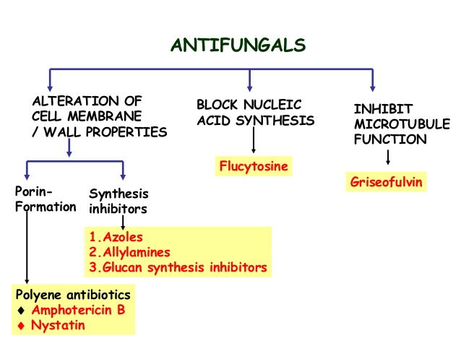

Slide 22
Antifungal Drugs: Azole antifungals
Mechanism: inhibit ergosterol synthesis→ cell wall disruption
Spectrum: some yeasts, dimorphic fungi, dermatophytes, asperigellus.
Side effects: nausea, vomiting, hepatotoxicity
Interactions:
Absorbtion affected by H2 blockers.
They are considered as hepatic enzyme inhibitors→ ppt. toxicity of other drugs. e.g. warfarin, quinolones, antituberculous
Rifampicin is a strong hepatic enzyme inducer-→ decrease action of these drugs.

Slide 23
Antifungal Drugs:Echinocandins Micafungin
Mechanism: glucan synthesis inhibitors (cell wall)
Spectrum: candidiasis
Dose 100 mg/day for 10-15 days.
Side effects: minor GIT upset, headache, flushing, rash, incressed liver enzymes, postmarketing Reports (Blood and lymphatic system disorders: white blood cell count decreased, hemolytic anemia, disseminated intravascular coagulation)
Interactions: very few interactions clinical significance

Slide 24
Antifungal Drugs: Echinocandins caposfungin
Mechanism: glucan synthesis inhibitors (cell wall)
Spectrum: candidiasis, aspergillosis
Dose: loading 70mg IV infused over 1hour
Maintenance 50 mg qDay IV infused over 1hour 10-14 days
Side effects: GIT upset, incressed liver enzymes (more than micafungin), respiratory failure, headache, flushing, rash postmarketing Reports (Blood and lymphatic system disorders: white blood cell count decreased, hemolytic anemia, disseminated intravascular coagulation)
Interactions: rifampicin, phenytoin, dexamethasone induce its metabolism→decreased action

Slide 25
Antiviral: Tamiflu (oseltamivir)
Dose:
H1N1 prophylaxis : 75 mg oral once/day (5days). within 7 days of exposure
H1N1 treatment: 75 mg oral twice/day (5days). within 48 hrs of exposure
Side effects: nausea, vomiting, rash, hepatitis, arrhythmia
Interactions: influenza vaccines (decreased effect of vaccine by antagonism)

Slide 26
Interactive cases

Slide 27
Case 1
A 25 year old man presented to the clinic with a 5 days-history of fever, cough, expectoration of yellowish sputum and rt. Sided chest pain. He looks apparently healthy with no signs of respiratory distress or cynosis with normal vital signs. CXR was done and showed RT. Lobar lobe pneumonia.
Q1: What’s the most likely organism?
Q2: Which antibiotic(s) should be prescribed by the physician?
Q3: The patient mentioned recent use of antibiotic. Which drug is better to be prescribed?

Slide 28
A case of community acquired pneunmonia, mostly mild case in otherwise healthy patient
A1: Strept. Pneumoniae, H. influenza, Chlamydia.
A2: Macrolides (e.g. clarithromycin 500 mg/12 hour )
A3: Recent exposure to antibiotics increase risk of drug resistant organism so different agents are better to be used:
Antipneumococcal quinolone (levofloxacin 750 mg/day)
High dose amoxicillin /clavulanic acid 4gm/day plus macrolide
High dose amoxicillin 3gm/day.

Slide 29
Case 2
A 58 year old diabetic woman was admitted to hospital for control of her blood sugar and debridement of her diabetic foot. On the 4th day, she developed fever, tachypnea, worsening oxygenation. Urgent CXR revealed bronchopneumonia. She became hypotensive and was admitted to the ICU to persue treatment and monitoring.
Q1: What organisms may be implicated?
Q2: Which antibiotic(s) is/are to be prescribed in such a case?

Slide 30
This is a case of severe hospital acquired pneumonia with high risk of death.
A1: -Gram –ve (pseudomonas, Kl., E.Coli)
- Staph. Aureus.
-Strept. Pneumoniae.
-Anaerobes.
A2: Two antipseudomonal drugs plus antistaphylococcal drug e.g.:
- Cefipime 2 gm/8 hrs
-levofloxacin 750 mg/day. IV
-Linezolid 600 mg / 12 hrs

Slide 31
Case 3
The following are the lab. Investigations of the previous patient:
CBC | Value
WBCS | 22,000 H
Hb | 11
Hct | 37 %
Plt. | 198,000
Renal Function | Value
Na | 132
K | 3.5 L
LFTs | Value
Bil | 0.1 mg/dl
ALT | 32 IU
AST | 35IU
ALB. | 3.6 mg/dl
TP | 8.2 mg/dl
Electrolyte | Value
Urea | 70 mg/dl H
Creatinine | 2.5 mg/dl H

Slide 32
Q1: The physician wants to change to (meropenem, amikacin, teicoplanin) as the patient is not responding. Report your considerations regarding the current regimen and the proposed one.
Q2: Mention any further investigations you would like to request.

Slide 33
A1: There’s evident renal impairment ( raised urea and creatinine)
The current regimen: levofloxacin is relatively nephrotoxic and cefepime is excreted by the kidney. So, the dose of both must be adjusted if to be continued. Linezolid does not need dose adjustment.
The proposed regimen: Amikacin is mainly excreted unchanged in urine, highly nephrotoxic so, it’s better to be avoided. Also meropenem and teicoplanin are nephrotoxic so, extreme caution must be paid if given together and certainly dose adjustment is necessary.
A2: Creatinine clearance to help dose adjustment.
Blood sugar level monitoring (levofloxacin causes dysglycaemia )

Slide 34
Case 4
A 60 year old man has community acquired pneumonia. He is maintained on ACEIs, clopidogril, spironolactone for treatment of IHD and amiodarone tablet for A.F. The patient was prescribed erythromycin 500 mg tab once/day for 5 days. After 2 days, he was rushed to the E.R. for palpitation where ECG monitoring revealed multiple ectopics.
Q1: What explains these ECG abnormalities?
Q2: The patient reported severe chest pain, his cardiac enzymes were elevated. He was diagnosed with new MI. What is the possible mechanism?

Slide 35
A1: Either:
Erythromy caused prolonged QT interval which lead to arrhythmias.
Erythromycin decreased metabolism of amiodarone→↑ its level-→ toxicity.
A2: Erythromycin decreased metabolism of clopidogel into its active metabolites-→ decreased effect→ thrombosis of coronary arteries→ MI. This patient should have had his dose increased.

Slide 36
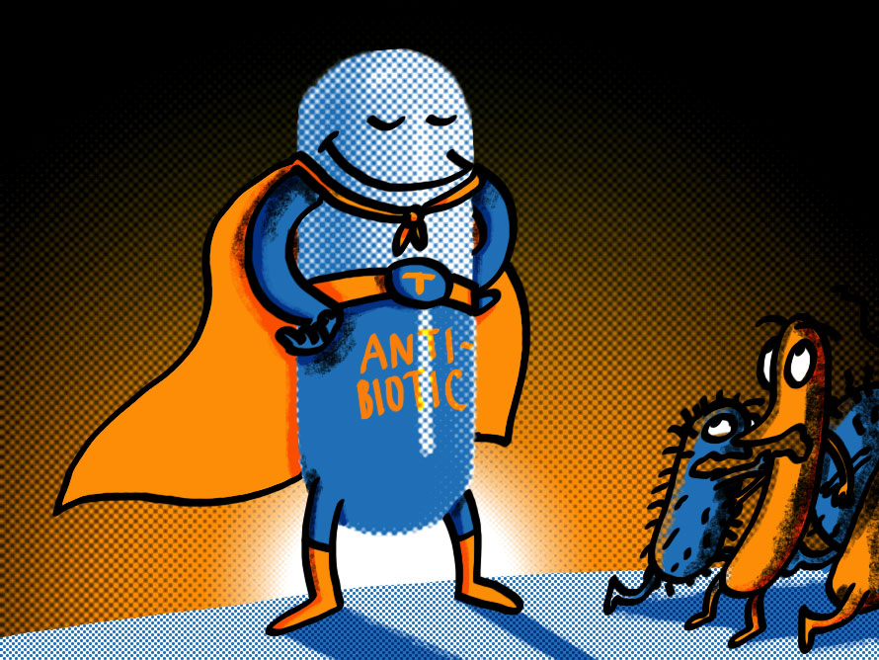
Thank You

