Slide 1
Bronchodilators case
By
Alaa salah
Assistant lecturer assuit university hospital

Slide 2
Case (1)

Slide 3
A 30 year old lady, works in biochemistry lab who presented with chronic cough, shortness of breath and wheezes which are encountered in the work place and sometimes at home. Her symptoms cause frequent arousal at night. She sought medical advice who referred her for spirometry and she was diagnosed with asthma.
Q1: Which medications should be prescribed for the patient? Mention the doses.
Q2: Mention three possible complications of the prescribed therapy.

Slide 4
A1:a) Controller medication including both:
ICS e.g. budesonide 200mcg twice, fluticasone 250mcg twice
LABA (inhaled) e.g. formoterol 12 mcg twice or salmeterol 25mcg twice.
LABA is never to be given as monotherapy (increase risk of exacerbation and asthma related death)
b) Reliever medication : SABA as per needed
A2: Tremors- Tachycardia- Hypokalaemia

Slide 5
Case (2)

Slide 6
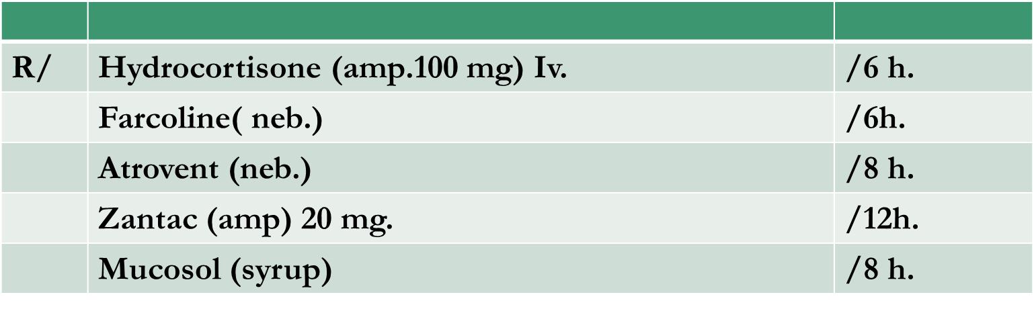
The following are the drugs prescribed for a 45 year old asthmatic patient who was admitted to the hospital for acute exacerbation 7 days ago and is not improving.

Slide 7
The followings are the BP, Blood sugar monitoring and serial investigations.
Date | BP (mmHg)
1 Feb | 110/70
2 Feb | 120/70
3 Feb | 130/80
4 Feb | 130/80
5 Feb | 140/90
6 Feb | 150/90
7 Feb | 140/80
Date | Blood sugar (mg/dl)
1 Feb | 170
2 Feb | 165
3 Feb | 190
4 Feb | 240
5 Feb | 205
6 Feb | 273
7 Feb | 300
Investigation | Value
WBCS | 15,000
Hb | 13
Hct | 38 %
Plt. | 264,000
Na | 132
K | 3

Slide 8
Q1: Report your opinion to the physician as regard the doses, possible interactions or complications you could detect.
Q2: Report any recommendations as regards re adjustment of treatment.

Slide 9
A1: a-High dose of steroid caused both BP and blood sugar to increase.
b-Combination of steroid and b-2 agonist caused Hypokalaemia.
A2: a- Decrease dose of steroid (recommended dose is equivalent to 40-50 mg prednisolone).
b- Add potassium Supplement.
c- consider antibiotics if infection is clinically evident (leukocytosis
).

Slide 10


