Slide 1
Aviation Safety Analysis Overview
Content:
This project analyzes aviation incident and accident data to identify patterns and key risk factors affecting flight safety.
The goal is to derive actionable insights that can support safer operational practices and informed decision-making.
Data source: FAA/NTSB aviation reports dataset.
Tools used: Python (Pandas, Matplotlib), Tableau, and Excel for data exploration and visualization.

Slide 2
Business Understanding
Content:
Objective: Reduce aviation incidents by identifying major contributing factors (human, mechanical, or environmental).
Stakeholders: Aviation authorities, airlines, and safety management teams.
Key Questions:
What are the most common causes of aviation incidents?
Which aircraft types and operators are most affected?
How can trends over time inform preventive measures?
Expected Outcome: Data-driven safety recommendations and resource allocation strategies.

Slide 3
Data Understanding
Content:
Contains key attributes such as:
Event Date, Location, Injury Severity, Aircraft Category, Make, Model, Purpose of Flight, and Cause Factors.
Time Frame: Covers incidents and accidents across multiple years.
Data Size: Over X records (to be confirmed after loading).
Challenges: Missing values, inconsistent categorization, and overlapping causes.
Preparation: Data cleaning, normalization, and extraction of meaningful patterns using Python.

Slide 4
Data Analysis
– Analysis: Accident Trends Over Time
Observed a decline/increase in accidents over time.
Possible Insight: Improvements in aviation safety regulations and technology.

Slide 5
Top Causes of Accidents
-Most frequent causes: Pilot error, Mechanical failure, Weather conditions.
-Insight: Human factors remain the leading cause of accidents.

Slide 6
Aircraft Type vs. Injury Severity
Compares Aircraft Category (e.g., Airplane, Helicopter, Balloon) with Severity (Fatal, Serious, Minor, None).
Insight: Smaller aircraft show a higher rate of serious injuries.

Slide 7
Recommendations
Content: Based on our aviation incident analysis, the following strategic recommendations are proposed:
Enhance Pilot Training Programs
Focus on emergency response and weather adaptation training.
Target reduction in pilot error-related incidents by 20%.
Strengthen Maintenance Protocols
Implement predictive maintenance using sensor data analytics.
Schedule more frequent checks for older aircraft models.
Improve Weather Monitoring Systems
Integrate real-time weather data into flight planning tools.
Reduce weather-related accidents through proactive decision-making.

Slide 8
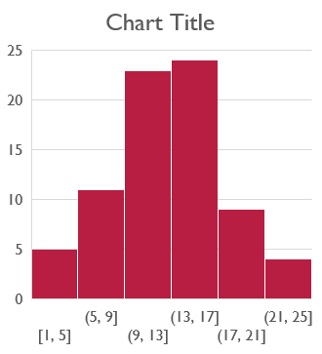
Next Steps
Content:
📊 Expand Data Sources: Include global datasets for cross-regional comparison.
🧹 Data Automation: Build ETL pipelines to clean and update aviation data in real time.
🤝 Collaboration: Work with aviation authorities and research partners to validate trends.
💡 Dashboard Deployment: Develop a Tableau dashboard for ongoing monitoring.

Slide 9

Thank You
Content: Thank you for your time and attention! We welcome your questions.
Presenter: SANDRA BOSIBORI LinkedIn: linkedin.com/in/sandra-bosibori-5a4153196 Contact: sandranyakundi@gmail.com

