Slide 1

G. H. Raisoni Institute of Engineering and Technology, Wagholi, Pune
Department of Computer
PROJECT NAME
Real-time Sign Language To English Language Conversion Using CNN For Disabled People
GROUP MEMBERS
Vaibhavi Padamwar
Sandeep Malviya
Harshada Patil
Sanghavi Appam
GUIDE NAME
Prof. Disha Deotale

Slide 2
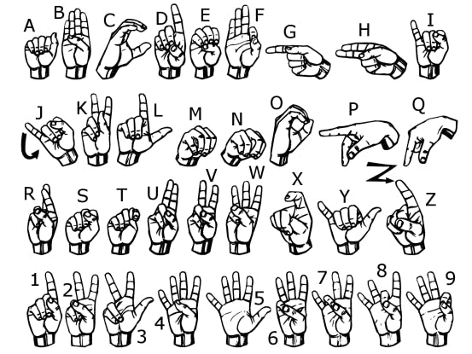
INTRODUCTION
There are people who are facing illnesses such as deafness or dumbness. They face difficulty interacting with others. Previously developed techniques are all sensors based and they didn’t give the general solution.
This presentation explains a new technique of virtual talking without sensors. Convolutional Neural Network has been used to train the System. Web Camera is used to take the image of different gestures and that will be used as input to the MATLAB.
The software will recognize the image and identify the cores sign language and convert them to English language and give voice output using a voice replay kit.
Such as two-way communications between the dumb and normal people would be capable by converting the sign language to text and voice for various uses such as on video conference.

Slide 3
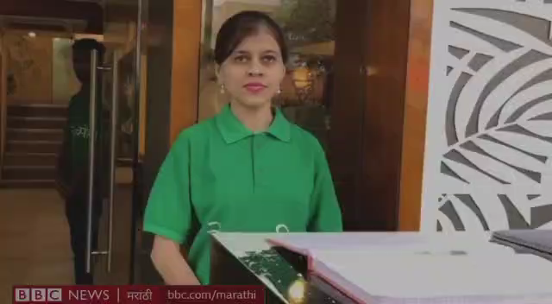
Video Demonstration

Slide 4
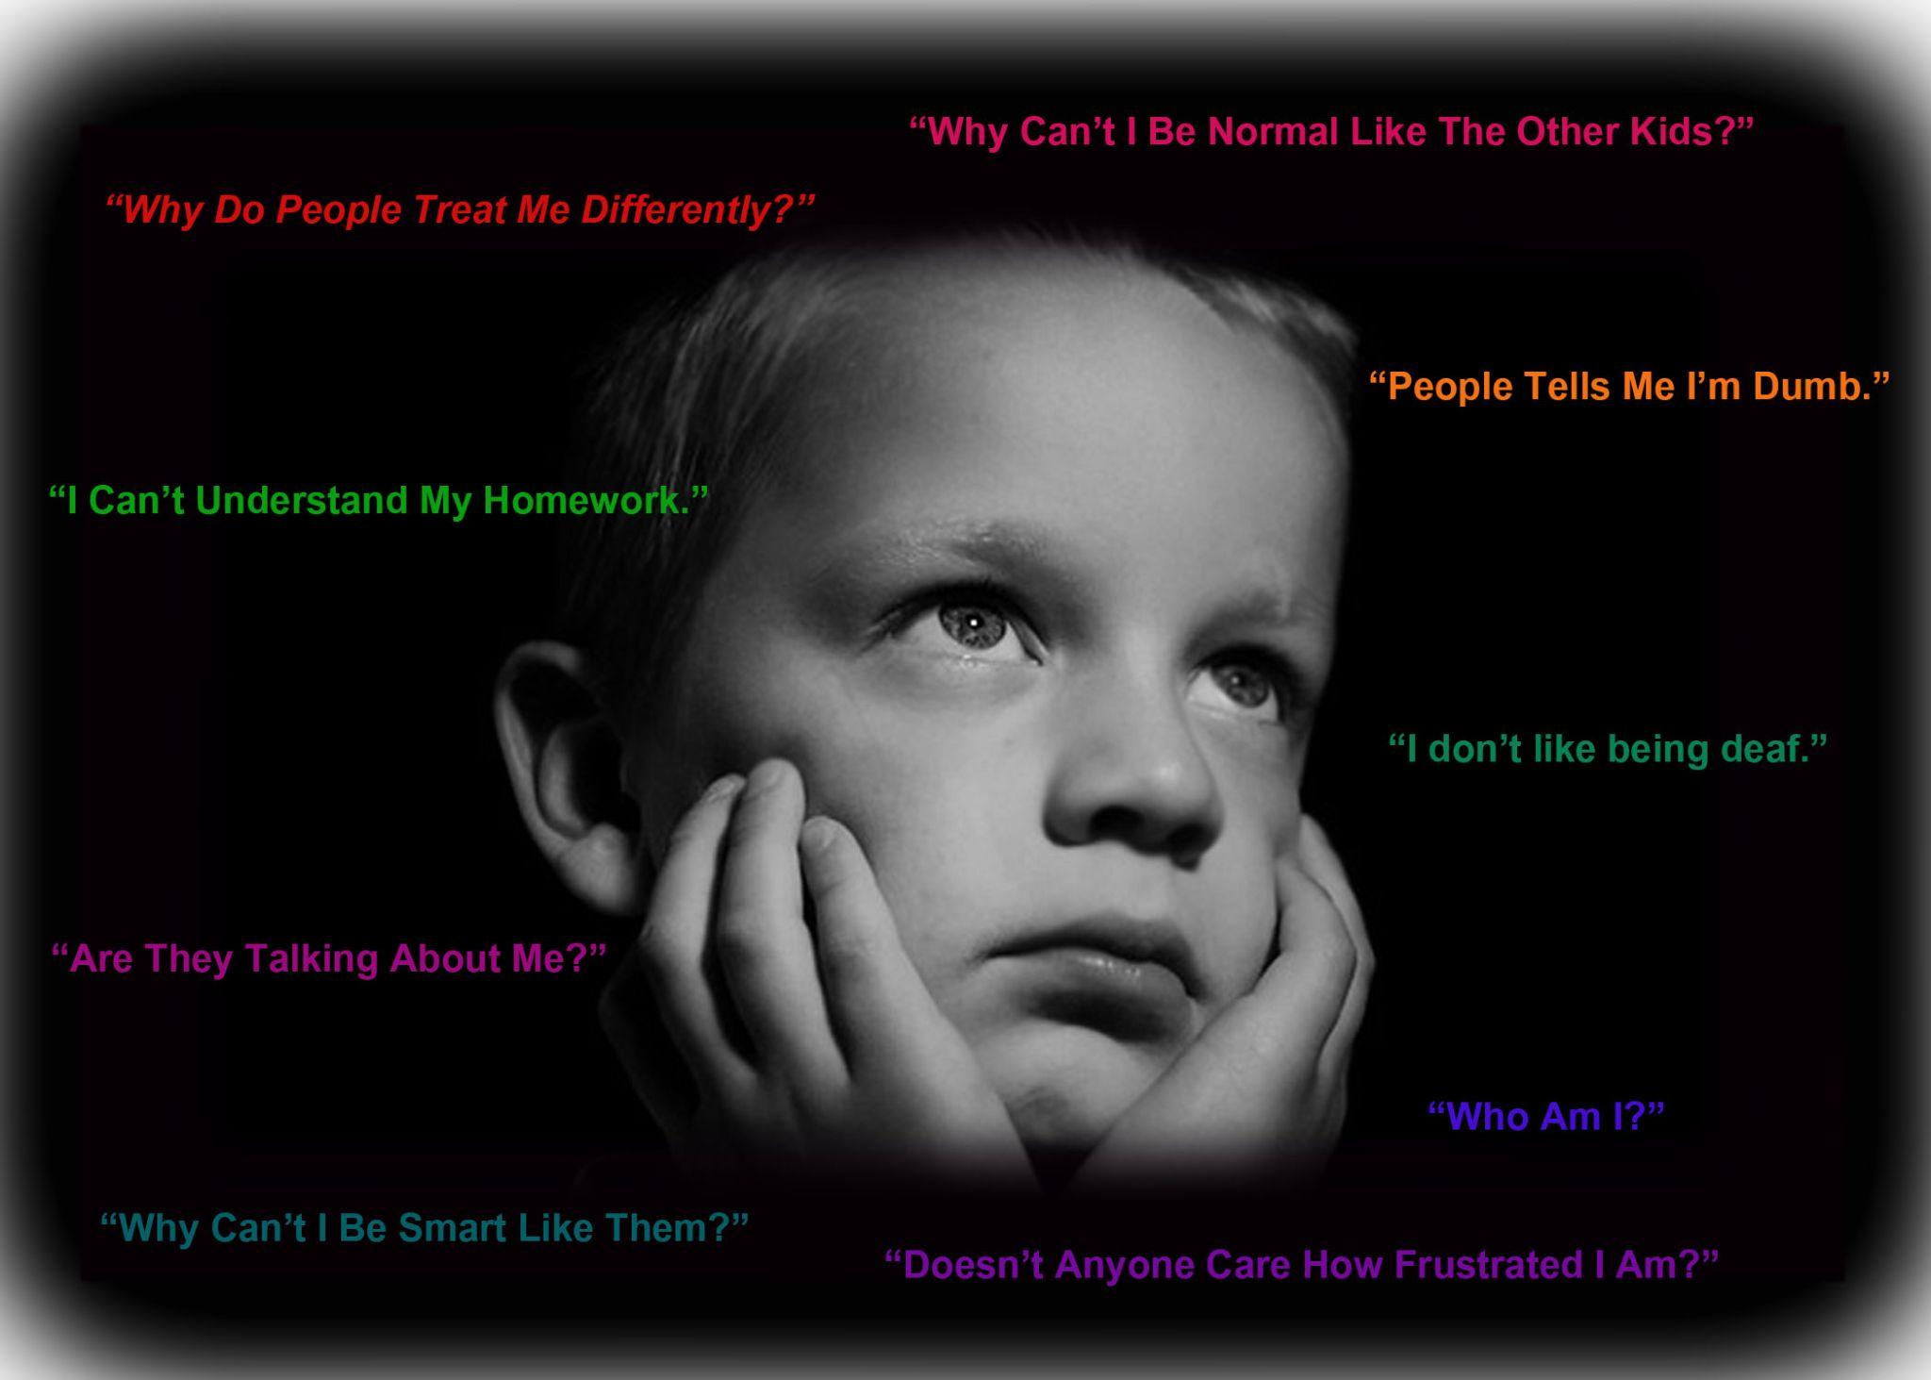

OBJECTIVE
To give dumb people ability to be express their ideas and thoughts.
Help them by increasing their motivation and confidence by making them think positively and to conquer that physical disability.
By using latest technologies and tools we are keeping objective to overcome this problem at the global level scale.

Slide 5
PROBLEM STATEMENT
Around 46 Million people in the world are handicap who can’t speak or listen properly.
Dumb people use hand signs to communicate, hence normal people face problem in recognizing their language by signs made.
The hearing impaired people always have problem in communicating with normal people.
They have problem in conveying their thoughts and ideas to normal people who have very limited or sometimes no knowledge in sign language.
This makes the hearing impaired community lose interest in common activities and they avoid communicating with normal people at times and live in isolation.

Slide 6
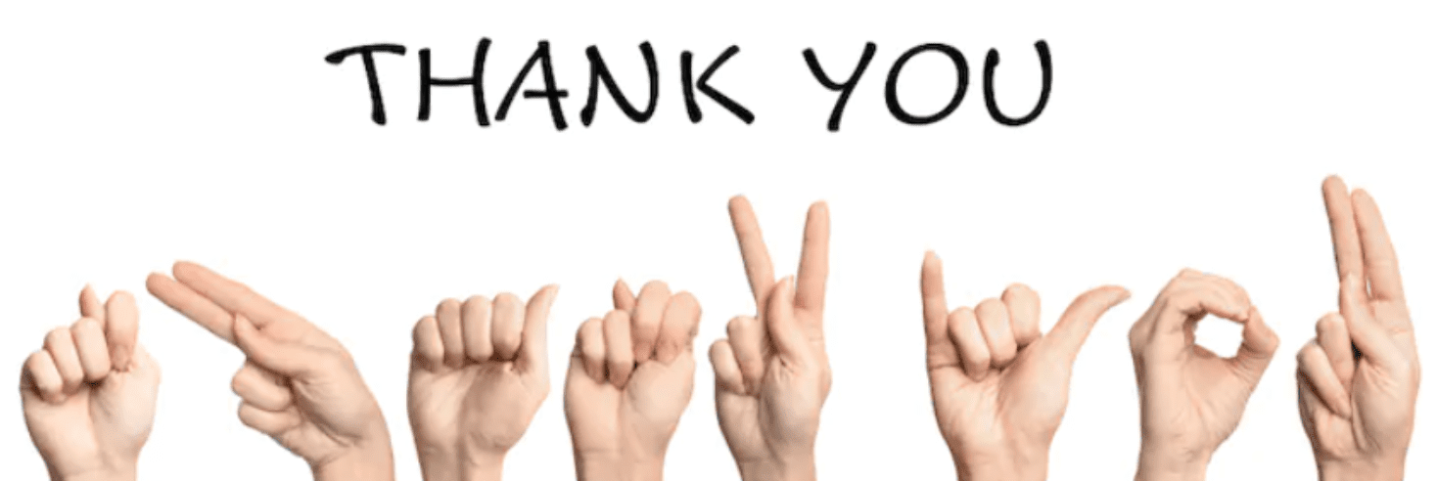

PURPOSE
We are keeping purpose of developing system that will make communication between Dumb and normal person easy and convenient.
To solve the miscommunication between such huge community and normal persons is our purpose with this proposed research.
Thank You

Slide 7
Literature Survey
Title | Year | Authors | Methodology | Disadvantages | Advantages | Future Scope
Glove Based American Sign Language Interpretation Using Convolutional Neural Network And Data Glass | 2020 | Galib Ibne Haidar Hasin Ishraq Reefat | Modeling Stage Image extraction, color filtering, cropping, scaling, greyscale conversion Predication Stage Convolutional neural network Visual Stage OLED Display, Data Glass | Just focused on identifying the features of sign language. No conversion of hand gest ures into text or voice | Meaning of different hand gestures is accurately interpreted Accuracy is 99.8% | we have used a raspberry-pi 3 to process the images and match it against the neural network model and predict the signs.But it is bulky and heavy.
Towards Multilingual Sign Language Recognition | 2020 | Sandrine Tornay Marzieh Razavi Mathew Magimai.-Doss | Kullback-Leibler Divergance HMM In this approach, the feature observations are probabilistic (posterior distributions). Each HMM state is parameterized by a category distribution of the same dimension as the feature observation and there parameters are estimated though embedded Viterbi expectation maximization algorithm with cost function based ok K-L Divergence. | The English language is converted into sign language. Only normal people can understand the language not the disabled ones | Using Mobile applications is easy and feasible to use. | Our future work will build upon these finding to address resource constraint issues in sign language processing such as, developing systems with reduced number of signers and examples. In addition, we will also investigate whether such a multilingual approach can be applied for sign language assessment.
Sign Language Recognition Using Template Matching Technique | 2020 | Soma Shrenika Myneni Madhu Bala | Novel Transformer This method jointly learn sign language recognition and translation in a end-to-end manner. They have utilized CTC loss to inject gloss level supervision into the transformer encoder. Training it to do sign language while learning meaningful representations for end goal of sign language translation. | Deals with sign language with limited vocabulary. Works with static images, does not capture real-time video. | Recognition of more than 2 human-understandable languages. Does not require any kind of database and special instruments | The process includes removal of noise and other less important data and applying smoothing algorithm to image, finding gradient magnitude followed by tracking the edges by hysteresis.

Slide 8
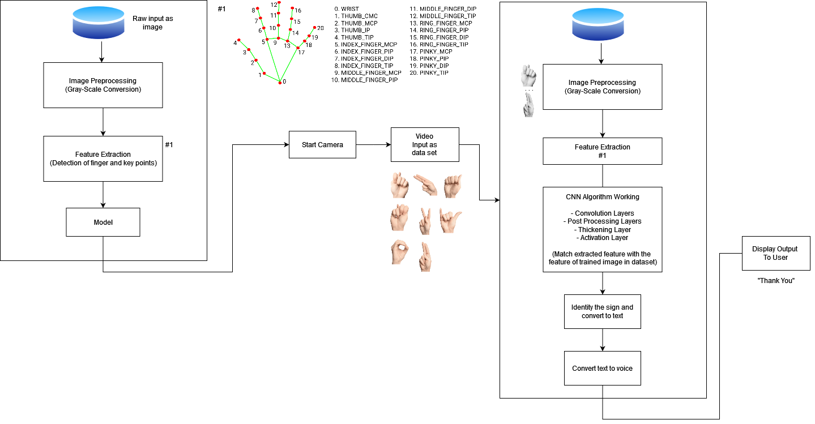
System Architecture

Slide 9
Methodology
Modeling Stage
System would take, video feed as input, from which Image would be extracted.
Image would be cropped and scaled to fixed ratio.
Colored image would be converted to greyscale image

Slide 10
… Methodology
Convolutional Layer
In a typical neural network each input neuron is connected to the next hidden layer.
In CNN, only a small region of the input layer neurons connect to the neuron hidden layer.
CNN Algorithm
Connect with frontend
Collection Of Data
Training Model
(CNN Algorithm)
Real Time Application

Slide 11
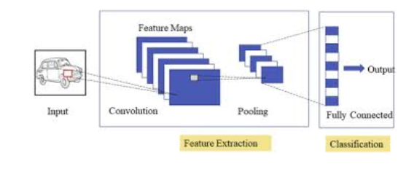
… Methodology
Pooling Layer
The pooling layer is used to reduce the dimensionality of the feature map.
There will be multiple activation & pooling layers inside the hidden layer of the CNN.

Slide 12
… Methodology
Fully-Connected layer
Fully Connected Layers form the last few layers in the network.
The input to the fully connected layer is the output from the final Pooling or Convolutional Layer, which is flattened and then fed into the fully connected layer.

Slide 13
… Methodology
Visual Stage
After previous steps, a predicted text would be given as output
We would convert the text-to-voice using the reliable python voice kit
Audio would be played after conversion

Slide 14

Data Flow Diagram
DFD0

Slide 15
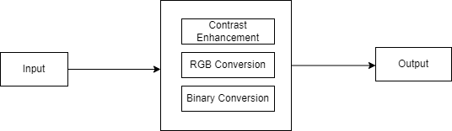
… Data Flow Diagram
DFD1

Slide 16
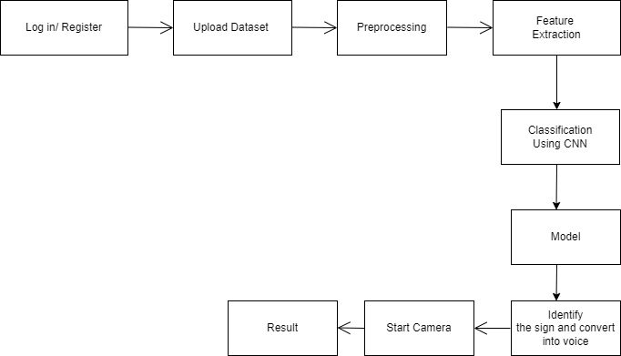
… Data Flow Diagram
DFD2

Slide 17
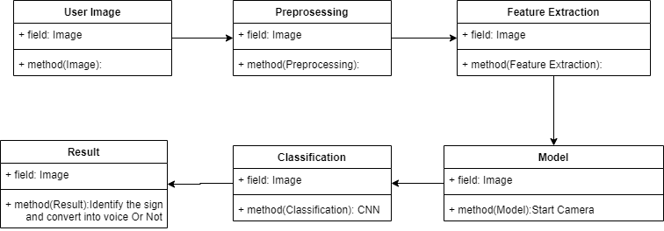
UML Diagram
CLASS

Slide 18
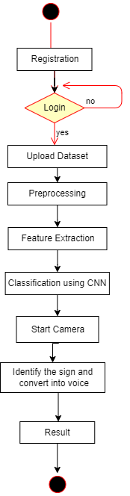
… UML Diagram
ACTIVITY

Slide 19
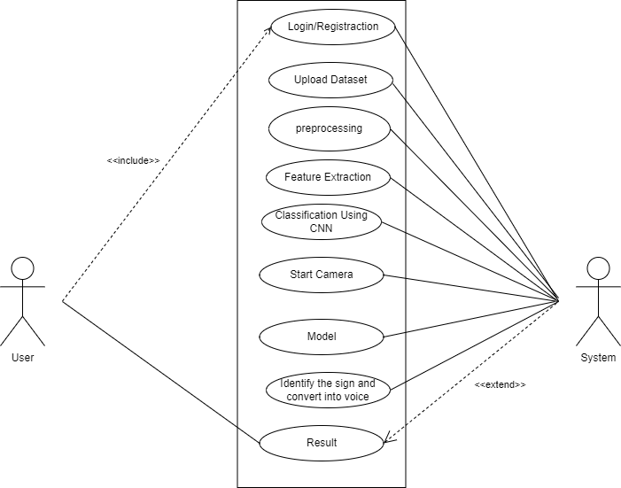
… UML Diagram
USE CASE

Slide 20
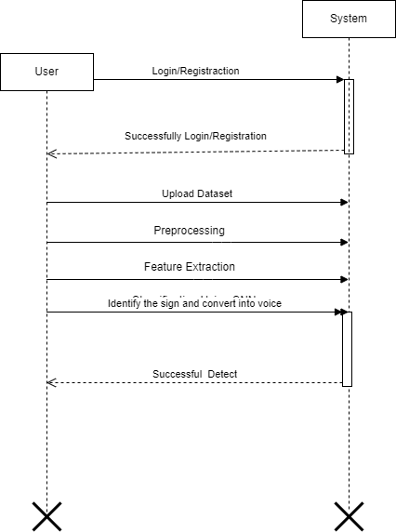
… UML Diagram
SEQUENCE

Slide 21
Minimum Hardware & Software Requirement
Software Requirements:
Operating system : 64 bit Windows 10
Coding Language : Python
Design constraints : Spyder
Hardware Requirements:
System Processors : Intel i5
Speed : 2.4 GHz
Hard Disk : 150 GB
RAM : 8 GB
Graphic Card : 2 GB

Slide 22
Conclusion
A neural network based method for automatically recognizing the finger spelling in Indian sign language is developed in this project.
The signs are identified by the features extracted from the hand shapes.
The method is implemented completely by utilizing digital image processing techniques so the user does not have to wear any special hardware device or gloves to get the features of the hand shape.
Our proposed method has low computational complexity and very high accuracy when compared to the existing methods.

Slide 23
References
Yufei Yan,Qunzhu Tao,Chenyu Liu Research on Dynamic Sign Language Algorithm Based on Sign Language Trajectory and Key Frame Extraction.gupta, Journal of Communications Technology, Electronics and Computer Science,2019
Akash. Asl alphabet. [Online]. Available: https://www.kaggle.com/grassknoted/asl-alphabet, 2018.
Galib Ibne Haidar,Hasin Ishraq Reefat, Glove Based American Sign Language Interpretation Using Convolutional Neural Network and Data Glass.2020 IEEE Region 10 Symposium (TENSYMP), 5-7 June 2020, Dhaka, Bangladesh
Myasoedova M.A.,Myasoedova Z., Multimedia technologies to teach Sign Language in a written form,Journal of Communications Technology, Electronics and Computer Science,2020
Aditya Das, Shantanu Gawde, Khyati Suratwala, and Dhananjay Kalbande. Sign language recognition using deep learning on custom processed static gesture images. In 2019 International Conference on Smart City and Emerging Technology (ICSCET), pages 1–6. IEEE, 2019.
S. Albawi, T. A. Mohammed and S. Al-Zawi, “Understanding of a Convolutional neural network,” 2017 International Conference on Engineering and Technology (ICET), Antalya, 2019, pp. 1-6, doi:10.1109/ICEngTechnol.2017.8308186.

Slide 24
Thank You

