Slide 1
Hexabin-Chart
File created on: 12/13/19 11:33:36 PM CST

Slide 2
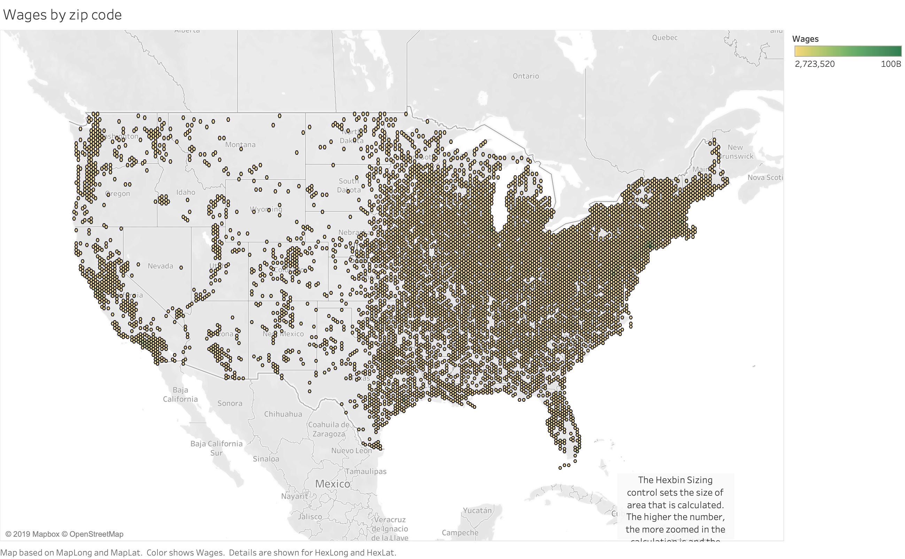

Slide 3
