Slide 1
DestinationMap
File created on: 12/13/19 11:30:15 PM CST

Slide 2
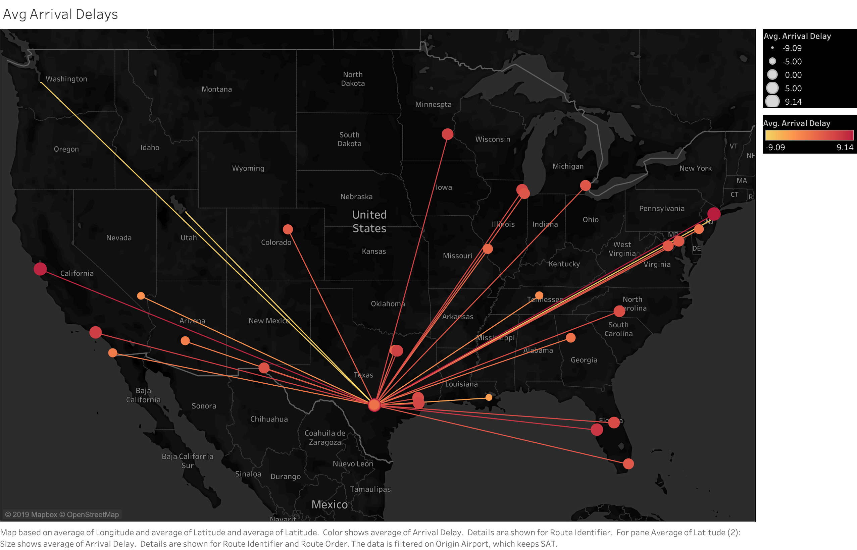

Slide 3
