Slide 1
LikertDivergentBarChart
File created on: 12/13/19 11:35:15 PM CST

Slide 2
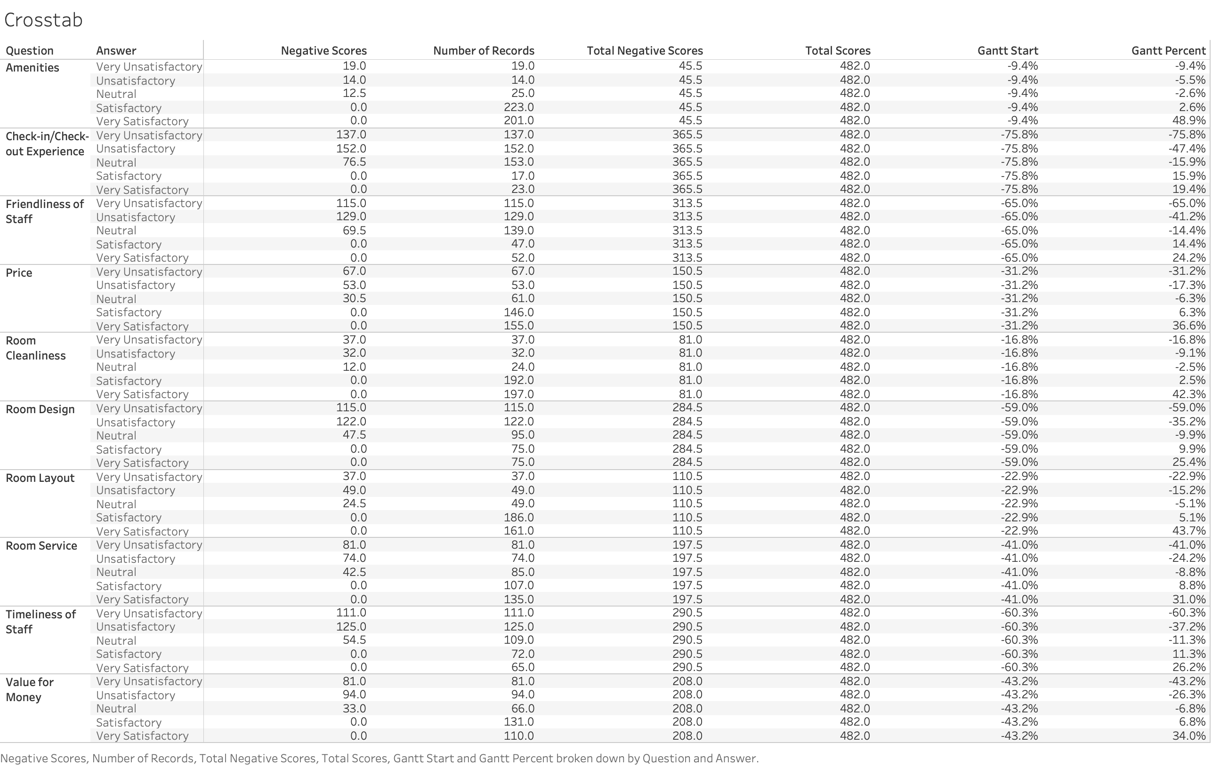

Slide 3
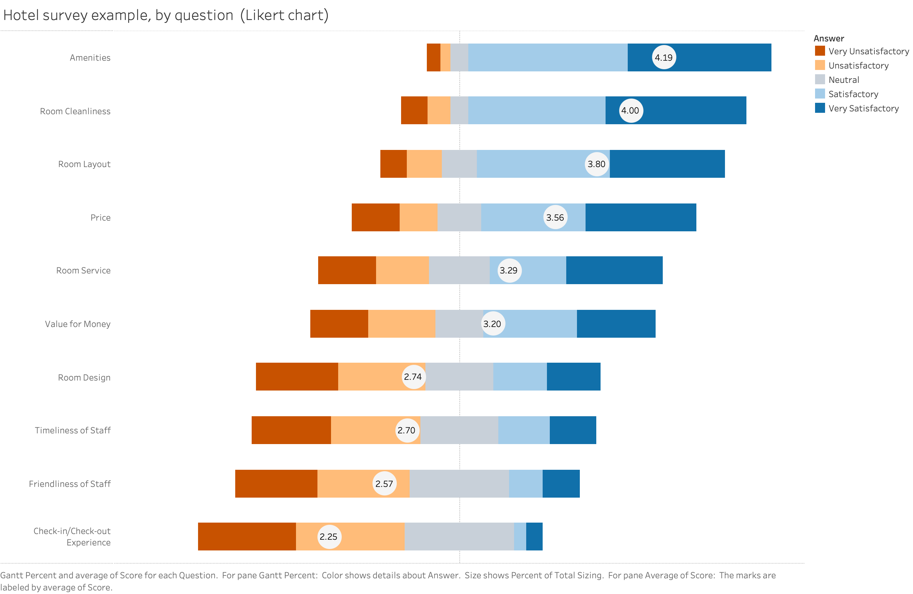

Slide 4
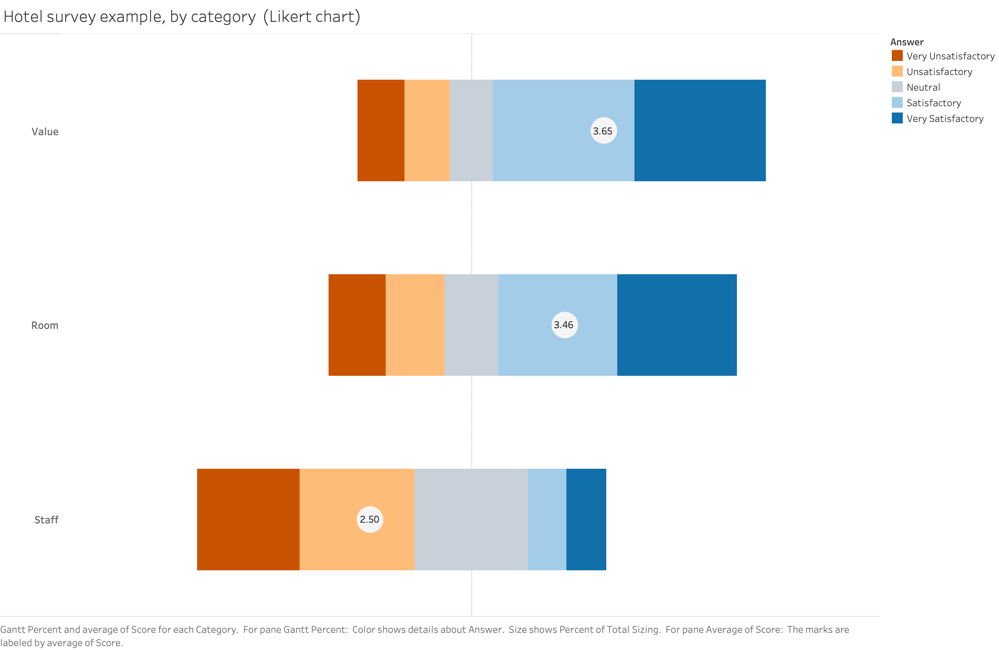

Slide 5
