Slide 1
SankeyOnSuperstoreData
File created on: 12/13/19 11:37:52 PM CST

Slide 2
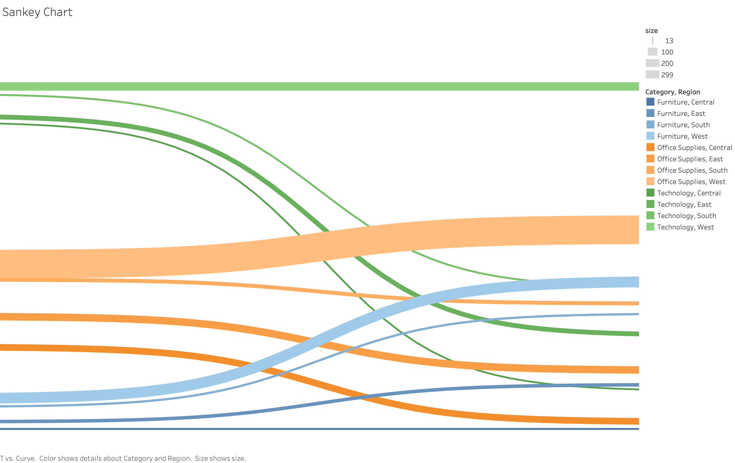

Slide 3
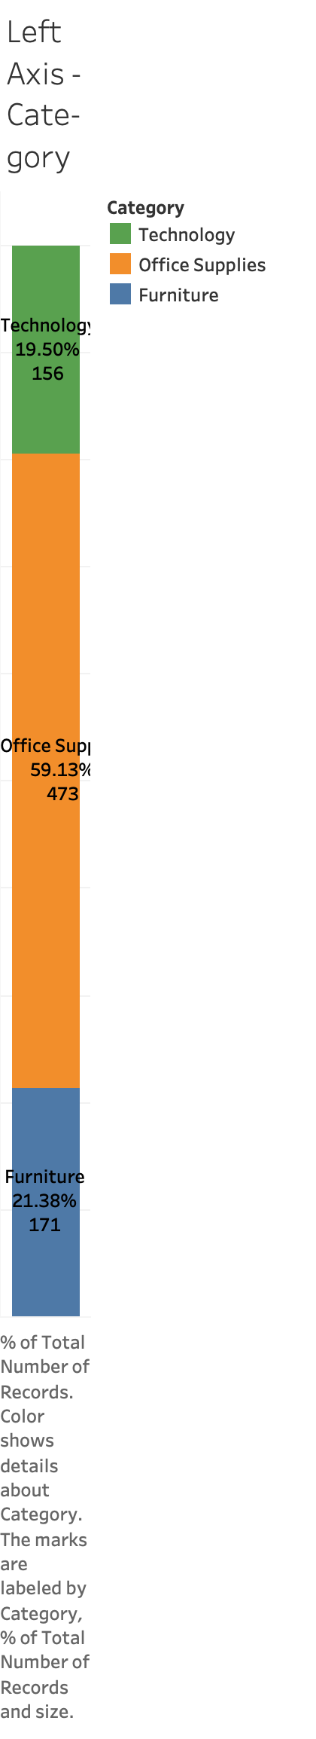

Slide 4
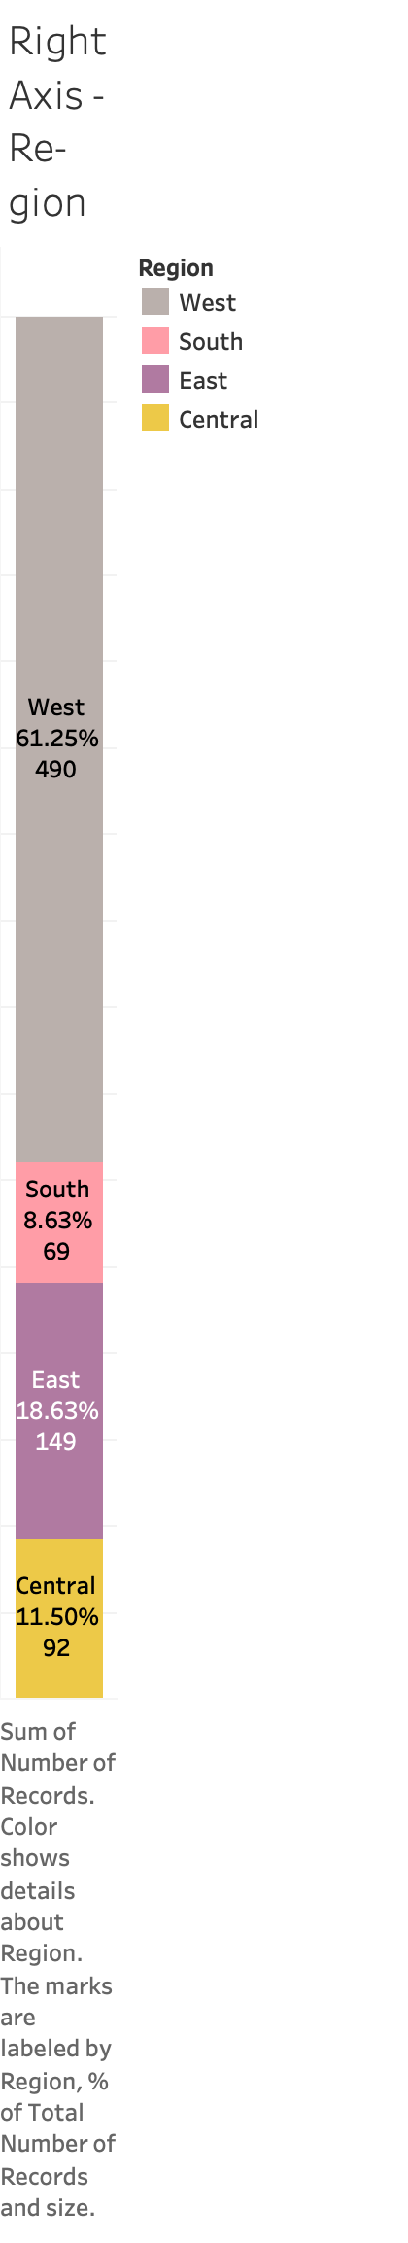

Slide 5
