Slide 1
Sunburst
File created on: 12/13/19 11:39:25 PM CST

Slide 2
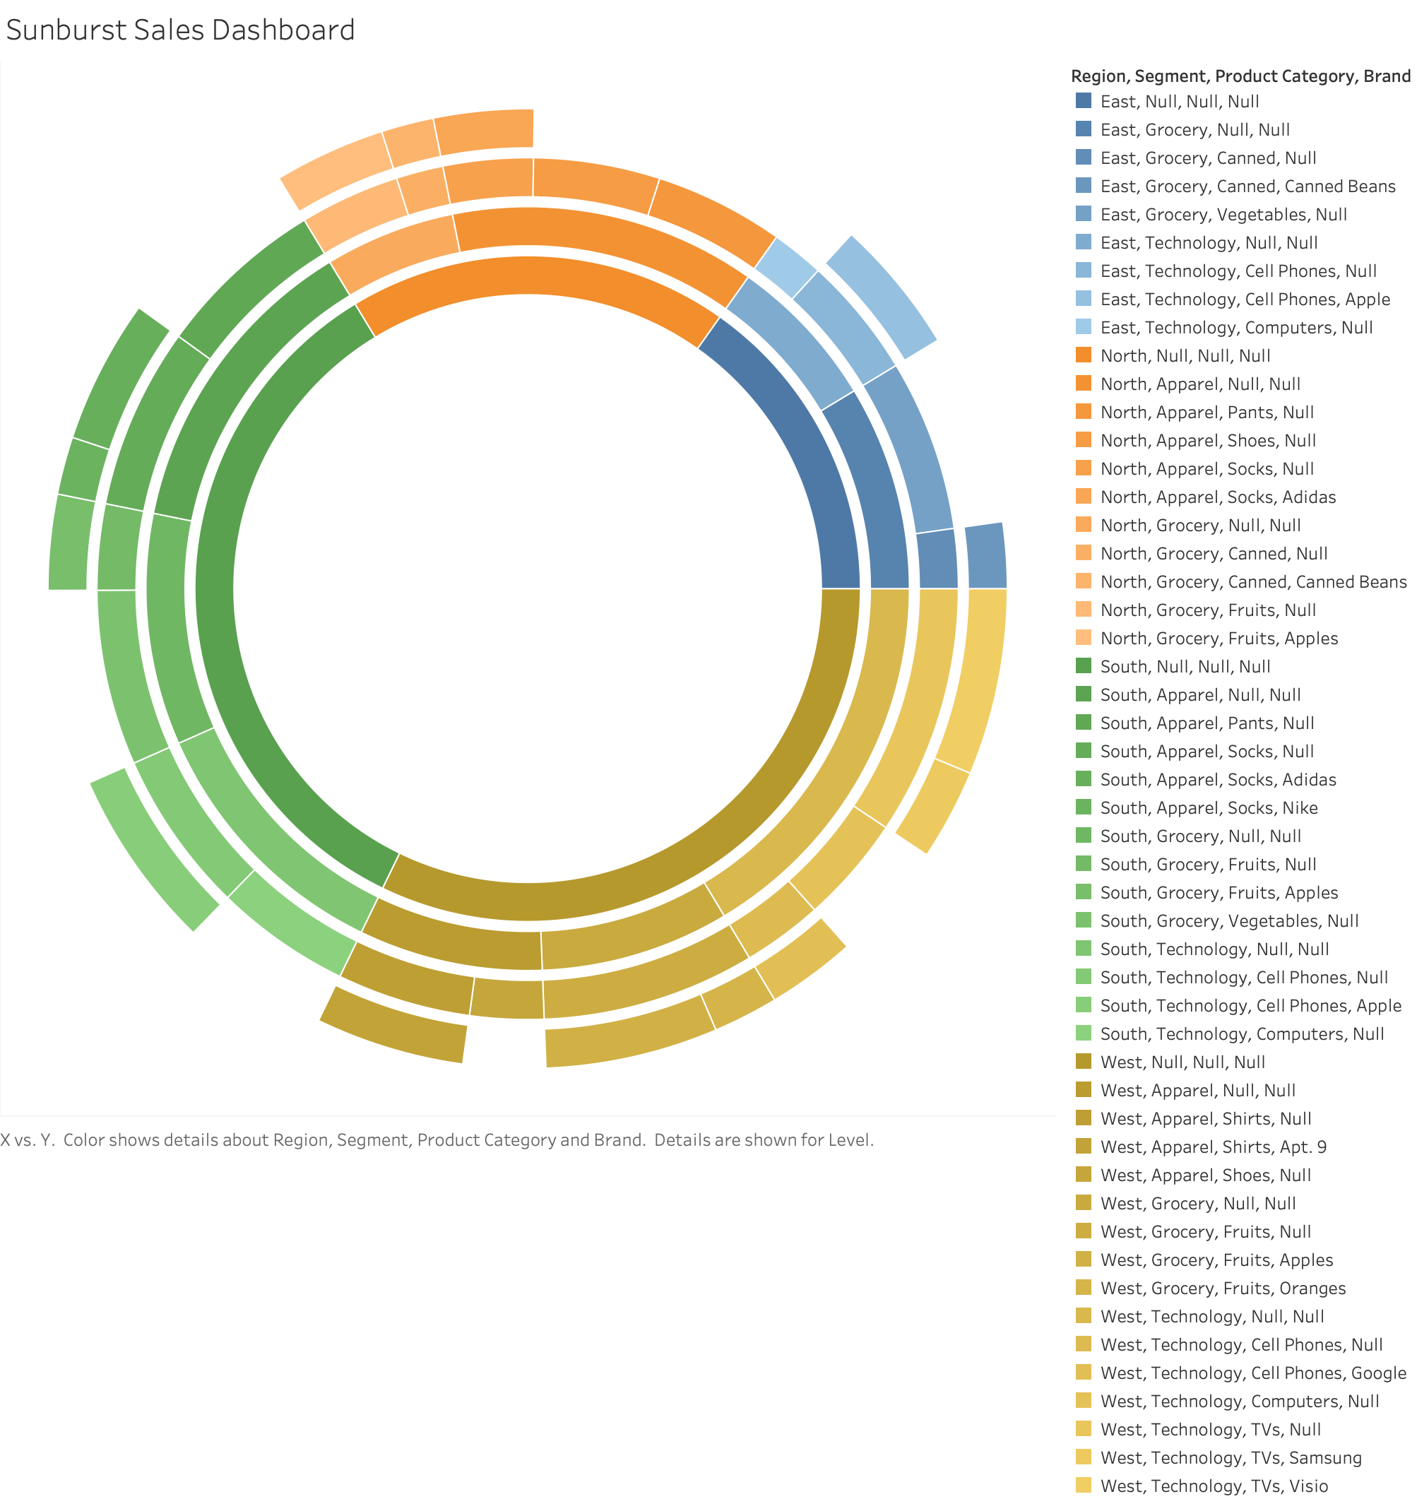

Slide 4
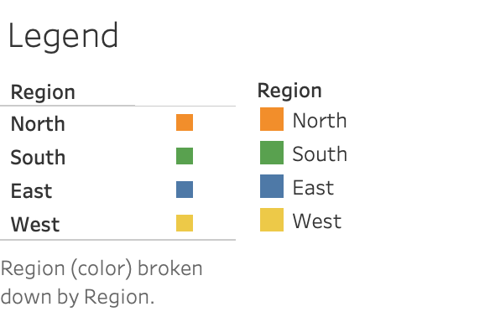

Slide 5
