Slide 1
WaffleChart
File created on: 12/13/19 11:44:03 PM CST

Slide 2
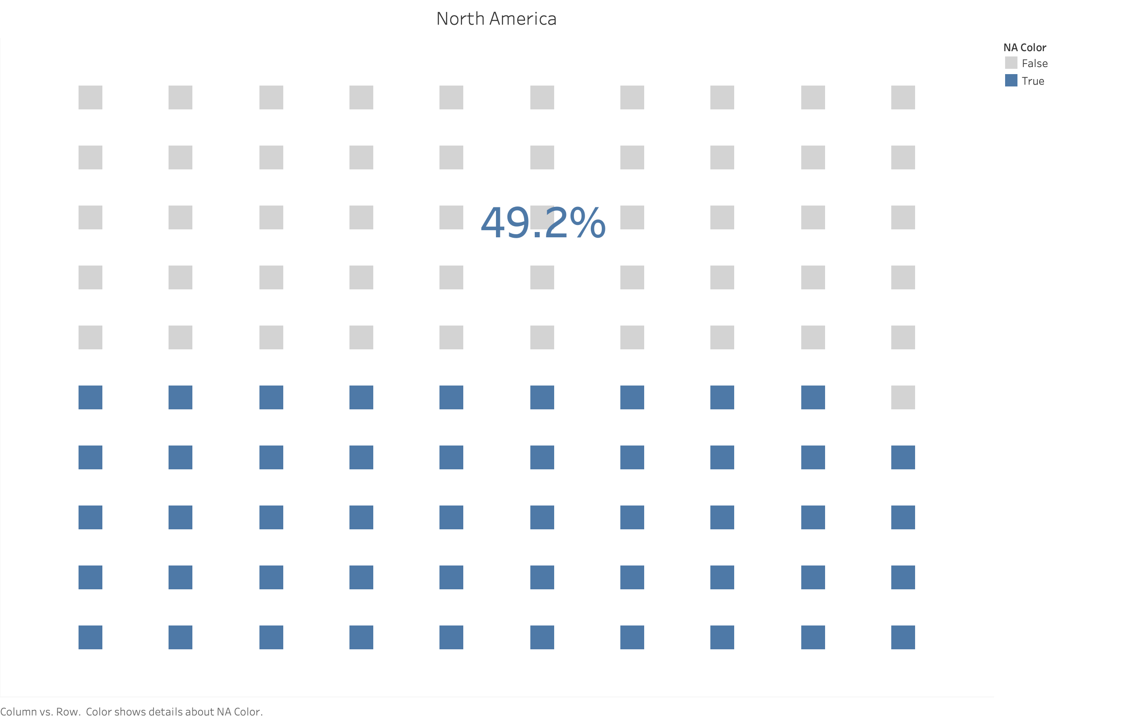

Slide 3
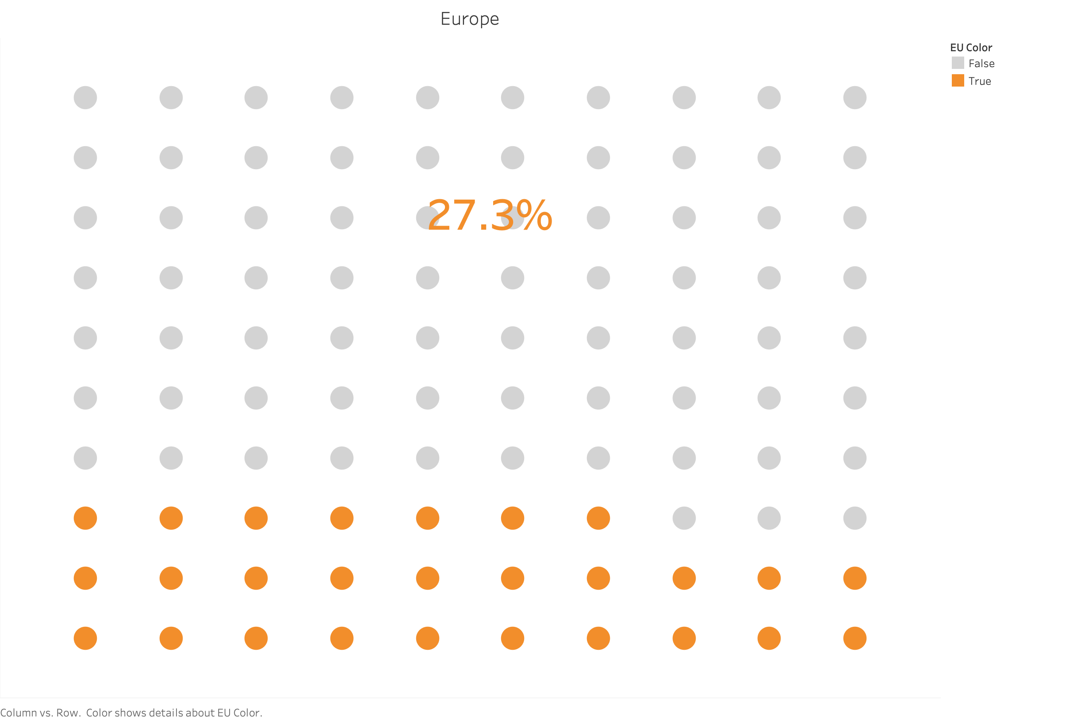

Slide 4
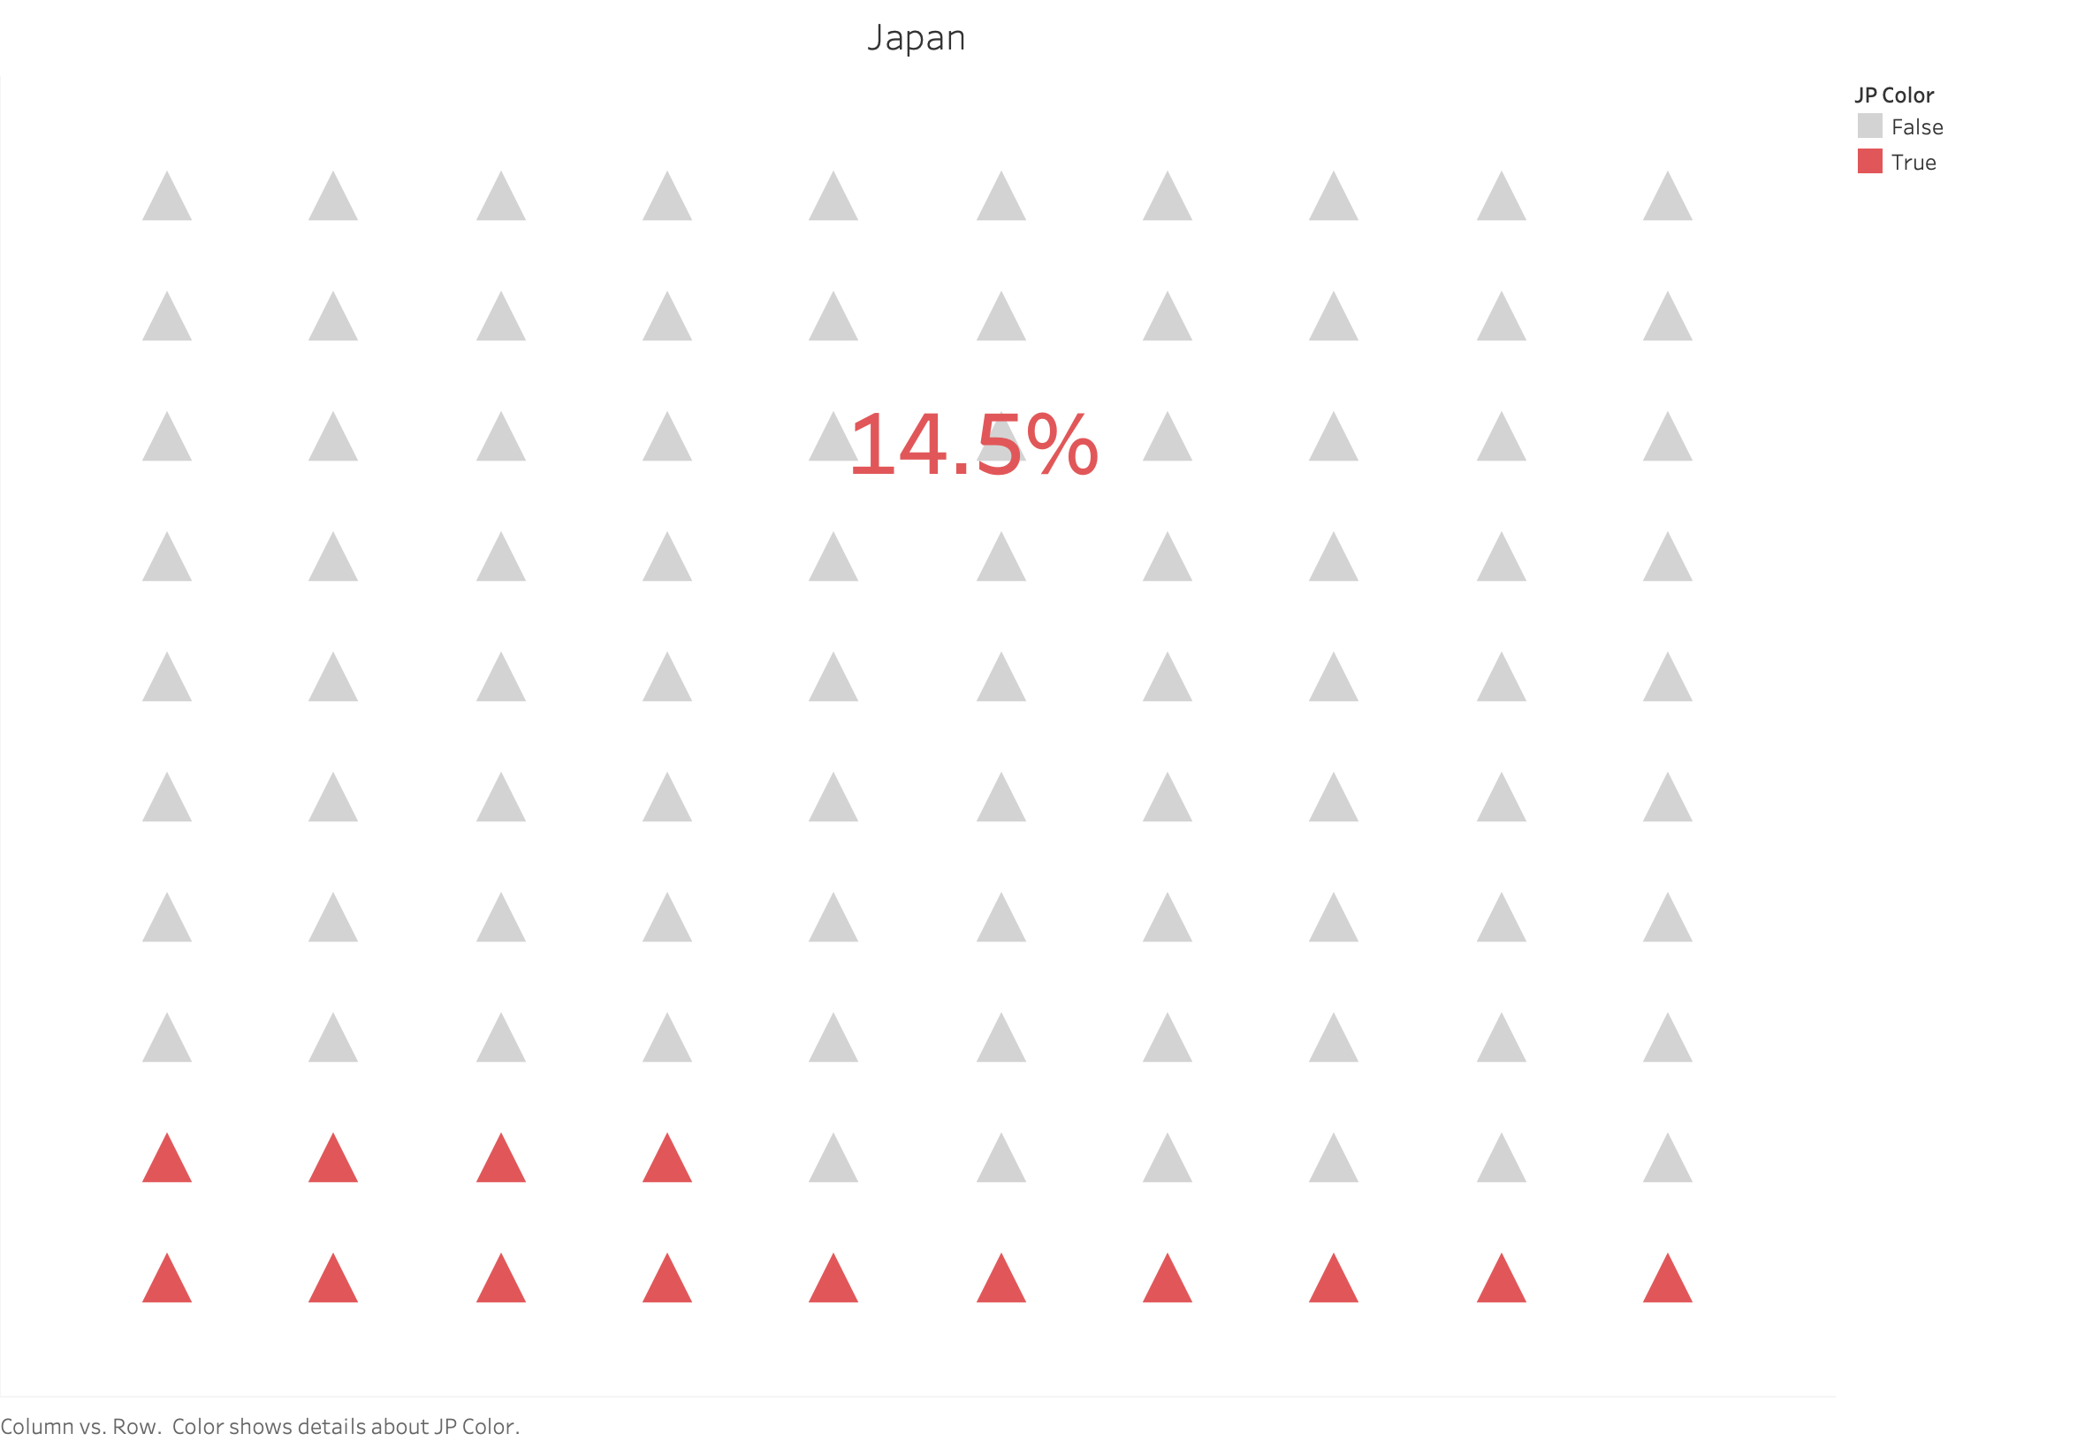

Slide 5
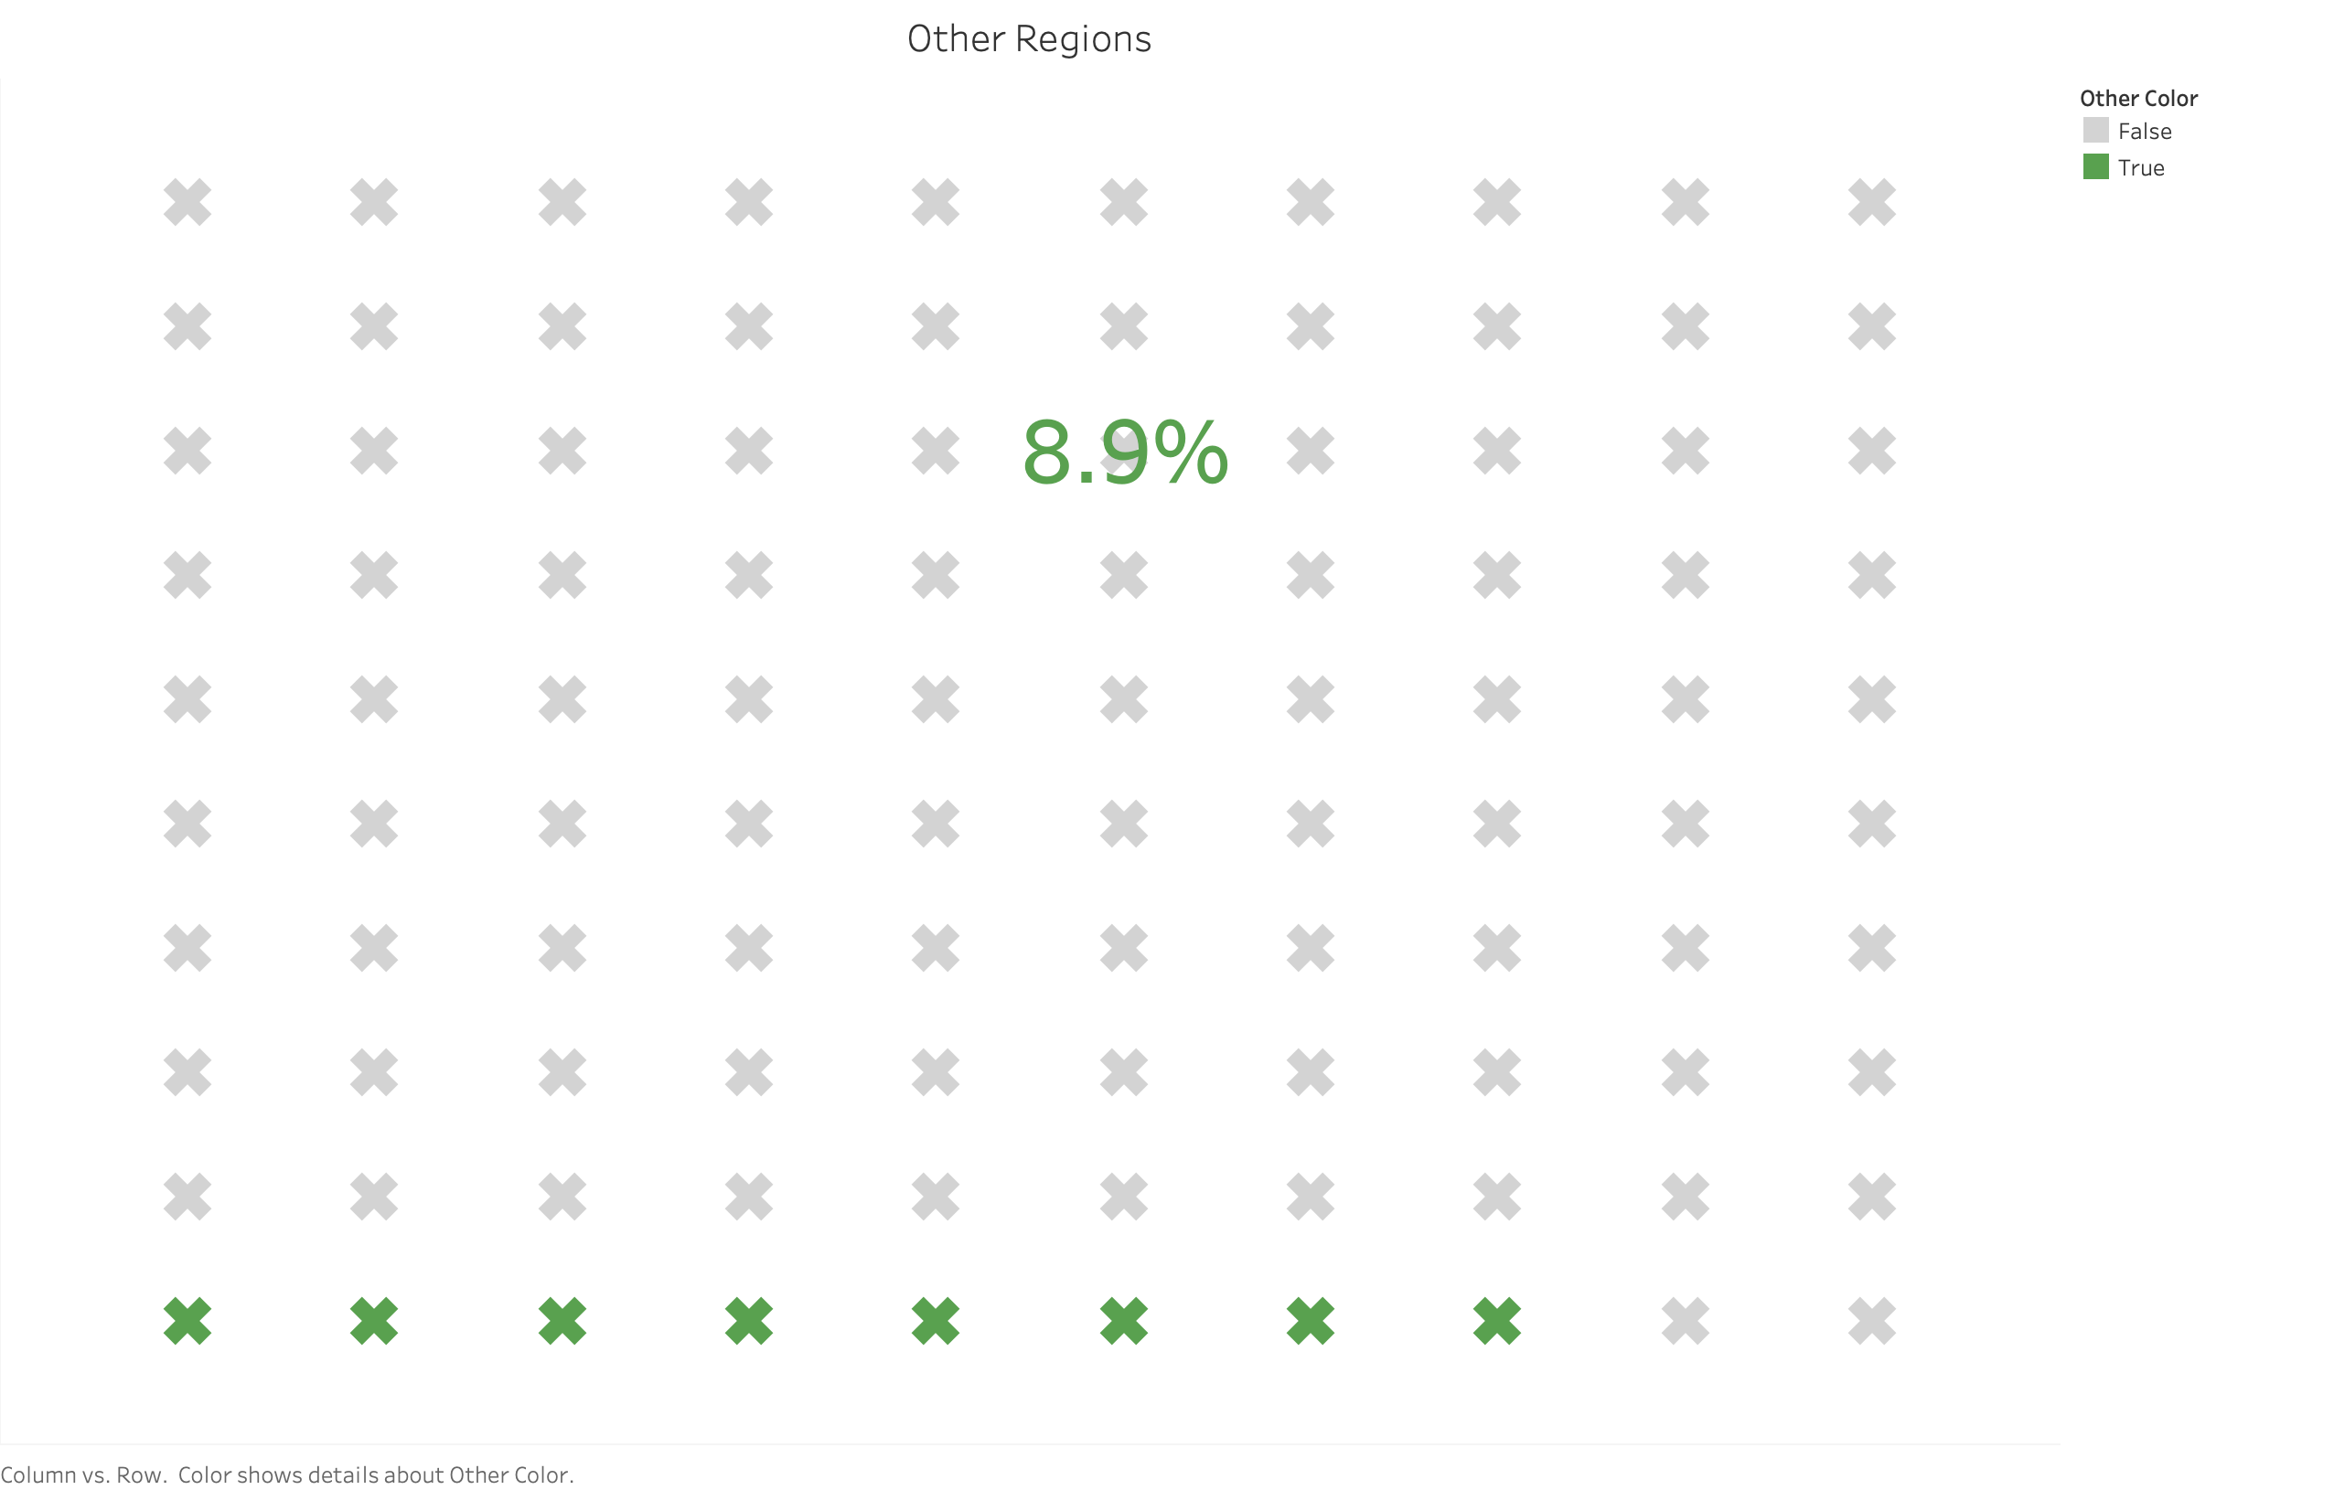

Slide 6
