Slide 1
Waterfall-Chart
File created on: 12/13/19 11:45:12 PM CST

Slide 2
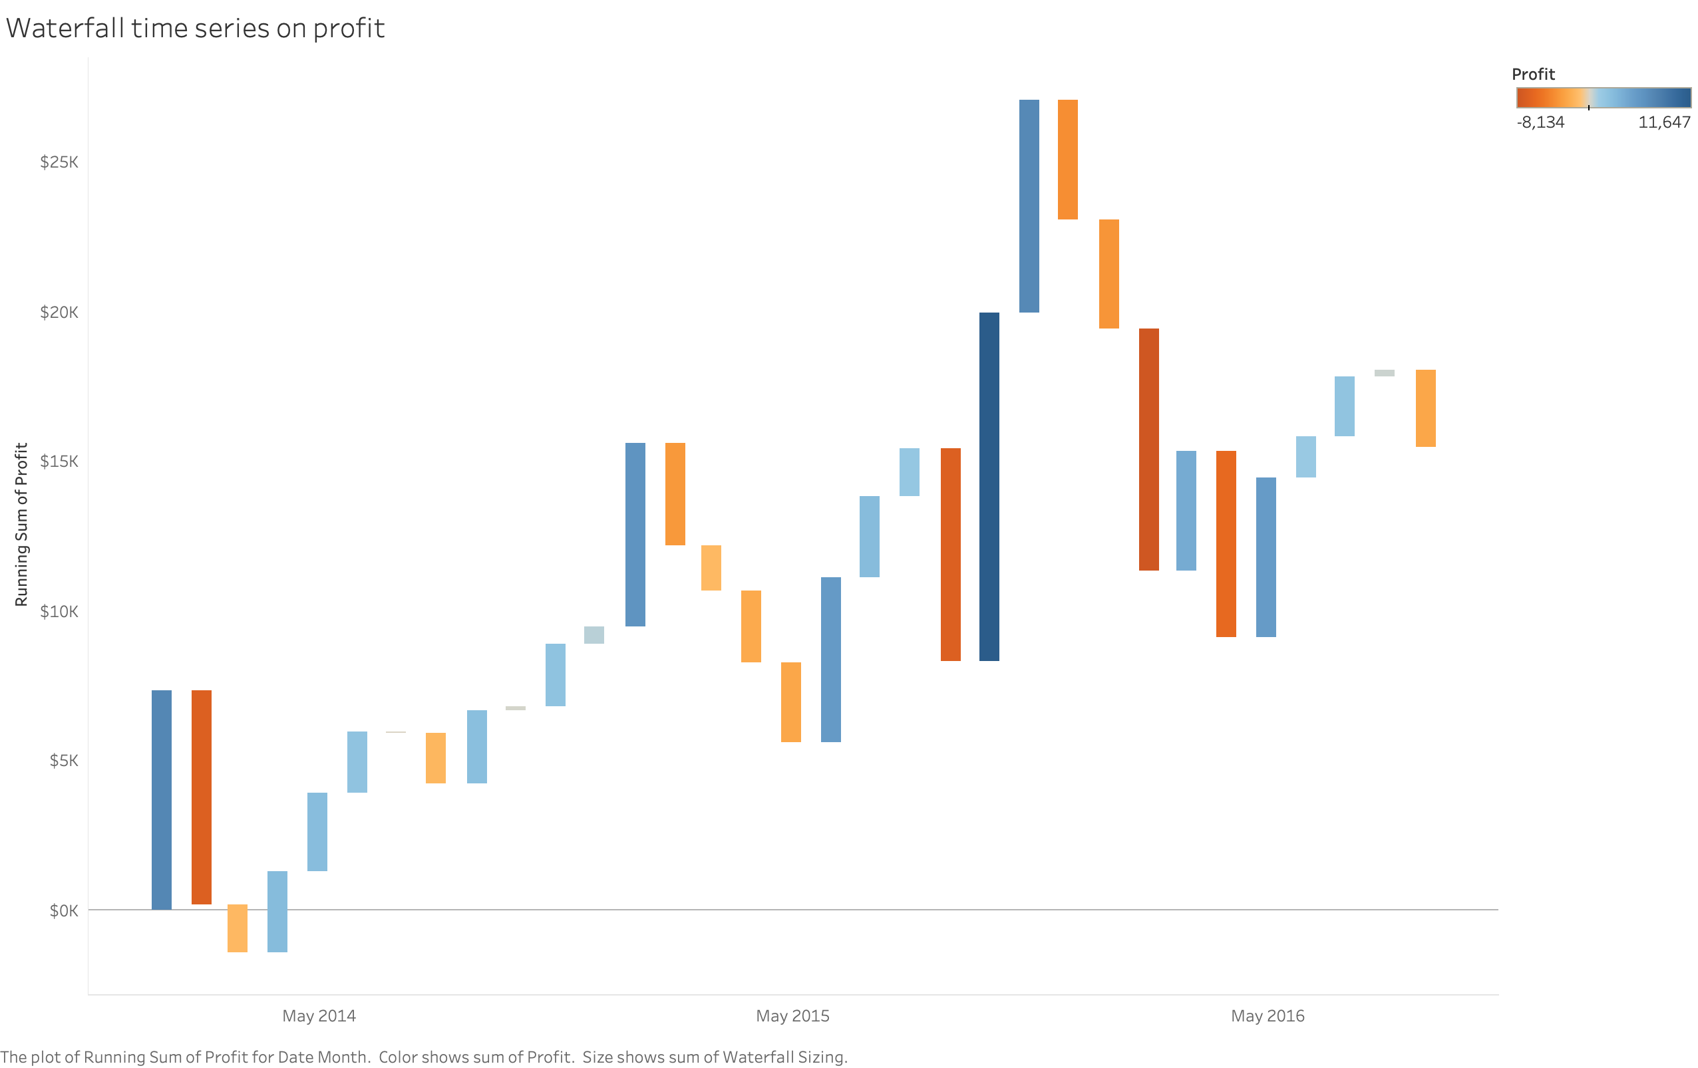

Slide 3
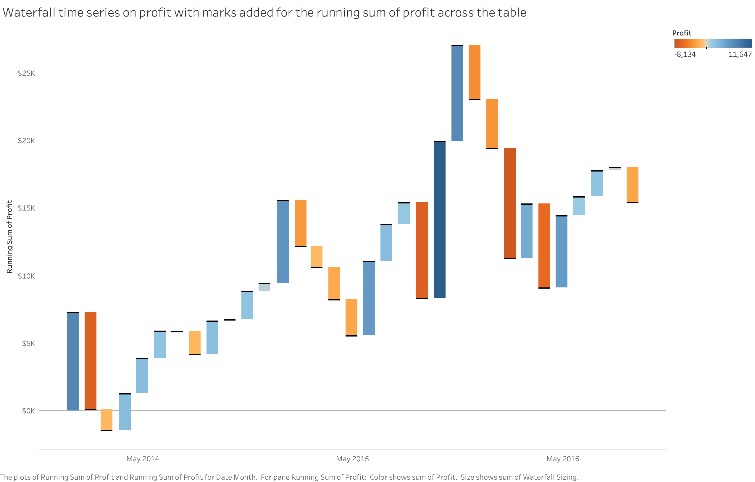

Slide 4
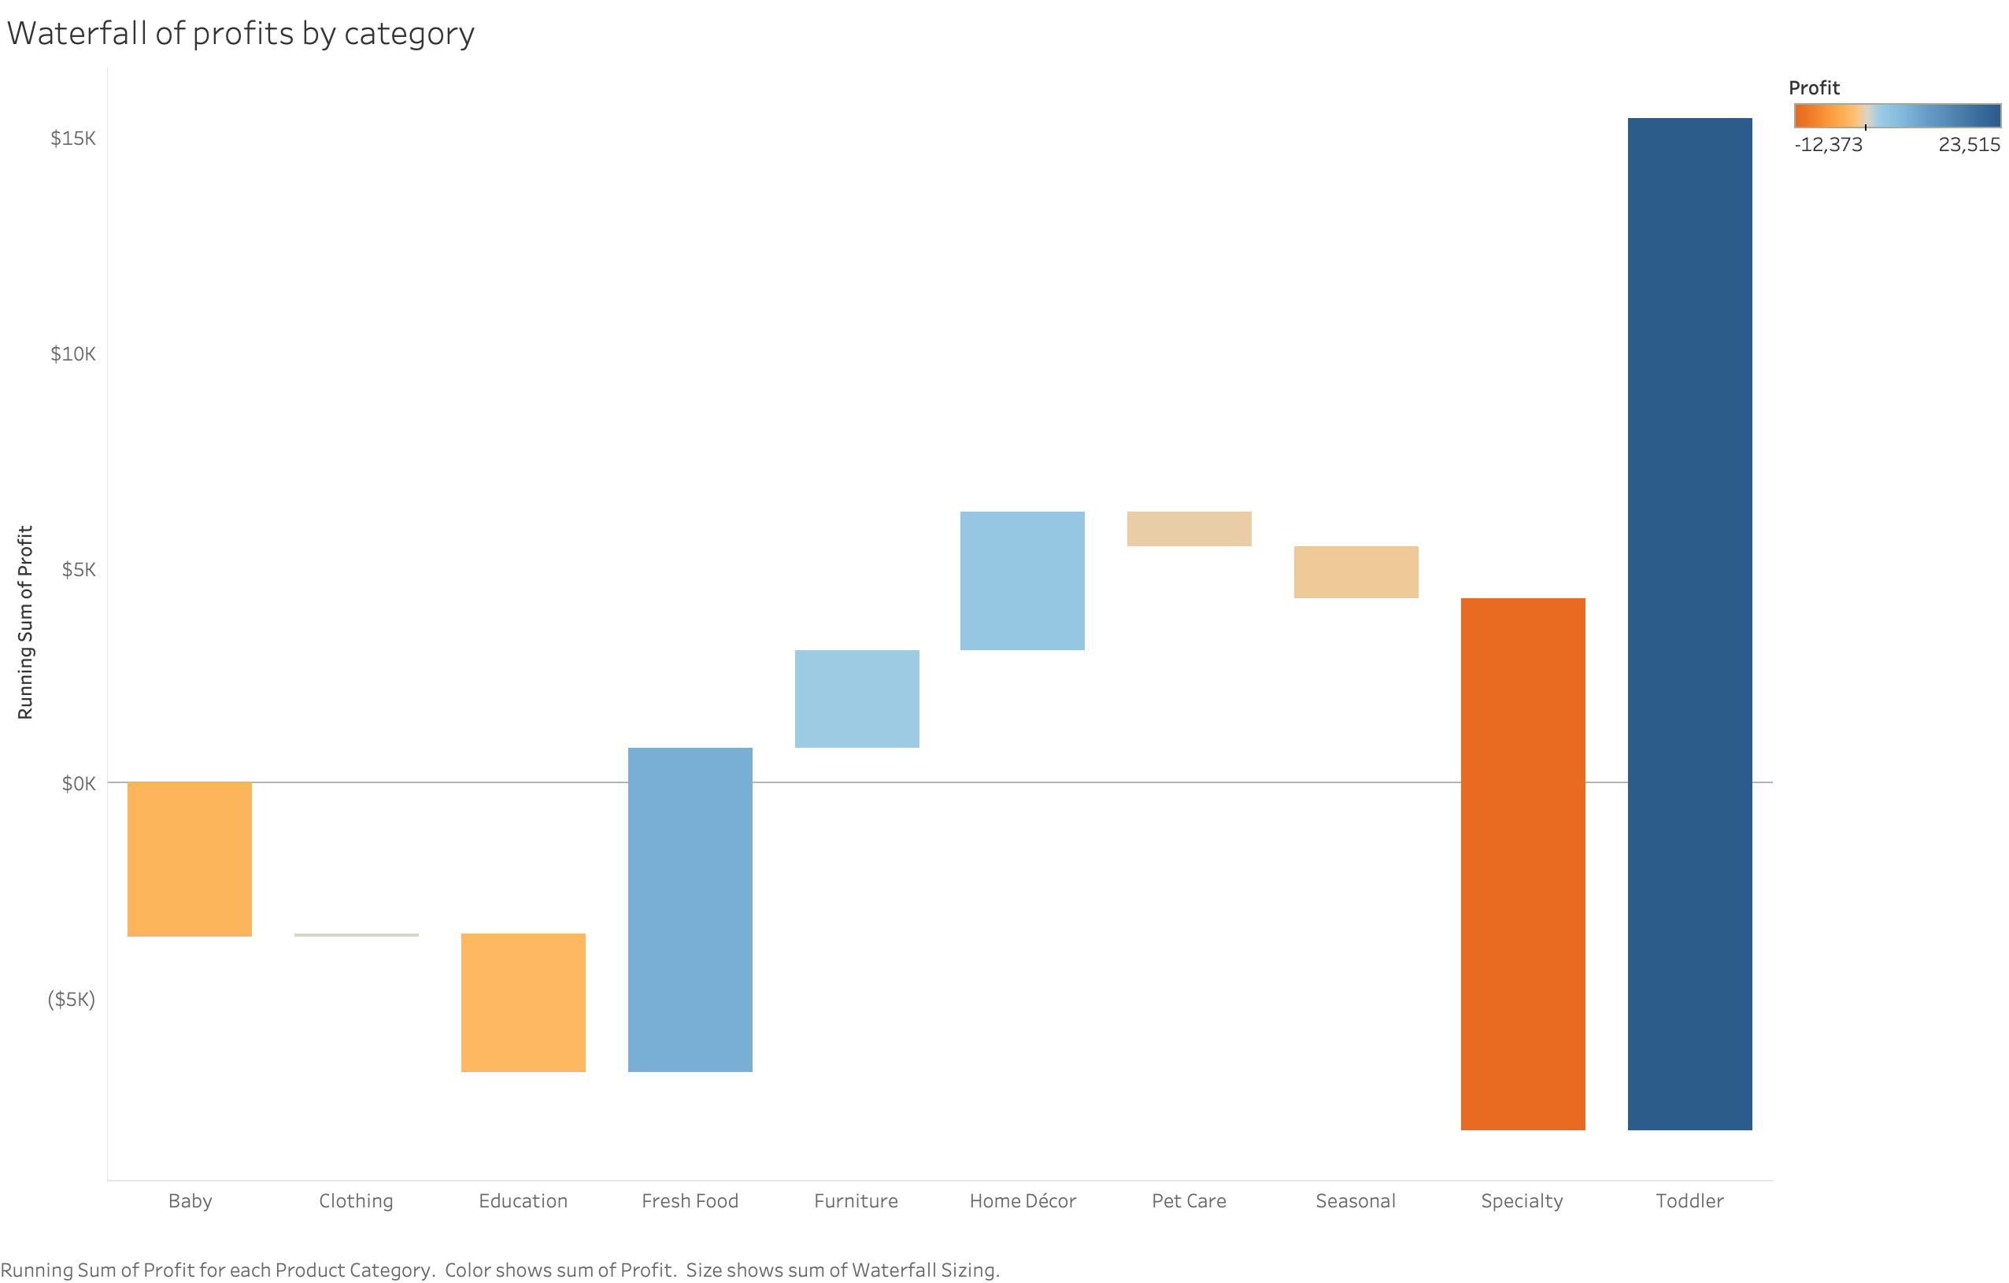

Slide 5
