Slide 1

Credit Card Approval Prediction
Presented By
Sandesh Pednekar
Date: 8/4/2024

Slide 2
Introduction
In today's digital age, credit card approval processes play a pivotal role in financial institutions' operations and consumers' financial well-being.
The Credit Card Approval Prediction project leverages machine learning techniques to enhance the credit decision-making process, aiming to optimize approval rates while minimizing risks.
Objectives:
Develop predictive models to accurately forecast whether a credit card application will be approved or rejected.
Utilize advanced data analysis and machine learning algorithms to identify key factors influencing credit card approval decisions.

Slide 3
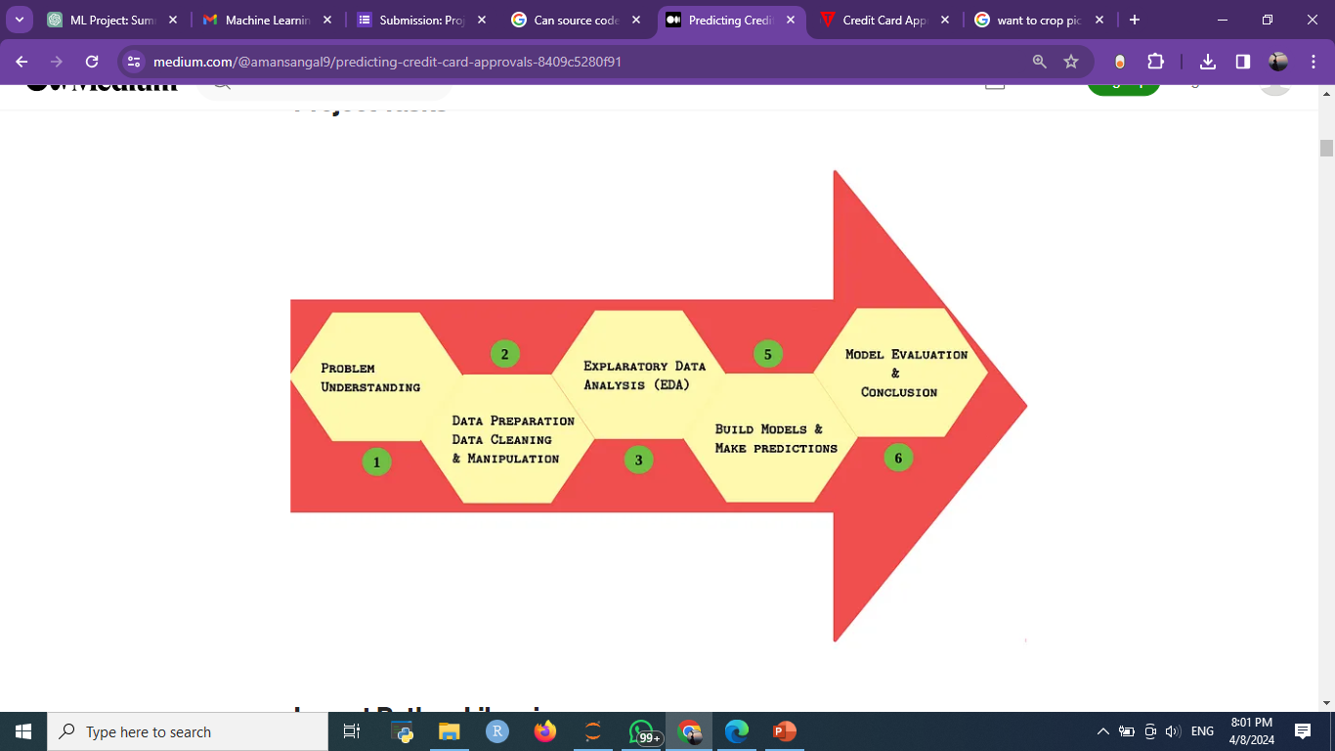
Problem Statement
The primary objective of this project is to predict the approval or rejection of credit card applications.
The challenge lies in understanding the key factors influencing credit card approval decisions and building a predictive model to assist in the decision-making process.
&
Roadmap

Slide 4
Dataset Overview
The dataset consists of comprehensive applicant information collected during credit card application processes.
It includes various attributes such as income, employment status, education level, marital status, and more.
Each record represents an individual credit card applicant, with a corresponding target variable indicating whether the applicant is considered high risk (1) or not (0).
Size and Composition:
The dataset comprises 36657 records with multiple columns capturing diverse applicant characteristics.
Each variable provides valuable insights into the applicant's financial situation, demographic profile, and risk level.
Purpose:
The dataset serves as the foundation for developing predictive models to assess credit card approval risks accurately.

Slide 5
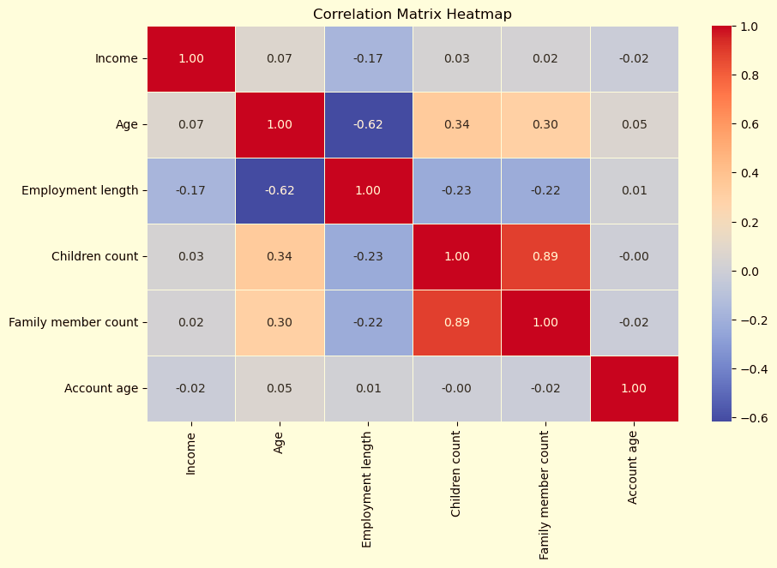
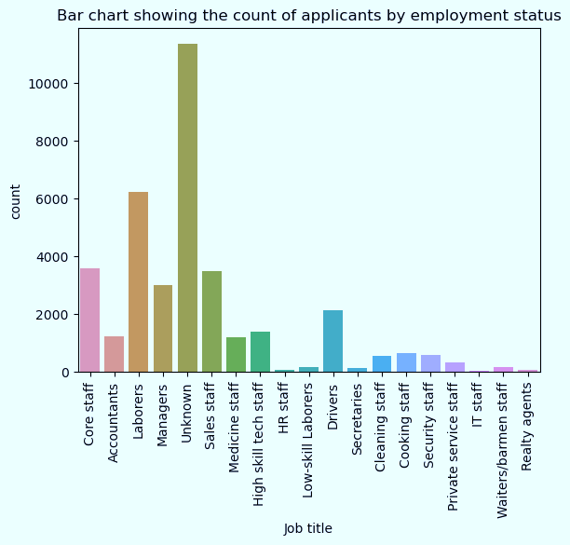
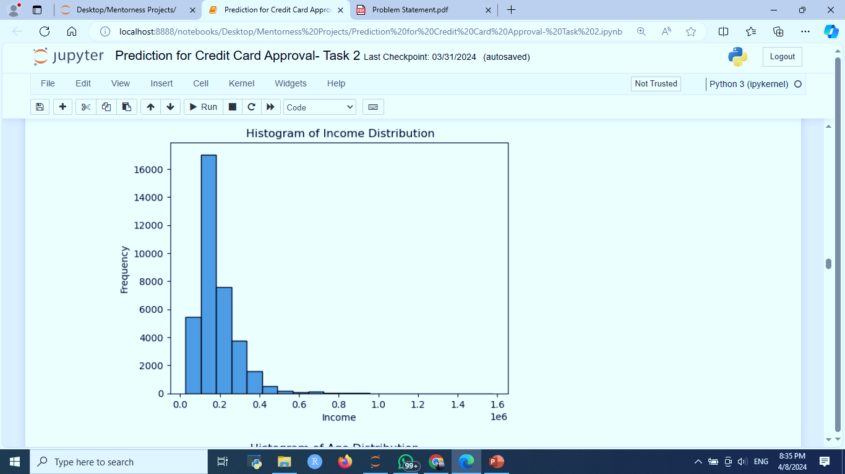
Exploratory Data Analysis (EDA)- Understanding the Data Through Visualization
EDA Continued….

Slide 6
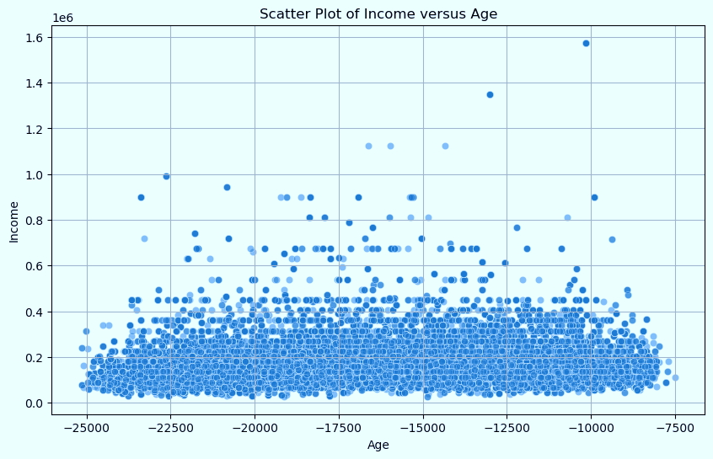
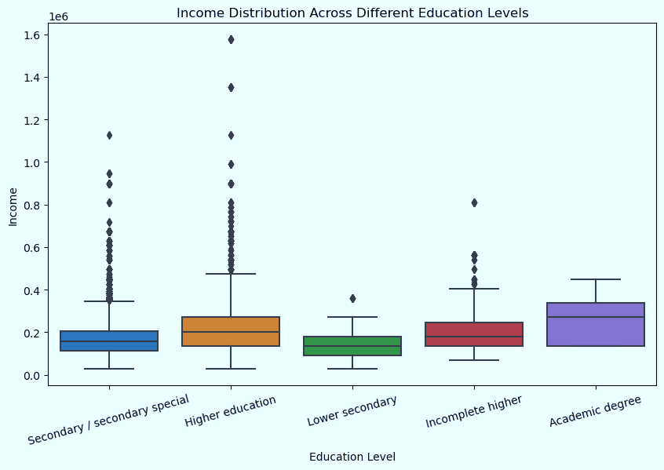
To identify outliers and assess the spread and variability of numerical variables such as income distribution across different education levels
relationships between numerical variables, such as income versus age to identify potential correlations or trends.

Slide 7
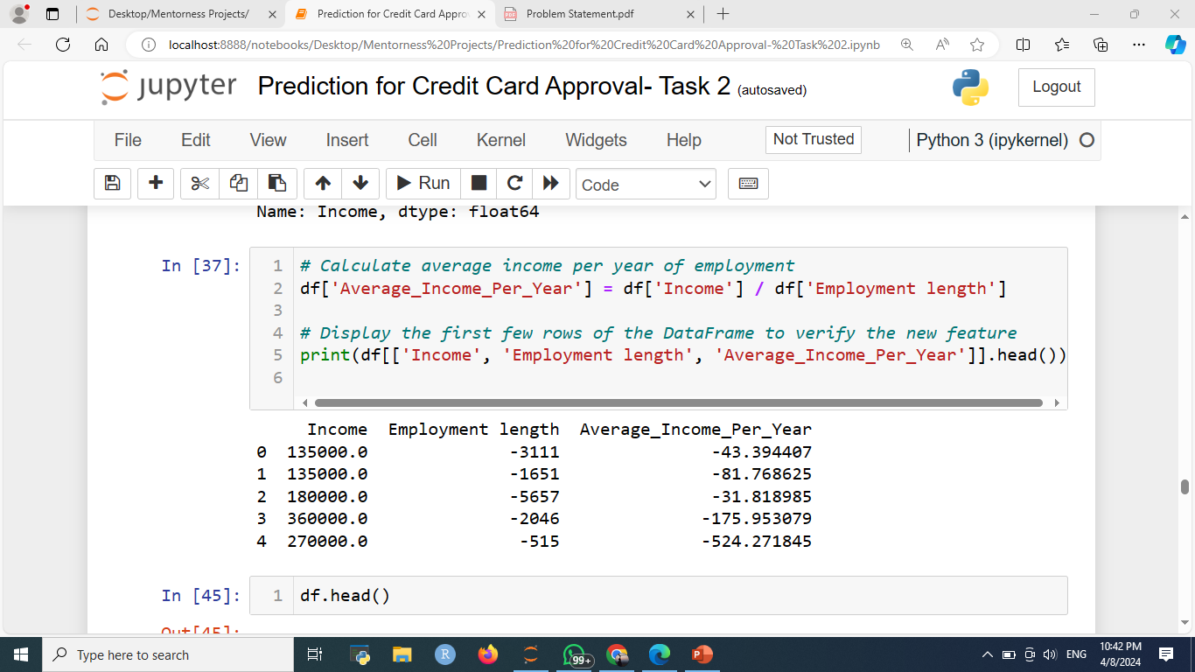
Feature Engineering Enhancing Data for Model Development
Feature engineering involves techniques such as aggregation, interaction terms creation.
Key Techniques:
Aggregation: Combining multiple related features to create new meaningful features. For example, aggregating income and employment length to calculate average income per year of employment.
Interaction Terms Creation: Creating new features by combining two or more existing features to capture their joint effects. For instance, creating interaction terms between income and education level to account for the impact of education on income.

Slide 8
Data Preprocessing
Handling missing values.
In the independent variable called “Job Title” there are some missing categorical variables. So we fill it with the “Unknown”
Encoding categorical variables.
Used one hot encoding for the categorical variables and also ordinal encoding for a column “Education Level”.
Feature scaling or normalization.
Min-Max Scaling: It scales the data to a fixed range, usually between 0 and 1, or -1 and 1. It's useful when the distribution of the data is not Gaussian or when you need the data within a specific range.
Purpose:
Prepare data for model training.
Ensure consistency and accuracy.

Slide 9
Machine Learning Model Development
Algorithms Used:
Logistic Regression: A linear model used for binary classification tasks, suitable for interpreting the relationship between features and the target variable.
Decision Trees: Non-linear models that partition the feature space into regions, making them interpretable and easy to visualize.
Random Forests: Ensemble learning method consisting of multiple decision trees, offering improved predictive performance and robustness.
Experimentation:
Model training and evaluation.
Comparison of different algorithms.

Slide 10
Model Evaluation & Predicting Credit Card Approval
Evaluating The models performance
Logistic Regression: Accuracy = 0.9830864874748583
Decision Tree: Accuracy = 0.9723898336076066
Random Forest: Accuracy = 0.9818065459864692
Best Model (Random Forest)
Accuracy: 0.981440848418358
Precision: 0.3392857142857143
Recall: 0.10270270270270271
F1 Score: 0.15767634854771787
ROC AUC Score: 0.5496309012444045
Confusion Matrix:
[[10716 37]
[ 166 19]]

Slide 11
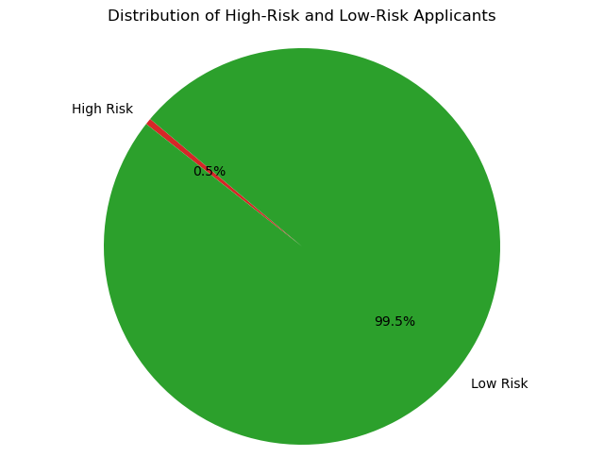

Slide 12

Recommendations
Top 5
Features with Higher Importance
Account Age
Age
Income age Interaction
Employment Length
Family member count
.
Consider focusing on features with higher importance such as 'Age' and 'Account age’.
Pay attention to 'Income_Age_interaction', which seems to have significant impact
Further analysis can be done on 'Employment length' and 'Education level' to understand their influence.

