Slide 1
SANTHOSH S
Final Project

Slide 2
PROJECT TITLE
LANGUAGE TRANSLATOR USING
DEEP LEARNING

Slide 3

AGENDA
Problem Statement
project overview
Data collection and processing
Model architecture
Applications and Impact
Future direction and Conclusion
who are the end users ?
solution and its value preposition
modeling
result

Slide 4

PROBLEM STATEMENT
Develop a language translation system utilizing deep learning techniques to seamlessly translate text across multiple languages. The system should be capable of accurately translating text from one language to another in real-time, facilitating effective communication regardless of linguistic differences. By leveraging deep learning models and advanced neural network architectures, the goal is to create a robust and efficient translation system that addresses the challenges of language barriers in various domains.

Slide 5

PROJECT OVERVIEW
INTRODUCTION:
The project aims to develop a language translator system employing deep learning methodologies to enable seamless translation between different languages. Utilizing advanced neural network architectures and state-of-the-art techniques, the system will accurately translate text in real-time, overcoming linguistic barriers. Through extensive data collection, preprocessing, model training, and optimization, the objective is to create a robust and efficient translation solution applicable across diverse domains.

Slide 6
OBJECTIVE:
The primary objectives of this project are to design and implement a language translation system powered by deep learning techniques. Specifically, the project aims to develop a model capable of accurately translating text between multiple languages in real-time. Through comprehensive data collection, preprocessing, and model training, the goal is to achieve high translation accuracy and fluency. Additionally, the system will be optimized for efficiency and scalability to handle translation requests efficiently. By leveraging advanced neural network architectures and continuous improvement strategies, the objective is to create a versatile language translator system that can effectively bridge language barriers across various domain

Slide 7
DATA COLLECTION AND PROCESSING
High-quality data is the cornerstone of successful deep learning models, particularly in language translation tasks. Gathering diverse and extensive datasets from reliable sources is crucial to ensure the model's robustness and accuracy. Various methods such as web scraping, utilizing existing parallel corpora, and crowd-sourcing can be employed for data collection. Preprocessing steps play a vital role in preparing the collected data for training. Techniques like cleaning to remove noise, tokenization to break text into individual words or subwords, and normalization to handle inconsistencies in capitalization and punctuation are essential for enhancing the quality of input data. Through meticulous data collection and preprocessing, the language translator system can effectively learn and generalize across different languages, improving overall translation performance.

Slide 8
MODEL ARCHITECTURE:
Neural Machine Translation (NMT) revolutionized language translation tasks by employing deep learning architectures capable of capturing complex linguistic patterns. In this context, understanding various deep learning architectures such as Recurrent Neural Networks (RNNs), Long Short-Term Memory (LSTM) networks, and Transformers is crucial. Each architecture offers unique advantages in handling sequential data and modeling contextual dependencies. Design considerations for language translation models include attention mechanisms to focus on relevant parts of the input sequence, layer normalization for stable training, and architectural modifications to address issues like vanishing gradients. By carefully selecting and customizing the model architecture, the language translator system can effectively capture and translate the nuances of different languages, leading to improved translation quality and fluency.

Slide 9
APPLICATIONS AND IMPACT
The application potential of language translator systems leveraging deep learning is vast and impactful across various sectors. In international business, such systems facilitate seamless communication and collaboration among global teams, fostering efficiency and productivity. In the travel and tourism industry, they enable tourists to navigate foreign countries with ease, enhancing their overall experience. Moreover, in healthcare, language translators aid in overcoming language barriers between patients and healthcare providers, ensuring effective communication and access to quality care. Additionally, these systems play a crucial role in diplomacy, education, and cross-cultural exchanges, promoting mutual understanding and cooperation on a global scale. Overall, the widespread adoption of language translator systems powered by deep learning has the potential to break down linguistic barriers, foster inclusivity, and drive positive socio-economic impact across diverse domains.

Slide 10
FUTURE DIRECTION AND CONCLUSION
Looking ahead, the future of language translation using deep learning holds promising advancements. Continued research and development in neural network architectures, such as further exploration of transformer-based models and incorporating multilingual learning techniques, will likely enhance translation accuracy and efficiency. Moreover, integrating real-time adaptation mechanisms to dynamically adjust to evolving linguistic nuances and domain-specific terminology will be pivotal.
In conclusion, the ongoing evolution of language translator systems driven by deep learning signifies a transformative journey towards breaking down language barriers, fostering global communication, and promoting cultural exchange on an unprecedented scale, ultimately contributing to a more connected and inclusive world.

Slide 11
WHO ARE THE END USERS?
Individuals: Everyday users seeking to communicate with people who speak different languages, such as tourists, immigrants, or language learners.
Businesses: Multinational corporations conducting international transactions, negotiations, and collaborations with partners and clients from diverse linguistic backgrounds.
Government Agencies: Diplomatic entities and government organizations requiring translation services for official documents, international treaties, and diplomatic communications.
Educational Institutions: Students, teachers, and researchers accessing educational materials, academic papers, and courses in different languages.

Slide 12
Healthcare Providers: Medical professionals communicating with patients from various linguistic backgrounds to provide accurate diagnoses, treatments, and healthcare information.
Travel and Tourism Industry: Travelers using translation services to navigate foreign countries, communicate with locals, and access information about cultural landmarks and attractions.
Non-Profit Organizations: NGOs and humanitarian groups assisting refugees, migrants, and marginalized communities by providing language translation services for essential needs and support.
Media and Entertainment: Content creators, publishers, and broadcasters translating media content, such as news articles, movies, TV shows, and online content, for global audiences.

Slide 13

YOUR SOLUTION AND ITS VALUE PROPOSITION
Provide Accurate Translation: Leveraging advanced neural network architectures, the system ensures precise translation of text with high fidelity to preserve original meaning.
Enable Real-Time Communication: With efficient deep learning models, the system facilitates instantaneous translation, enabling real-time conversations and interactions.
Enhance User Experience: Offering a user-friendly interface and intuitive design, the system enhances user experience by simplifying the translation process and promoting accessibility.
Foster Global Collaboration: By breaking down language barriers, the system promotes cross-cultural collaboration and cooperation among individuals, businesses, and organizations worldwide.

Slide 14
Improve Efficiency: Automating the translation process using deep learning algorithms streamlines workflows, reduces manual effort, and increases productivity.
Ensure Scalability and Adaptability: With scalable architecture and adaptable learning capabilities, the system accommodates evolving linguistic needs and scales to handle growing translation demands.
Promote Inclusivity: By providing translation services for multiple languages, the system fosters inclusivity and accessibility, ensuring that language differences do not hinder communication or access to information.
Drive Innovation and Progress: As a cutting-edge application of deep learning technology, the system drives innovation in language processing and contributes to advancements in cross-linguistic communication, ultimately fostering global progress and understanding.

Slide 15
MODELING
The modeling process for the language translator system involves designing and implementing sophisticated deep learning architectures tailored for natural language translation tasks. This includes selecting appropriate neural network architectures such as recurrent neural networks (RNNs), long short-term memory (LSTM) networks, or transformer models, which excel at capturing sequential dependencies and contextual information in text data. Additionally, attention mechanisms are incorporated to focus on relevant parts of the input sequence during translation. The modeling phase also encompasses hyperparameter tuning, optimization techniques, and training strategies to enhance the model's performance and convergence. Through meticulous modeling, the language translator system can effectively learn complex language patterns and produce accurate translations across multiple languages, thereby facilitating seamless communication and bridging linguistic divides.

Slide 16
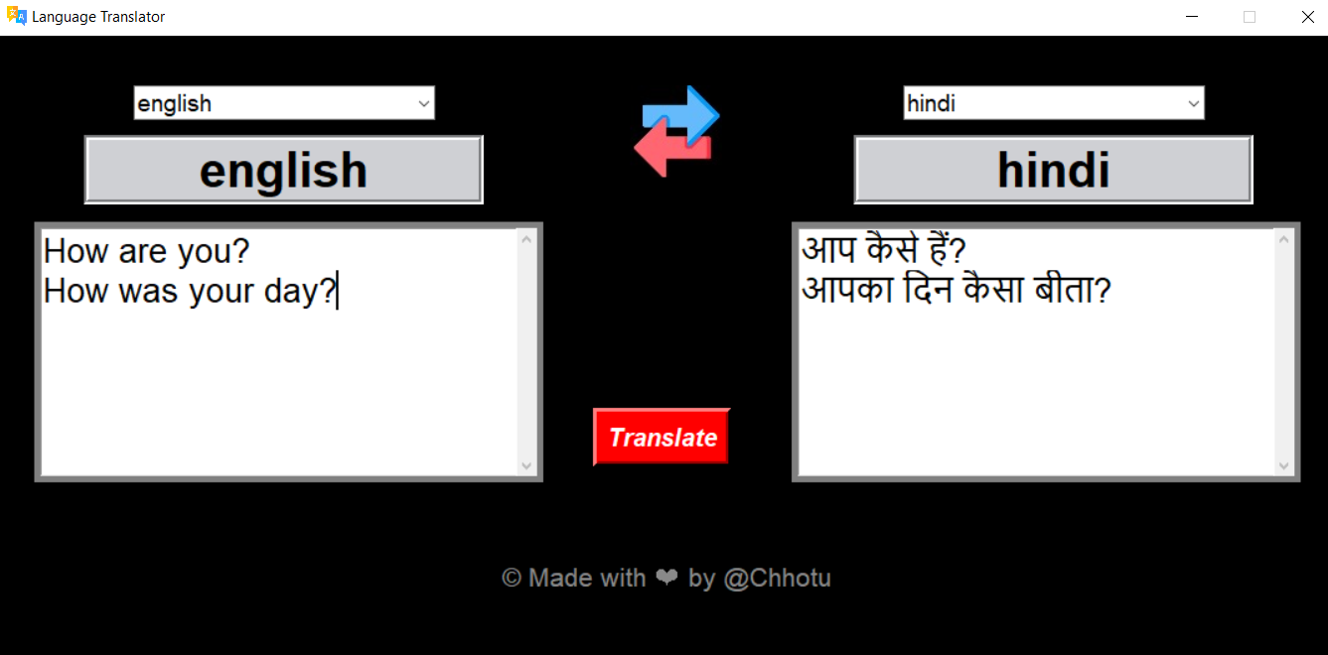
RESULTS
CODE: https://github.com/SandySanthosh10/TNSDC_Generative-AI.git

