Slide 1

Project Title –Car Market Trends Analysis with Car Dekho Data
[Sandya M D]

Slide 2

PROBLEM STATEMENT
The goal of this project is to perform comprehensive analysis and visualization of Car Dekho's dataset to uncover meaningful insights into the car market trends. The analysis should address key questions and provide actionable recommendations based on the findings.

Slide 3
Project Description [The analysis aims to provide Car Dekho and its stakeholders with actionable insights into market trends, pricing strategies, and consumer preferences. This can facilitate better decision-making, improved inventory management, and enhanced customer satisfaction in the competitive automotive market. ]

Slide 4

WHO ARE THE END USERS?
Car Dealerships and Sellers
Car Buyers
Automotive Industry Analysts
Marketing and Strategy Teams
Financial Institutions and Insurers
Government and Regulatory Bodies

Slide 5

Technology Used
Matplotlib
Seaborn
Pandas
Numpy
Google Colab

Slide 6
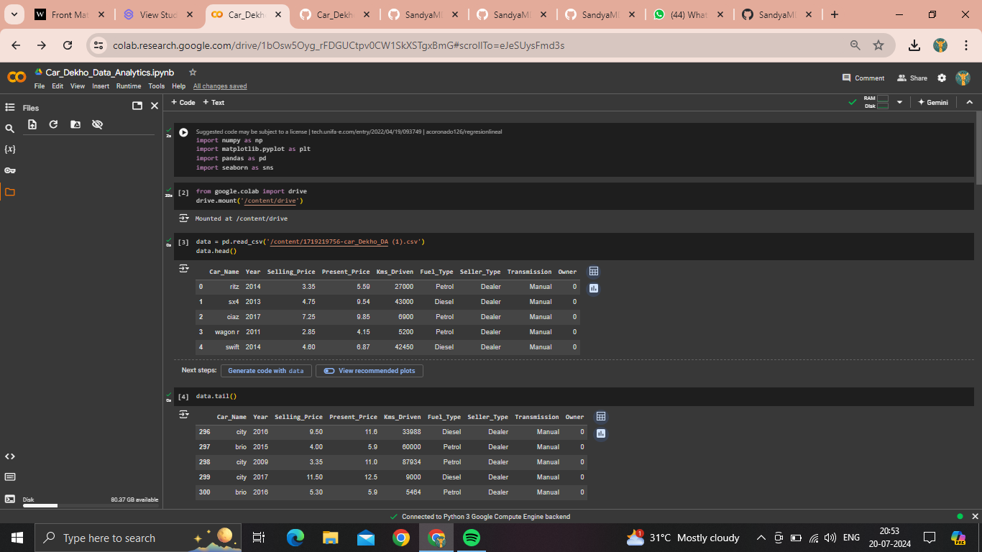
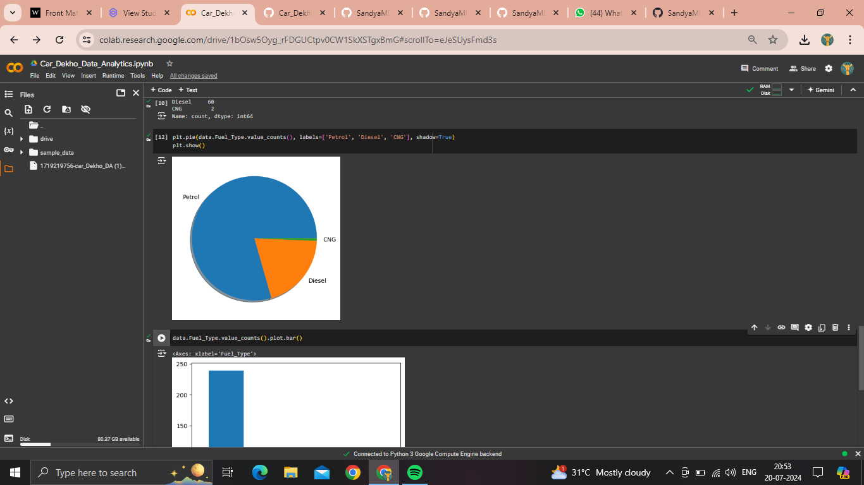
RESULTS
[Add screen shots of your code ]
Demo Link

Slide 7
Thank you
Google colab link
https://colab.research.google.com/drive/1bOsw5Oyg_rFDGUCtpv0CW1SkXSTgxBmG?usp=sharing
.
.

