Slide 1
“Network anatomy and in vivo physiology of visual cortical neurons”
Davi Bock, et. al, 2015
Presented by Joshua Vogelstein

Slide 2
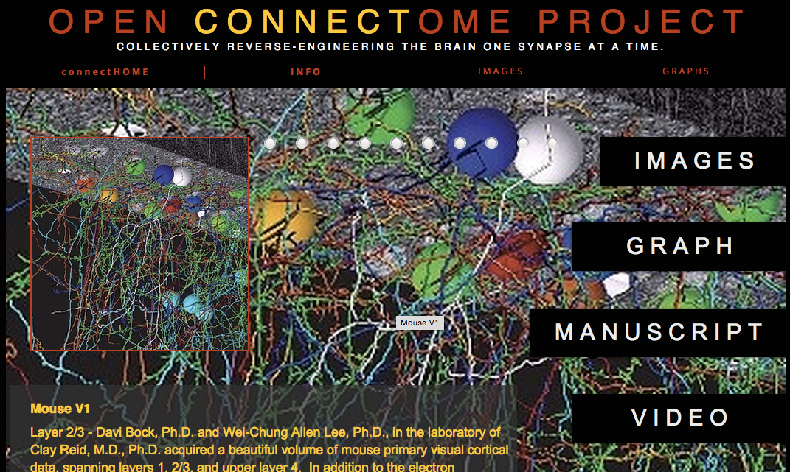
Outline
Opportunity
Challenge
Action
Resolution
Discussion

Slide 3
Opportunity
Serial Section Electron Microscopy (SSEM) is enabling relatively high-throughput anatomy
Two-photon microscopy of calcium physiology imaging (2P CaI) is enabling relatively high-throughput physiology
We can better understand the brain by understanding structure in terms of function and vice versa
We don’t understand the relationship between connectivity and tuning properties in V1 of mouse
Previous hypothesis: that inhibitory interneurons in the mouse primary visual cortex receive dense, convergent input from nearby excitatory (pyramidal) neurons with widely varying preferred stimulus orientations

Slide 4
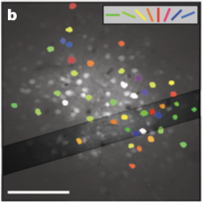
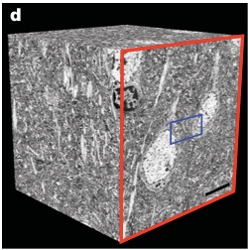
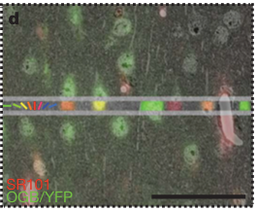
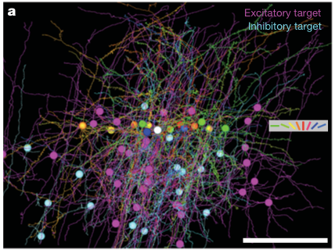
Challenge
SSEM is relatively slow
2PCaI might degrade EM data
Not clear how to register EM and 2P data
Tracing EM data is hard

Slide 5
Action
Build TEMCA
Collect “pilot” 2P data
Register and trace manually
Analyze relationship between connectivity and tuning

Slide 6
Resolution
2P does not seem to significantly degrade EM quality
EM data can be manually traced
EM & 2P data can be manually co-registered
Convergent inhibitory connections are independent of tuning properties

Slide 7
Discussion
2P doesn’t degrade EM too much
Don’t fret aligning 2P & EM
Scalable EM and manual sparse tracing is totally doable
Seems like convergence onto inhibitory neurons is independent of tuning, now can confirm that and check other stuff
We need automatic tools for graph inference from EM data

Slide 8
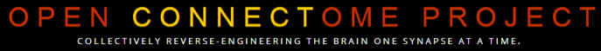

Thank you. Questions?
Stats | C. Priebe, M Maggioni, D Dunson, G Sapiro, B Caffo, M Miller
Code | Randal Burns,
Data | C Reid, M Milham, K Deisseroth, J Lichtman, S Smith, M Ahrens
Funds | TRA (NIH), XDATA & GRAPHS (DARPA), BIGDATA & CRCNS (NIH/NSF)
Love | yummy, family, friends, earth, universe, multiverse!?
e: jovo@jhu.edu, c:443.858.9911
w: jovo.me, openconnecto.me

