Slide 1
A Multivariate Distance-Based Analytic Framework for Connectome-Wide Association Studies
Shehzad et al. 2014

Slide 2

Opportunity
It would be nice to be able to compare brains of normal people vs. connectomes of brains with diseases
study correlations between functional connections and phenotypes
Notes:
ROI and phenotypes, voxels vs. whole brain

Slide 3
Challenge
Computationally expensive
Rely on prior information: dimensionality of data, parameters of graph construction (ie. centrality)
Notes:
Current calculations use linear models, and assume each voxel is independent of other voxels, which means they have to compute v1-v2 in each brain, v2-v3 etc etc and end up doing n choose 2 calculations. (univariate analysis)

Slide 4
Action
Use multivariate distance matrix regression (MDMR)
Compare to current methods to verify reproducibility and robustness
Apply MDMR to find associations between various phenotypes and functional patterns
Notes:
can look at entire sets of functional connections to a phenotypic variable simultaneously

Slide 5
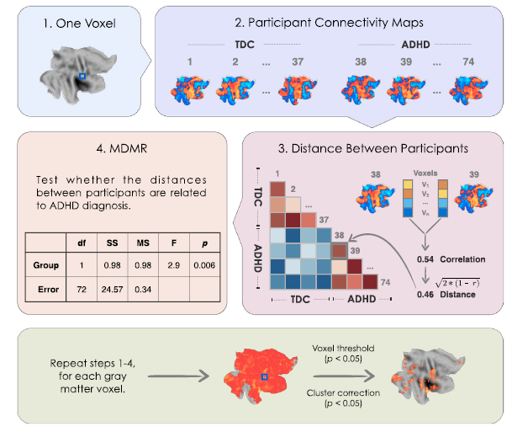
Method
Notes:
imaging echoplanar imaging with 2 resolutions over time. Took voxels that were consistent over participants, some other pre-processing
Within-subject analysis: Connectivity maps of 74 subjects by correlation matrix (v x v) showing correlation b/t each pair of voxels
Distance matrix (n x n): given a voxel, how dissimilar are my patients
MDMR for each voxel- get a pseudo statistic and do permutation testing to get a null

Slide 6
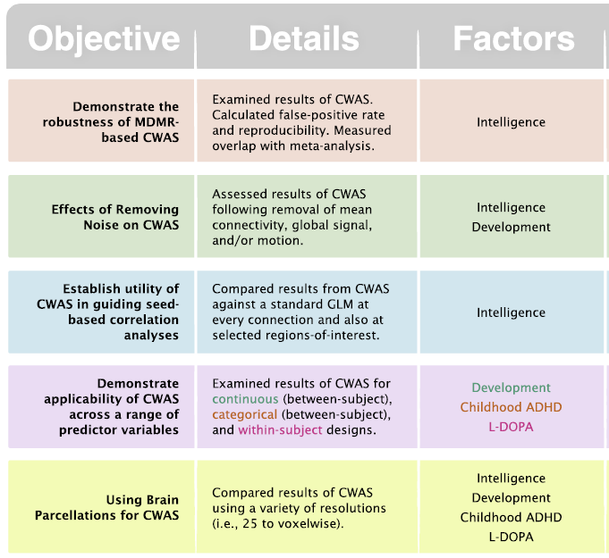
Resolution

Slide 7
Future
structural connectome
including directional information
use autoregressive processes
Limitation: viewing whole brain decreases sensitivity to local regions, can be overcome by limiting data set

