Slide 1
Employee Data Analysis using Excel
STUDENT NAME: Sandhiya M
REGISTER NO: 312220828
DEPARTMENT: COMMERCE
COLLEGE: Govt Arts & Science College, Sriperumbudur, Kundrathur, Chennai- 600 069.

Slide 2
PROJECT TITLE
Employee Termination Analysis using Excel

Slide 3


AGENDA
Problem Statement
Project Overview
End Users
Our Solution and Proposition
Dataset Description
Modelling Approach
Results and Discussion
Conclusion
3/21/2024 Annual Review

Slide 4

PROBLEM STATEMENT
Topic: Employee Termination Analysis
WHY SHOULD DO THIS ANALYSIS
IMPROVE RETENTION STRATEGIES: By recognizing the factors
Contribute to resignation and companies can develop targeted strategies to improve employee satisfaction and reduce resignation.
ENHANCE RECRUITMENT PRACTICES: Insights from resignation
analysis can inform better hiring practices by highlighting which types of
Job roles should be visible in clear cut through this analysis.

Slide 5

PROJECT OVERVIEW
EMPLOYEE DATA ANALYSIS
Employee data analysis helps companies understand workforce trends, improve retention, and overall organisational effectiveness.
By examining data such as resignation rates, performance scores, and employee demographics, company can identify patterns, address issues, and implement strategies to boost satisfaction, optimize recruitment, and reduce turnover.
This process is crucial for making informed decisions and fostering a more productive and engaged workforce.

Slide 6






WHO ARE THE END USERS?
Human Resource Manager (HR): Manage workforce planning.
Recruitment Team : Refine hiring practices based on resignation trend.
Leadership & Executives : Make strategic decision and allocate resources effectively.
Department Manager : Address specific resignation issues within their team.
Training & Development Teams : Design target to address skill gaps and improve engagement.

Slide 7

OUR SOLUTION AND ITS VALUE PROPOSITION
Conditional formatting - Identify the missing values
Filter – Remove the missing values
Formulas – Use to identify the performance level of employee based on resignation analysis
Pivot Table- Create the summary about resignation analysis
Graph- Put a graph to “DATA VISUALISATION”

Slide 8
Dataset Description
Employee Dataset Extract from:
Sign-in-Process = go to chrome > search “Kaggle” > press “first link” > press sign in option > sign in with google > select your Email.
Download Dataset = go to search option in Kaggle > search the dataset as your wish > then download the dataset> that will store in “This PC” Downloads.
Dataset - have 26 columns I extract only 4 columns such as,
EMPLOYEE ID : It had numerical value was used to find no.of.employees in each status.
DEPARTMENT TYPE : It had text values was used to find department wise resignation.
TERMINATION TYPE : It had text values was used to find termination type of each employee.
GENDERCODE : It had text values was used to find gender wise resignation.

Slide 9

THE "WOW" IN OUR SOLUTION
USE PIVOT TABLE TO SUMMARIZE THE DATA
GenderCode | (All)
Count of EmpID | Column Labels
Row Labels | Involuntary | Resignation | Retirement | Unk | Voluntary | Grand Total
Admin Offices | 11 | 13 | 12 | 32 | 12 | 80
Executive Office | 5 | 5 | 6 | 5 | 3 | 24
IT/IS | 49 | 75 | 53 | 206 | 47 | 430
Production | 264 | 236 | 243 | 1006 | 271 | 2020
Sales | 39 | 36 | 50 | 167 | 39 | 331
Software Engineering | 20 | 15 | 13 | 51 | 16 | 115
Grand Total | 388 | 380 | 377 | 1467 | 388 | 3000
3/21/2024 Annual Review
9

Slide 10
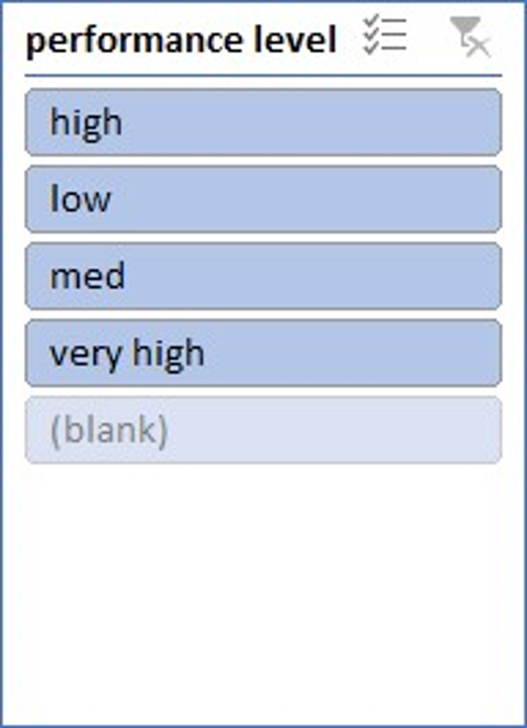
THE "WOW" IN OUR SOLUTION
USING INSERT SLICER TO ANALYSIS EACH EMPLOYEE TERMINATION ANALYSIS ACCORDING TO PERFORMANCE LEVEL

Slide 11
MODELLING
DATA COLLECTION:
Go to Naan Mudhalvan portal> put username and password> select “Mandatory Courses”
Select “ Data Analysts using Excel” topic>click “WATCH”> get dialog box> click “access course”> towards show my profile> select “EMPLOYEE DATA”> that was “download in THIS PC”>extract the data from employee data in “This PC”.
FEATURES COLLECTION:
Collect my topic according data such as,
EMPLOYEE ID : It had numerical value was used to find number of employees in each type.
TERMINATION TYPE : It had text values was used to find termination type of each employee.
GENDER CODE : It had text values was used to find gender wise resignation.
DEPARTMENT TYPE : It had text values was used to find department wise resignation.
DATA CLEANING:
Identify missing data: Using “CONDITIONAL FORMATTING” to identify the missing values in dataset
( Select missing value columns>click “conditional formatting”> highlight cell rules>more rules>format only cells that contain> select “BLANK CELL”>change colour>click “ok” two times.)
Remove missing values: Using “FILTER OPTION” to remove missing values
( Select missing values highlighted columns>click sort&filter option>click filter> filter by color>no fill.)
11

Slide 12
MODELLING
SUMMARY:
Select entire data>insert tab>insert pivot table>put “EMPLOYER ID” drag into value option and convert into count values
Drag termination type into column, Drag department type into row, Drag gender code into filter
VISUALISATION:
Select the entire pivot table> insert recommended chart>add “+” icone merge useful elements of chart such as,
If we filter the gender (female or male) .
If we can filter the department wise visualisation.
If we know which type of termination is higher.

Slide 13
RESULTS
TOTAL FEMALE EMPLOYEE TERMINATION ANALYSIS
13

Slide 14
RESULTS
INVOLUNTARY TYPE

Slide 15
conclusion
IN THIS ANALYSIS,
INVOLUNTARY TERMINATION PREDOMINENT IN PRODUCTION
OBSERVATION:
THE PRODUCTION DEPARTMENT HAS A HIGHER RATE OF INVOLUNTARY TERMINATIONS.
2. IMPLICATIONS:
THIS INDICATES POSSIBLE ISSUES RELATED TO PERFORMANCE OR MISCONDUCT IN THE PRODUCTION DEPARTMENT. IT MAY BE BENEFICIAL TO REVIEW PERFORMANCE MANAGEMENT PROCESSES AND TRAINING PROGRAM TO REDUCE THE NEED FOR INVOLUNTARY TERMINATIONS AND SUPPORT EMPLOYEES IN IMPROVING THEIR PERFORMANCE
RECOMMENDATIONS:
Evaluate and refine performance management processes in ther production department to minimize involuntary terminations and support employee development.

