Slide 1
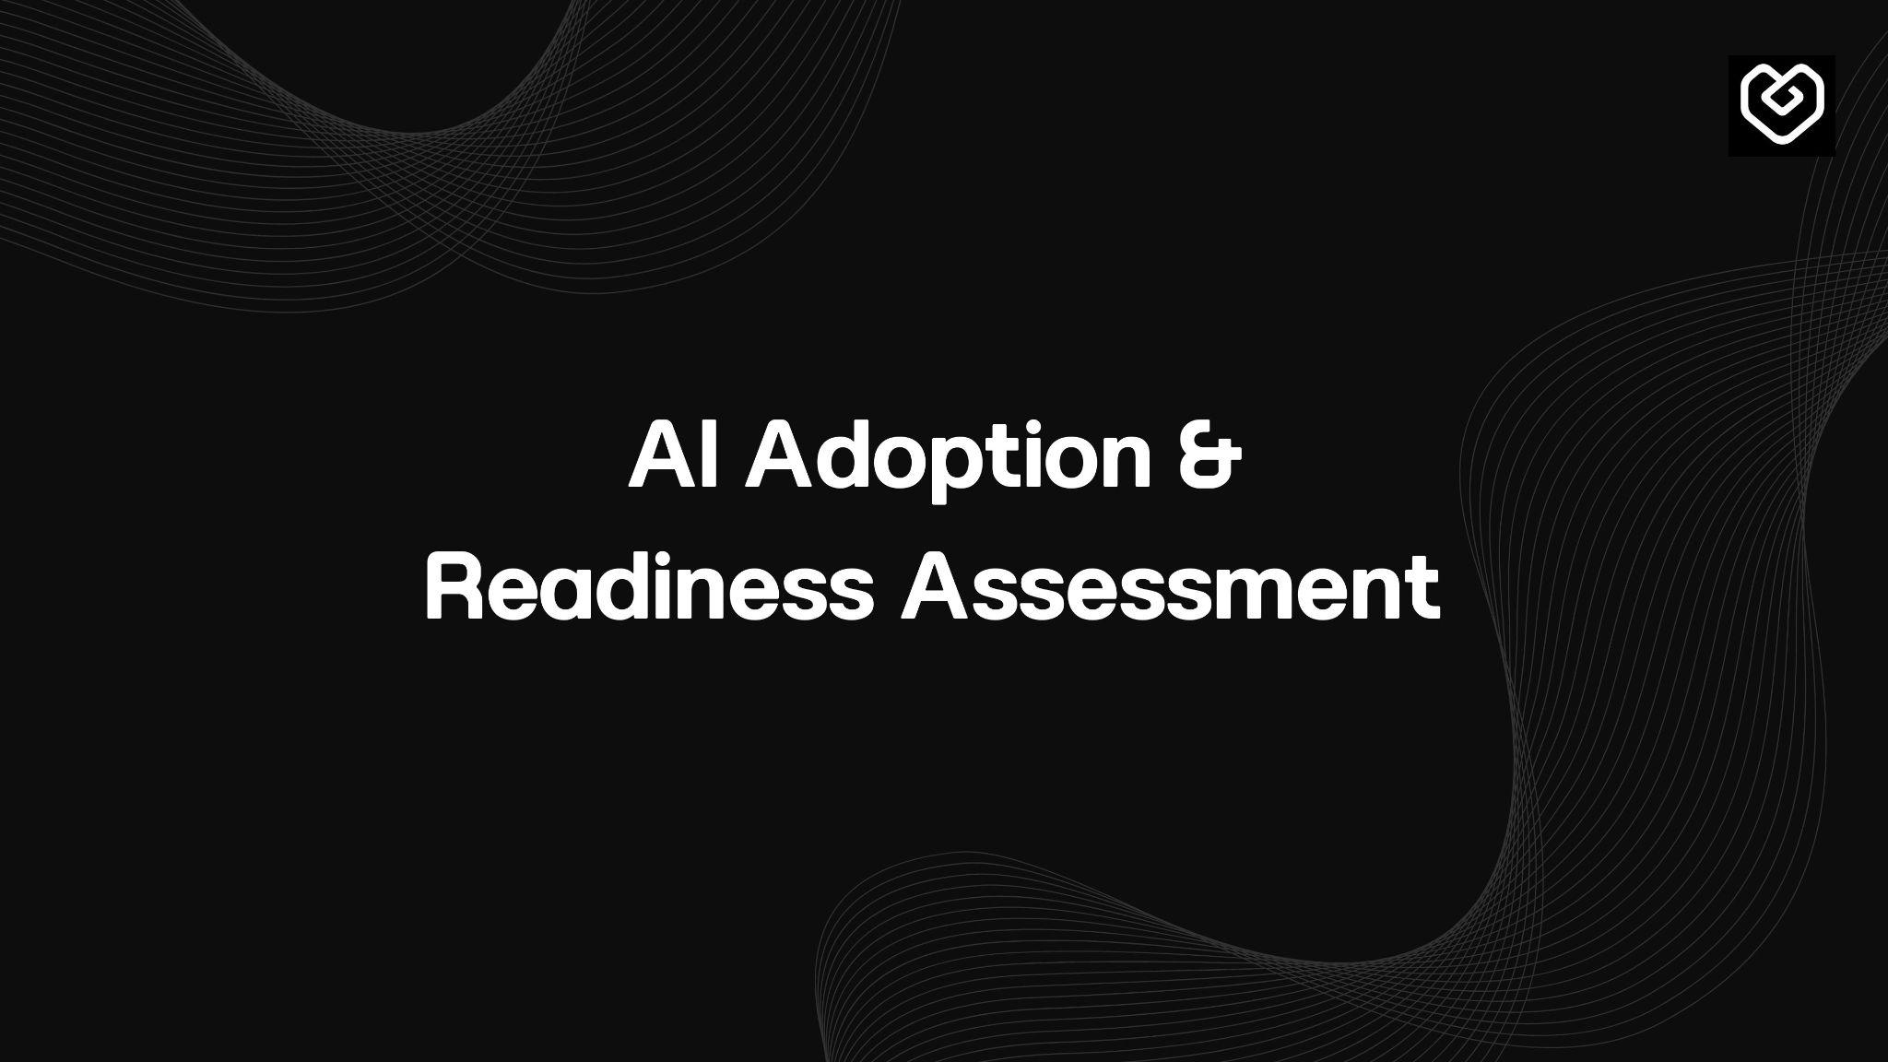
DECEMBER 2025
Total Responses: 923

Slide 2
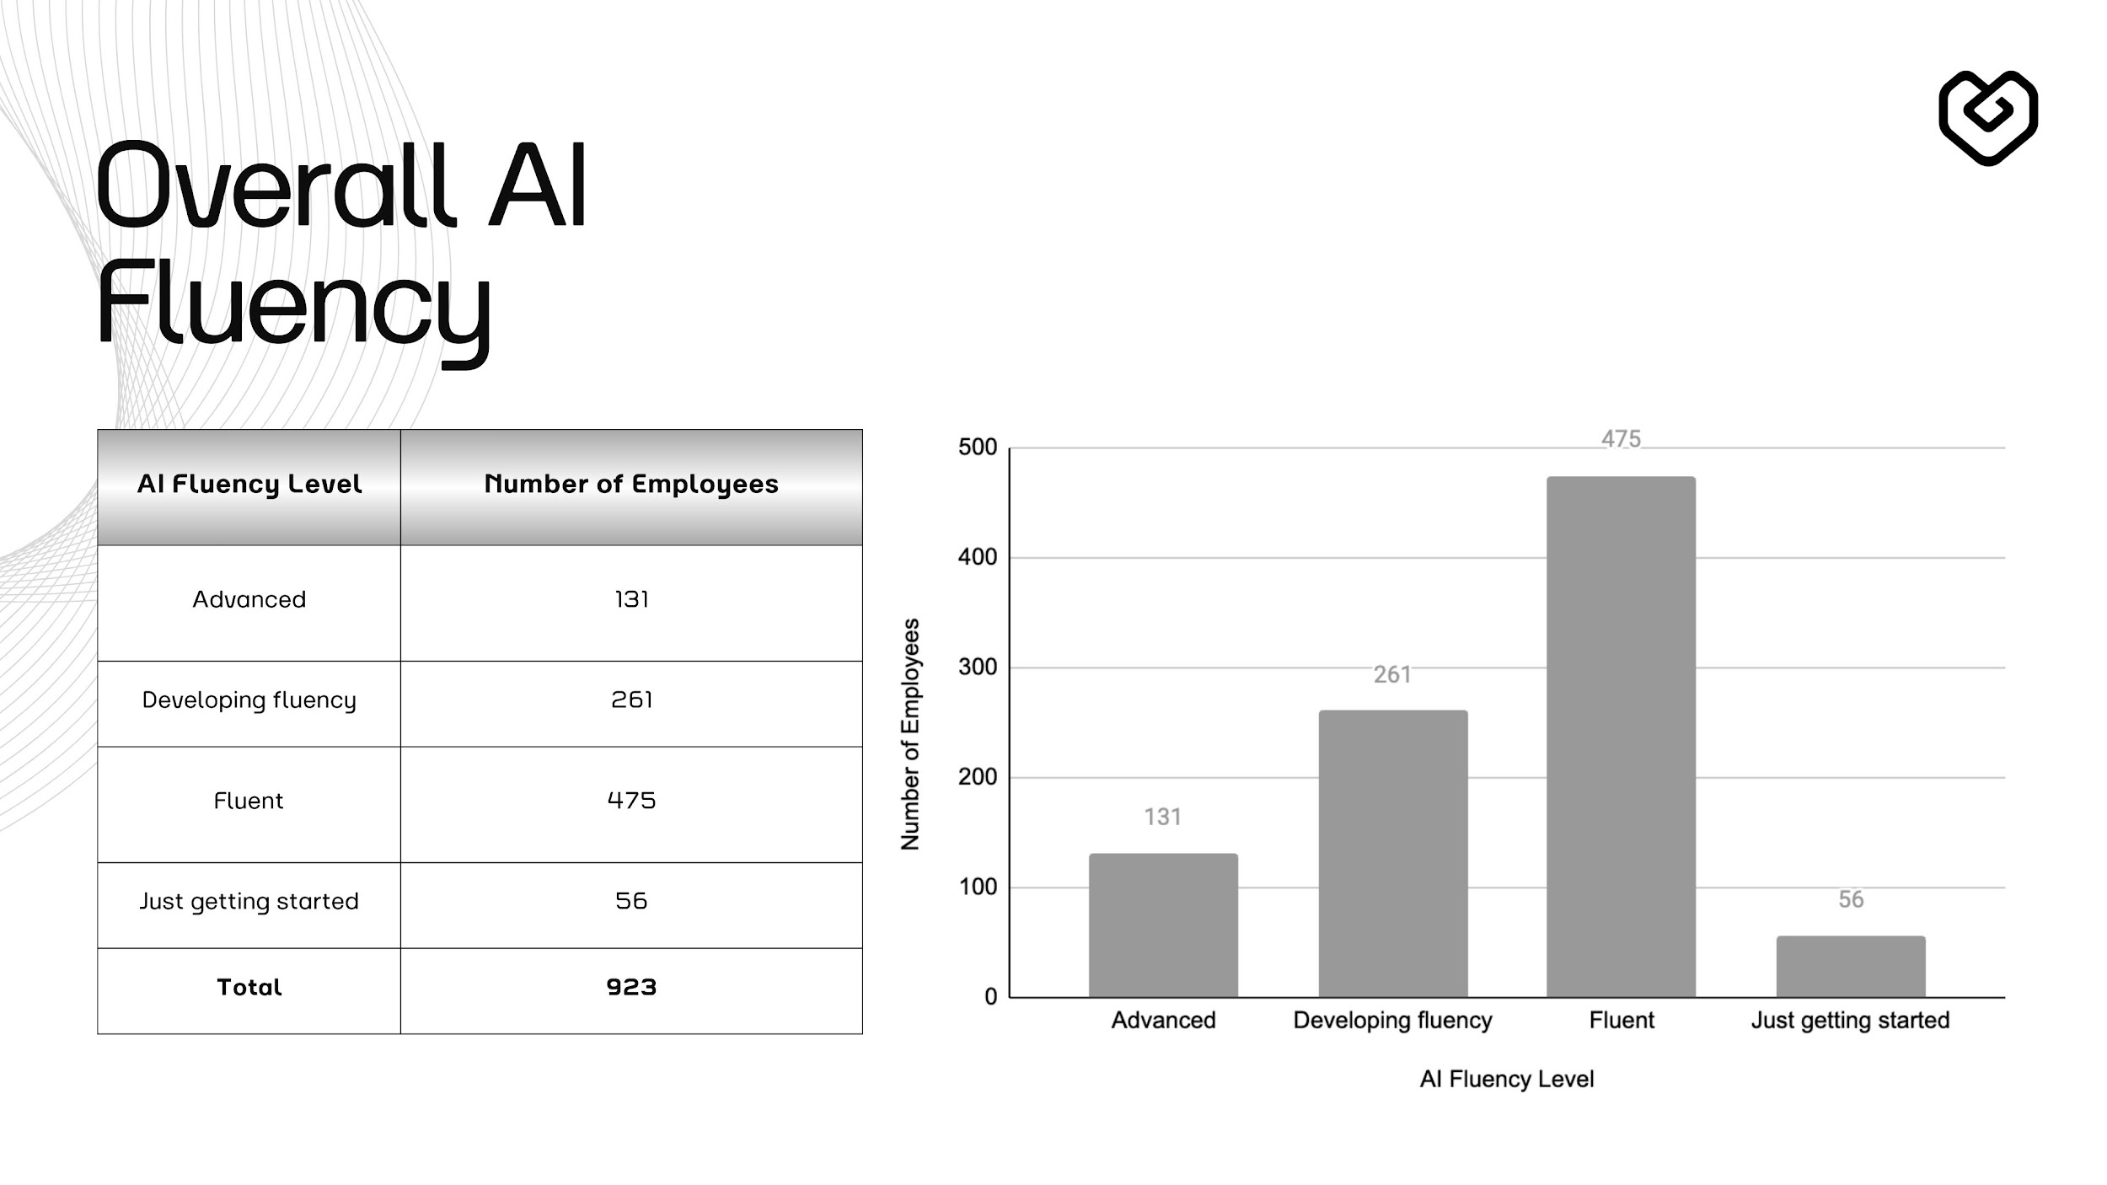

Slide 3
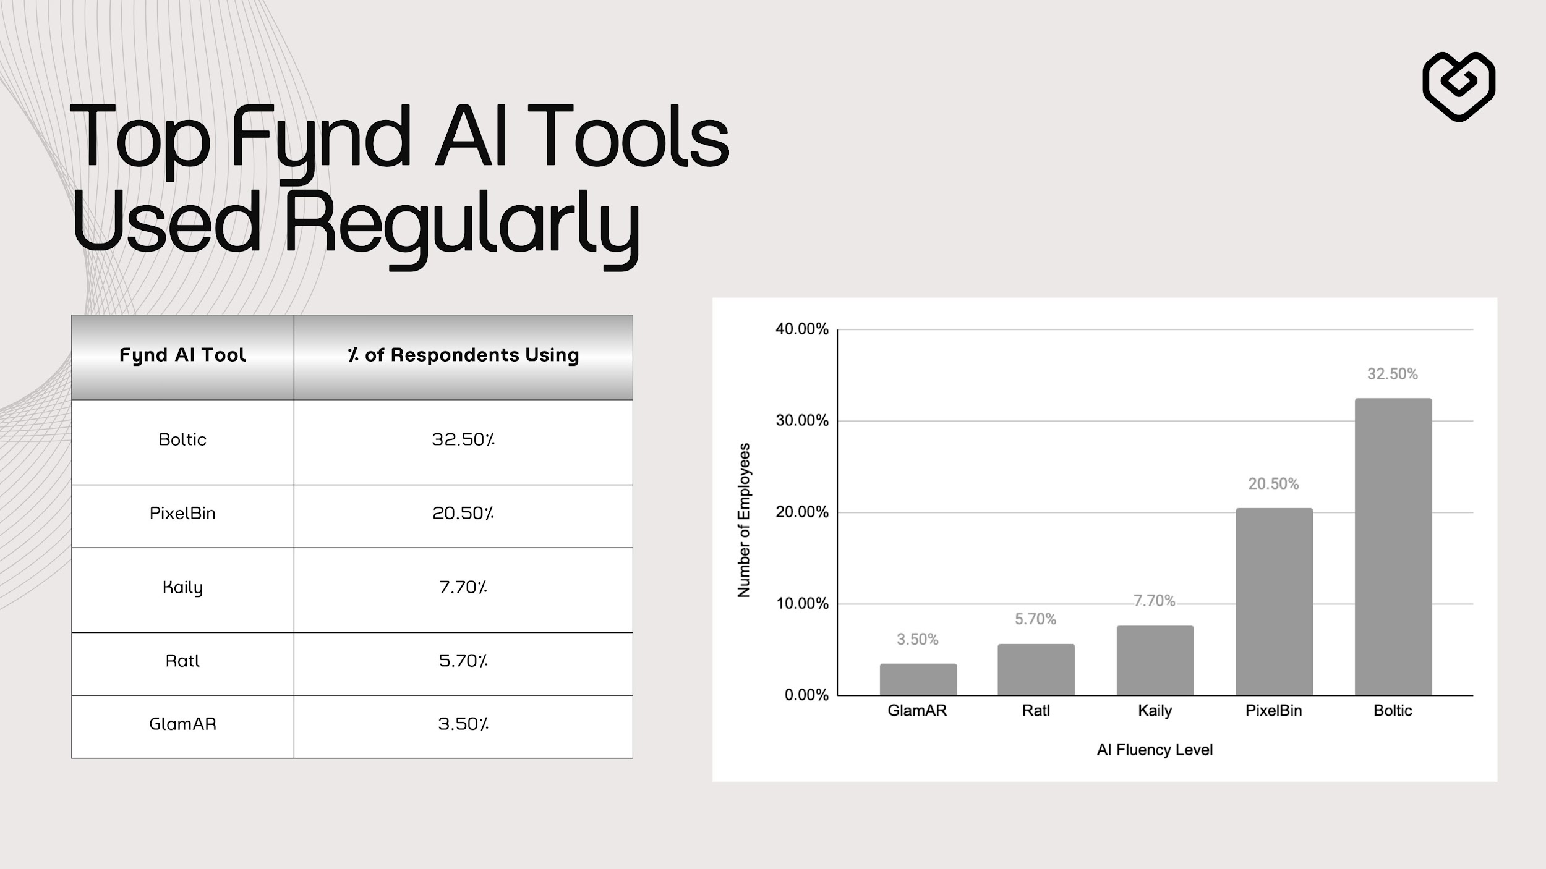

Slide 4
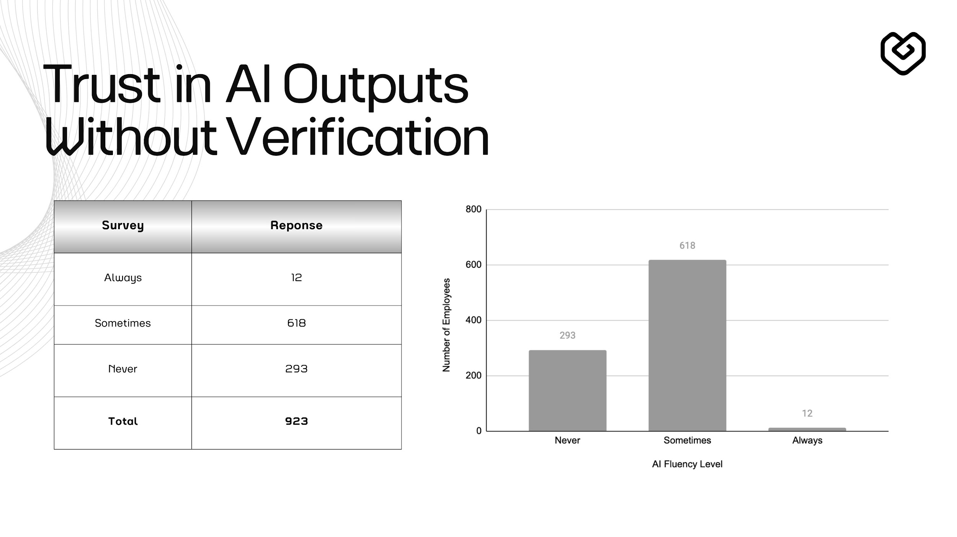

Slide 5
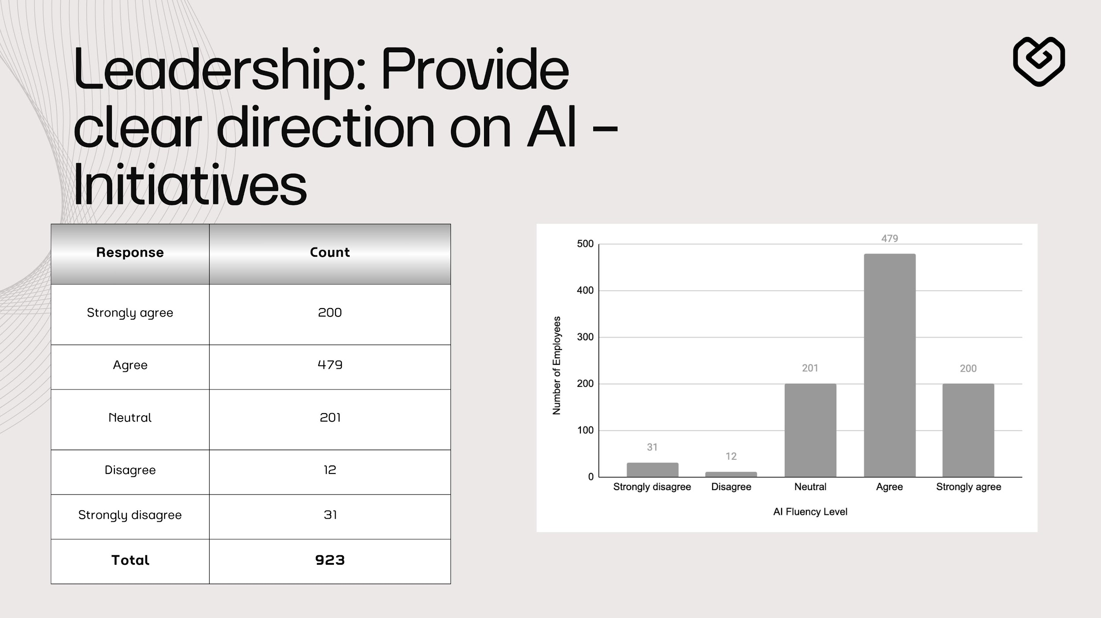
While ~74% perceive leadership direction positively, the neutral segment highlights an opportunity to improve visibility of AI priorities, roadmaps, and success stories

Slide 6
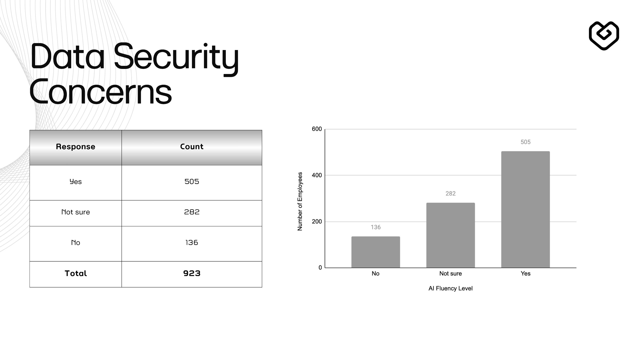

Slide 7
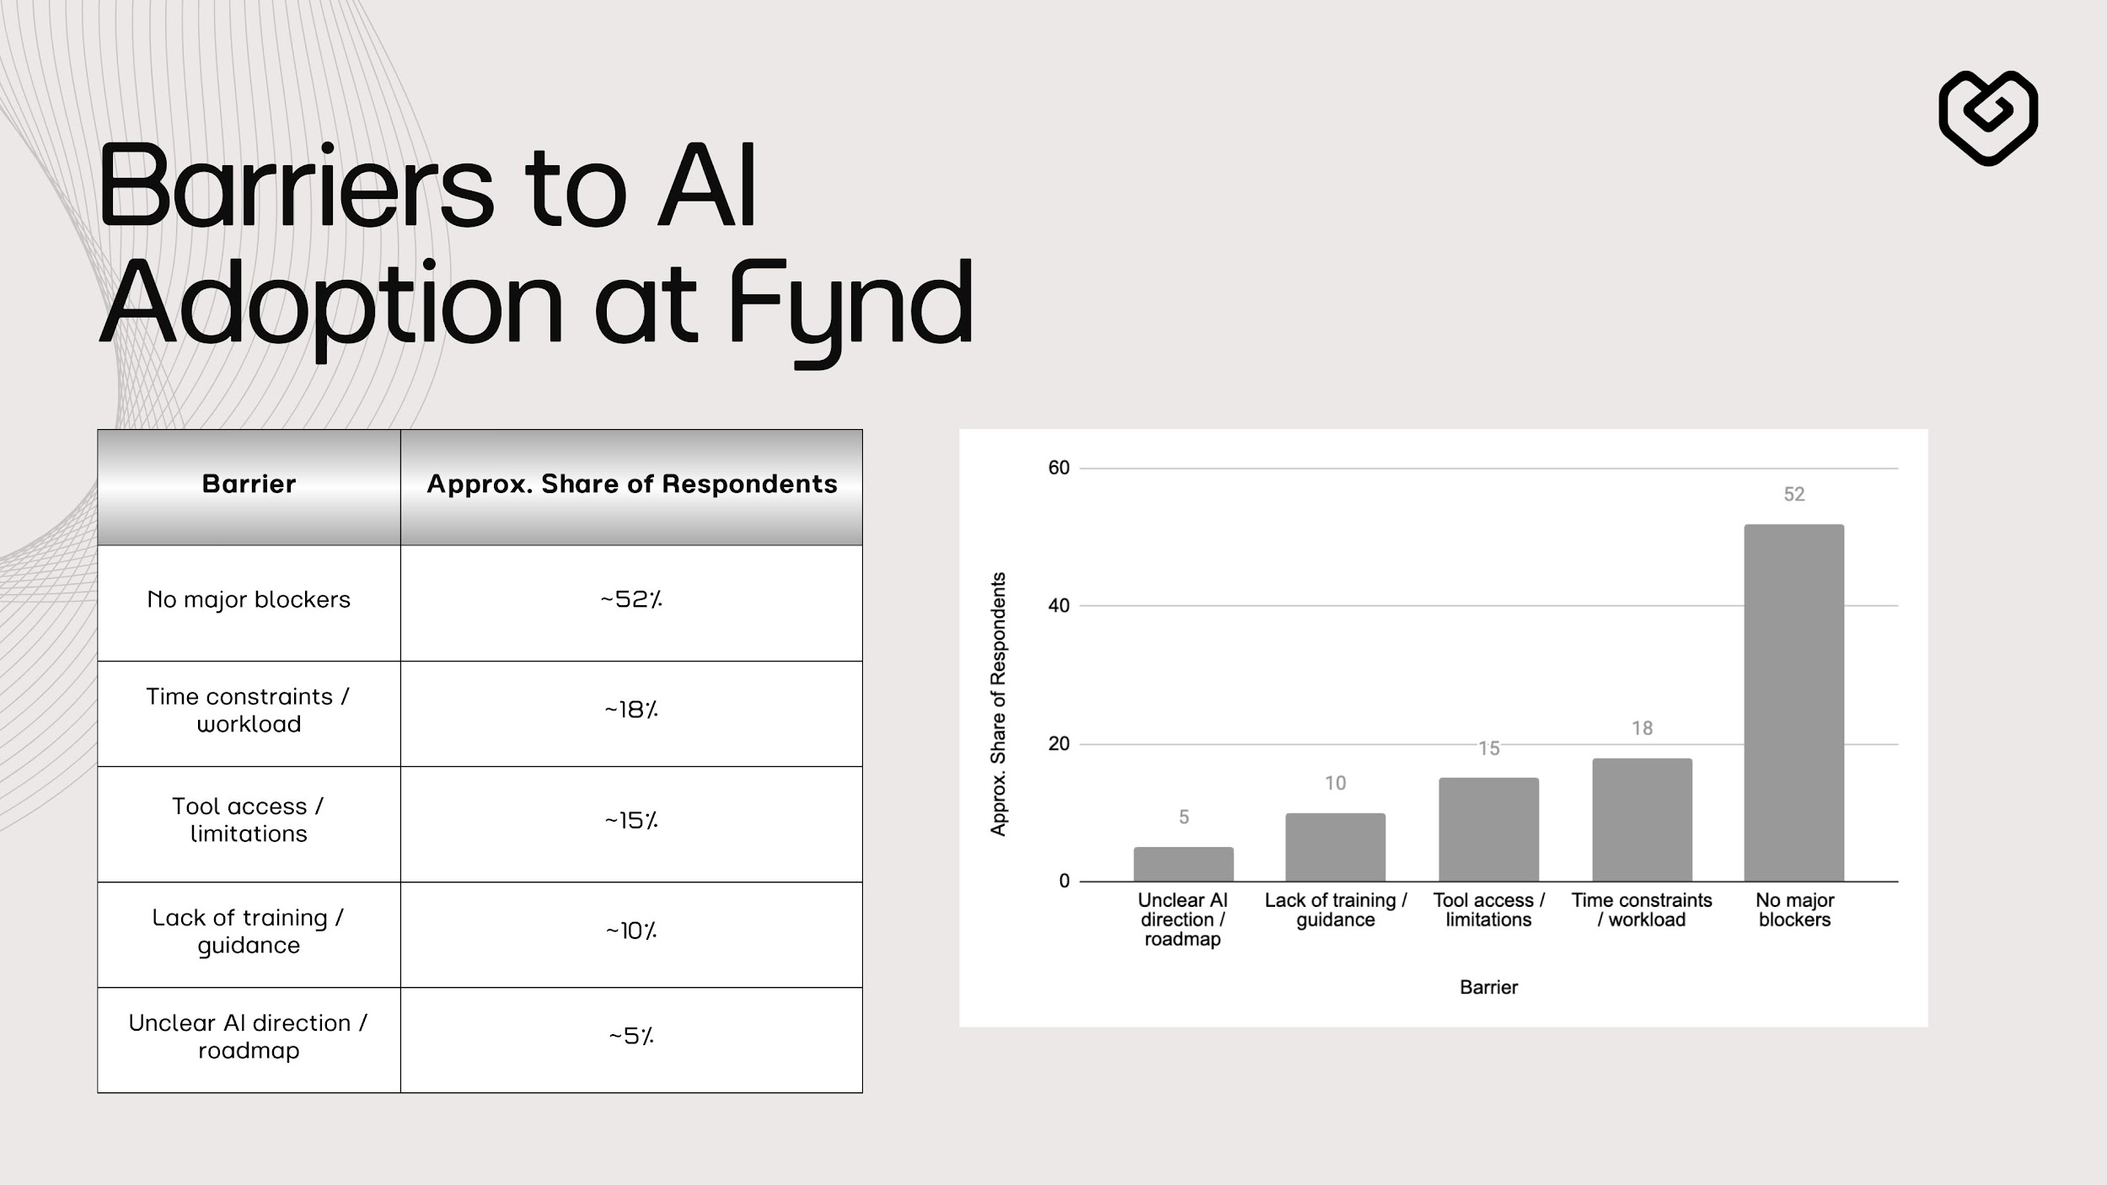
Data exposure concerns are the single largest confidence gap, emphasizing the need for clear AI data governance and approved usage guidelines.

Slide 8
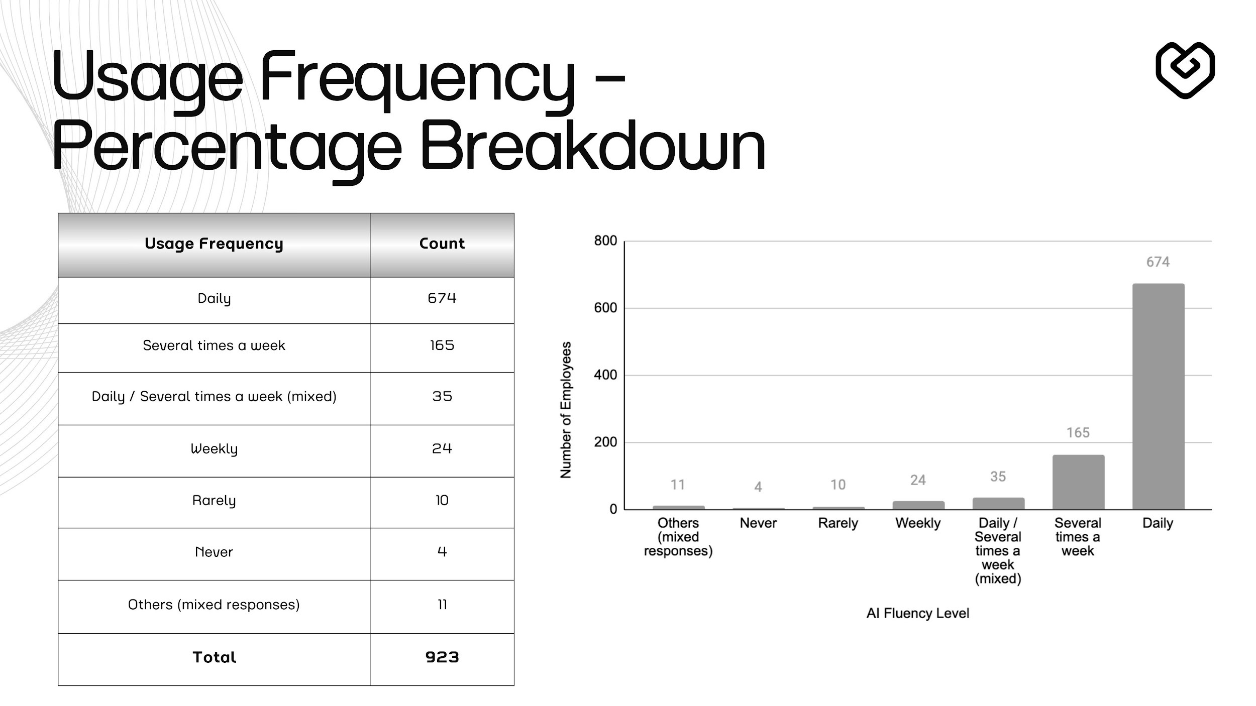

Slide 9
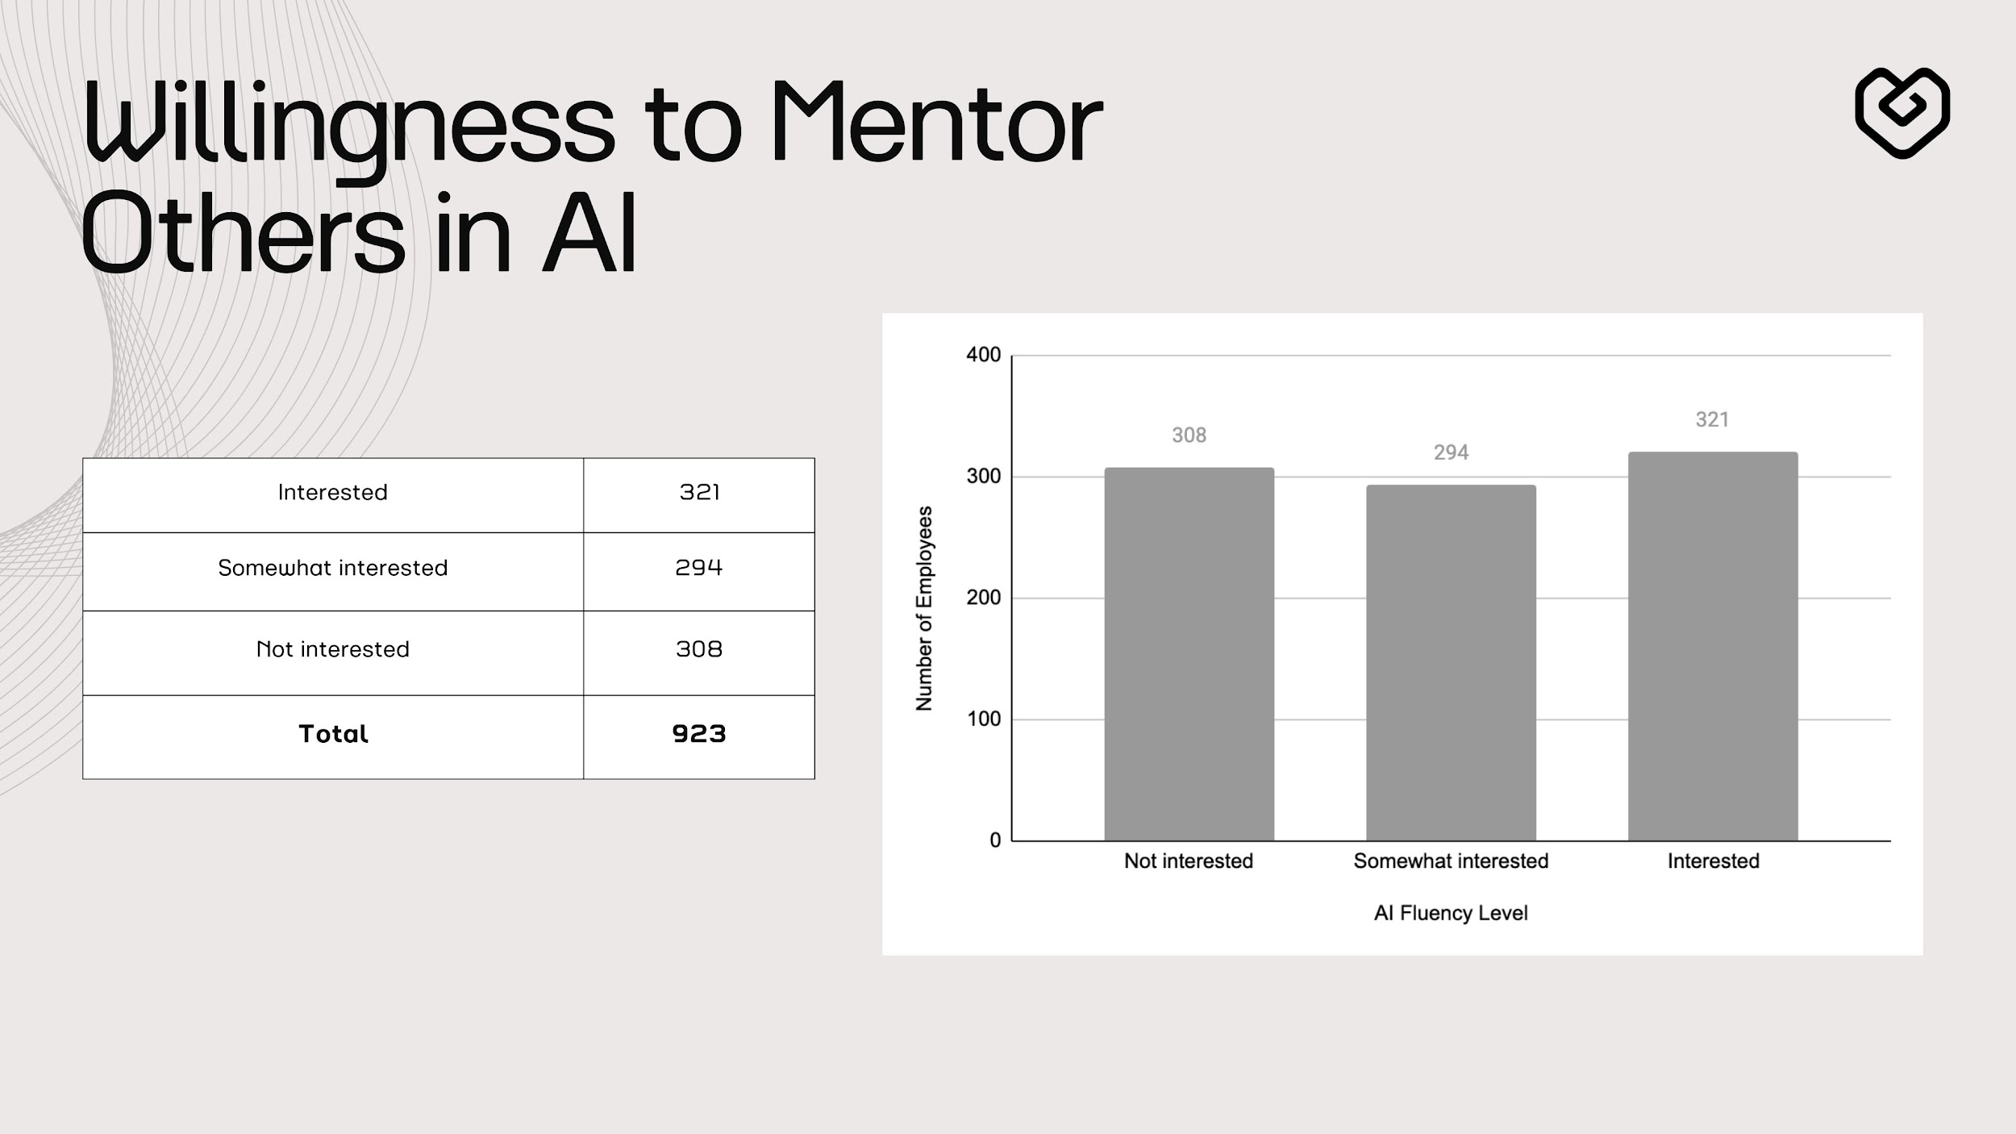

Slide 10
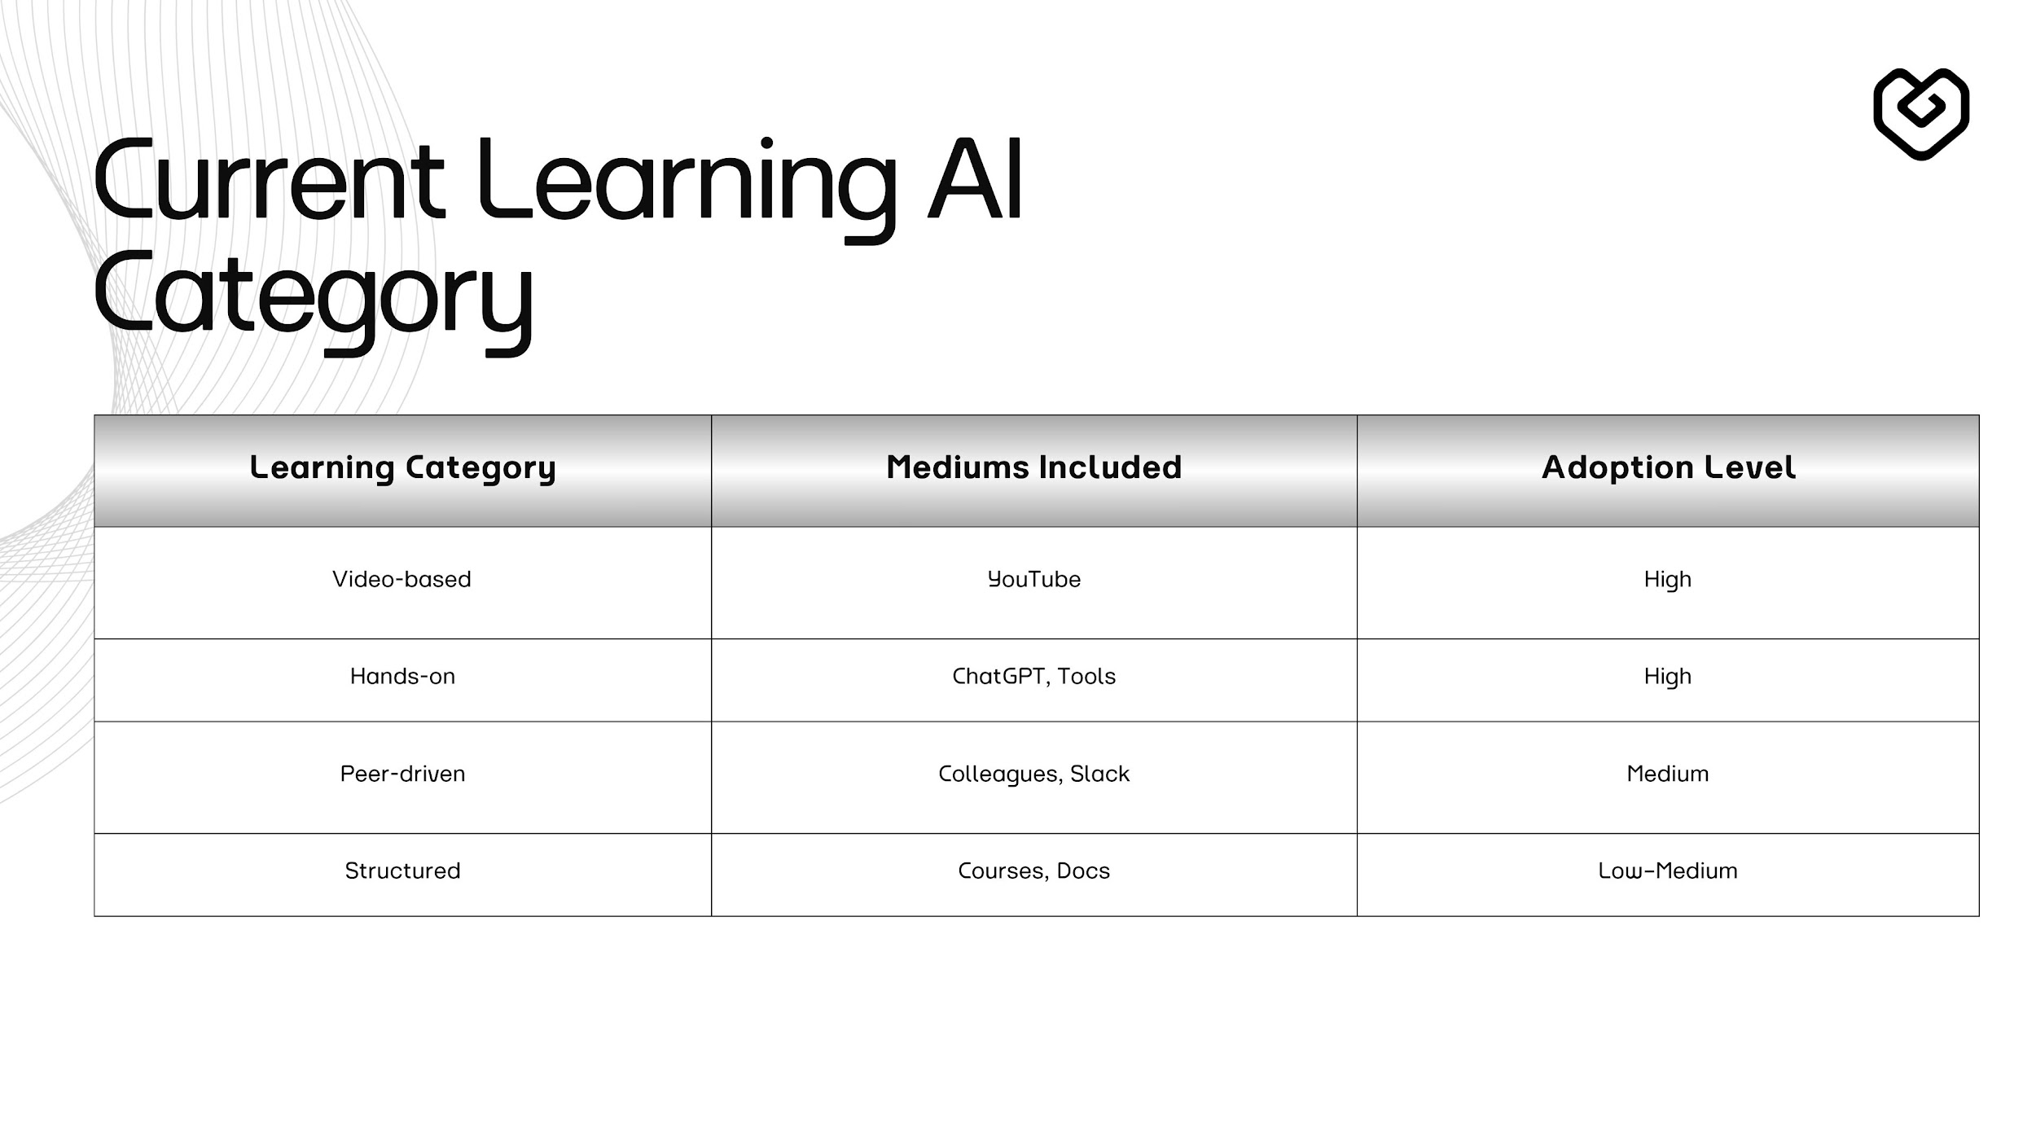

Slide 11
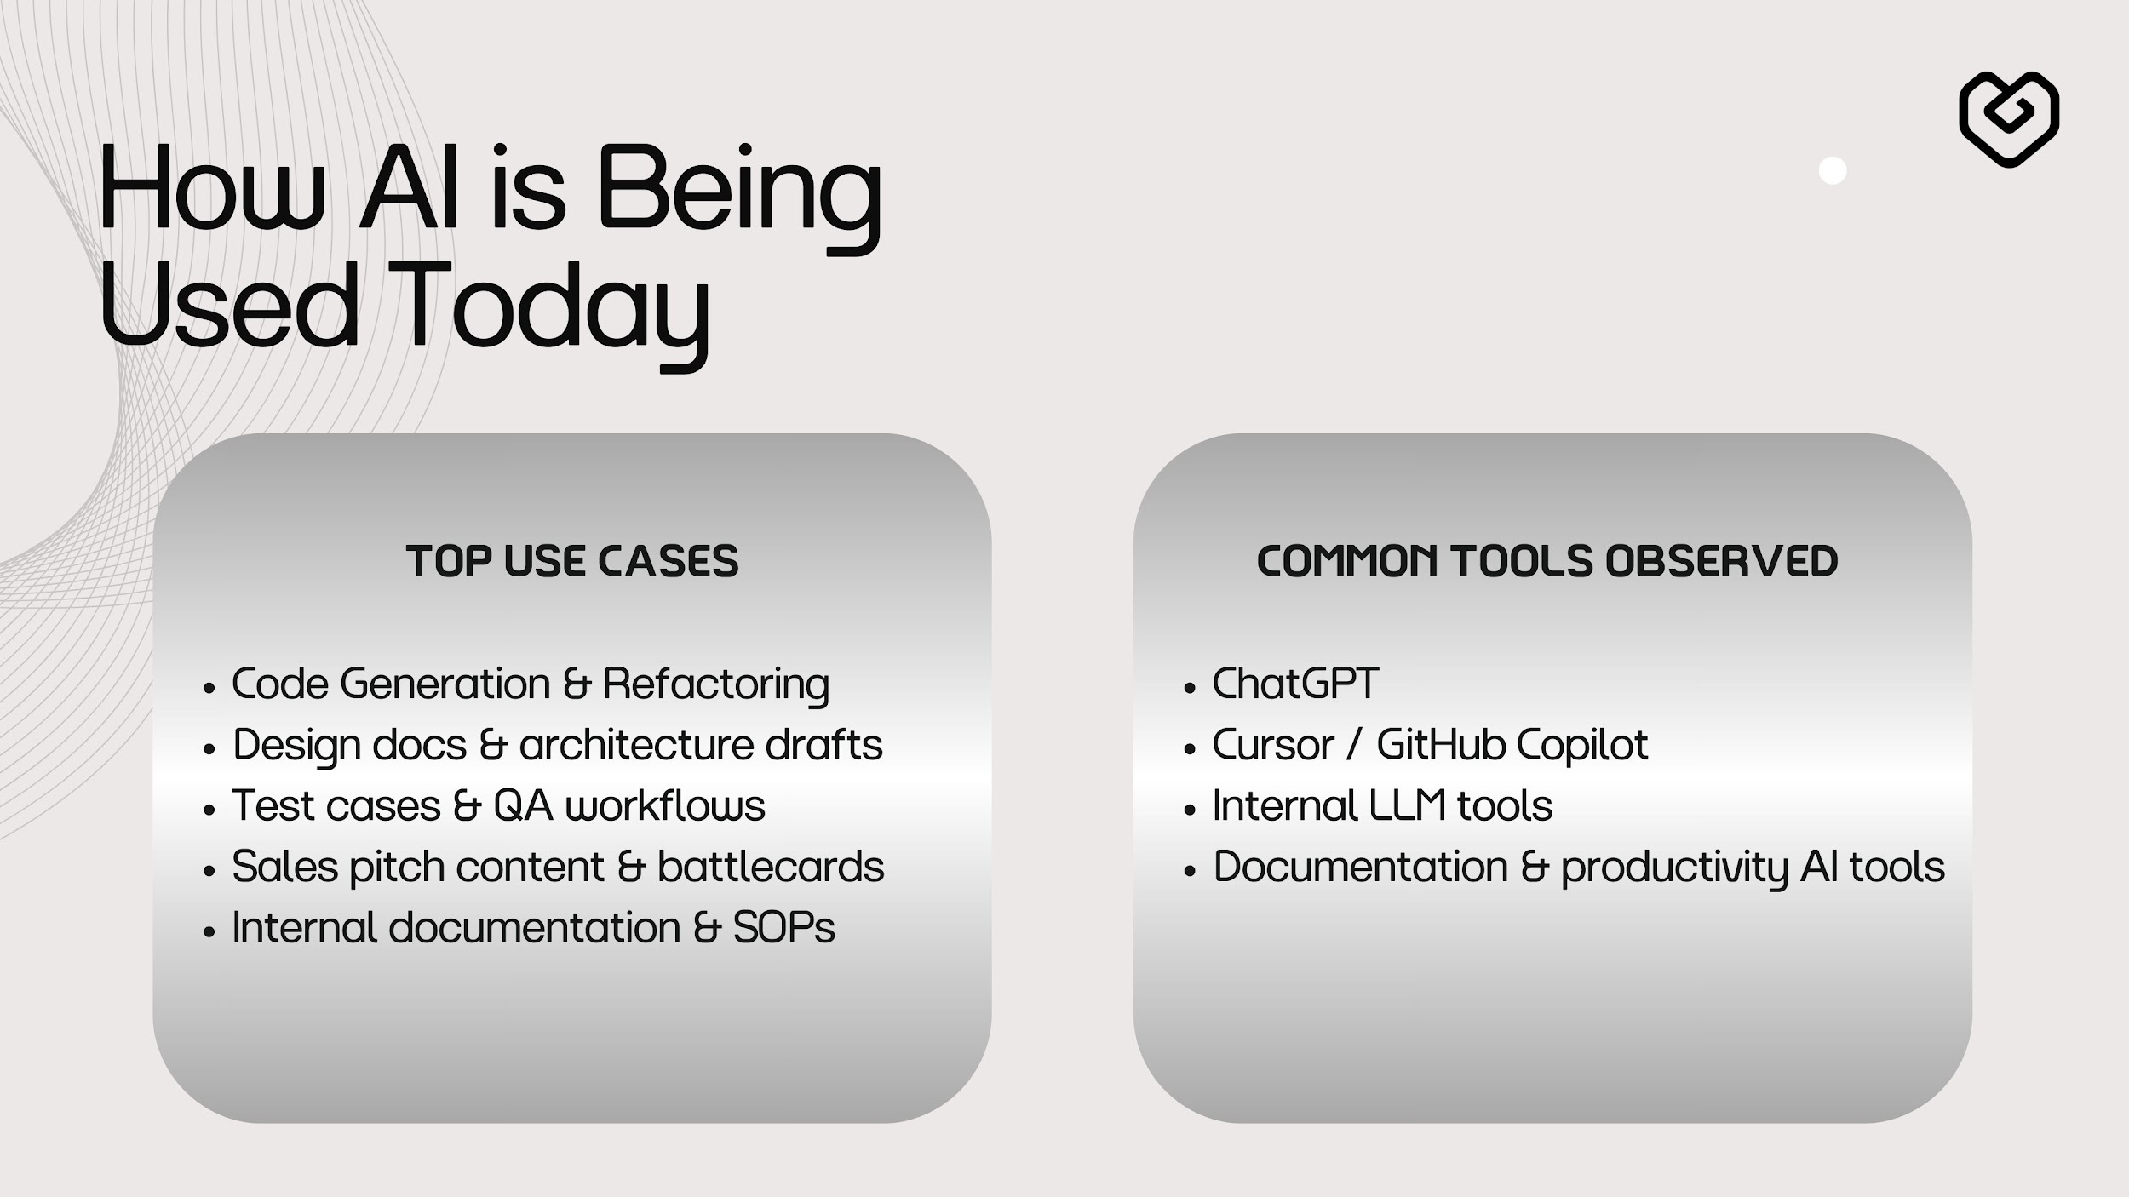

Slide 12
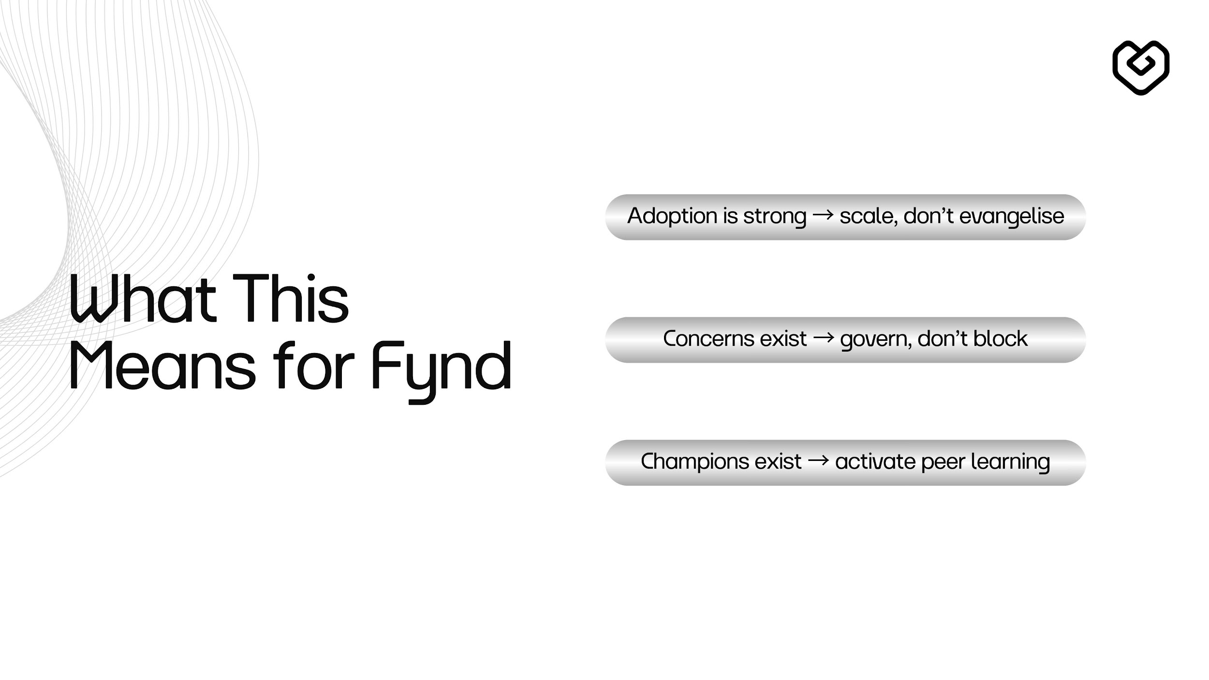

Slide 13
