Slide 1
Tips for Running zCall
Jackie Goldstein
October 3rd, 2012

Slide 2
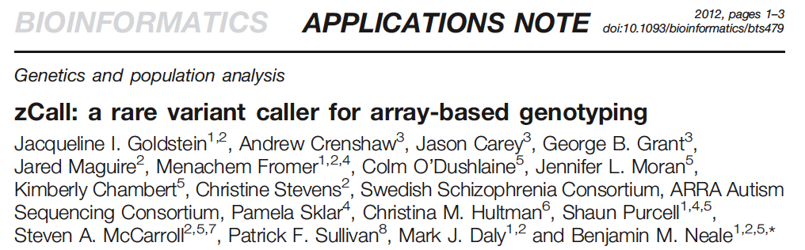
Availability
Download code
http://atguweb.mgh.harvard.edu/apps/zcall
Manuscript available at Bioinformatics website

Slide 3
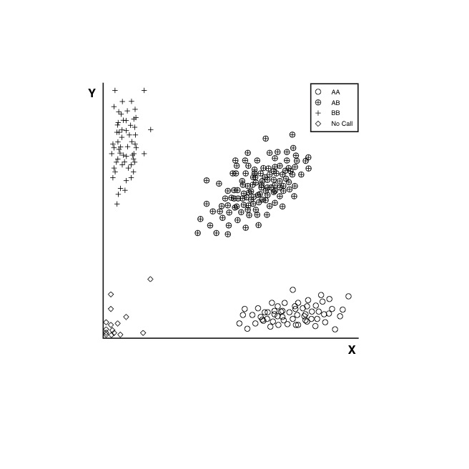
Schematic of how zCall works
Notes:
Schematic of a Typical Cluster Plot for a common SNP from an Illumina Array.

Slide 4
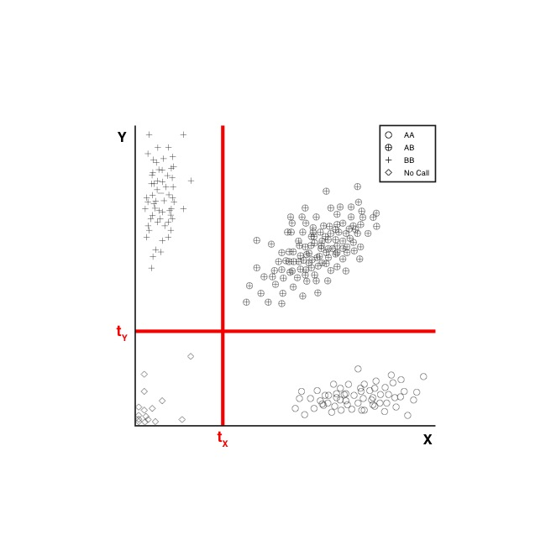
Schematic of how zCall works
Notes:
Two thresholds (Tx and Ty) divide up the space into 4 quadrants that separate each of the clusters (AA,AB,BB)

Slide 5
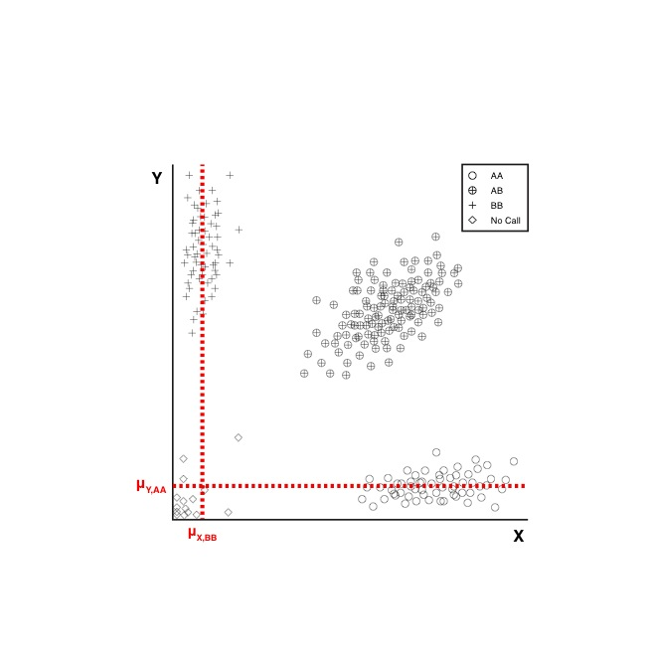
Schematic of how zCall works
Notes:
How do we calculate Tx and Ty? We can start by calculating the means of each homozygote cluster…

Slide 6
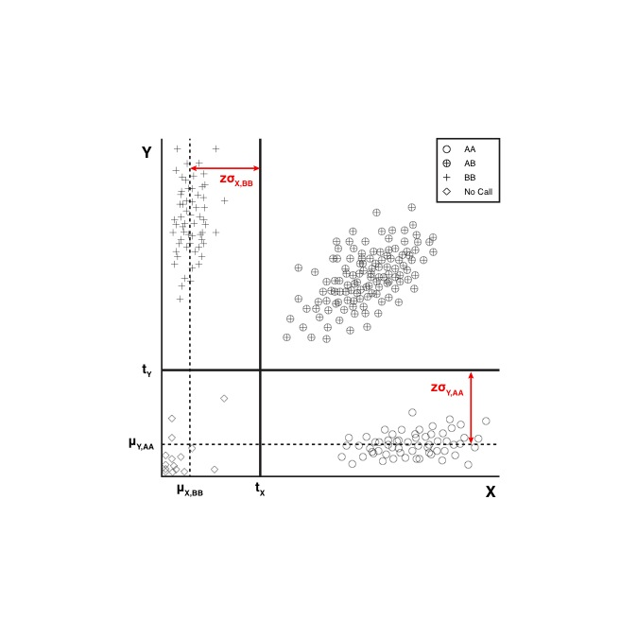
Schematic of how zCall works
Notes:
… and then adding z standard deviations from the mean to get Tx and Ty.

Slide 7
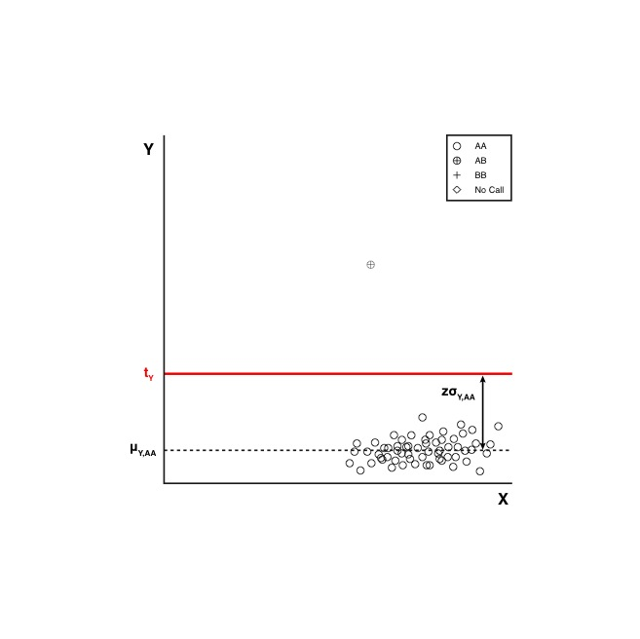
Schematic of how zCall works
Notes:
However, for rare variants, we can only calculate one threshold because there is only one homozygote cluster.

Slide 8
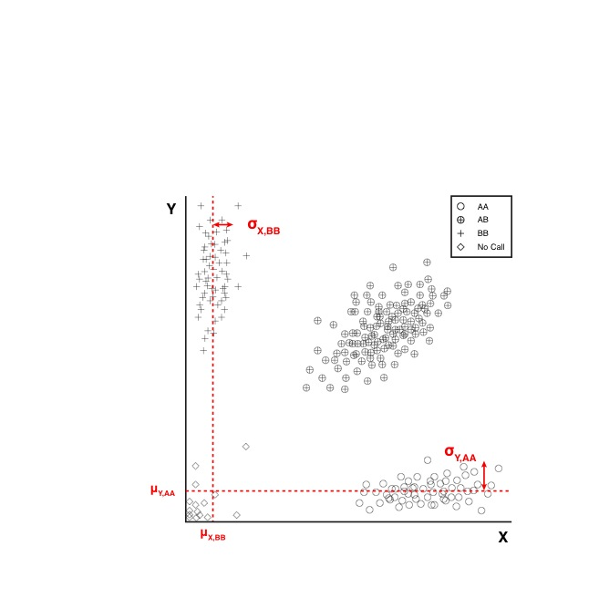
Schematic of how zCall works
Notes:
To solve this problem, we use common sites to define a linear regression model that relates sd_AA to sd_BB and mean_AA to mean_BB.

Slide 9
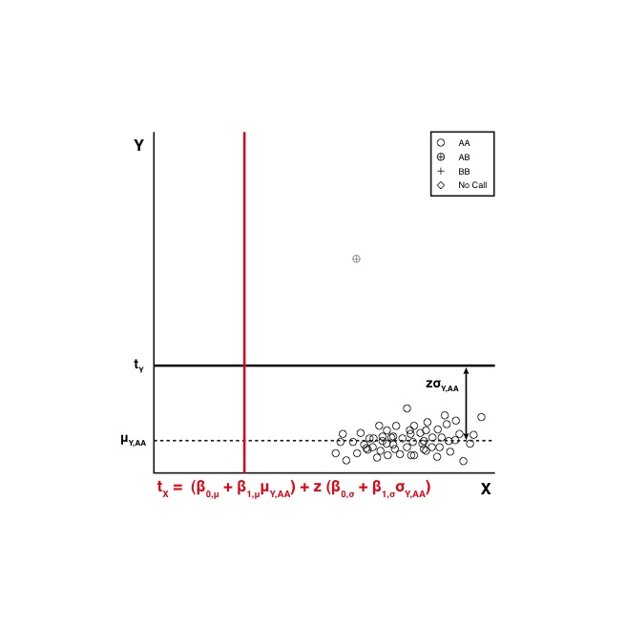
Schematic of how zCall works
Notes:
Now, for rare variants, we can use the linear regression model to solve for the unknown threshold using the known mean and standard deviation from the defined homozygote cluster and the linear regression model.

Slide 10
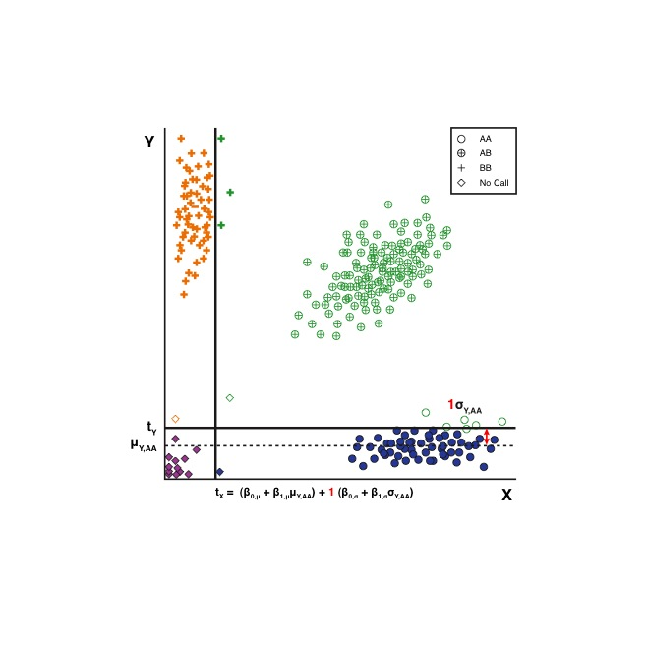
Schematic of how zCall works
Notes:
The next question is what should the z-score threshold be to properly separate the three clusters. If z is too small, then the thresholds overlap the homozygote clusters…

Slide 11
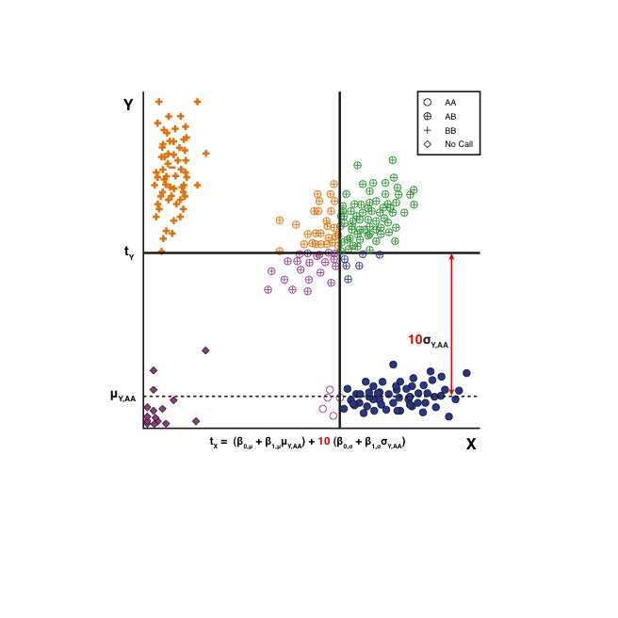
Schematic of how zCall works
Notes:
If z is too big, then the thresholds lie in the heterozygote cluster. To find the optimal z-score, we use common sites (where clustering algorithms work well) to gauge which z-score works best. The z-score (test from 3-15) that maximizes the global concordance between zCall and the original caller is the one that should be used.

Slide 12
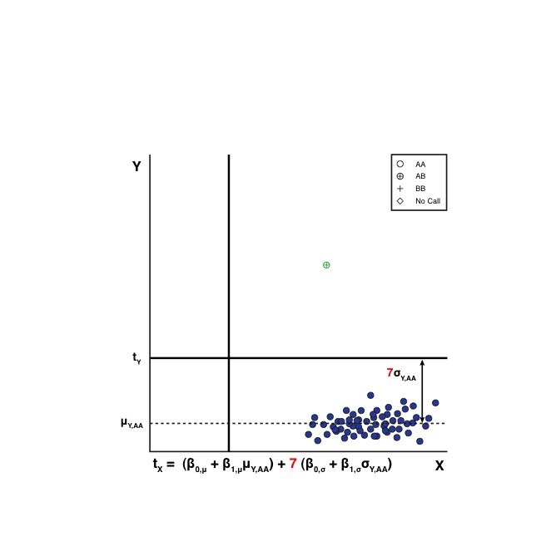
Schematic of how zCall works
BB
AB
NC
AA
Notes:
Once the z-score has been determined from common sites and the linear regression model is known, Tx and Ty can be calculated for each site. Then points are assigned genotypes based on where they lie with respect to the thresholds. We found that the default Illumina caller works well when it calls a point as either (AA,AB,BB). Therefore, the zCall code only recalls No Calls (NC) from the original Illumina calls.

Slide 13
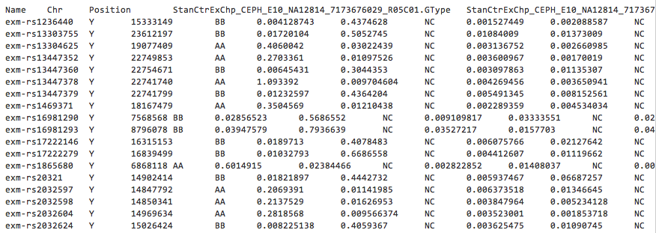
Getting Started…
Download Version 3.3 zip file package available on the github website
Unzip the files (there should be a README, python scripts, and one R script)
Input is an Illumina Genome Studio report

Slide 14
Instructions for Generating Report After a Genome Studio Project Has Been Created
In GenomeStudio select 'Full Data Table' tab.
Click on 'Column Chooser' icon.
In Displayed Columns select 'Name', 'Chr','Position', and all your samples.
In Displayed Subcolumns select 'GType', 'X' and 'Y'.
Hit OK then click on 'Export displayed data to a file' icon.
Alex McKenzie (Duke University)

Slide 15
What does the zCall code do in addition to what’s listed in the manuscript?
Thresholds are derived for all sites (except sites with μ < 0.2 or less than 2 SNPs in the minor allele homozygote cluster) based on the linear regression model
Bad SNPs are not included in the derivation of the regression model
HWE p > 1e-5
MAF > 5%
Call Rate > 99%
At least 10 points in both homozygote clusters
There’s an option to use weighted linear regression in the R code – this improves the R^2 achieved by the model
All No Calls (NC) by GenCall are recalled by zCall
All Calls made by GenCall (AA, AB, BB) are unchanged

Slide 16
Factors that Affect zCall Performance
Bad Samples need to be removed before running zCall
Throw off the calculation of μ and σ
Thresholds are not calibrated correctly
Data needs to be normalized so cluster is as tight as possible and batch effects are minimized (GenomeStudio does this)
zCall will not work very well if the clusters are not separated as depicted in the schematic (Call Rate, P_HWE, and/or GenCall cluster separation scores based on the original Illumina calls can be a proxy for this)
If different batches have significantly different intensity properties, then these should be run through zCall separately in order to get the most accurate μ and σ for each batch

Slide 17
zCall Workflow Step 1: Remove Bad Samples
Use PLINK to identify bad samples based on call rate and heterozygosity
Bad samples will have excess het calls and/or high missing rates compared to the majority of samples
Use convertReportToTPED.py script to turn the Genome Studio report into PLINK files
Use dropSamplesFromReport.py to remove bad samples from GenomeStudio report
Faster version of this script is available separately on github website

Slide 18
zCall Workflow Step 2: Derive the Linear Regression Model
Use the script findMeanSD.py to calculate μ and σ of both homozygote clusters for common sites (MAF > 5%)
Take the output of Step 1 and run findBetas.r to derive the linear regression model
We suggest using the “1” flag for weighted linear regression

Slide 19
zCall Workflow Step 3: Derive the Thresholds
Use the output from findBetas.r and the clean GSR to determine which z-score threshold to use by running calibrateZ.py for different z-score threshold inputs (i.e. 3-15)
There was a small bug in the calibrateZ.py script making it so the script would not run.
Determine which z-score threshold works best for your dataset based on the output statistics
Use the findThresholds.py script to derive the thresholds using the linear regression model, the optimal z-score threshold, and the clean GSR

Slide 20
zCall Workflow Step 4: Make Genotype Calls
Use the zCall.py script with the clean (or original) GSR and the thresholds output from findThresholds.py. Output is a TPED and TFAM file with only No Calls recalled by zCall.

Slide 21
Things to Note About Resulting TPED
Since all NC’s have been recalled, using the zCalls for QC is not advised.
Bad SNPs and samples should be determined from the original calls. These can then be removed from the zCalls using --remove and --exclude

Slide 22
Questions
Jackie Goldstein (jigold@broadinstitute.org)

