Slide 1
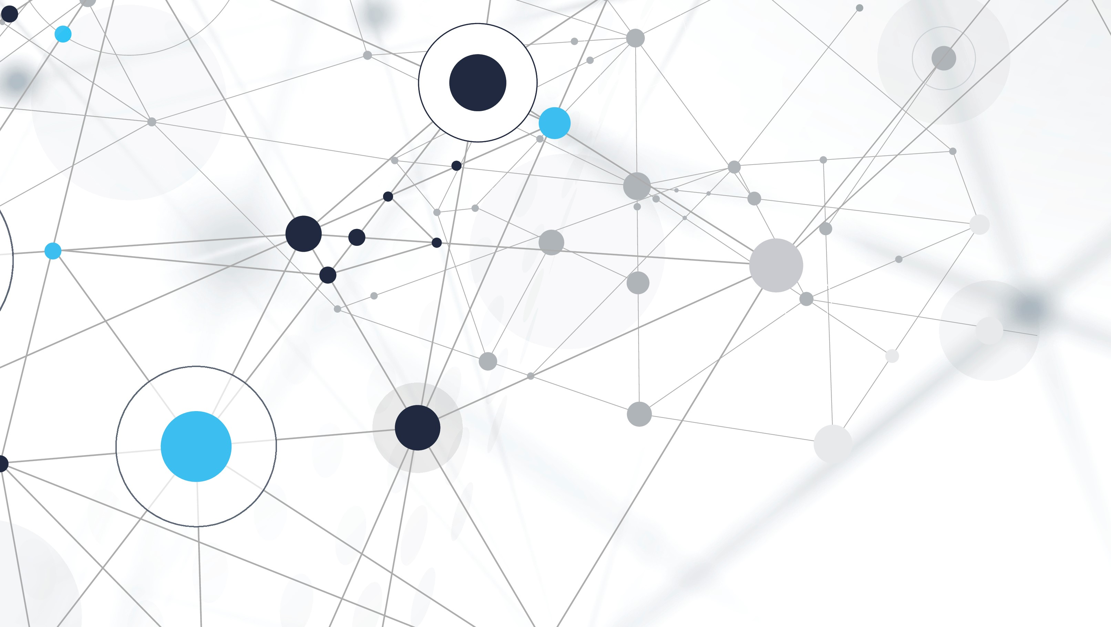
Multi-class Classification of Brain MRI Scans using Machine Learning
Eric Lehmphul

Slide 2
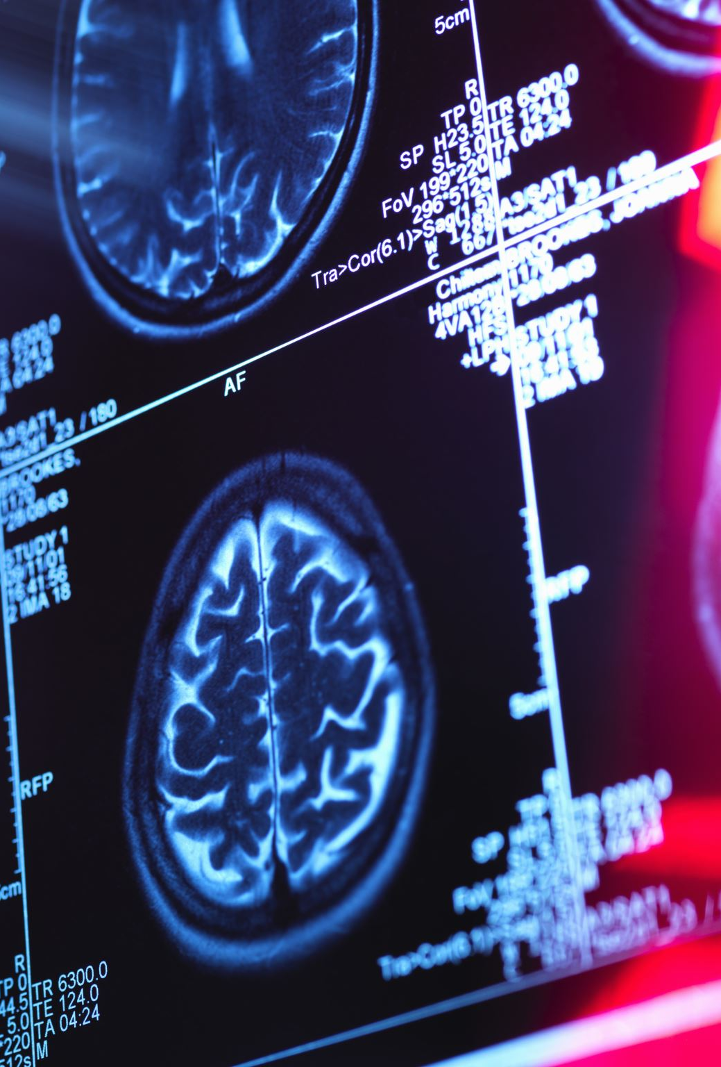
Introduction
Brain related cancers constitute a serious health concern worldwide, accounting for the 10th deadliest cancer in terms of mortality quantity in 2019 (Roser & Ritchie, 2015). Early and accurate diagnosis is imperative for survival chance. Traditionally, the process of tumor classification has relied heavily on the expertise of radiologists. Deep learning has dramatically increased the effectiveness of computer vision tasks, including those in the medical domain. This study will explore a machine learning approach to classify brain MRI images into 4 different categories: Normal, Glioma, Meningioma, and Pituitary. The goal is to create a deep learning algorithm to aid radiologists in diagnosing by providing fast and accurate predictions of brain MRI scans.

Slide 3

Literature Review

Slide 4

Convolutional Neural Network Classification on Medical Images
Krizhevsky et al. (n.d.) proved CNNs to be effective at achieving significant results on the ImageNet dataset
Kermany et al. (2018) leveraged transfer learning on optical coherence tomography (OCT) images to classify 4 different types of retinal conditions. They achieved an accuracy of 96.6%, sensitivity of 97.8%, and a specificity of 97.4%. They found that the best model outperformed experts.
Khan et al. (2021) developed a CNN to segment and classify the various types of breast abnormalities. They utilized the previously trained model, ResNet50, via transfer learning. The model architecture contained 13 convolutional layers, 5 pooling layers, 3 dense layers, and 1 output layer. The proposed model achieved an accuracy of 88% of 4 different types of breast abnormalities.

Slide 5

Data Augmentation
Kiryati & Landau (2021) describe the challenging and costly methods for obtaining relevant medical images. Typlically, images need to obtain regulatory approvals, be found in an institutional archive, and have identifing details removed prior to use.
Pan et al. (2019) explored the effects of image augmentation on a food recognition CNN algorithm. They enacted basic image transformations like flipping and rotating images to expand the training size. The augmented dataset outperformed the non-augmented dataset in two of the three model frameworks.
Yang et al. (2022) used several data augmentation methods to improve overall model accuracy. Image manipulation methods, image erasing methods, and image mix methods were all applied to the data to create the augmentation dataset. They found that the accuracy improvements ranged from 0.07% to 2.8% on the datasets used.

Slide 6
Methodology
Data Exploration
Data Preparation
Convolutional Neural Network Analysis

Slide 7
Data Source
Contained 3264 image files of brain MRI scans.
2585 were used for training
285 used for validation
394 used for testing
Retrieved from Kaggle.com (https://www.kaggle.com/datasets/sartajbhuvaji/brain-tumor-classification-mri)

Slide 8
Data Exploration

Slide 9
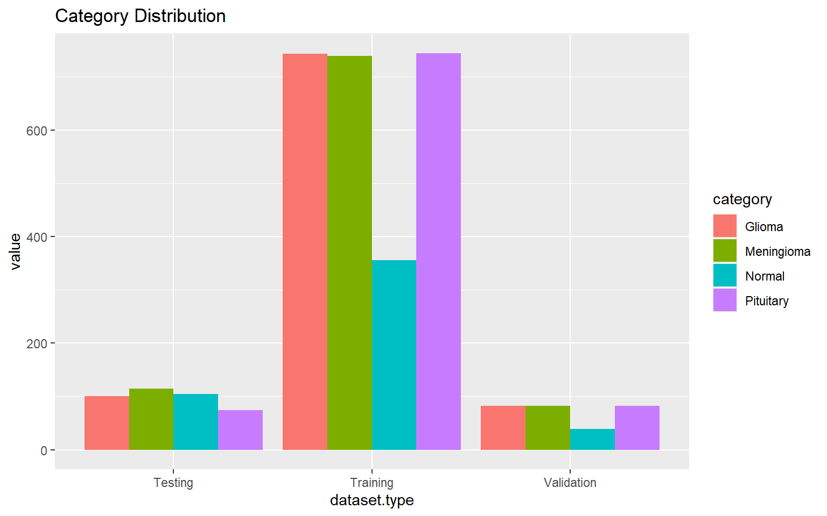
Data Distribution

Slide 10
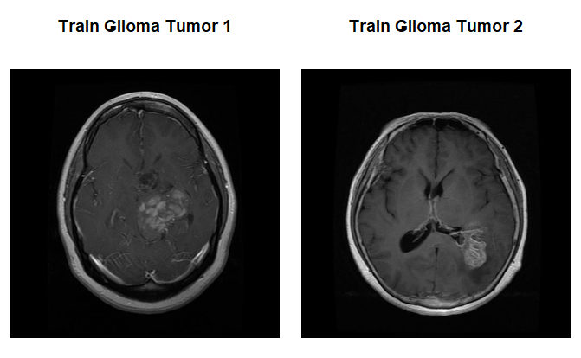
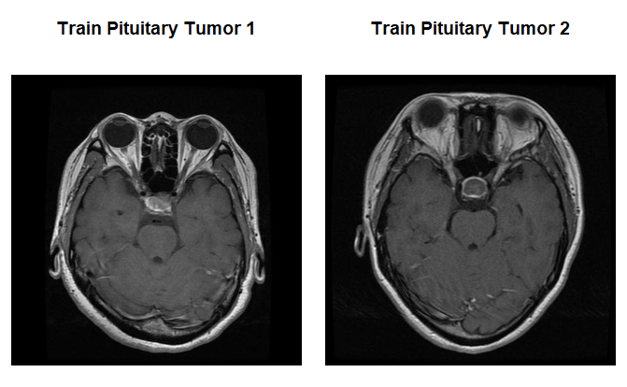
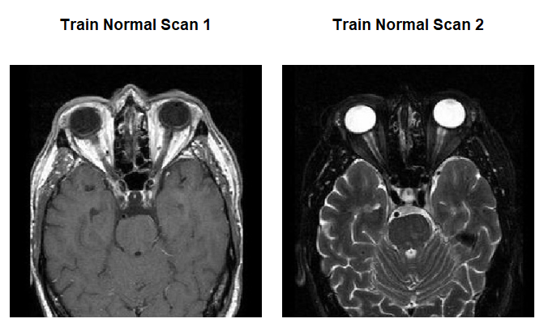
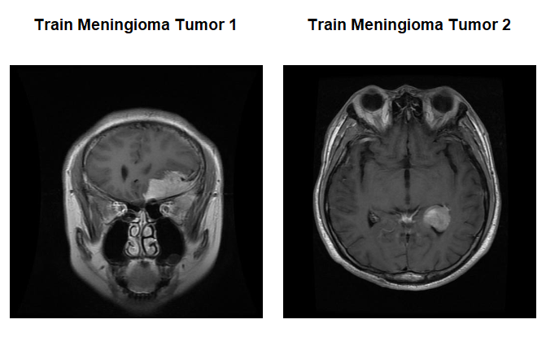
Images

Slide 11
Data Preparation

Slide 12
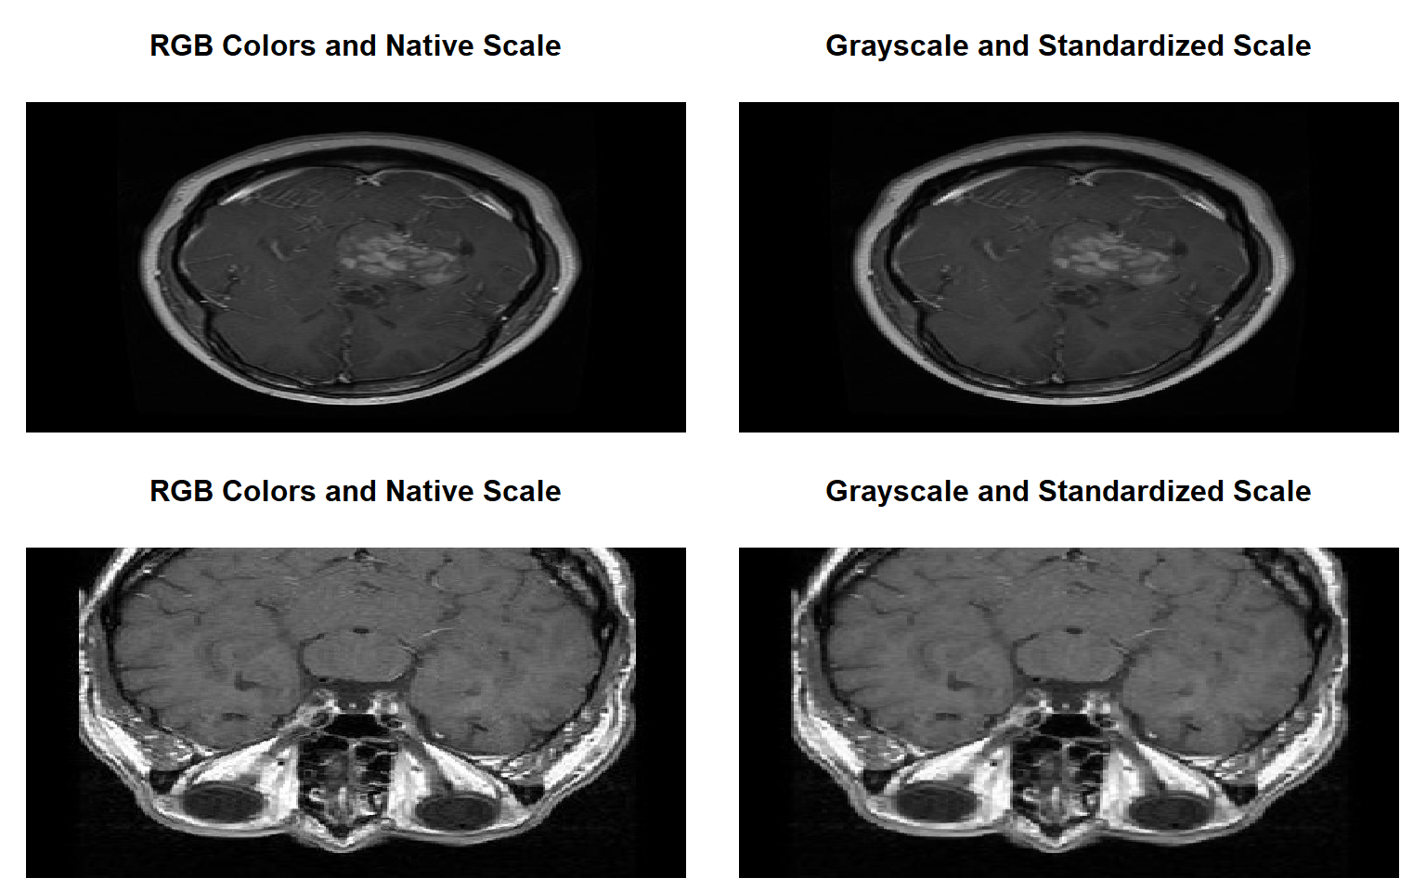
Data Adjustments
Resized images to 256 pixels x 256 pixels. Study found optimal f1 score with 256 x 256 resolution (Thambawita et al., 2021)
Converted the RGB color channel images to a single channel grayscale image
Normalized pixel intensity to be between 0 and 1

Slide 13
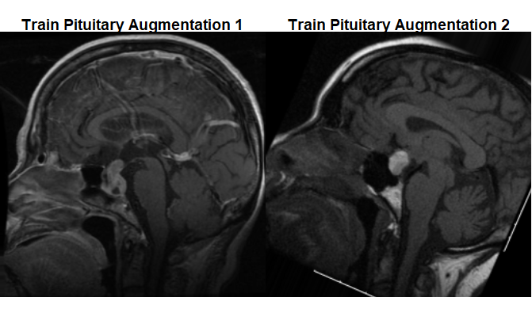
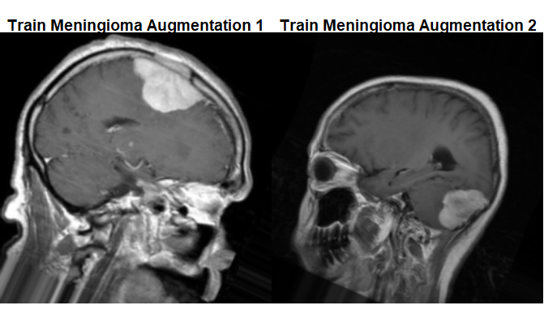
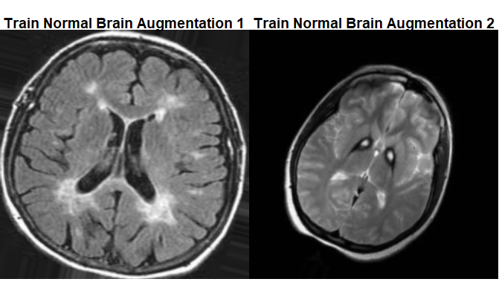
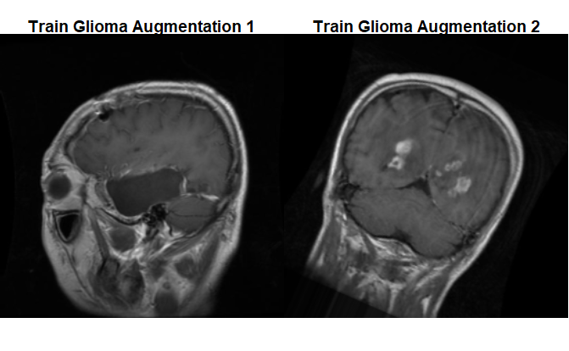
Image Augmentation
Used to expand the number of images the dataset, allowing for the model to more effectively generalize. The images were:
Randomly flipped across the y axis
Randomly rotated between 0 and 30 degrees

Slide 14
Convolitional Neural Network Analysis

Slide 15
Model Architectures
Model 1 | Model 2
Input Image: 256 x 256 x 1 | Input Image: 256 x 256 x 1
Convolutional Layer: Filters = 32, Kernel = 4 x 4, Padding = same, Activation = ReLu | Convolutional Layer: Filters = 16, Kernel = 5 x 5, Padding = same, Activation = ReLu
Pooling Layer: Size = 3 x 3 | Pooling Layer: Size = 4 x 4
Dropout Layer: Rate = 0.1 | Dropout Layer: Rate = 0.1
Convolutional Layer: Filters = 32, Kernel = 4 x 4, Padding = same, Activation = ReLu | Convolutional Layer: Filters = 16, Kernel = 5 x 5, Padding = same, Activation = ReLu
Pooling Layer: Size = 3 x 3 | Pooling Layer: Size = 4 x 4
Dropout Layer: Rate = 0.1 | Flatten Layer
Convolutional Layer: Filters = 32, Kernel = 4 x 4, Padding = same, Activation = ReLu | Dense Layer: Units = 12, Activation = ReLu
Pooling Layer: Size = 3 x 3 | Dense Layer: Units = 4, Activation = Softmax
Flatten Layer
Dense Layer: Units = 16, Activation = ReLu
Dense Layer: Units = 4, Activation = Softmax

Slide 16
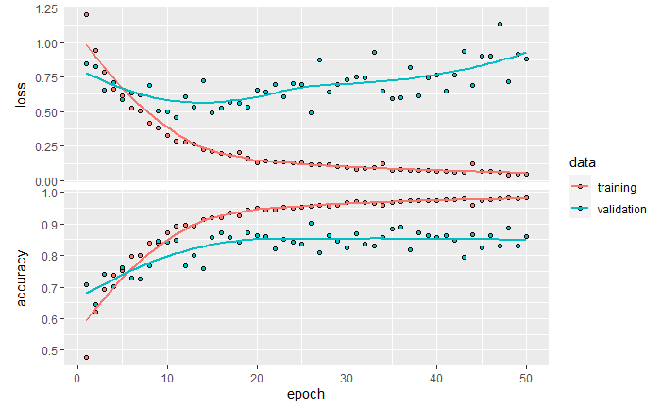
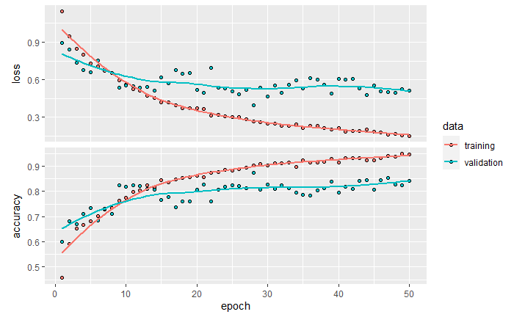
Model Training
Model 1:
Optimized via Adam algorithm
Loss function: Categorical Crossentropy
Trained for 50 epochs
Batch size of 20 images. 130 batches were used per epoch and 15 batches were used during validation
Model 2:
Optimized via Adam algorithm
Loss function: Categorical Crossentropy
Trained for 50 epochs
Batch size of 32 images. 80 batches were used per epoch and 9 batches were used during validation

Slide 17
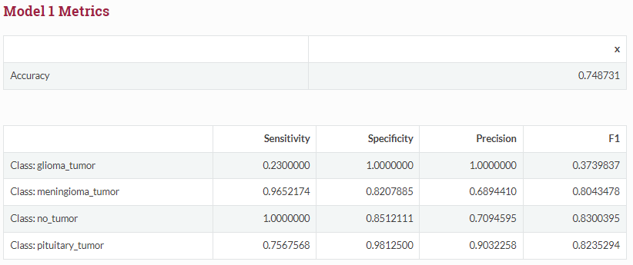
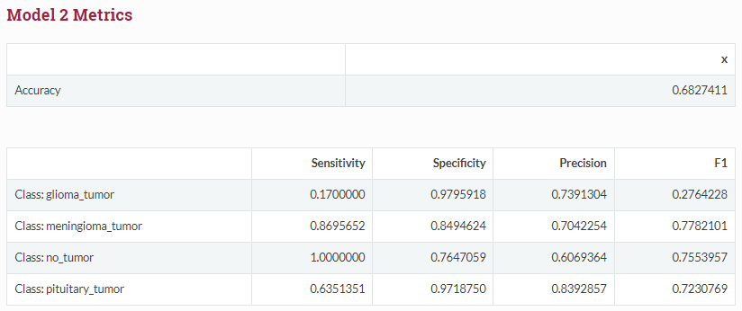
Model Evaluation

Slide 18
Conclusion
The best model created achieved 74.87% with high F1 scores for 3 of the 4 categories. The class, glioma, severely underperformed which is likely due to the glioma tumor class did not have enough diverse images to successfully generalize.
Results are promising to be used within a medical setting
Limitations:
Limited amount of medical image availability
Time
Future research for this project:
Transfer Learning
Increase number of classes
Leverage more in-depth data augmentation techniques
Develop more comprehensive model architectures

Slide 19
Bibliography
Bhuvaji, S. (2020, May 24). Brain tumor classification (MRI). Kaggle. https://www.kaggle.com/datasets/sartajbhuvaji/brain-tumor-classification-mri
Kermany, D. S., Goldbaum, M., Cai, W., Valentim, C. C. S., Liang, H., Baxter, S. L., McKeown, A., Yang, G., Wu, X., Yan, F., Dong, J., Prasadha, M. K., Pei, J., Ting, M. Y. L., Zhu, J., Li, C., Hewett, S., Dong, J., Ziyar, I., … Zhang, K. (2018). Identifying medical diagnoses and treatable diseases by image-based Deep Learning. Cell, 172(5), 1122–1131. https://doi.org/10.1016/j.cell.2018.02.010
Khan, M. H.-M., Boodoo-Jahangeer, N., Dullull, W., Nathire, S., Gao, X., Sinha, G. R., & Nagwanshi, K. K. (2021, August 26). Multi- class classification of breast cancer abnormalities using deep convolutional neural network (CNN). PLOS ONE. https://doi.org/10.1371%2Fjournal.pone.0256500
Kiryati, N., & Landau, Y. (2021, August 20). Dataset growth in Medical Image Analysis Research. MDPI. https://www.mdpi.com/2313-433X/7/8/155
Krizhevsky, A., Sutskever, I., & Hinton, G. E. (n.d.). ImageNet Classification with Deep Convolutional Neural Networks. https://proceedings.neurips.cc/paper_files/paper/2012/file/c399862d3b9d6b76c8436e924a68c45b-Paper.pdf
Pan, L., Qin, J., Chen, H., Xiang, X., Li, C., & Chen, R. (2019). Image augmentation-based food recognition with Convolutional Neural Networks. Tech Science Press. https://www.techscience.com/cmc/v59n1/27933
Roser, M., & Ritchie, H. (2015, July 3). Cancer. Our World in Data. https://ourworldindata.org/cancer#:~:text=About%20ten%20million%20people%20die,health%20problems%20in%20the%20world
Thambawita, V., Strümke, I., Hicks, S. A., Halvorsen, P., Parasa, S., & Riegler, M. A. (2021, November 24). Impact of image resolution on deep learning performance in Endoscopy Image Classification: An experimental study using a large dataset of endoscopic images. Diagnostics (Basel, Switzerland). https://www.ncbi.nlm.nih.gov/pmc/articles/PMC8700246/
Yang, S., Xiao, W., Zhang, M., Guo, S., Zhao, J., & Shen, F. (2022, April 19). Image Data Augmentation for Deep Learning: A Survey. arXiv.org. https://arxiv.org/abs/2204.08610

