Slide 1

Apartments.com
Group 9
SANEEL TARE (002951543)
UTKARSH DHANDE (002958223)
RUTUJA GHOGARE (002924946)
ANJALI KAKADE (002923023)
RITI GAWADE (001059647)
NIKITA PATIL (002176202)

Slide 2
PRODUCT OBJECTIVES
To design the search box so that no irrelevant information is displayed
To enhance consumer a realistic representation of the rental property through 3D walkthroughs and videos
Developing chatbot functionality to offer user-friendly customer care
Added and updated filtering options to suit users' requirements for purchasing rental property
To provide consumers the option to rate and review properties
Creating an agent profile with information ,which results in a verified agent profile for advertising apartments
Providing consumers with information about nearby conveniences and the amenities available at the specified property
To only provide users with advertisements for unsold properties
To provide consumers the opportunity to book a tour with a rental agent to look at a particular rental home

Slide 3

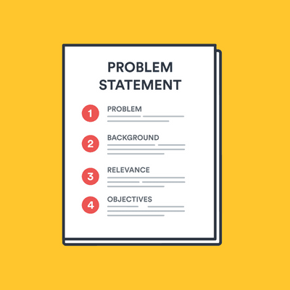
PROBLEM STATEMENT
Apartment.com has problems related to property search filtering option, chatbot implements, and weak login security for property owners and brokers

Slide 4

PROPOSED SOLUTION
Our main objectives is to enhance the property search filtering option, implement chatbots, and create improved login inputs that use features like license number input and state id upload

Slide 5
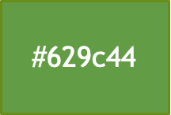
DESIGN SYSTEM
#AC3F27
It is used for buttons and pop-up messages
#dfedd6
It is used for footer in every page
#e61610
It is used for important warning and alerts
#3d8af7
This color has used for chatbot function
#d6d6d6
It is used to display chat between user and customer support

Slide 6
TARGET AUDIENCE
Age Group
18-70 years (Students, Men/Women, Old age people who are looking for apartments)

Slide 7
DESIGN PROCESS
Product Definition
To improve the user experience when searching for apartments, we want to overhaul the search bar, image arrangement, and search filters. We plan to create a new function, like a chatbot, to assist users with their fundamental needs
Research
We conduct Individual in-depth interviews with the users and agents to understand their basic needs and expectation towards the website
Analysis
We created personas based on the user's stories, performed card sorting techniques with users
Design
To understand whether users and agent are comfortable with the model we implemented the porotype wireframing using Moqups
Validation
We obtain the feedback from the users regarding the apartment they lived, or they schedule the tour their chosen apartments.

Slide 8
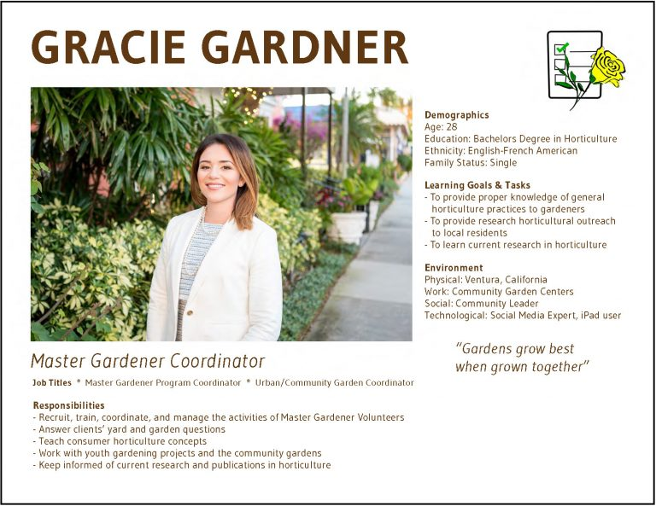
PERSONA 1
Name | Emily
Location | Boston
Status | Master's student
Bio | Relocated from Boston to Florida
 | Looking for ways to envision her new apartment without driving to the university
Goals and Needs | Validation from customer reviews
 | Comparison of different apartments
 | Pictures from every angle to setup her desktop environment
Frustrations | Search engine does not show relevant results
 | Hard to envision overall image of the room
 | Avoid driving to university and stores
 | Multiple steps and slow leading times of application

Slide 9

PERSONA 2
Name | Musk
Location​ | Cambridge
Status​ | Engineer
Bio​ | Currently living in condo with his spouse
​ | Place is getting expensive, hence looking for a cheaper one to save money for future home
Goals and Needs​ | Become a homeowner
​ | Enough money for down payment of his own permanent home
​ | One day back to his homeland
Frustrations​ | Finding a cheaper apartment
​ | Location constraints
​ | Not enough selection while searching online

Slide 10
PERSONA 3
Name​ | John
Location​ | New York
Status​ | Product Manager
Bio​ | Lives with his girlfriend
​ | Living in rented apartment, 2.5 rooms with his girlfriend and works at MNC
 | After a tiring day, he likes to throw on couch in front of the TV
Goals and Needs​ | Design house at low investment
​ | Apartment should look same as given on the website
Frustrations​ | Unable to provide feedback for apartments whose in-person tour was taken so new customers might not mislead
​ | Damaged interior kept unrepaired by management because of previous renters
Location​ | New York

Slide 11
PERSONA 4
Name​ | Evelyn
Location​ | Andover
Status​ | Retired Homemaker
Bio​ | A homemaker who do not usually prefer walking
​ | She takes her car out for buying grocery
 | She has an emotional support animal named Lili
Goals and Needs​ | Try not to stress for unnecessary things
​ | Staying healthy in whatever ways possible
 | Wants to move to a town with less people and find an apartment at low prices and which has got a garage for parking and the apartment is pet-friendly
Frustrations​ | Unavailability of parking slots
​ | More crowded area

Slide 12
USER NEEDS
Location is one of the most crucial factors when choosing a place to stay. The website needs to be more specified about the locations searched by the user
The website should mention all the details of the convenient travelling facility near the apartment. The user needs detailed information of what modes of transportation are available for them, when he purchases the apartment
Utility should be included in the description so that the users get more details about the apartments. Also, specifically the user expects the details of the utility paid by the lessor and lessees
Included in the description of the website about the pet’s policy
If the user filters for expected budget rent in certain areas, then the website is expected to show results within that range
The website must include all the facilities that are at walkable distance from the apartment

Slide 13
USABILITY TESTING OBJECTIVES & TASKS
Understand the competition and identify opportunities
Provides valuable insights to develop a UX strategy
Enhance product user experience and business value

Slide 14
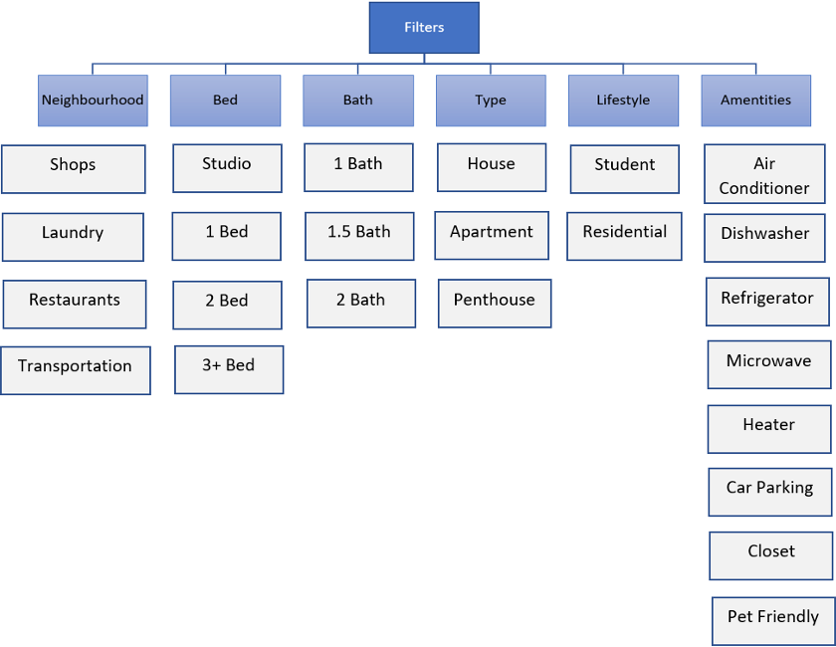
CARD SORTING IMPLEMENTATION
Open Card Sorting

Slide 15
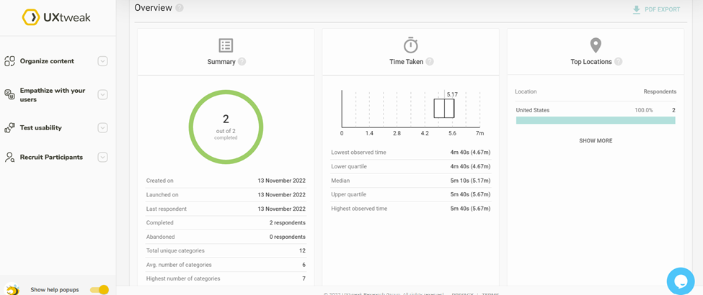
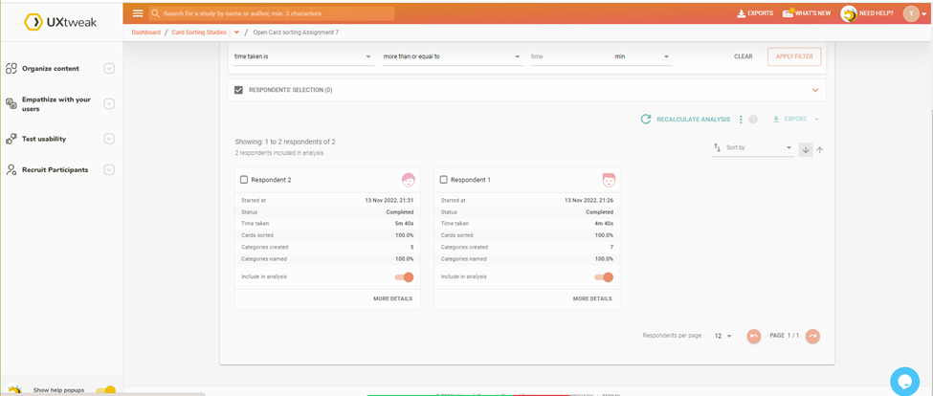
Screenshots
Open Card Sorting

Slide 16
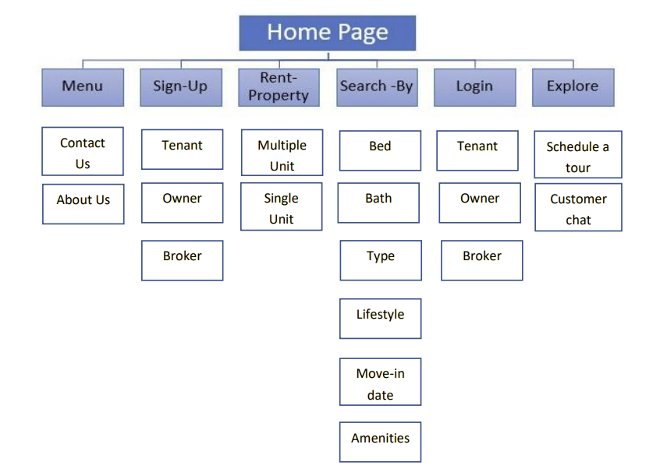
CARD SORTING IMPLEMENTATION
Closed Card Sorting

Slide 17
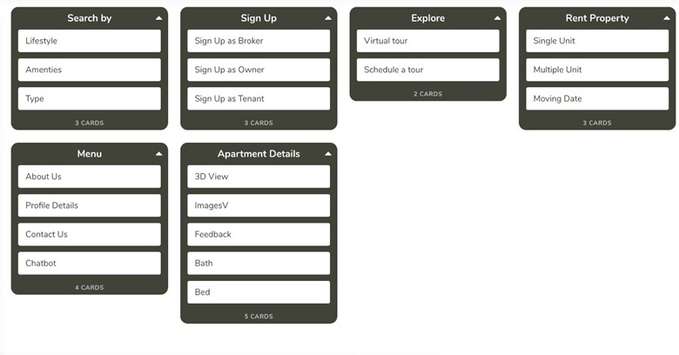
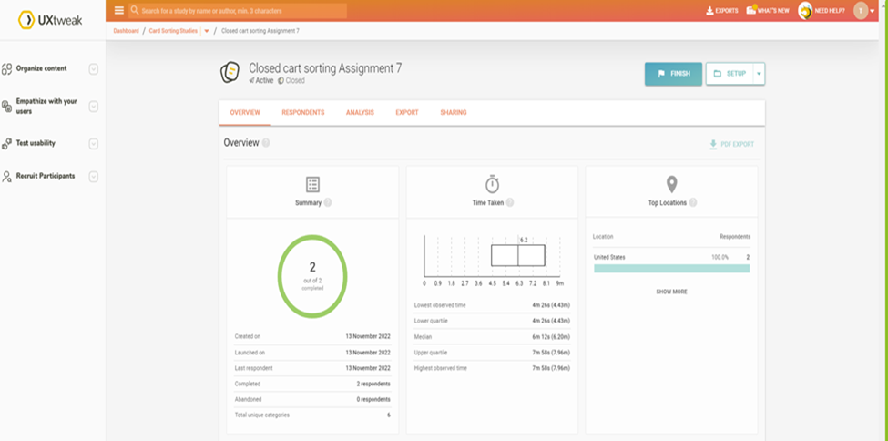
Screenshots
Closed Card Sorting

Slide 18
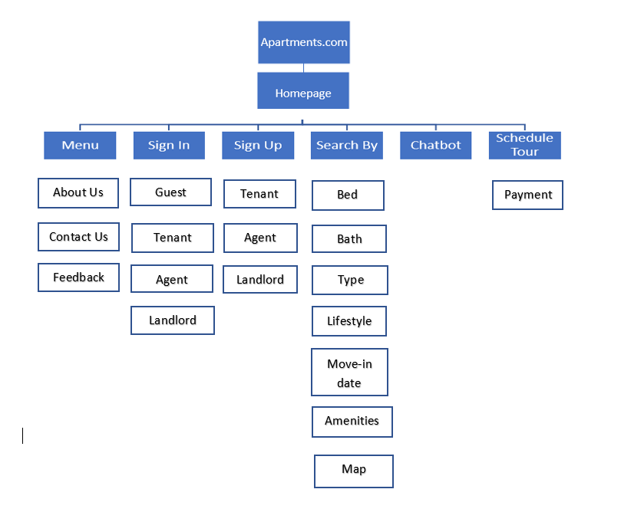
INFORMATION ARCHITECTURE

Slide 19
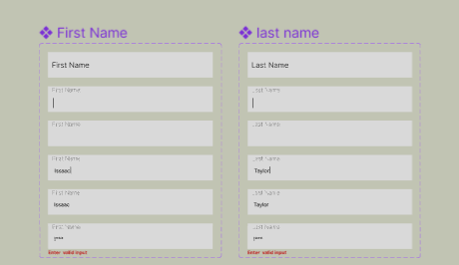
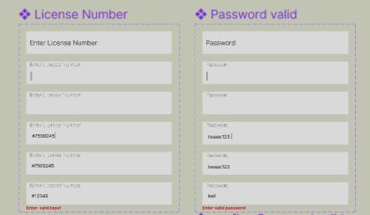
ERROR HANDLING

Slide 20
USABILITY TESTING OBJECTIVES & TASKS
Step-I: Plan carefully
Step-II: Prepare your product or prototype for testing
Step-III: Selecting user personas
Step-IV: Conducting the Usability Bug Review
Step-V: Document the test results well
Step-VI: Analyze the results thoroughly and repeat

Slide 21
SUMMARY of each PLANE
Strategy Plane: We learn why we are developing our website in this plane and how it will meet user demands. Here, our primary goal is to give individuals a platform to rent properties and market those properties on our website. Making apartment accessible and reasonable for individuals is our major goal
Scope Plane: We used a scope plane to define the project's scope. We split requirements into categories based on priority, such as chat functionality and the most crucial filtering based on user location, and included looking for apartments by filtering them according to their needs and convenience

Slide 22
SUMMARY of each PLANE
Structure Plane: The structure plane provides us an idea of the kind of information we may include, so our apartment page includes details on the unit's amenities, transportation, and grocery shops. Additionally, we gather ideas to include on the apartment page is .it also gave us the idea to include svhatbot feat
Skelton Plane: The Skelton plane aids in our understanding of how to organize the material on our website so that consumers can easily browse and discover desired services facilities. In order to simplify the rental procedure, we included a payment option on the apartment website
Surface Plane: For our product to compete with other applications that offer the same services, surface plane is crucial. This assisted us in choosing colors that would be calming to the user's eyes and make them prefer our application to others. Numerous seemingly little factors, like as font size and element placement, have a significant impact. We conducted research, examined the contrasts, and chose the best one for our project

Slide 23
MosCow Techniques
Must Have
User’s privacy
Should Have
Chatbot for live communication
Could Have
Dark mode feature
Will Not Have
Multiple language
Rating for property
Information about facilities and amenities
Providing proper filter and search features
Available apartments listings to be sent.

Slide 24
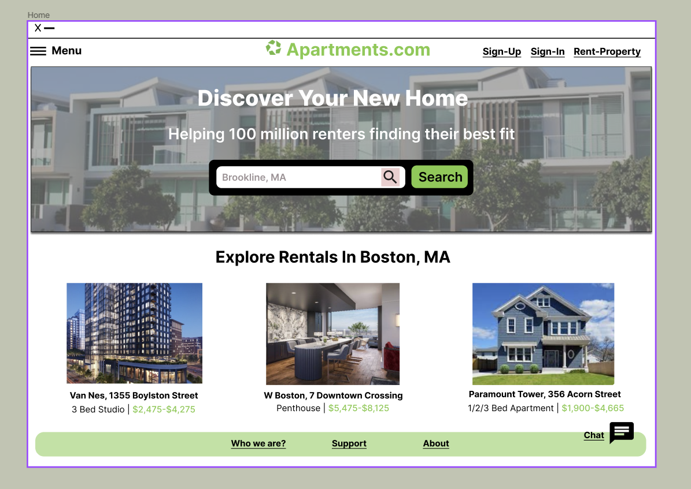
Onboarding Screens

Slide 25
REFERENCES
https://www.techtarget.com/searchsoftwarequality/definition/MoSCoW-method#:~:text=The%20MoSCoW%20method%20is%20a,make%20the%20acronym%20more%20pronounceable
https://medium.com/designcentered/ux-design-5-planes-method-b1b1d6587c05
HTTPS://WWW.NNGROUP.COM/ARTICLES/USER-NEED-STATEMENTS/
https://usabilitygeek.com/how-to-develop-goals-usability-test/

Slide 26
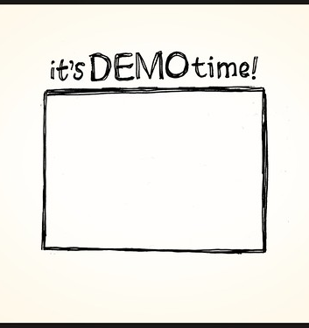
DEMO

