Slide 1
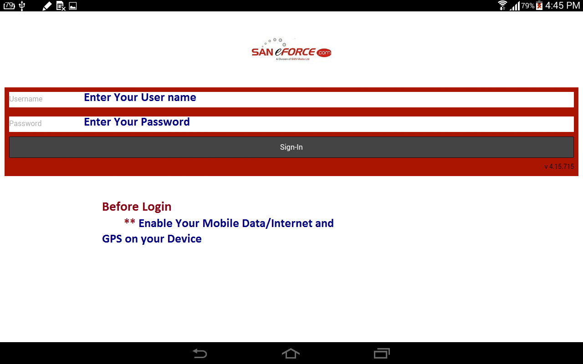

Slide 2
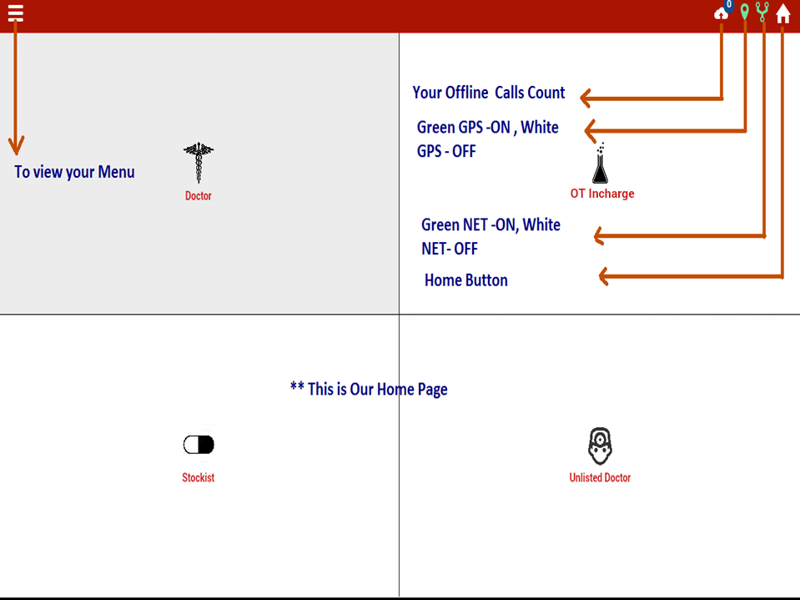

Slide 3
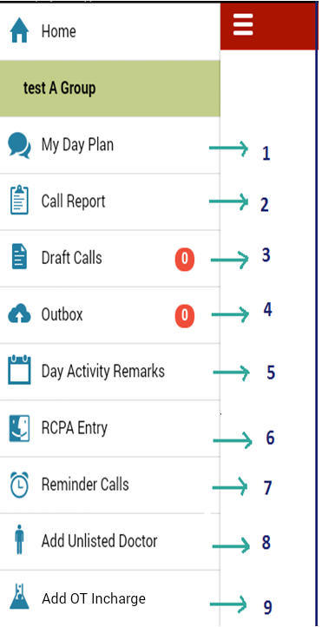
1.To Capture your Plan for day
2.To Capture your DCR for Day
3.If your DCR call has incomplete and not ready to final submit you save the call in “Draft”
4.When you are working in without internet your call’s are saved in “Outbox calls”
5.To capture your Whole day remarks on “Day Activity remarks”
6.To capture your Competitor details in “RCPA entry”(Retail Chemist Prescription Audit)
7.Whose Doctors are reminding from your end for your product promotion these details captured in “Reminder calls”
8.Add your new doctor’s in “Add Unlisted Doctor”
9.Add new chemist in “Add Chemist”

Slide 4
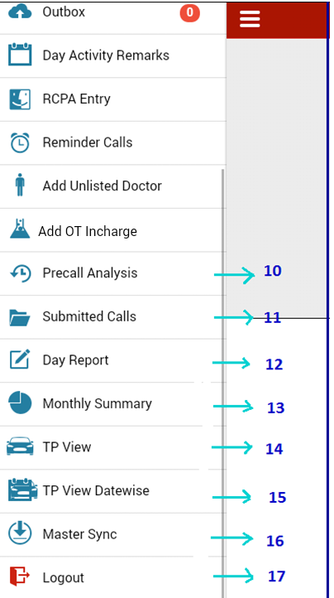
10.Previous Call History of Doctor’s view in “Precall Analysis”
11.You are view/Edit/Delete your submitted calls in “Submitted Calls”
12.View Your Day wise Call Report in “Day Report”
13.View your Monthly wise Call Report in “Monthly Summary”
14.View Your TP for Monthly wise in “ TP view”
15.View your TP for Day wise in “ TP View datewise”
16.Reload your Master data in “ Master Sync”
17.Logout your Login

Slide 5
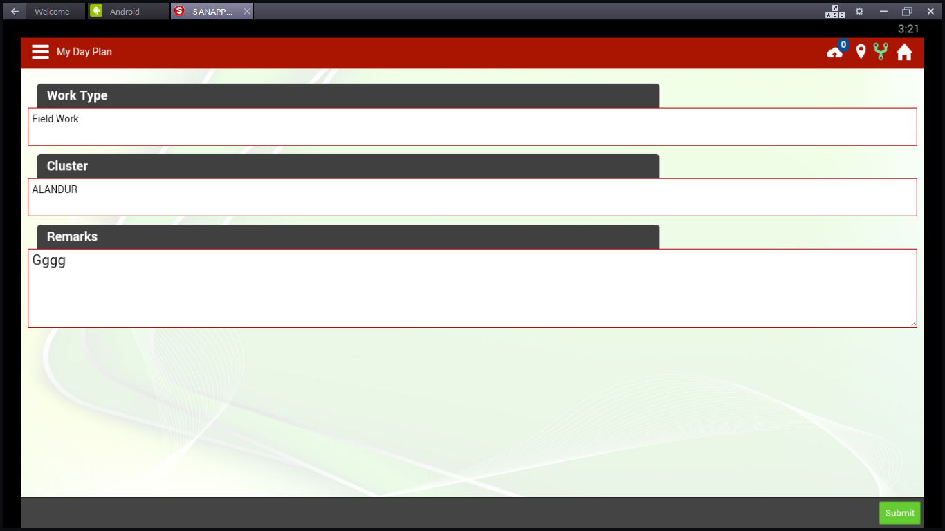
Select Work Type/Cluster/Remarks
Admin Work, Camp Work, Cycle Meeting, DRS Survey, Field Work, Holiday, Induction work, Leave, Meeting, No Field work, Stockists work, Super stockists work,
Training, Transit, Week off
Remarks – We can enter any special comments like, Team work, NPL work, etc…

Slide 6
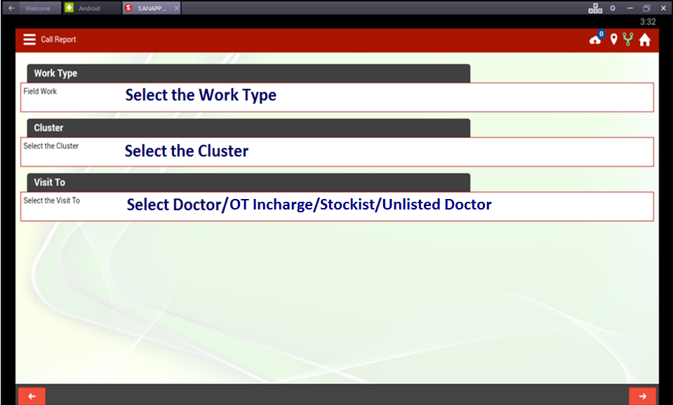
To go to Previous Screen, touch here
To go to Next screen, touch here

Slide 7
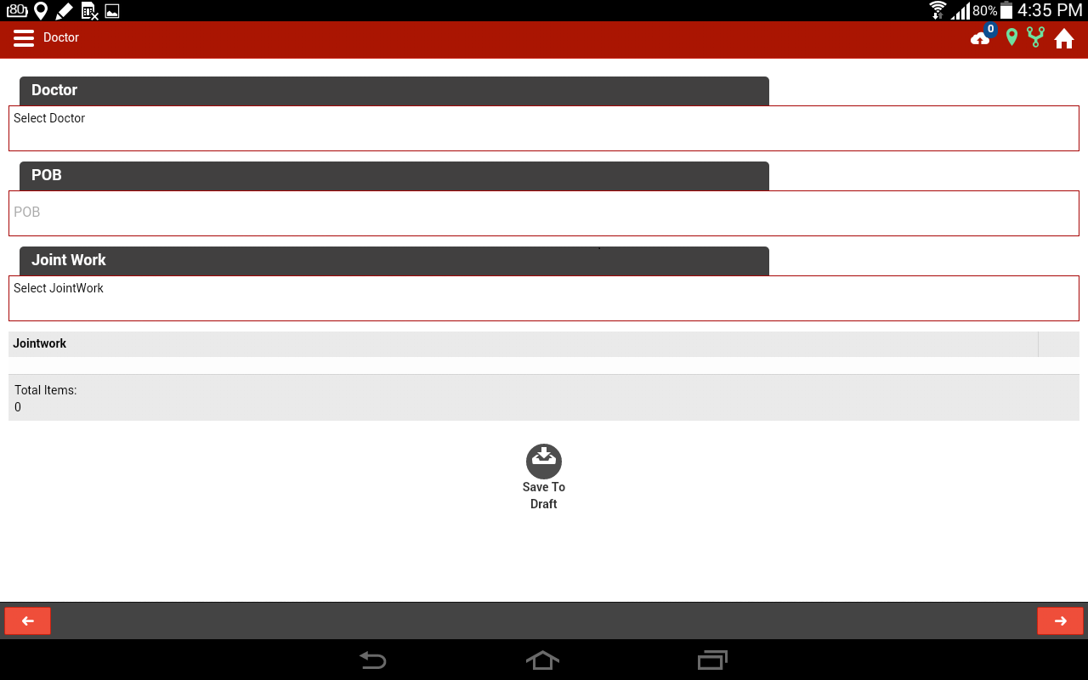
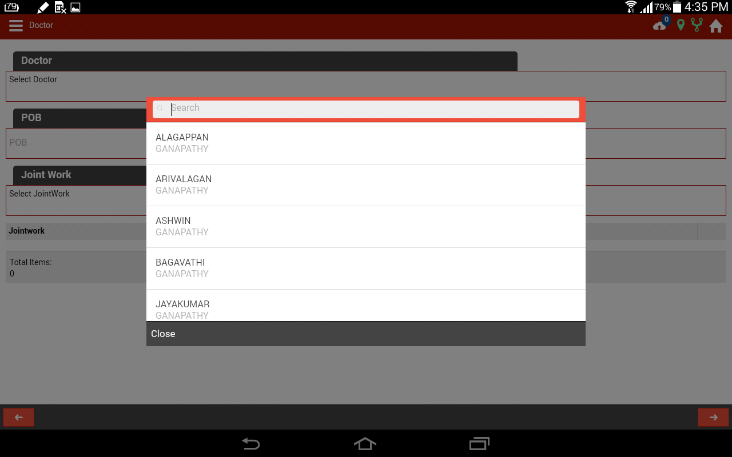
Select the Doctor Name And enter POB Value

Slide 8
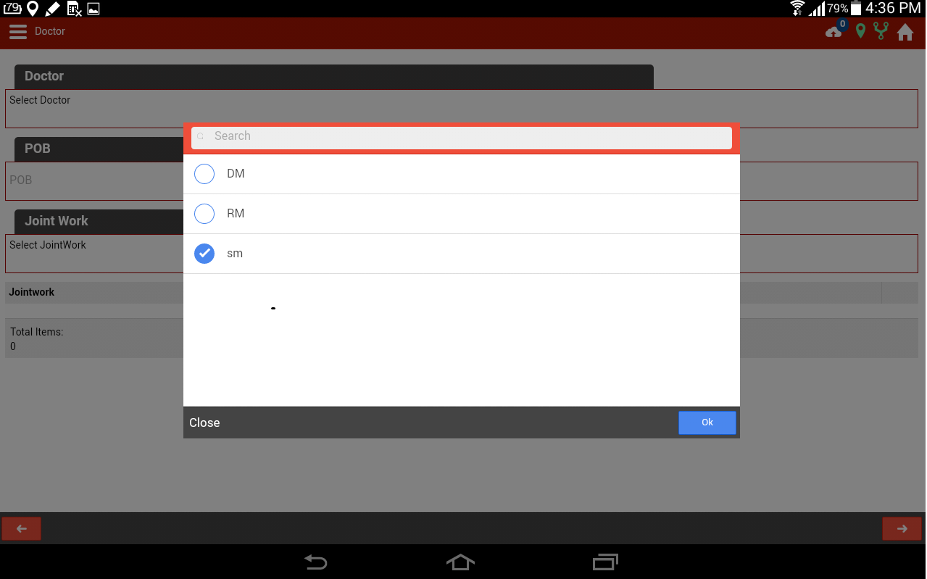
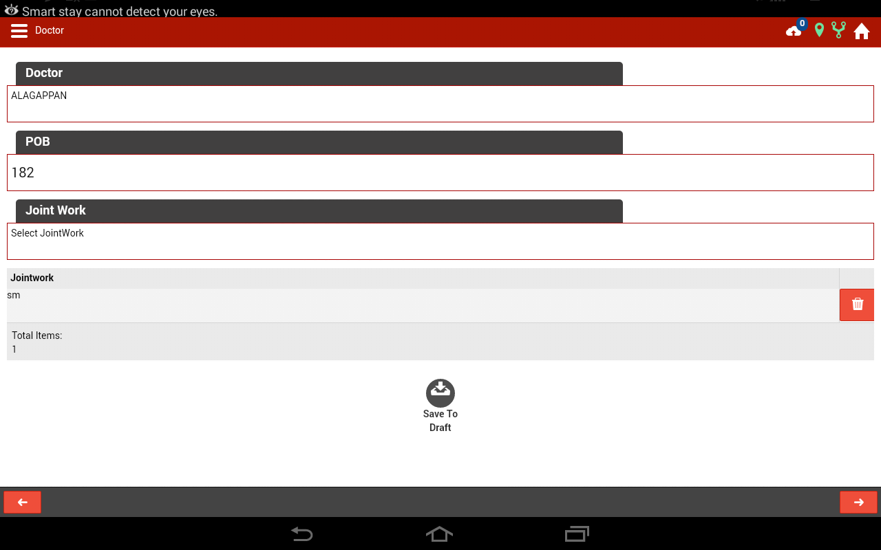
Select The Joint work details

Slide 9
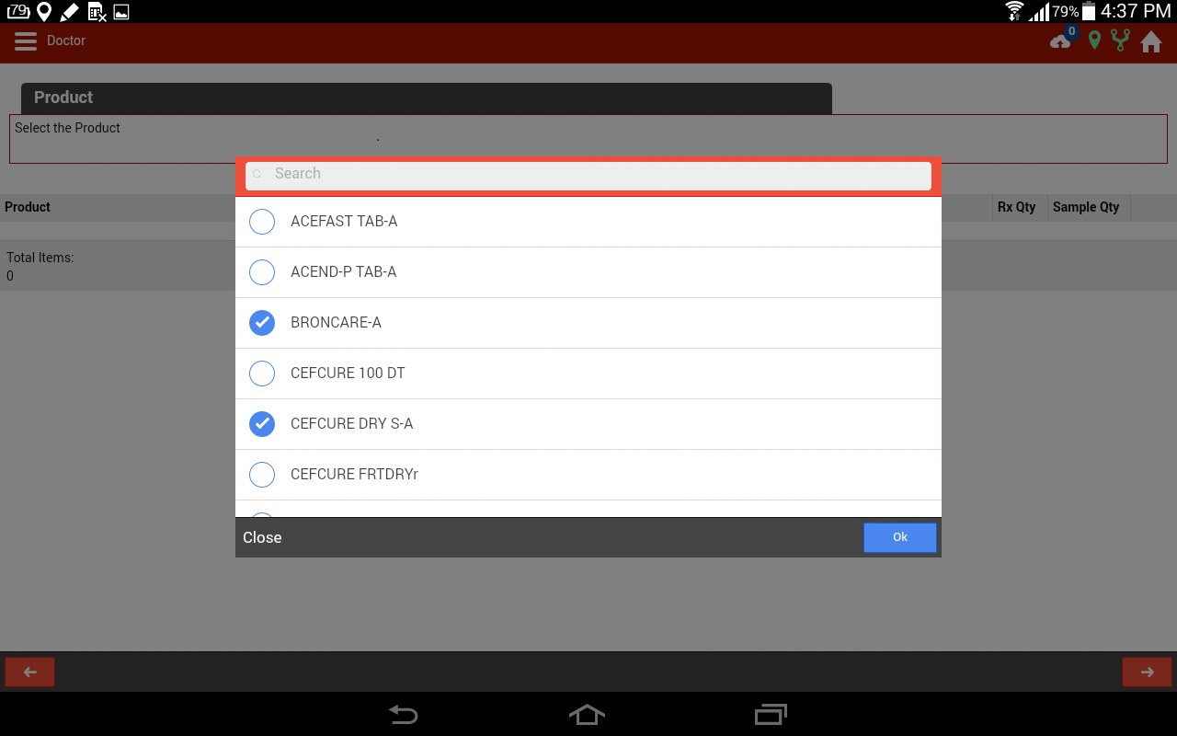
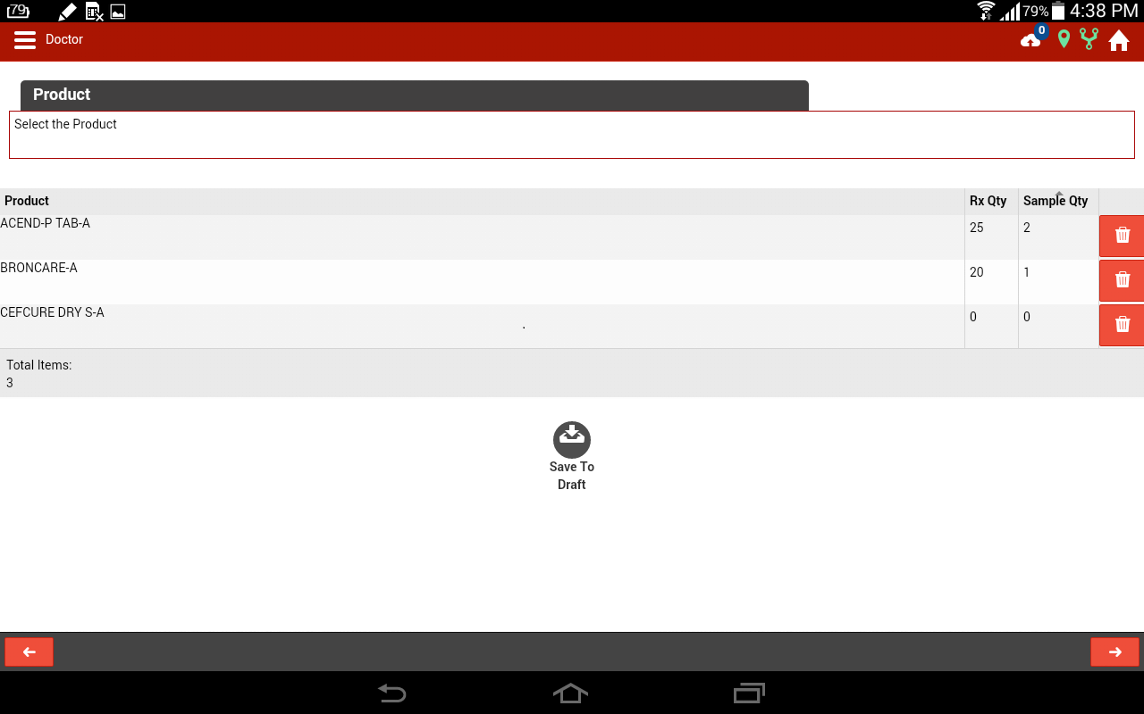
Enter Prescription Value
Enter the Sample Value

Slide 10
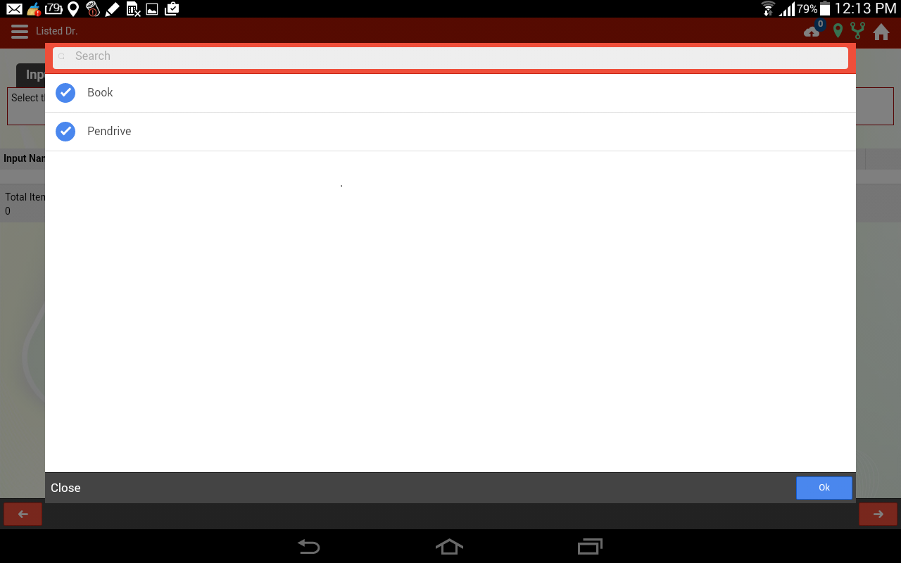
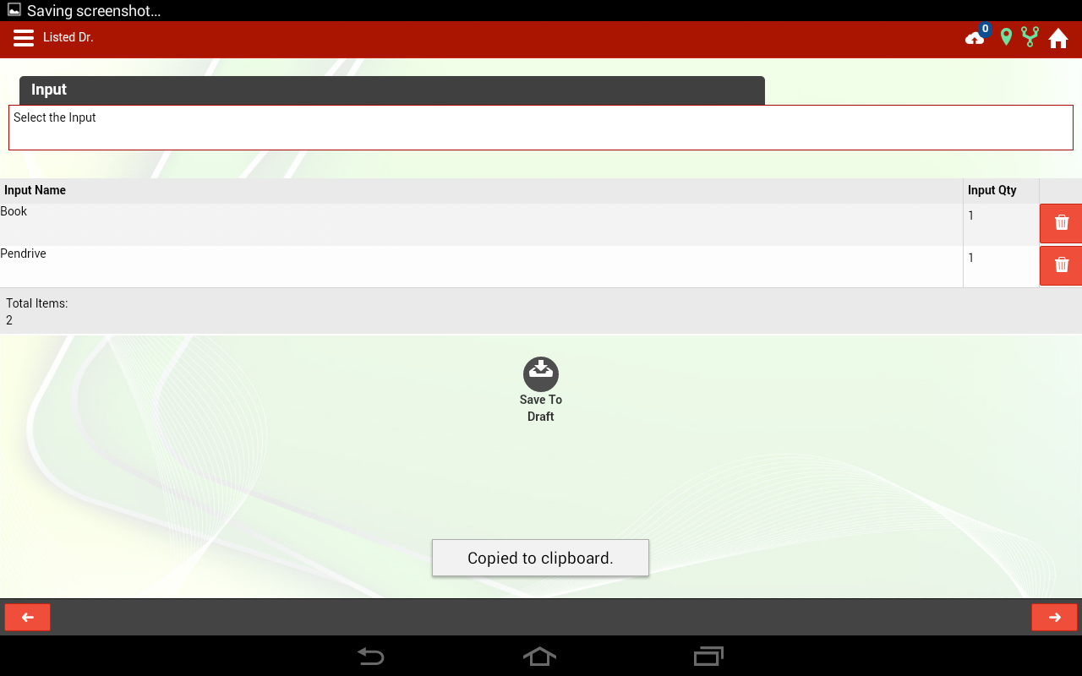
Select Input From list
Enter input quantity

Slide 11
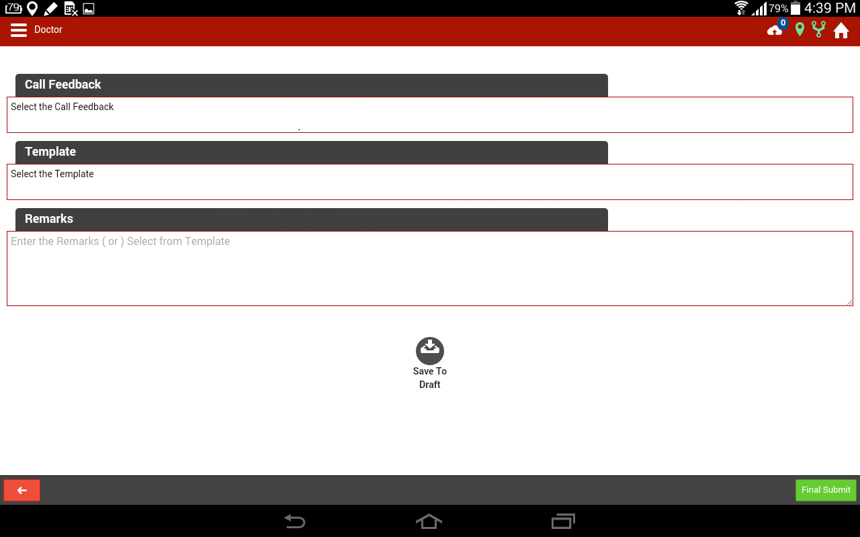
Enter Your Remarks
If call is incomplete, some order is pending,
touch “Save to draft”
Final submit can be touched to complete the call

Slide 12
The same procedure can be followed for:
Chemist
Stockist
Unlisted Dr call reports

Slide 13
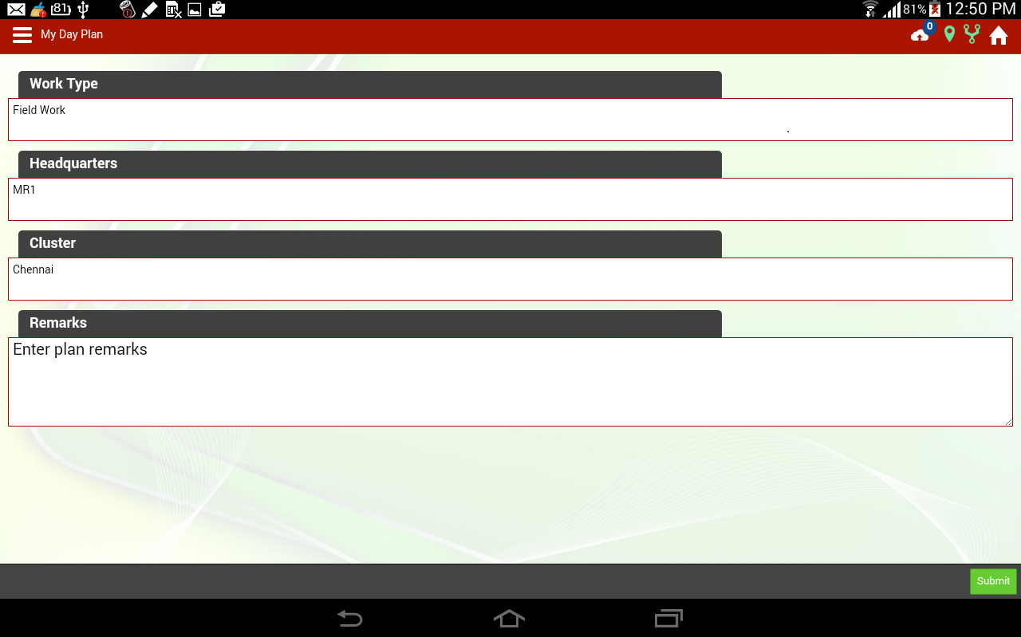
How to Submit DCR entry in
Manager Login
Select the work Type from list
Select The Headquarter from field force list
Select Cluster From list
Enter Today plan remarks
Click submit

Slide 14
The same procedure can be followed for Manager DCR as Field force does
Doctors
OT Incharge
Stockist
Unlisted Dr call reports

Slide 15
THANKING YOU
By
SANeFORCE.com
9789033008

