Slide 1
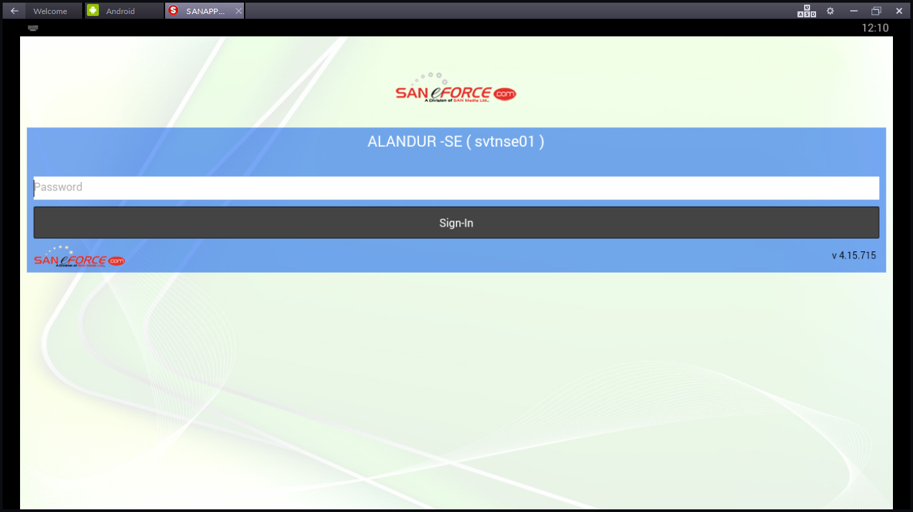
Enter the user name & Password to login
It is one time activity for the new users till the app installation, clear user name & Passwords in the phone

Slide 2
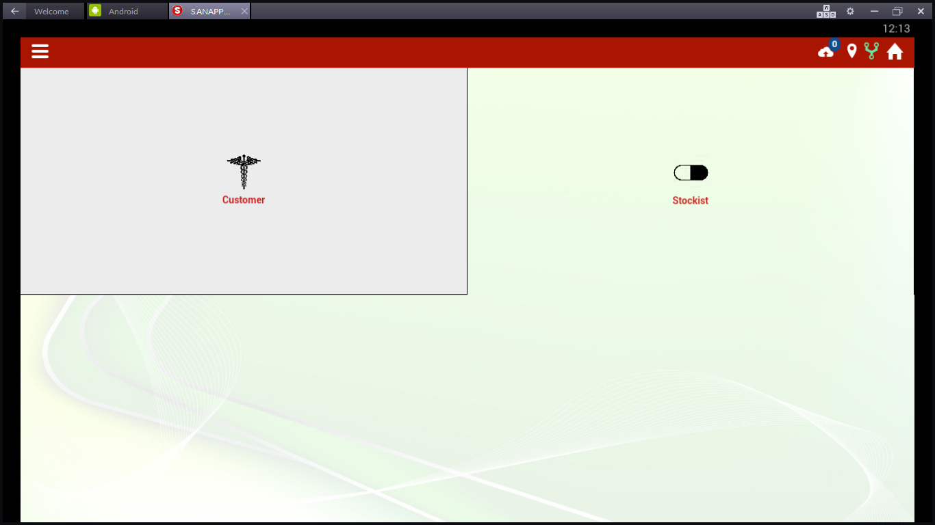
Any Synch & Update info
GPS is on if it is green, white GPS off
Opening screen of the app
Internet is on if it is green White – Internet off
Home – Back to front screen
To view menu to action

Slide 3
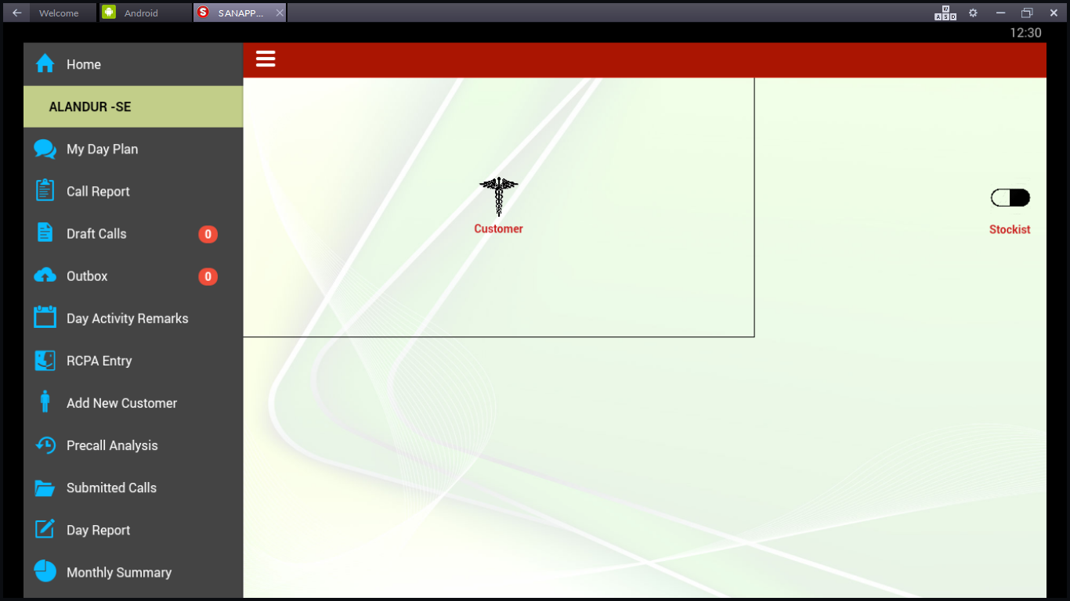
To capture the plan for the day
To Capture the DSR outletwise
DSR which is not given as “submit”will be saved in draft until
status given as “submit”
Submitted DSR will be in this box if the internet is in “OFF”
This is to capture specialties of the day in the market for
furture reference
Competitor details can be captured in this screen
Adding new customer with brief details
This is to view the outlet details & history
This is to view/Edit/Delete the submitted call details
This is to view the outlet details
This is to view the daywise details

Slide 4
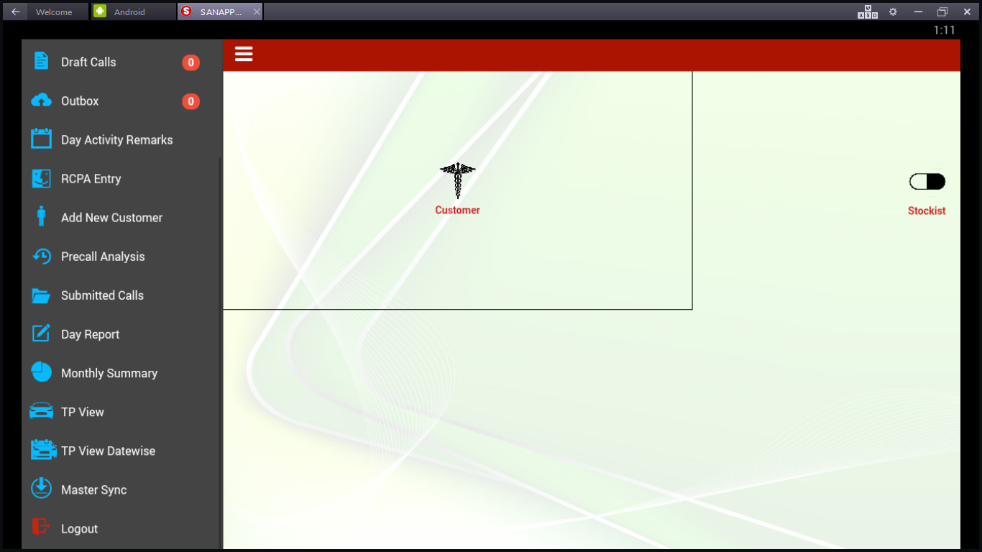
To view the Daywise Tourplan for the month
To View the datewise Tourplan
To synch the data when the day starts and day close to give and
take the data to the server
To Logout the App

Slide 5
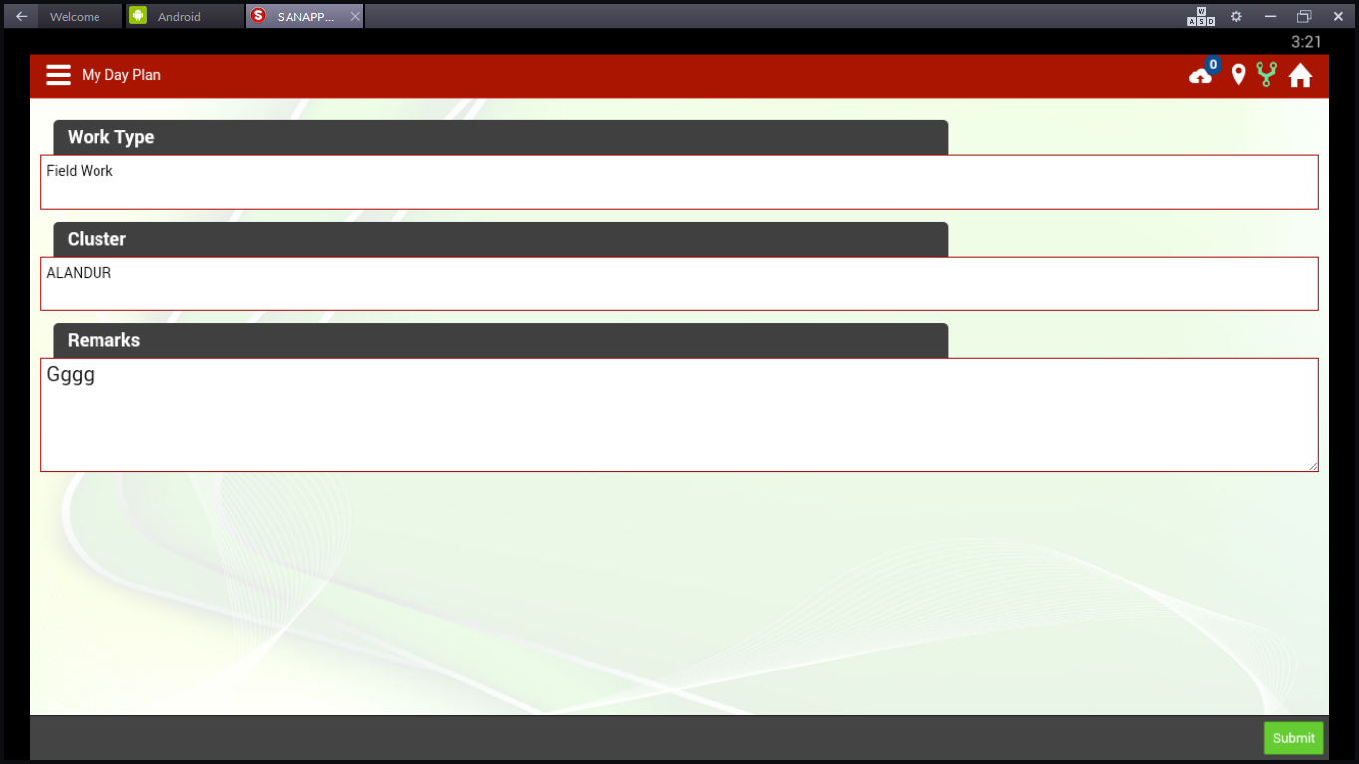
Select Work Type/Cluster/Reamrks
Admin Work, Camp Work, Cycle Meeting, DRS Survey, Field Work, Holiday, Induction work, Leave, Meeting, No Field work, Stockists work, Super stockists work,
Training, Transit, Week off
Remarks – We can enter any special comments like, Team work, NPL work, etc…

Slide 6
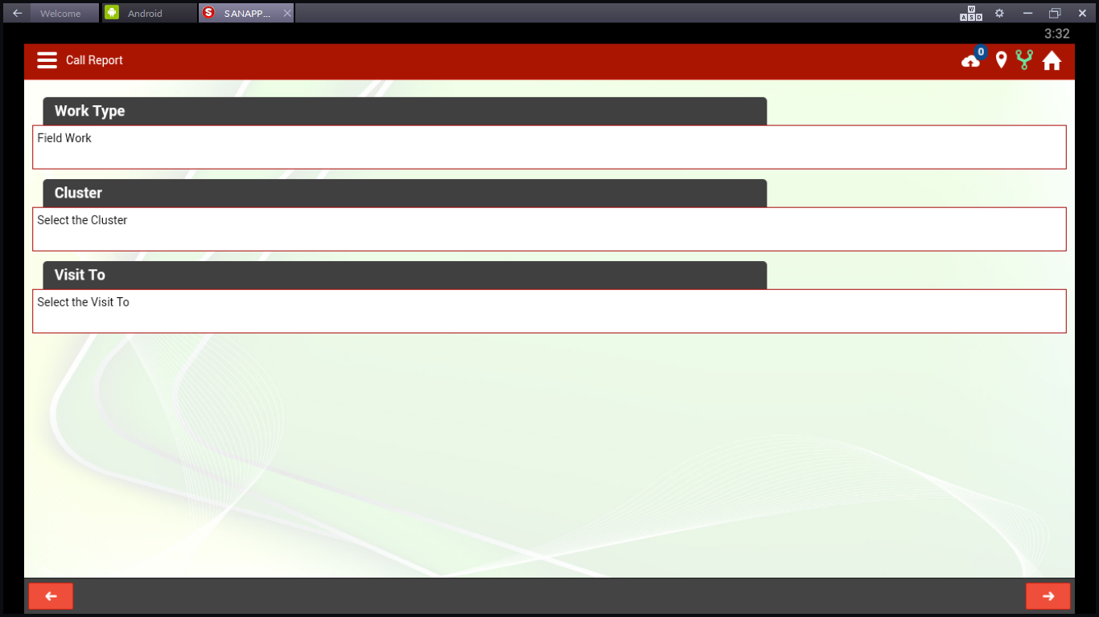
Call Report
Select the field work from work type
Select the route from the assigned routes
Select Customer or Stockists
To go to Previous Screen,touch here
To go to Next screen, touch here

Slide 7
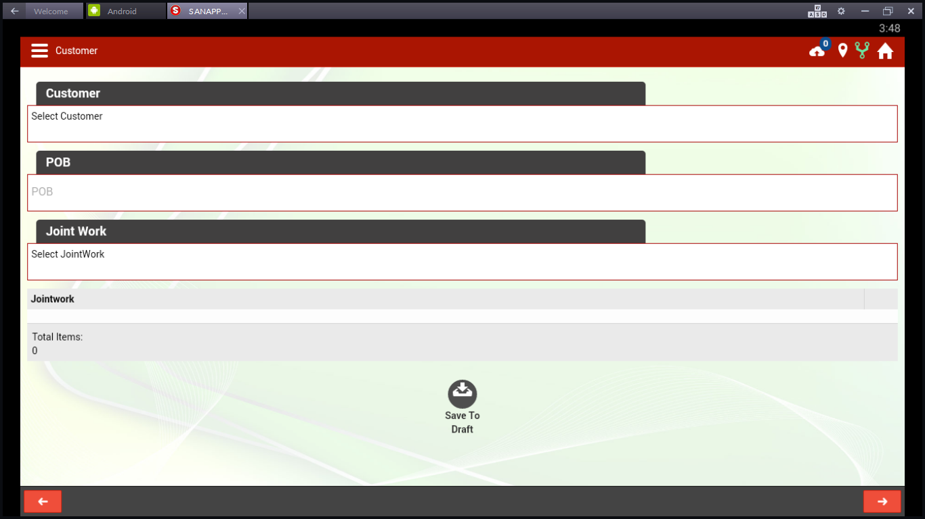
Select the Retailer Name
Enter the orders – Not a mandatory field, we can leave
If there is any joint work with Reporting Mgr. We can select, Not a mandatory field
Want to save it to draft, we can save for future edit
To go to Previous Screen,touch here
To go to Next screen, touch here

Slide 8
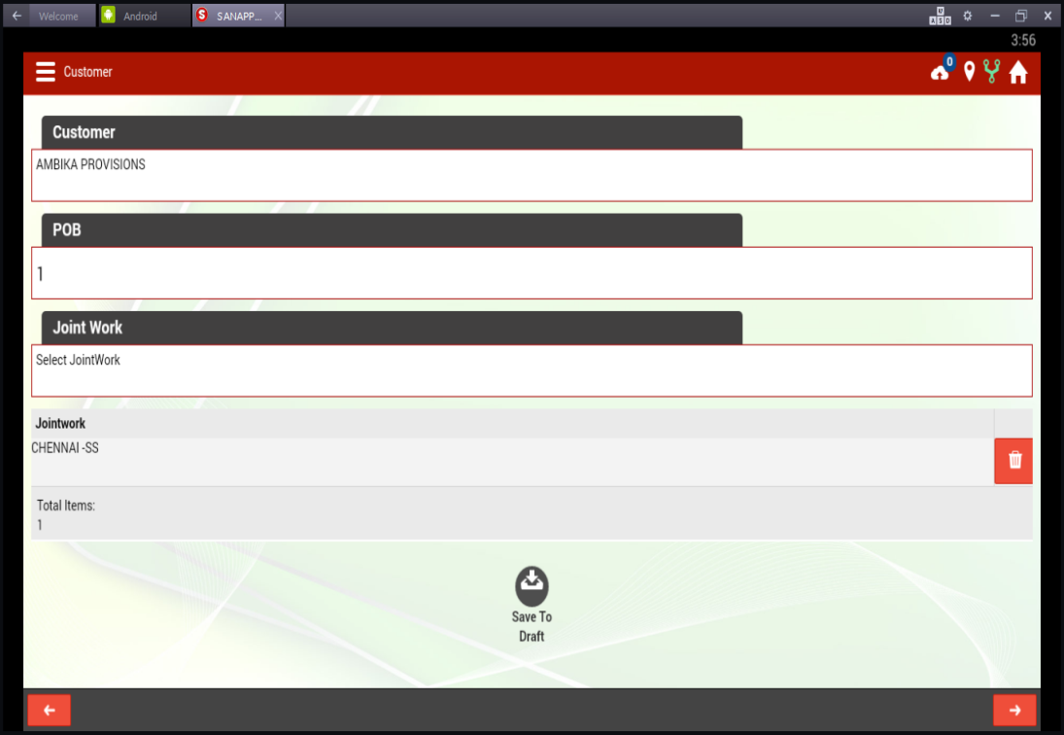
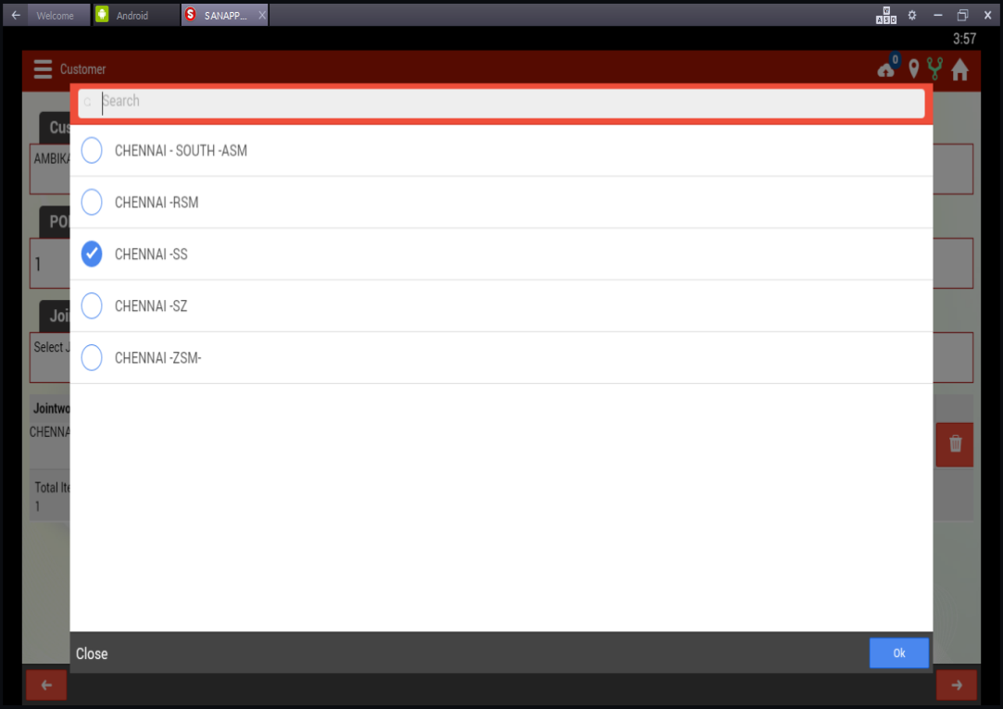
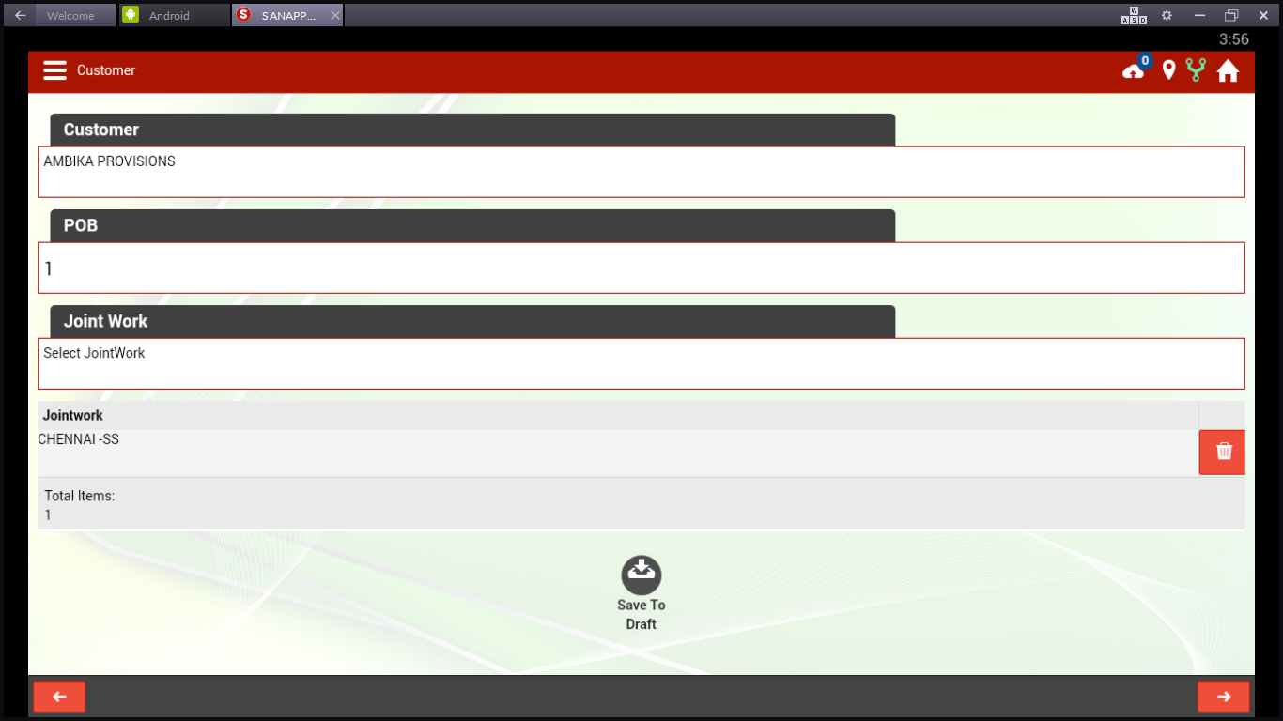
Outlet Name & Order No.captured
Joint Work Details Selection
To go to Next screen, touch here
To remove the joint work, touch the dust bin button

Slide 9
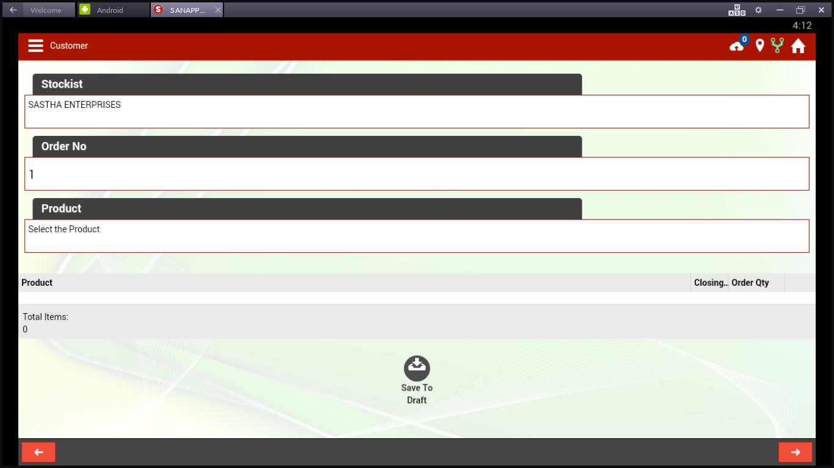
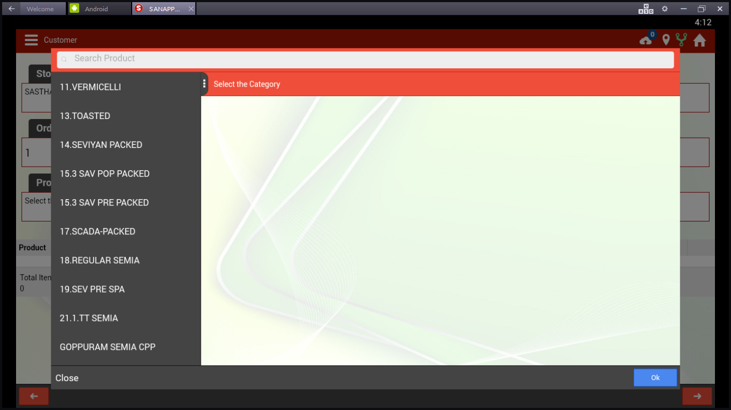
Select the distributor to service for this outlet from the assigned distributors
Enter the order No.– Not a mandatory field, we can leave
Touch “Select the product” , below screen will appear
By Touch “Select the product, Black screen with Product category can be viewed in the screen by dragging slider

Slide 10
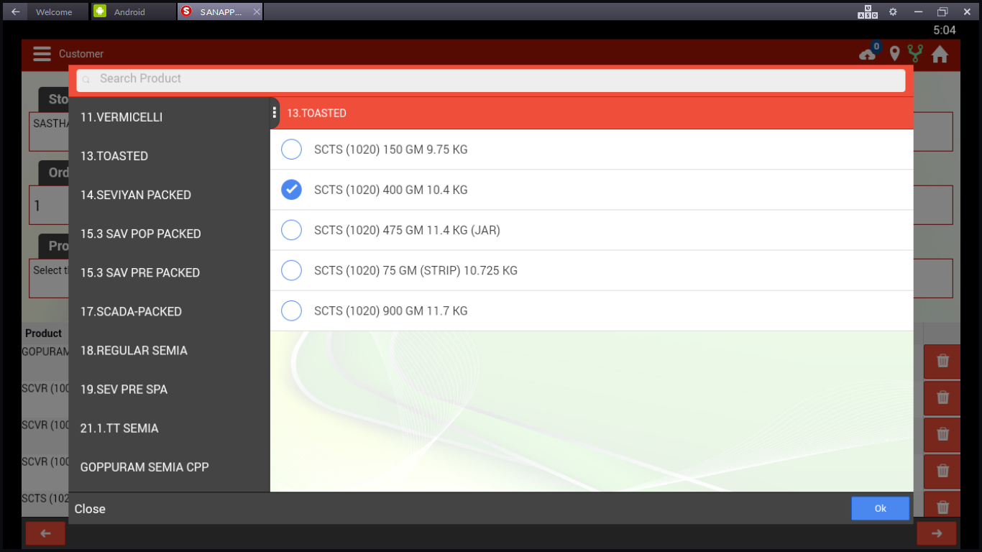
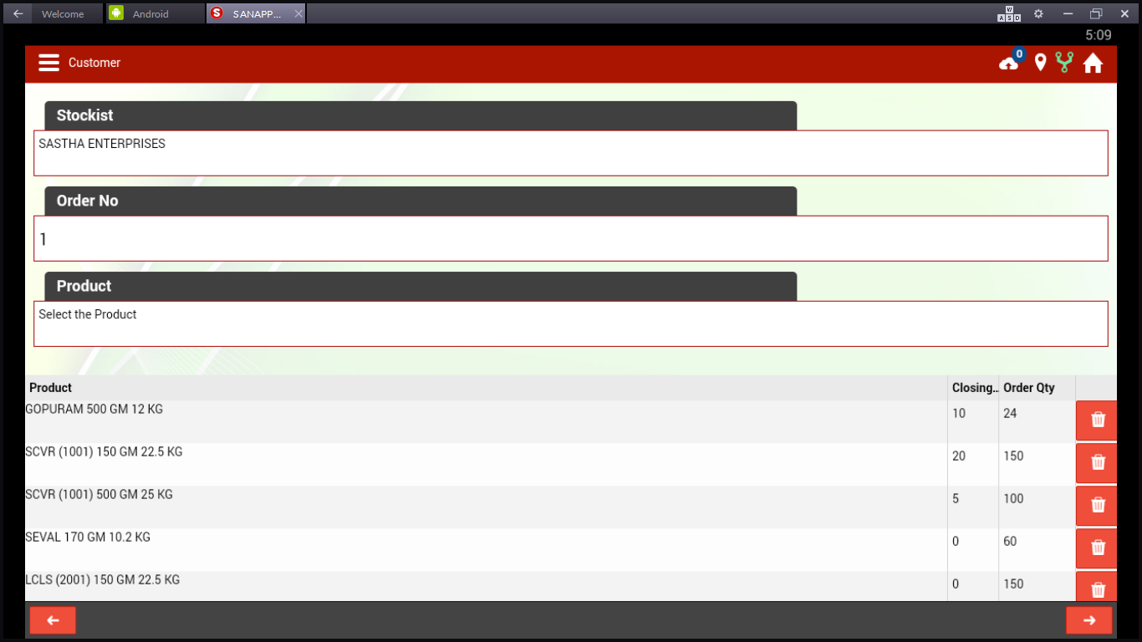
To go to Previous Screen,touch here
To go to Next screen, touch here
01.Stock available @ outlet needs to be captured
02.Order Qnty needs to be captured in the box.
03.Remove the item from selection, touch on dust bin
04.Add the product, touch ”select the product” in the top

Slide 11
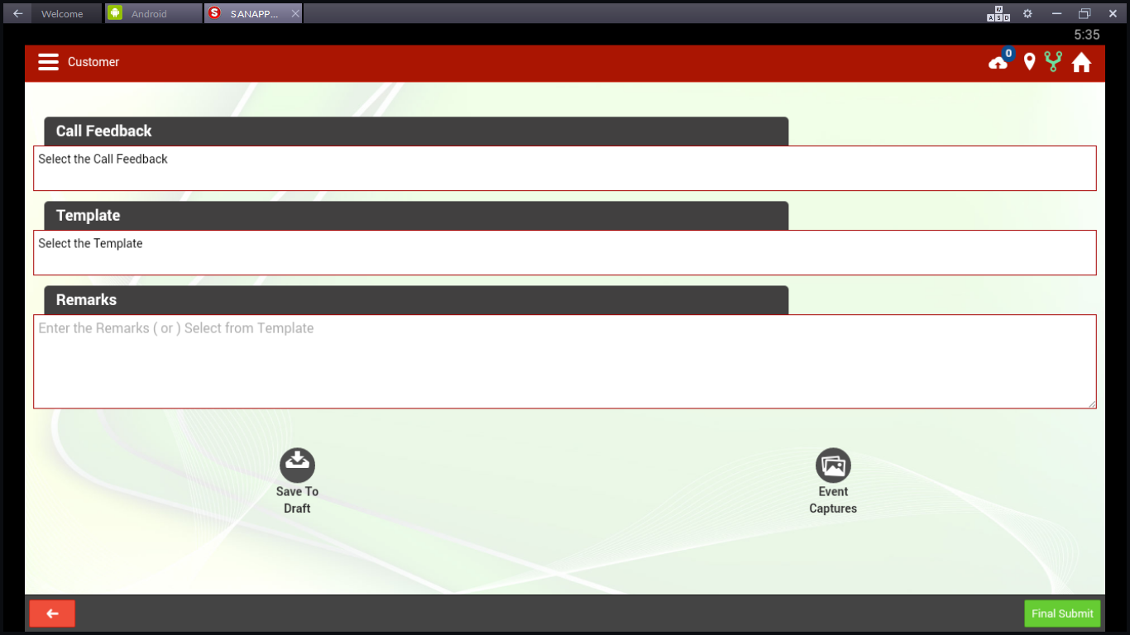
After Order booked, select the call feedback, “Not mandatory field”
Not Mandatory field
Any remarks, We can add, not a mandatory field
If call is incomplete, some order is pending,
touch “Save to draft”
If any photos of product display,staking,damages
Can be taken as snap and attached
To go to Previous Screen,touch here
Final submit can be touched to complete the call

