Slide 1
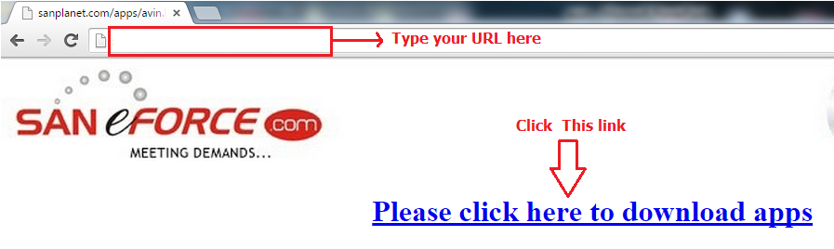
APPS INSTALLATION STEPS:
1. Click ok button when it shows this message.
2. Once the download is complete, go to the notification and click the downloaded apps to install.

Slide 2
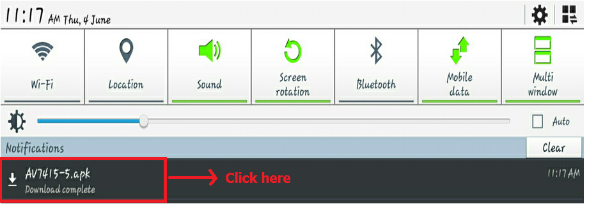
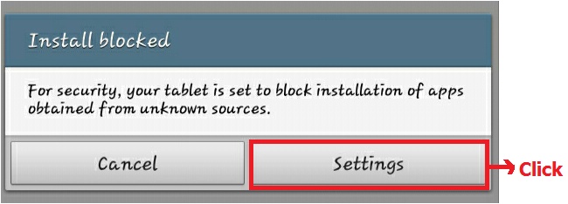
STEP:1
STEP:2

Slide 3
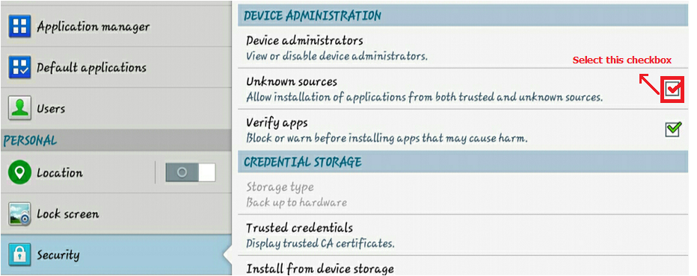
STEP:3

Slide 4
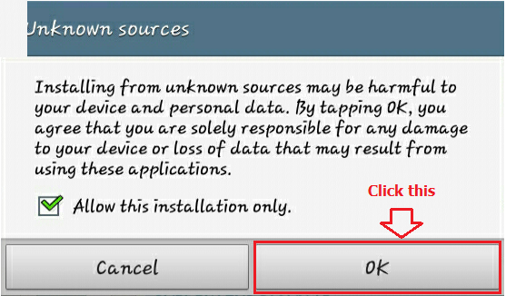
STEP:4

Slide 5
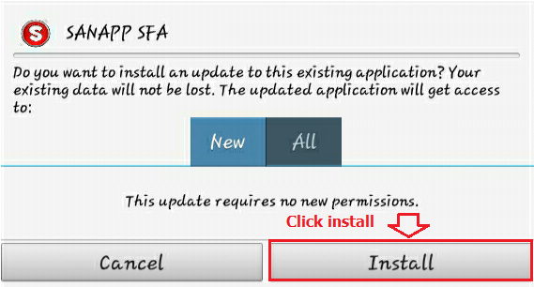
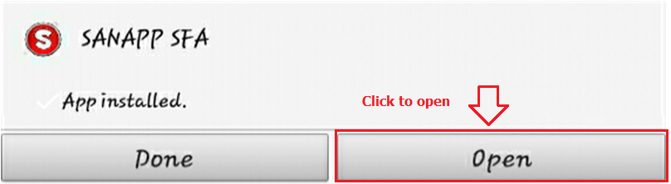
STEP:5
STEP:6

Slide 6
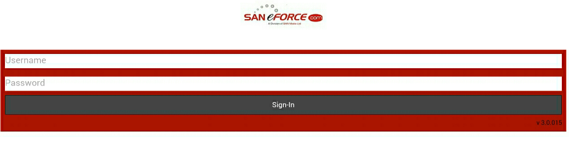
STEP:7
CONGRATULATION YOU ARE SUCCESSFULLY INSTALLED

