Slide 1


Mobile Apps

Slide 2
BEFORE INSTALL APPS PLEASE FOLLOW THIS INSTRUCTION
Turn on internet service in your device.
If you need location service enable location service in your device .

Slide 3
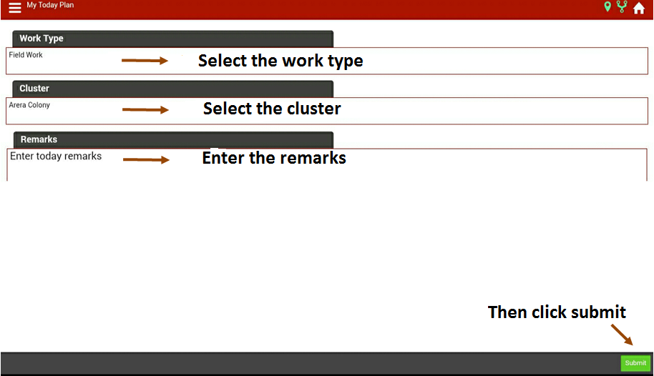
My Day Plan Entry

Slide 4
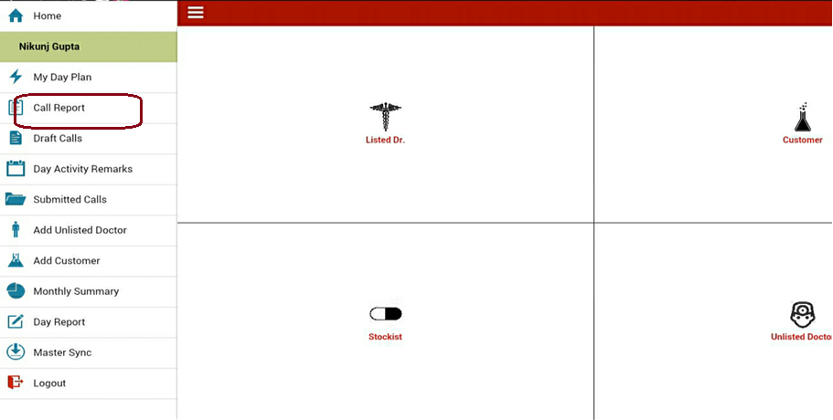
DCR entry for listed Dr

Slide 5
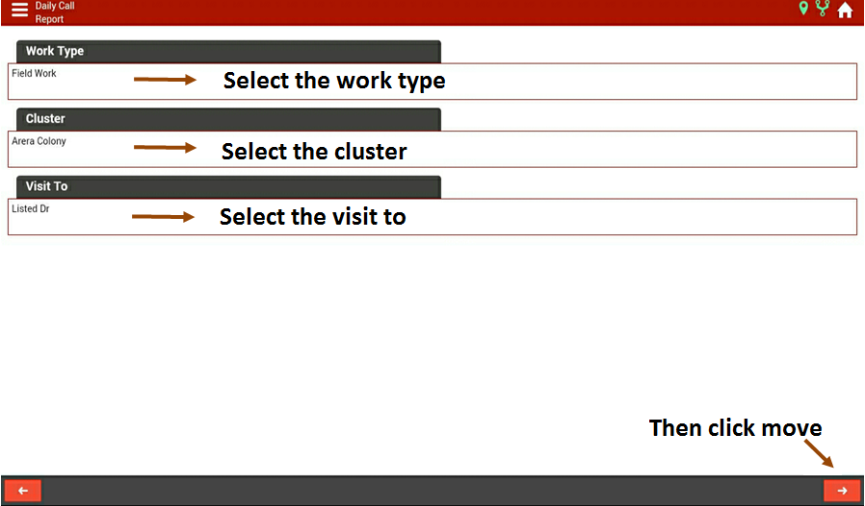
Select cluster & visit to

Slide 6
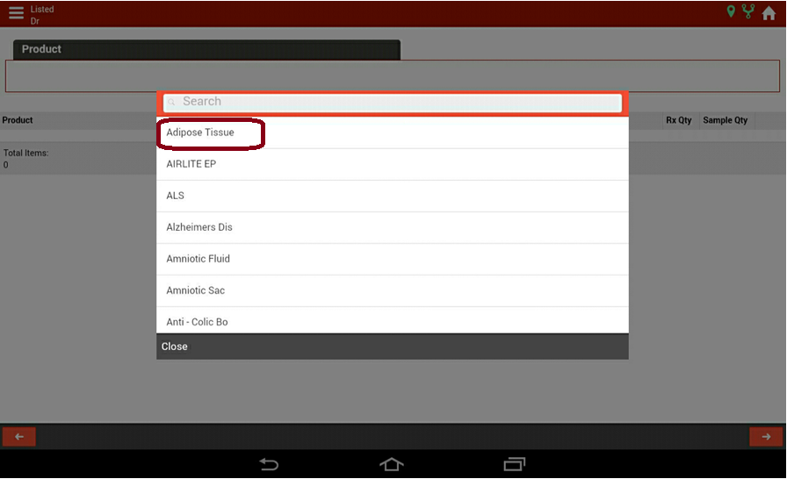
Product Promoted / Rx / Sample Qty

Slide 7
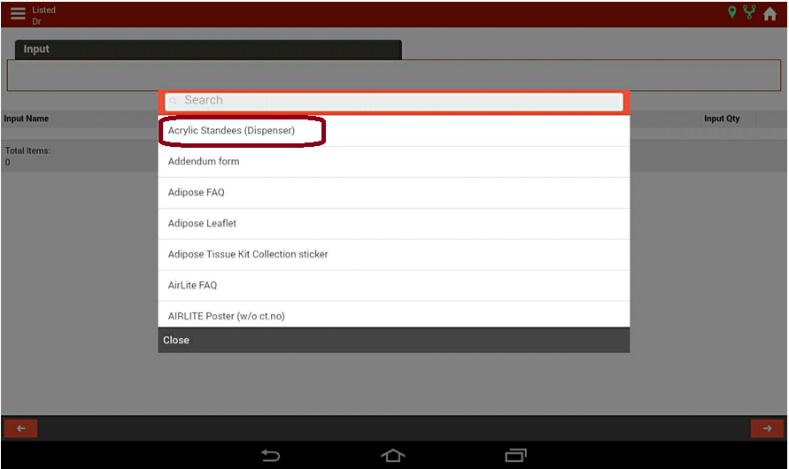
Input Name and Qty

Slide 8
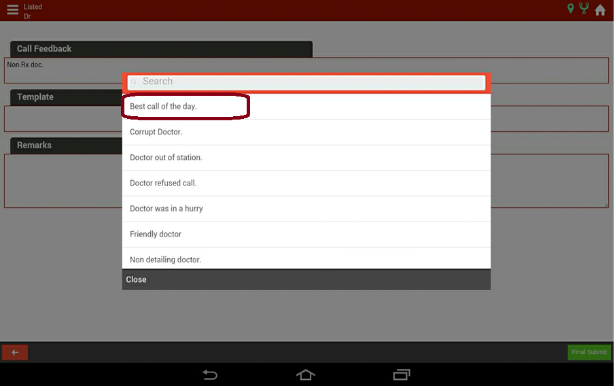
Call Feedback and Remarks →Final Submit

Slide 9
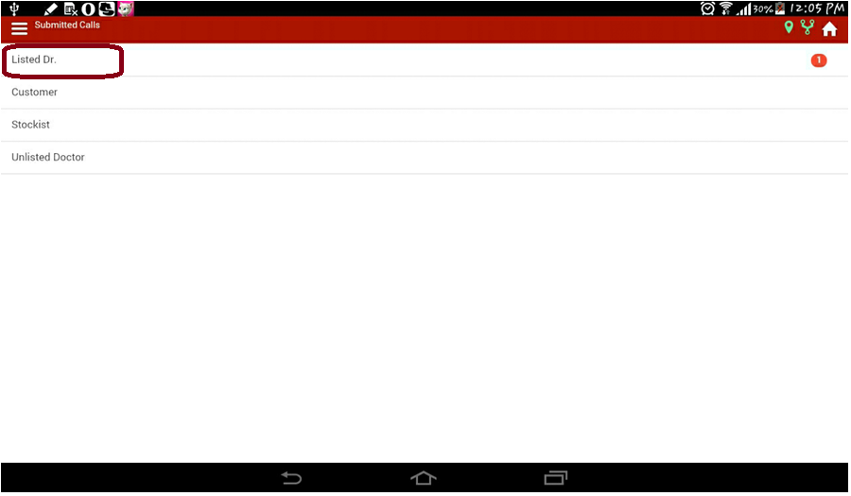
View Call reports → Submitted Calls

Slide 10
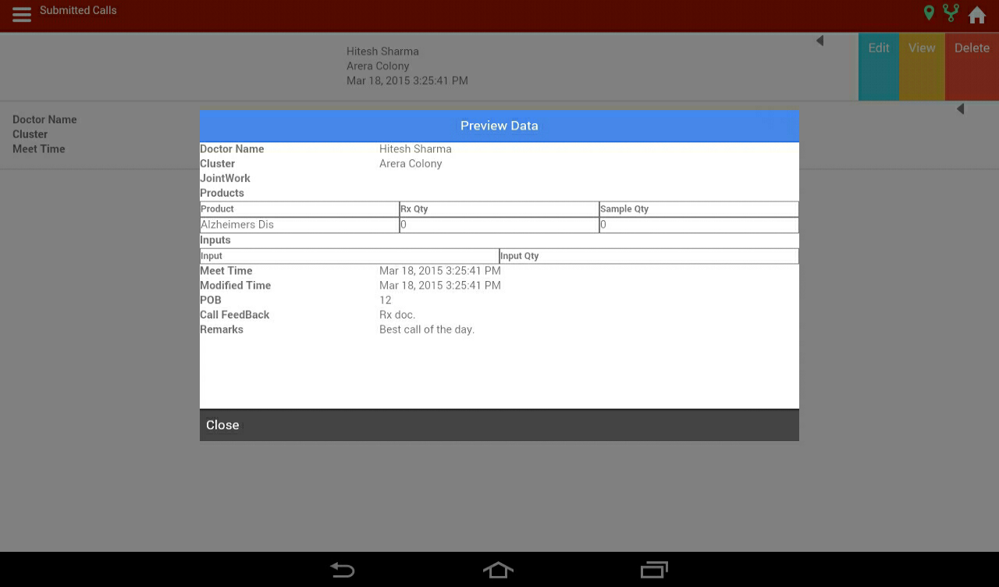
View / Edit the Submitted Calls

Slide 11
The same procedure can be followed for:
Chemist
Stockist
Unlisted Dr call reports

Slide 12
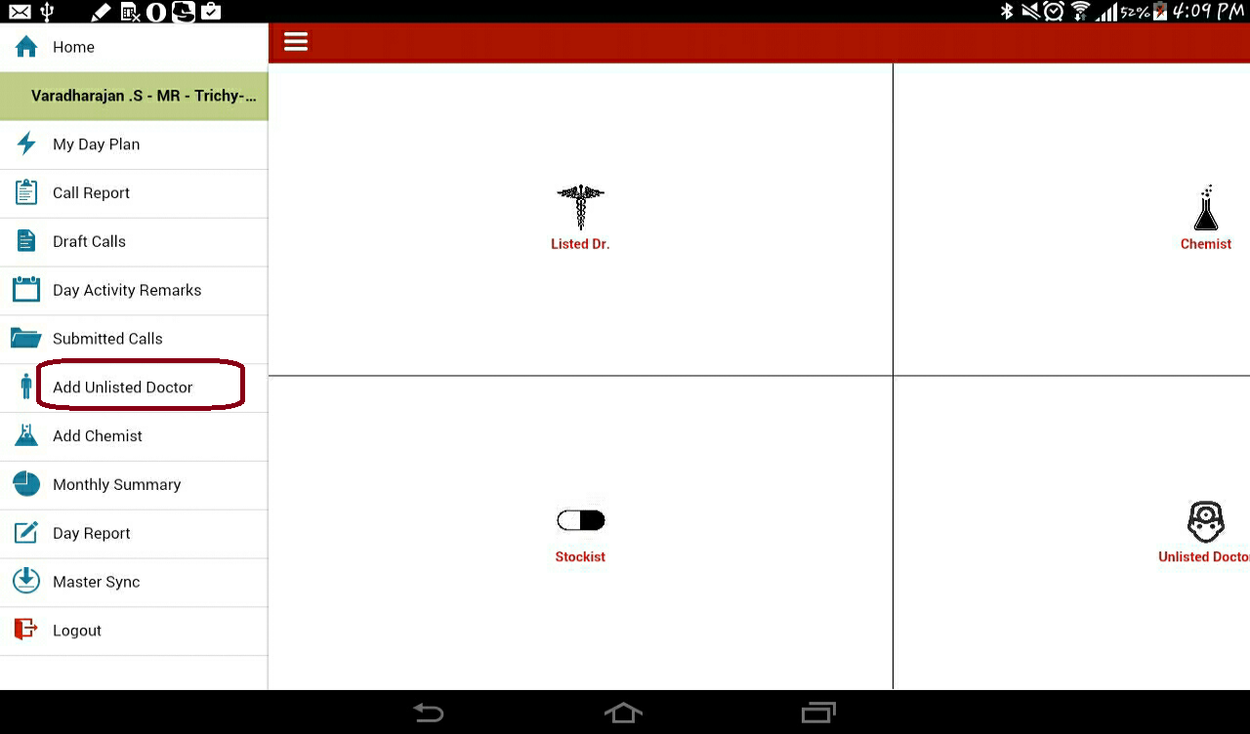
Add Unlisted Doctor

Slide 13
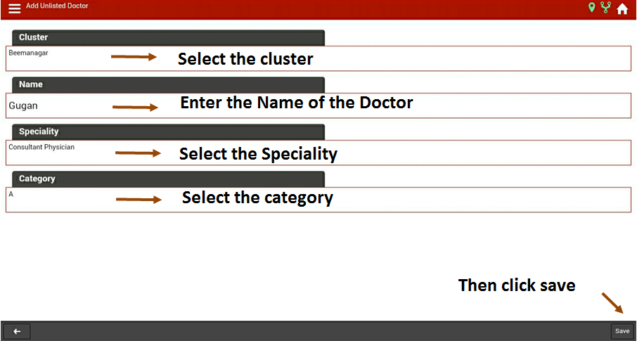
Select Cluster ,Name, Speciality & category

Slide 14
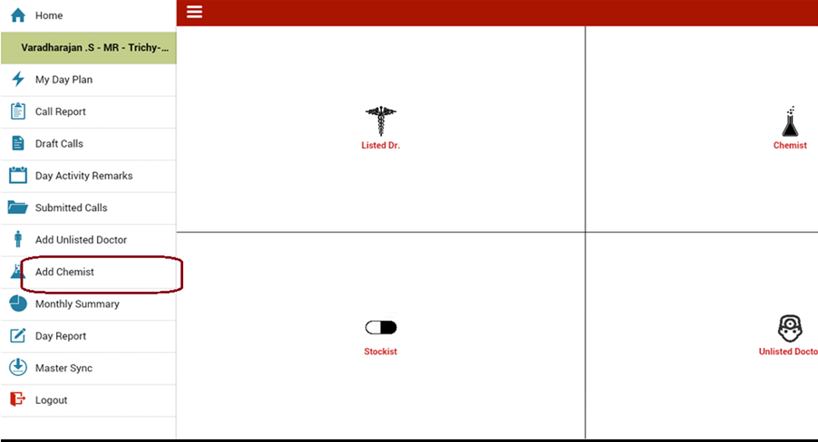
Add New Chemist

Slide 15
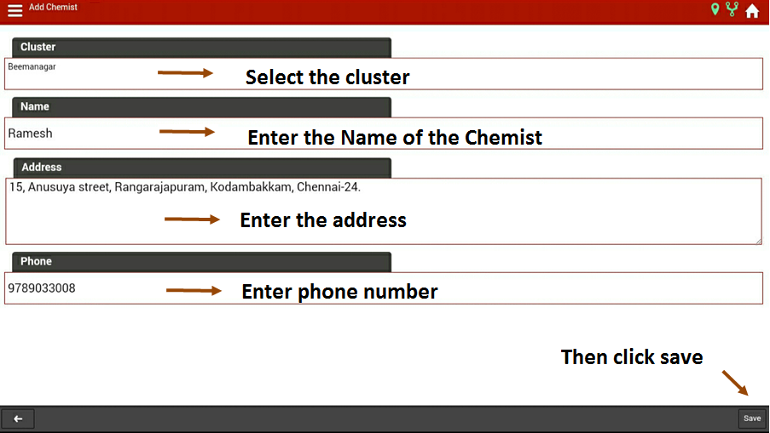
View / Edit the Submitted Calls

Slide 16
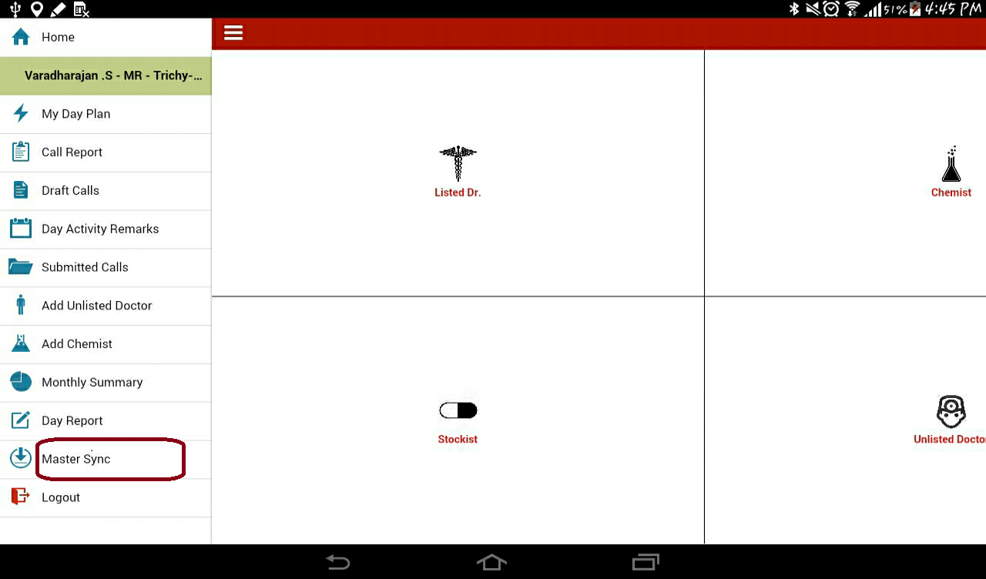
Click Master sync to reload the Data

Slide 17
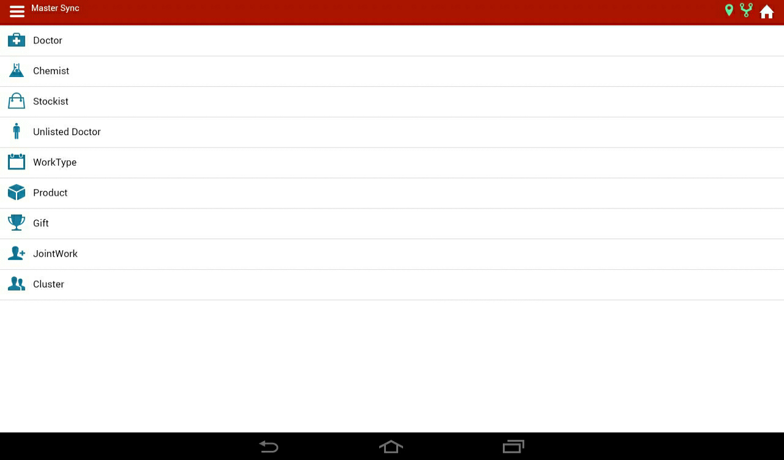
Reload the Master Data from Web

Slide 18
Thanking you
By
SANeFORCE.com
9789033008

