Slide 1

Welcome To eDetailing Installation Details

Slide 2
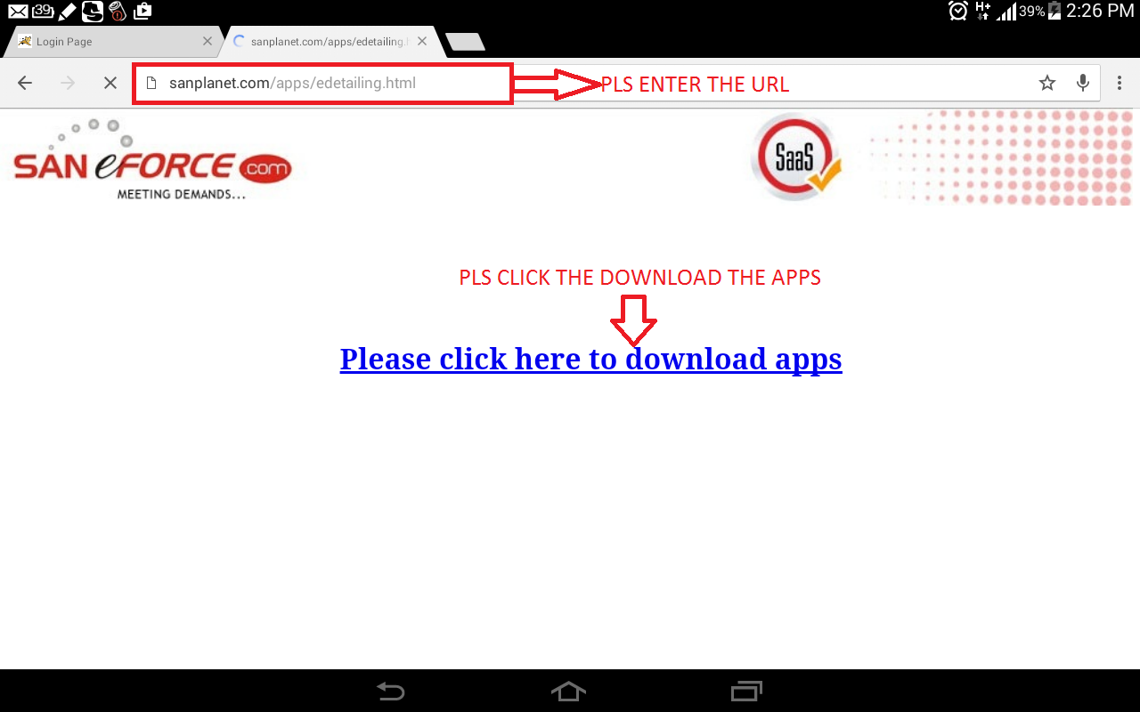
Apps Installation Steps
Step 1
1.Download the .apk file

Slide 3
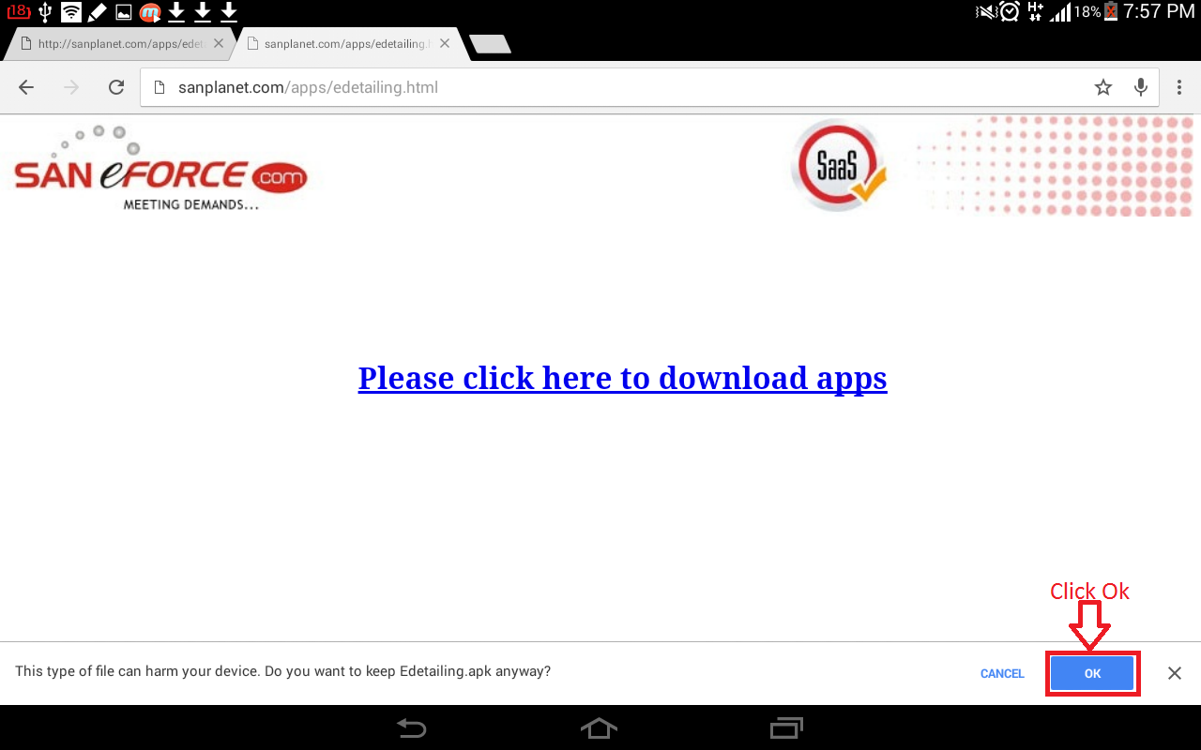
2. Click ok button when it shows this message.
3. Once the download is complete, go to the notification and click the downloaded apps to install.

Slide 4
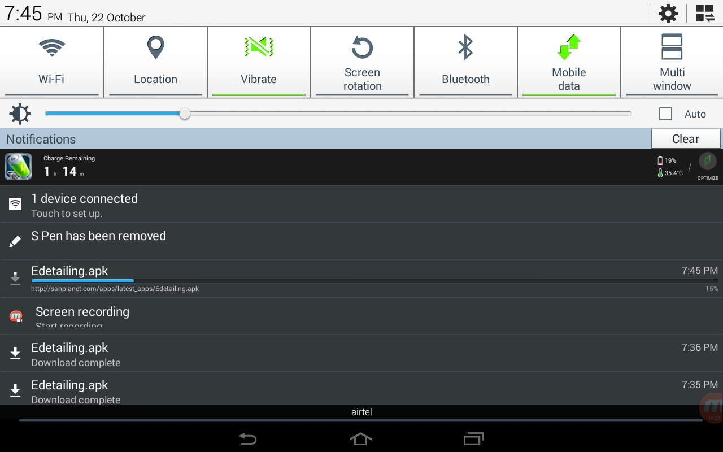
Steps 2
1.To Install The .apk File

Slide 5
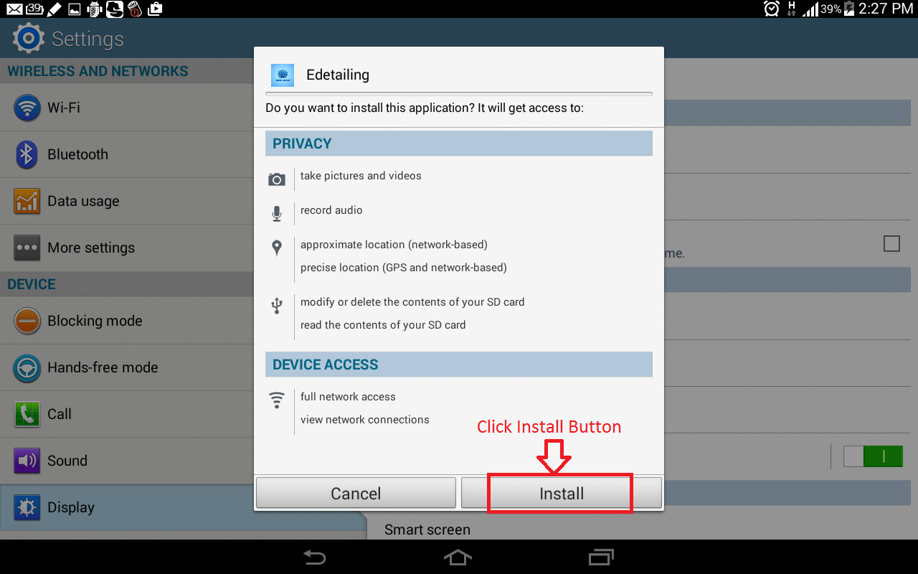
2.To Click Install Button

Slide 6
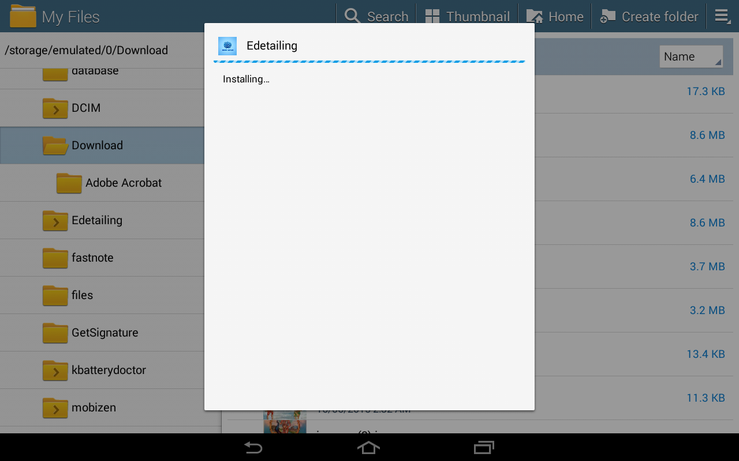

Slide 7
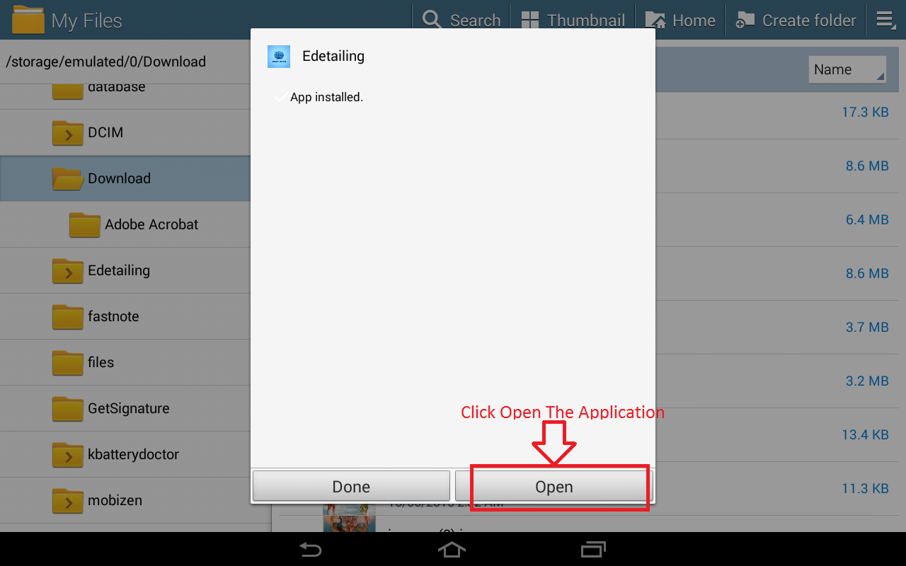
3.To Click Open The Application

Slide 8


Slide 9
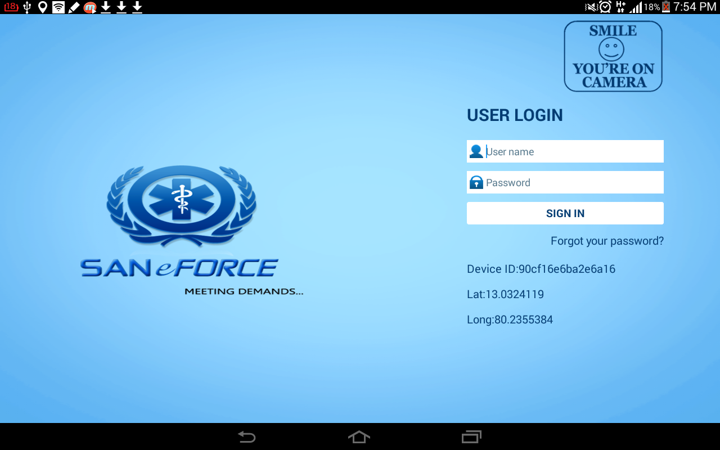
CONGRATULATION YOU ARE SUCCESSFULLY INSTALLED

Slide 10
Thanking you
By
SANeFORCE.com
9789033008

